Slide 1















Dual coding symbols:
Practise
Explain
Organise
Big Question
Reflect
Present
Compare
Evaluate
Activate
Discuss
Predict
Connect
Summarise
Recall
Vocabulary

Slide 2










Editable reading ruler
Every child in an Archway school will become a fluent reader
 | RETRIEVE the words or phrases you need from the text | DECODE the words or phrase to address a breakdown | CONNECT with words or phrases you know from the text or your memory | VISUALISE the images in as much detail as possible | SUMMARISE the main ideas of the text in a few words | INFER meanings that might be within the text | PREDICT what might happen next using details from the text | EXAMINE how the writer uses words to construct meaning
 | ASK THOUGHTFUL QUESTIONS TO HELP YOU UNDERSTAND THE TEXT

Slide 3





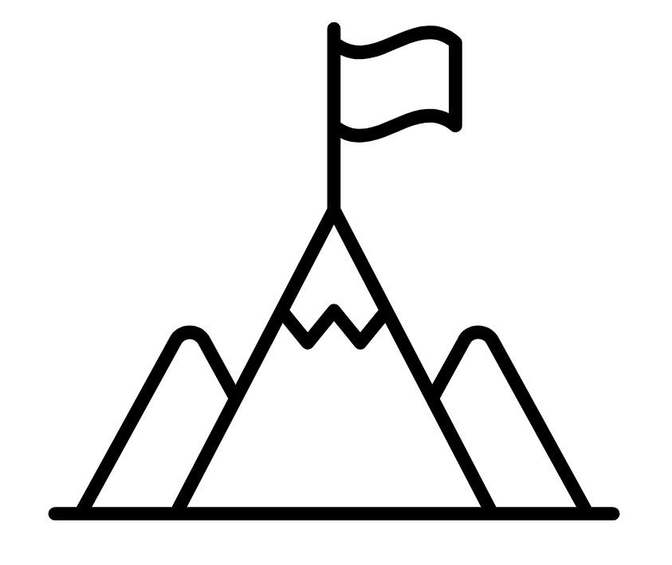
A
B

Slide 4
LESSON TITLE:

Slide 5
NTOVEMME
MOVEMENT
IEALVCRT
VERTICAL
AOTONHLZRI
HORIZONTAL
GEHTL
LENGTH
TIONRANTSLA
TRANSLATION
OTCRVE
VECTOR

Slide 6






Key vocabulary:
Decode the word
Definition
.
Vector
Examples
Non-examples

Slide 7

Can you create a square journey?
Notes:
Students attempt to draw a square on their starter sheet based upon the given vector

Slide 10
Working with Column Vectors
Understand what a column vector represents
Be able to manipulate column vectors and understand what the resultant vector represents

Slide 11
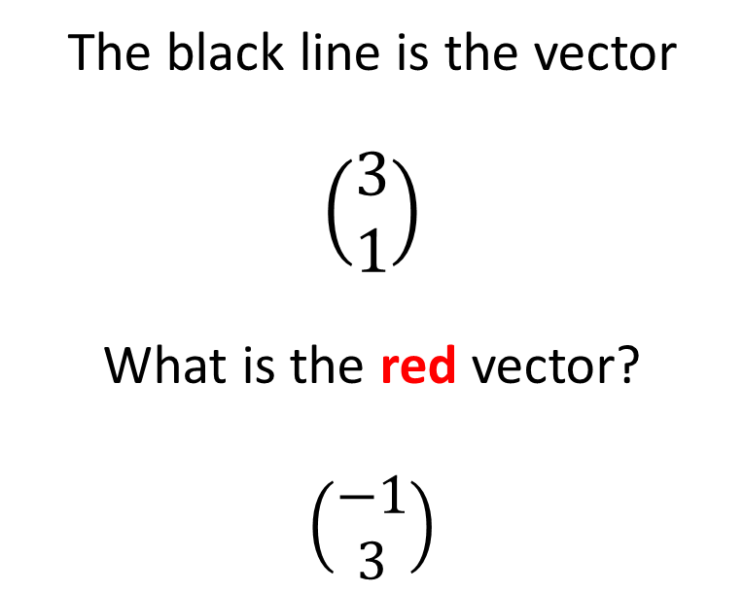
Square Journey
The black line is the vector
$$\left(\begin{matrix}3 \\ 1\end{matrix}\right)$$
What is the red vector?
$$\left(\begin{matrix}−1 \\ 3\end{matrix}\right)$$

Slide 12
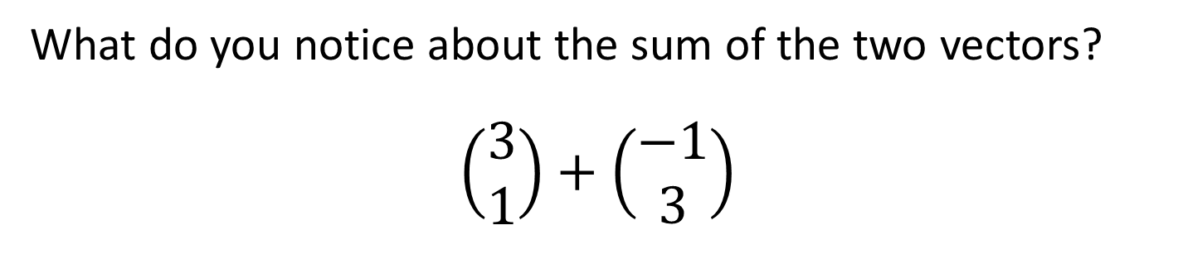
Square Journey
What do you notice about the sum of the two vectors?
$$\left(\begin{matrix}3 \\ 1\end{matrix}\right)+\left(\begin{matrix}−1 \\ 3\end{matrix}\right)$$

Slide 13

Square Journey
Can you find the vector path of the square?
$\left(\begin{matrix}3 \\ 1\end{matrix}\right)$ $\left(\begin{matrix}−1 \\ 3\end{matrix}\right)$
What do you notice?
Draw another vector path that makes a different square.
How can you prove that this vector path creates a square?

Slide 14

Square Journey
Can you find the vector path of the square?
$\left(\begin{matrix}3 \\ 1\end{matrix}\right)$ $\left(\begin{matrix}−1 \\ 3\end{matrix}\right)$ $\left(\begin{matrix}−3 \\ −1\end{matrix}\right)$ $\left(\begin{matrix}1 \\ −3\end{matrix}\right)$

Slide 15
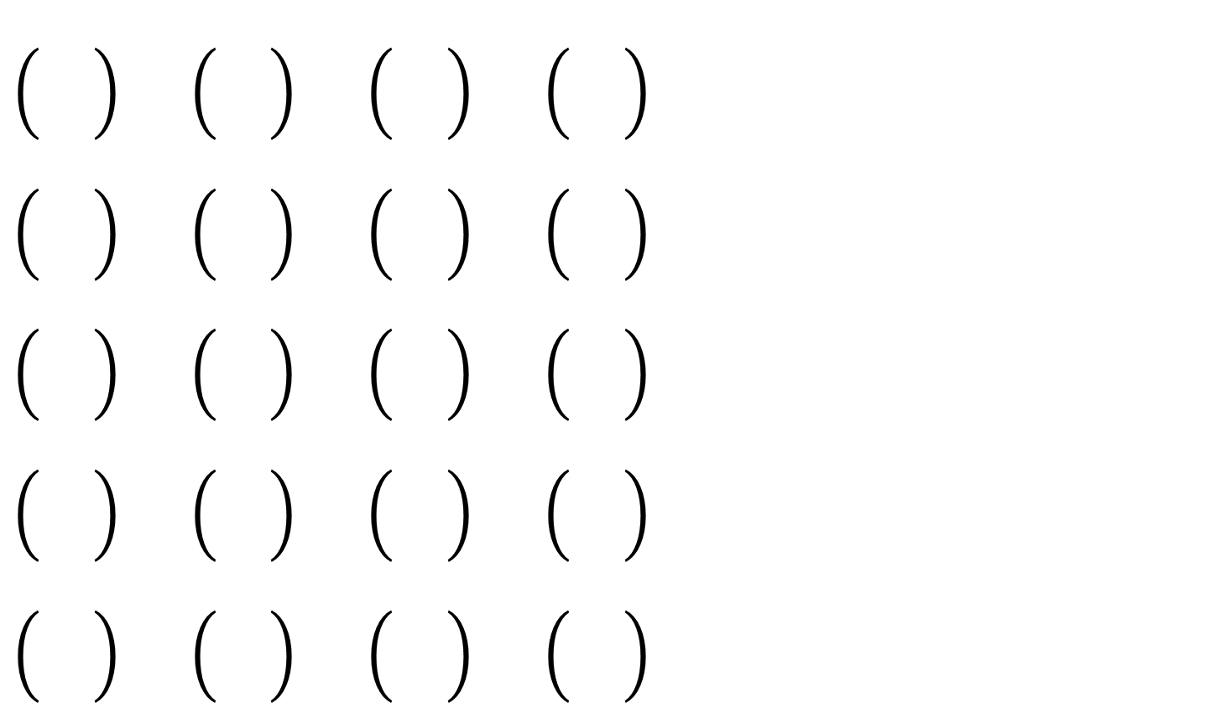
Other square vector paths
Do these have anything in common?
Does it apply to all vector paths?
How could you check a vector path makes a square?

Slide 16
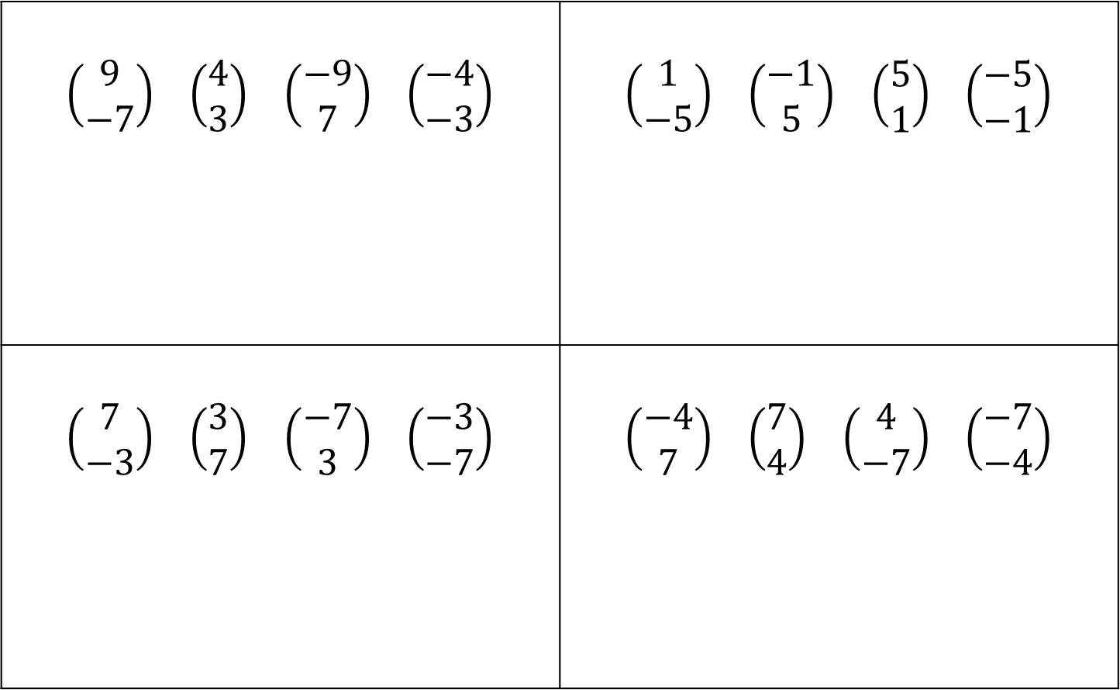
Square or not?
$\left(\begin{matrix}9 \\ −7\end{matrix}\right)$ $\left(\begin{matrix}4 \\ 3\end{matrix}\right)$ $\left(\begin{matrix}−9 \\ 7\end{matrix}\right)$ $\left(\begin{matrix}−4 \\ −3\end{matrix}\right)$ | $\left(\begin{matrix}1 \\ −5\end{matrix}\right)$ $\left(\begin{matrix}−1 \\ 5\end{matrix}\right)$ $\left(\begin{matrix}5 \\ 1\end{matrix}\right)$ $\left(\begin{matrix}−5 \\ −1\end{matrix}\right)$
$\left(\begin{matrix}7 \\ −3\end{matrix}\right)$ $\left(\begin{matrix}3 \\ 7\end{matrix}\right)$ $\left(\begin{matrix}−7 \\ 3\end{matrix}\right)$ $\left(\begin{matrix}−3 \\ −7\end{matrix}\right)$ | $\left(\begin{matrix}−4 \\ 7\end{matrix}\right)$ $\left(\begin{matrix}7 \\ 4\end{matrix}\right)$ $\left(\begin{matrix}4 \\ −7\end{matrix}\right)$ $\left(\begin{matrix}−7 \\ −4\end{matrix}\right)$

Slide 17
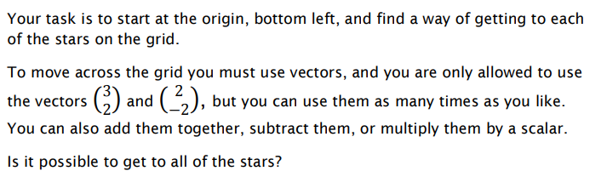
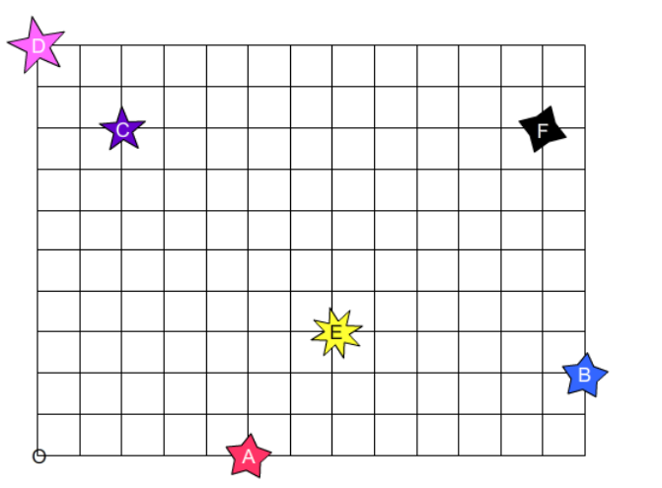
Notes:
From MathsPad
Vectors.php

Slide 18
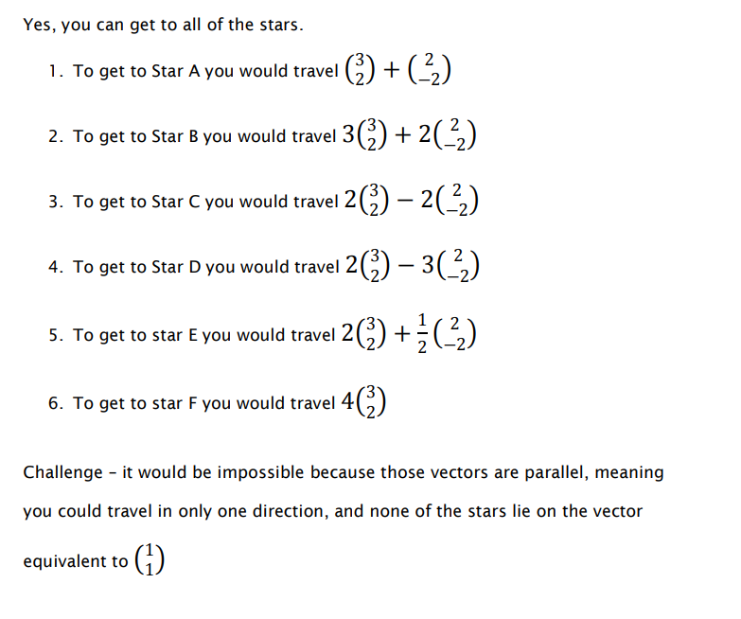
Notes:
Answers

Slide 19


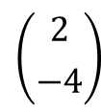



















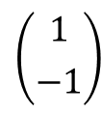





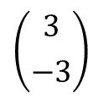

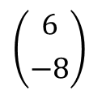

Create a sequences of column vectors that make…
$$\left({1 \atop 0}\right)$$
$$\left({0 \atop −1}\right)$$
$$\left({−1 \atop 0}\right)$$
$$\left({0 \atop 1}\right)$$
a
A unit square
?
Hint 1
$$\left({2 \atop 0}\right)$$
$$\left({0 \atop −2}\right)$$
$$\left({−2 \atop 0}\right)$$
$$\left({0 \atop 2}\right)$$
b
Another square
?
Hint 2
$$\left({1 \atop −1}\right)$$
$$\left({−1 \atop −1}\right)$$
$$\left({−1 \atop 1}\right)$$
$$\left({1 \atop 1}\right)$$
c
Another unit square
?
Hint 3
d
A slanted square with integer side lengths
$$\left({4 \atop −3}\right)$$
$$\left({−3 \atop −4}\right)$$
$$\left({−4 \atop 3}\right)$$
$$\left({3 \atop 4}\right)$$
?
$$\left({3 \atop 0}\right)$$
$$\left({0 \atop −2}\right)$$
$$\left({−3 \atop 0}\right)$$
$$\left({0 \atop 2}\right)$$
?
e
A rectangle
$$\left({3 \atop −3}\right)$$
$$\left({−2 \atop −2}\right)$$
$$\left({−3 \atop 3}\right)$$
$$\left({2 \atop 2}\right)$$
Another rectangle
?
f
g
A slanted rectangle
$$\left({2 \atop −4}\right)$$
$$\left({−2 \atop −1}\right)$$
$$\left({−2 \atop 4}\right)$$
$$\left({2 \atop 1}\right)$$
?
h
A slanted rectangle with only integer side lengths
$$\left({6 \atop −8}\right)$$
$$\left({−4 \atop −3}\right)$$
$$\left({−6 \atop 8}\right)$$
$$\left({4 \atop 3}\right)$$
?

