Slide 1















Dual coding symbols:
Practise
Explain
Organise
Big Question
Reflect
Present
Compare
Evaluate
Activate
Discuss
Predict
Connect
Summarise
Recall
Vocabulary

Slide 2








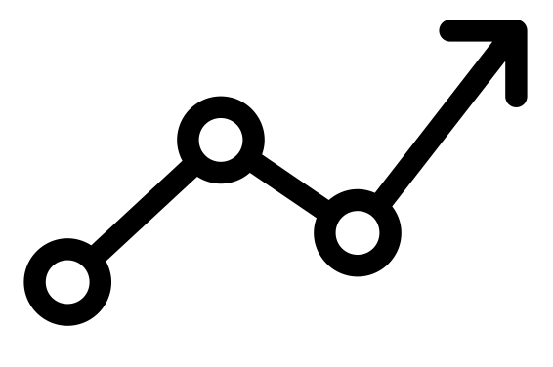

Editable reading ruler
Every child in an Archway school will become a fluent reader
 | RETRIEVE the words or phrases you need from the text | DECODE the words or phrase to address a breakdown | CONNECT with words or phrases you know from the text or your memory | VISUALISE the images in as much detail as possible | SUMMARISE the main ideas of the text in a few words | INFER meanings that might be within the text | PREDICT what might happen next using details from the text | EXAMINE how the writer uses words to construct meaning
 | ASK THOUGHTFUL QUESTIONS TO HELP YOU UNDERSTAND THE TEXT

Slide 3
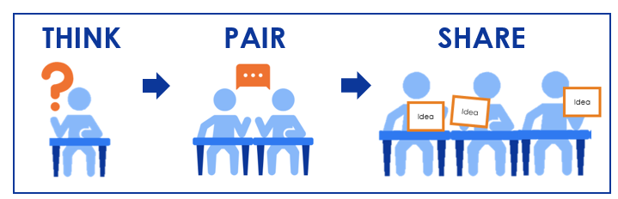





A
B

Slide 4
Vectors & Quadrilaterals

Slide 5






Key vocabulary:
Decode the word
Definition
.
Rhombus
Examples
Non-examples

Slide 6
Key vocabulary:
Decode the word
Definition
.
Parallelogram
Examples
Non-examples

Slide 7
Key vocabulary:
Decode the word
Definition
.
Trapezium
Examples
Non-examples

Slide 8
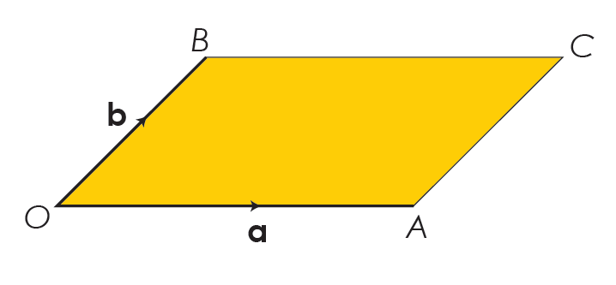


This diagram shows a parallelogram
$$b$$
What is $\vec{AC}$?

Slide 9


This diagram shows a parallelogram
$$−a$$
What is $\vec{CB}$?

Slide 10

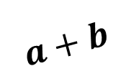
This diagram shows a parallelogram
$$a+b$$
$$b$$
$$How can we write \vec{OC }$$
$in terms of a and b$?

Slide 11

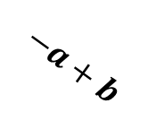
This diagram shows a parallelogram
$$−a+b$$
What is $\vec{AB}$?

Slide 12
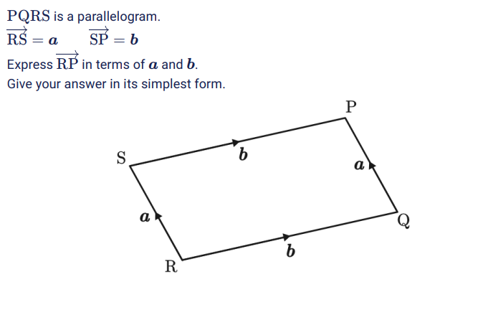


Slide 13
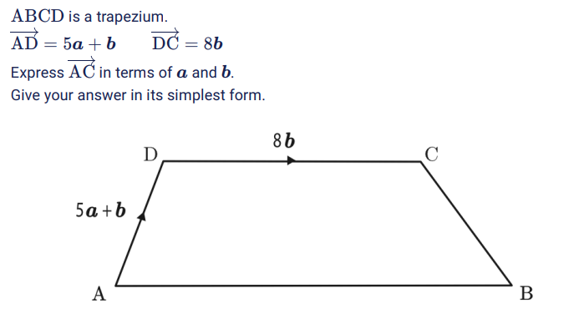

Slide 14
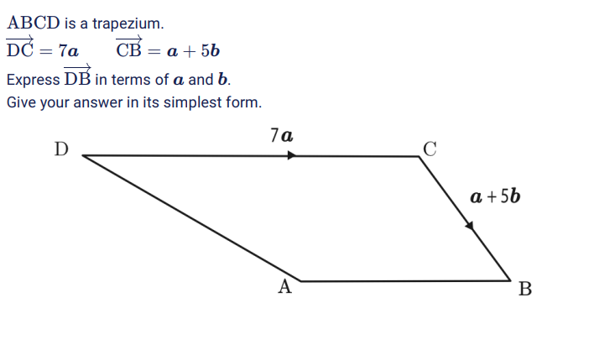

Slide 15
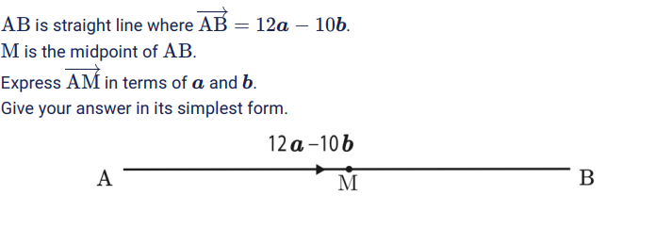

Slide 16
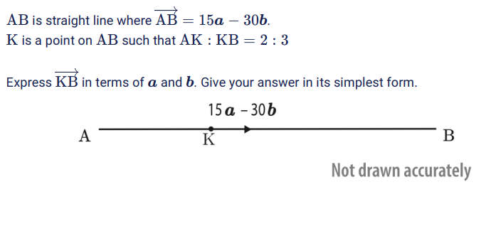

Slide 17
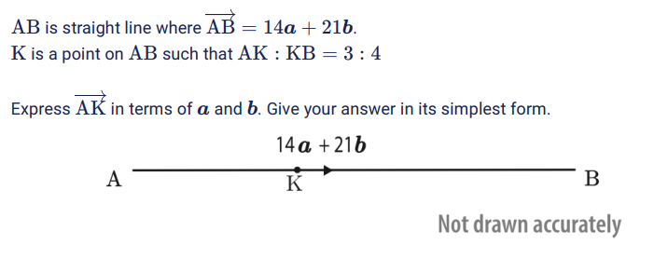

Slide 18
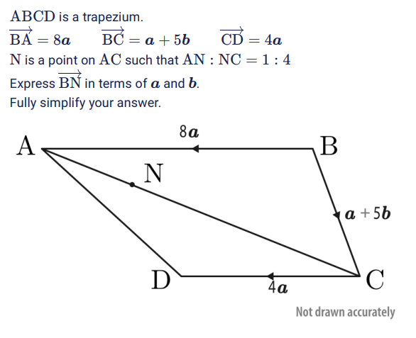

Slide 19
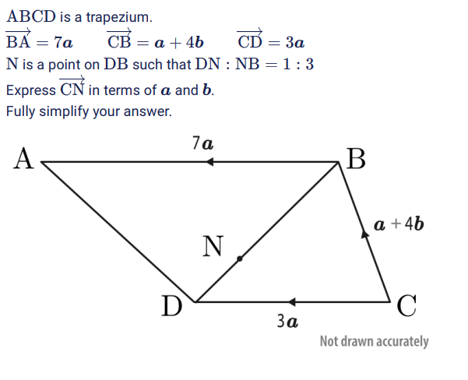

Slide 20
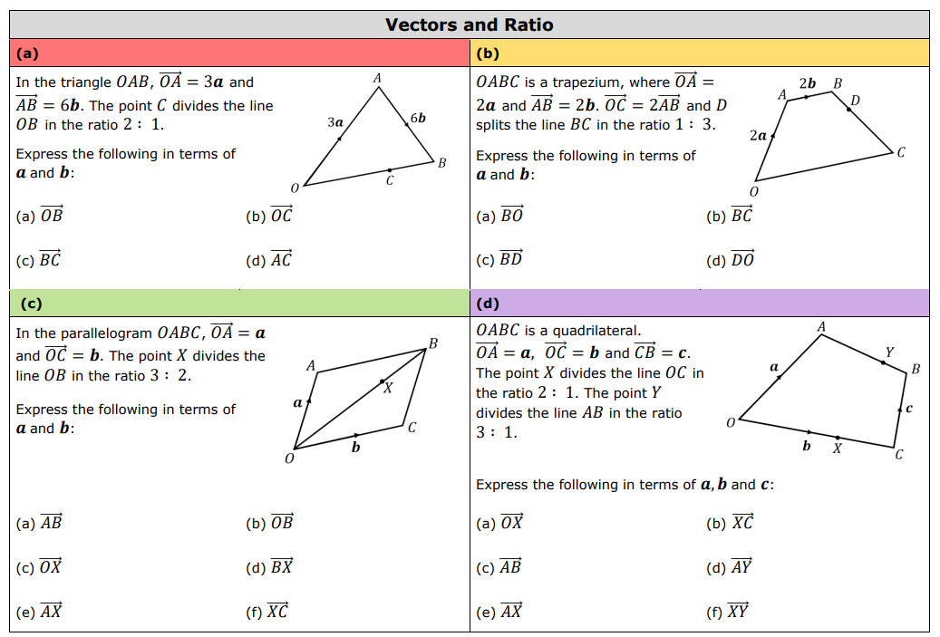

Slide 21
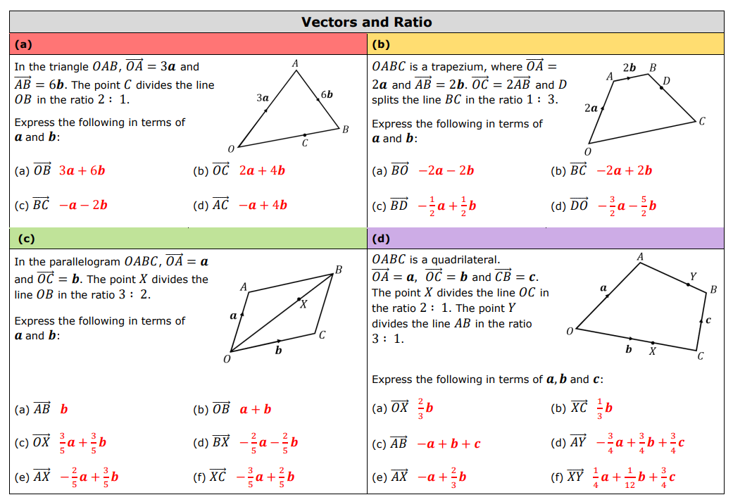
Notes:
7ac124_9ba80adaf4ff40948fa85ce9ffb072a8.pdf

Slide 22
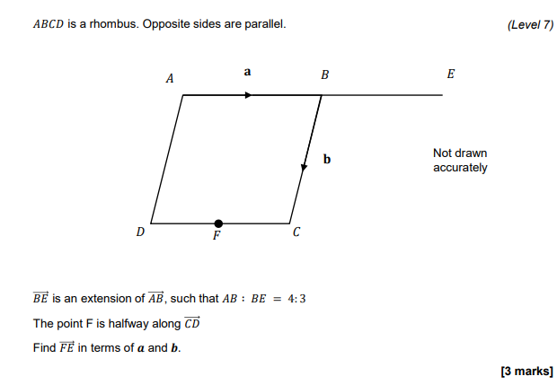
EXAM QUESTION 1

Slide 23
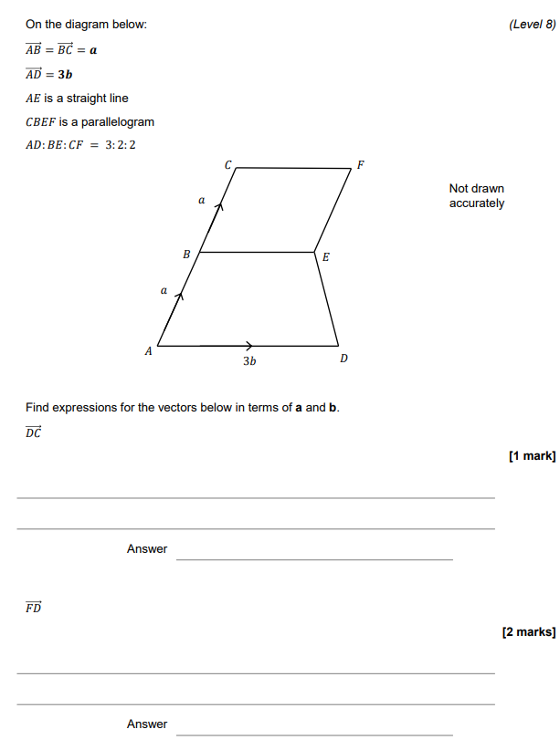
EXAM QUESTION 2

