Slide 1
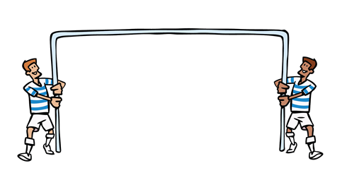
Goal Free
Vectors

Slide 2
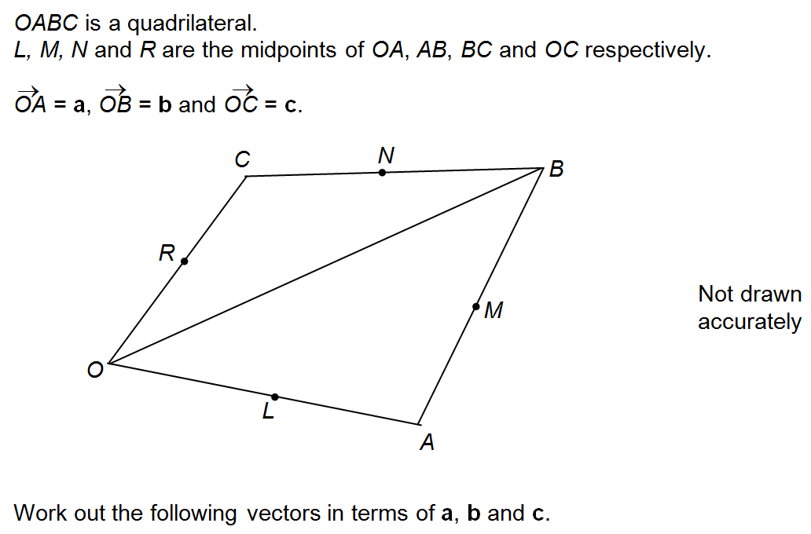
Work out as many different vectors as you can
Notes:
From AQA Higher Topic Test

Slide 3
Question is: Work out $\vec{LM}$ [4 marks]
Which of your vectors will help you answer the question?
Notes:
From AQA Higher Topic Test

Slide 4

Question is: Work out $\vec{LM}$ [4 marks]
$$\vec{LM}=\frac{1}{2}b$$
1 mark for $\vec{LA}=\frac{1}{2}a$
1 mark for $\vec{AB}=−a+b$ or $\vec{BA}=a−b$
1 mark for $\vec{AM}=−\frac{1}{2}a+\frac{1}{2}b$ or$\vec{BM}=\frac{1}{2}a−\frac{1}{2}b$
Notes:
From AQA Higher Topic Test

Slide 5
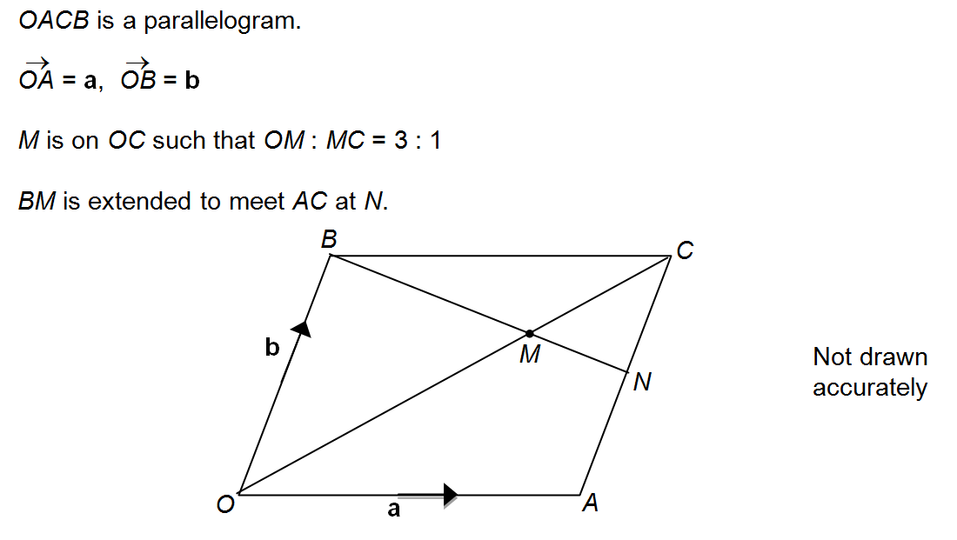
Work out as many different vectors as you can

Slide 6

Question is: Work out $\vec{BM}$ [3 marks]
1 mark for $\vec{BM}=\frac{3}{4}a−\frac{1}{4}b$
1 mark for $\vec{OC}=a+b$
1 mark for $\vec{OM}=\frac{3}{4}a+\frac{3}{4}b$

Slide 7
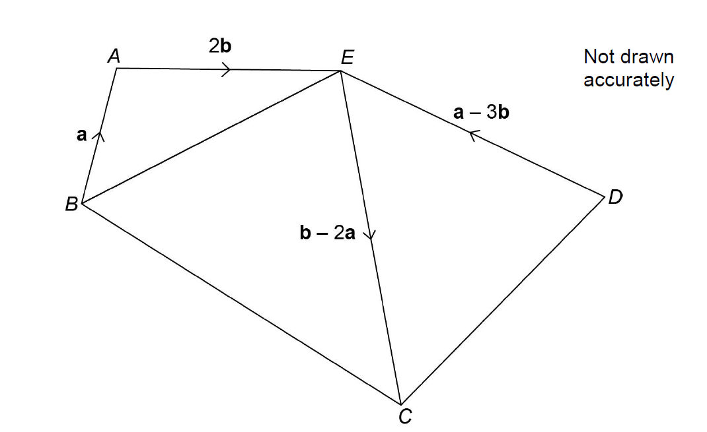
Work out as many different vectors as you can
Notes:
From Nov 2017 Paper 2

Slide 8
Question is:
Which of your vectors will help you answer the question?
Notes:
From Nov 2017 Paper 2

Slide 9
Question is:
1 mark for $\vec{BE}=a+2b$
1 mark for $\vec{CD}=−b+2a−a+3b=a+2b$ (correct working out must be seen)
1 mark for BE is equal and parallel to CD $∴BCDE is a parallelogram$
Notes:
From Nov 2017 Paper 2

Slide 10
Another solution:
2 marks for $\vec{CB}=−b+2a−2b−a=a−3b$ (correct working must be seen)
1 mark for CB is equal and parallel to DE $∴BCDE is a parallelogram$
Notes:
From Nov 2017 Paper 2

Slide 11
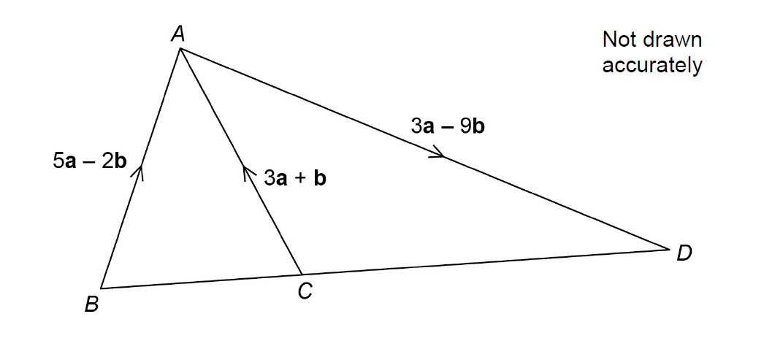
Work out as many different vectors as you can
Notes:
From Nov 2017 Paper 2

Slide 12
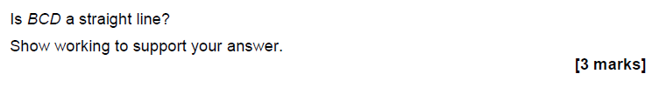
The question is:
1 mark for $\vec{BC}=2a−3b$ oe
1 mark for $\vec{CD}=6a−8b$ oe
1 mark for NO because $3\vec{BC}≠\vec{CD}$
Notes:
From June 2017 Paper 2

