Slide 1















Dual coding symbols:
Practise
Explain
Organise
Big Question
Reflect
Present
Compare
Evaluate
Activate
Discuss
Predict
Connect
Summarise
Recall
Vocabulary

Slide 2








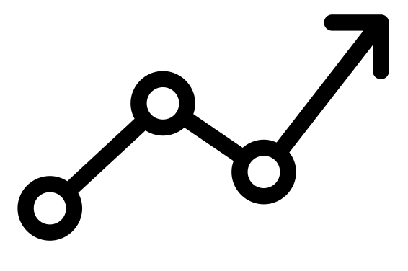

Editable reading ruler
Every child in an Archway school will become a fluent reader
 | RETRIEVE the words or phrases you need from the text | DECODE the words or phrase to address a breakdown | CONNECT with words or phrases you know from the text or your memory | VISUALISE the images in as much detail as possible | SUMMARISE the main ideas of the text in a few words | INFER meanings that might be within the text | PREDICT what might happen next using details from the text | EXAMINE how the writer uses words to construct meaning
 | ASK THOUGHTFUL QUESTIONS TO HELP YOU UNDERSTAND THE TEXT

Slide 3

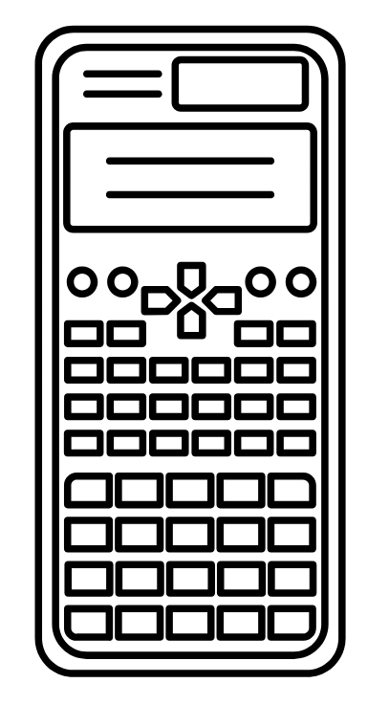



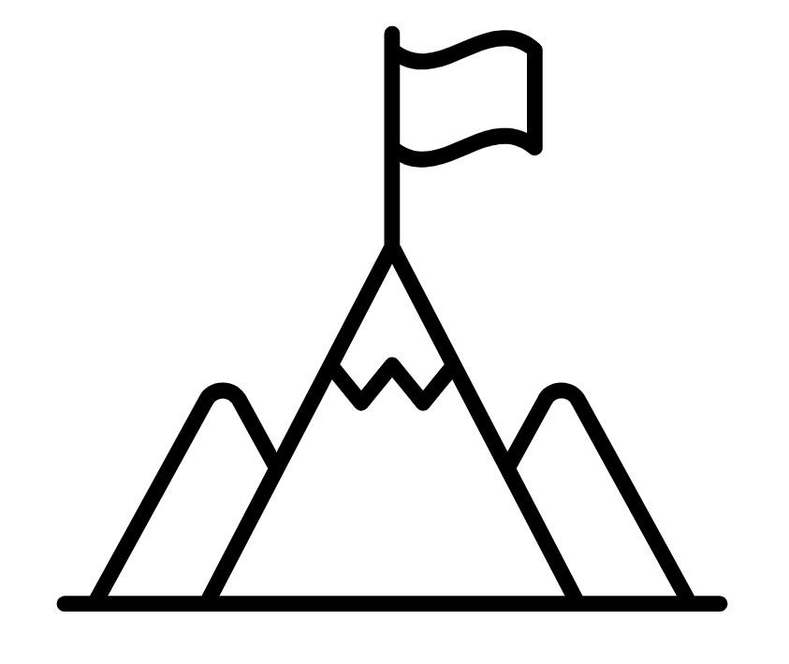
A
B

Slide 4

LO: To use inequality symbols to compare integers.
Key vocabulary:
Word | Definition
Number
Numeral
Retrieve from memory without prompts or discussion. You must write something for each.
RETRIEVE
INSTRUCT
PRACTISE
SECURE

Slide 5
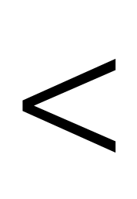


What do these 3 symbols mean?
$<$
$=$
$>$
RETRIEVE
INSTRUCT
PRACTISE
SECURE

Slide 6
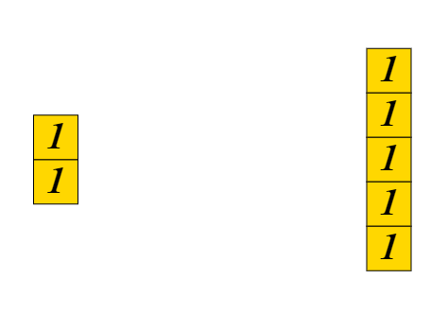
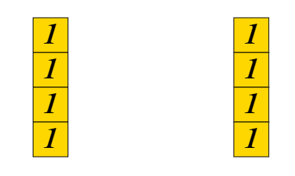


How do I remember which way round my symbols go?
$=$
$<$
4 is equal in size to 4 so we use the equals symbol to say 4 is equal to 4 as both sides are the same size.
2 is smaller than 5 so we use an inequality symbol to say 2 is less than 5. The smaller side of the symbol goes to the smaller of the two values.
RETRIEVE
INSTRUCT
PRACTISE
SECURE

Slide 7
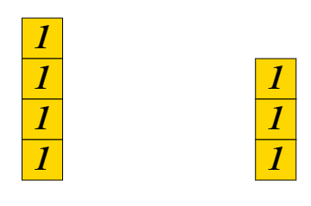
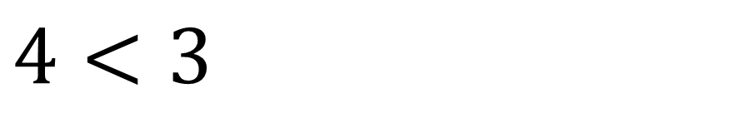

With your partner: Have I used the correct symbol?
$4<3$
$>$
RETRIEVE
INSTRUCT
PRACTISE
SECURE

Slide 8

With your partner: Have I used the correct symbol?
$10=1+0$
RETRIEVE
INSTRUCT
PRACTISE
SECURE

Slide 9
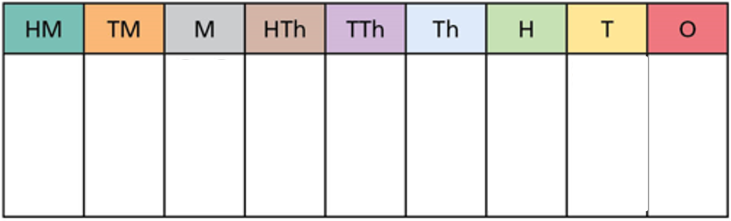


I DO:
WE DO:
$32000$ $30200$
$1040$ $1400$
RETRIEVE
INSTRUCT
PRACTISE
SECURE

Slide 10


I DO:
WE DO:
$6×4$ $5^{2}$
$6+4$ $19−10$
RETRIEVE
INSTRUCT
PRACTISE
SECURE

Slide 11
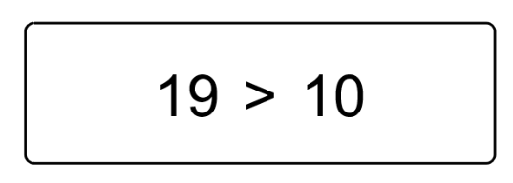
True or False?

Slide 12
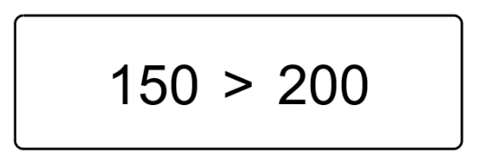
True or False?

Slide 13
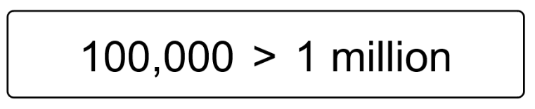
True or False?

Slide 14
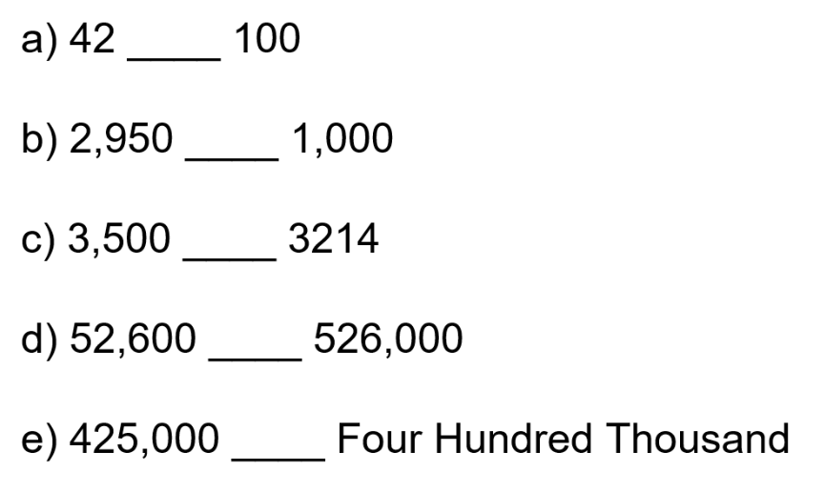

Slide 15
Mini WBs:
RETRIEVE
INSTRUCT
PRACTISE
SECURE

Slide 16
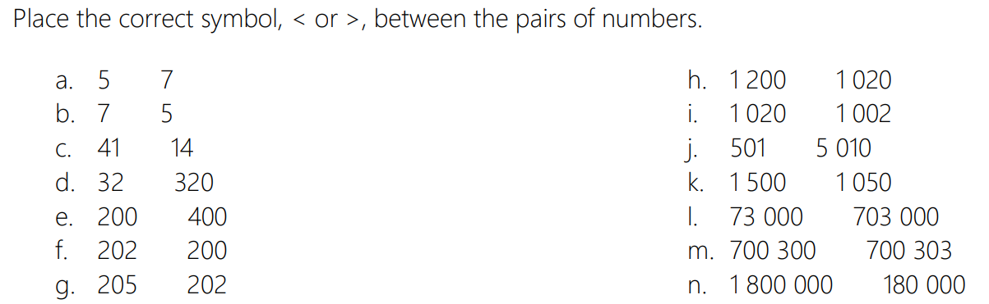
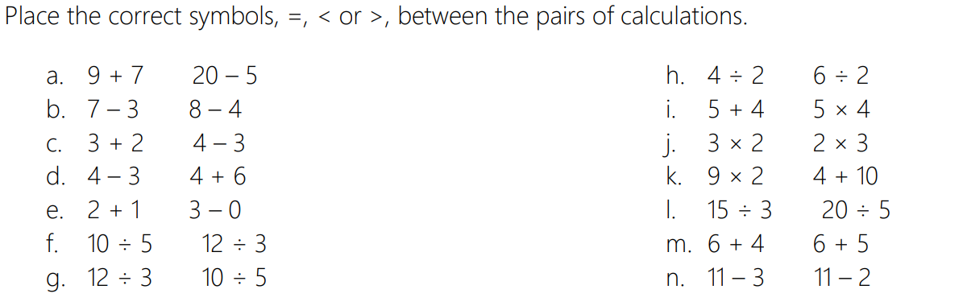
Independent practice:

Slide 17








Depth:
Place the correct symbol between the calculations below. Each pair of calculations is linked. Try and work out which symbol to use without completing the calculations. Use a calculator to then check whether you were correct.
If you were wrong, can you now look at the calculations and explain why the symbol needed works?
$16×43$ $8×86$
$164÷48$ $82÷24$
$35×41$ $17×82$
$152÷25$ $304÷49$
$15×406$ $7×812$
$234÷42$ $276÷43$
$15×66$ $45×22$
$1640÷48$ $16.4÷0.48$
RETRIEVE
INSTRUCT
PRACTISE
SECURE

Slide 18
To finish…
Fill in the blanks.
a) cm > 2 m e) mm > 20 cm > m
b) m < 400 cm f) mm < 40 cm < m
c) 200 cm < m g) 20 cm > mm > m
d) 4 m > cm h) 40 km < m < cm
km < m < cm < mm
Notes:
Answers
a) Any value greater than 200cm
b) Any value less than 4m
c) Any value greater than 2m
d) Any value less than 400cm
e) Any value greater than 200mm and less than 0.2m
f) Any value less than 400mm and greater than 0.4m
g) Any value less than 200mm and less than 0.2m
h) Any value greater than 40000m and 4000000cm
? (for example): 2 km < 3 000 m < 400 000 cm < 5 000 000mm or 0.1 km < 101 m < 10101 cm < 101011 mm
Suggested questioning
Which measurement needs to be bigger? What does this mean for the value? What might your answer be if the units were the same? How can you change it?
Things to think about
This activity makes students think about conversions of length – there are deliberate similarities to provide opportunities to discuss the inequality and the conversion.

