Slide 1















Dual coding symbols:
Practise
Explain
Organise
Big Question
Reflect
Present
Compare
Evaluate
Activate
Discuss
Predict
Connect
Summarise
Recall
Vocabulary

Slide 2








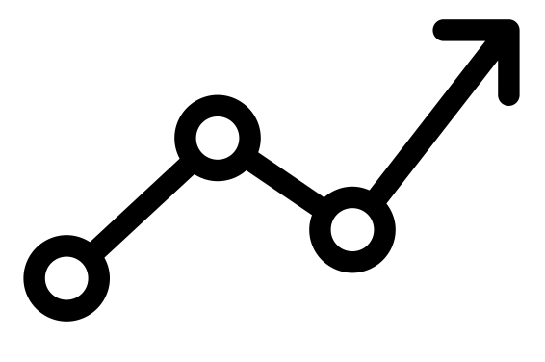

Editable reading ruler
Every child in an Archway school will become a fluent reader
 | RETRIEVE the words or phrases you need from the text | DECODE the words or phrase to address a breakdown | CONNECT with words or phrases you know from the text or your memory | VISUALISE the images in as much detail as possible | SUMMARISE the main ideas of the text in a few words | INFER meanings that might be within the text | PREDICT what might happen next using details from the text | EXAMINE how the writer uses words to construct meaning
 | ASK THOUGHTFUL QUESTIONS TO HELP YOU UNDERSTAND THE TEXT

Slide 3

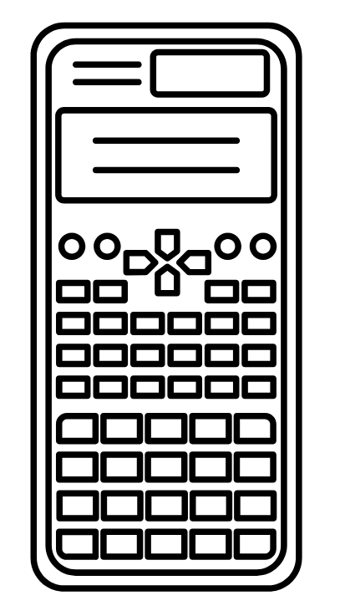



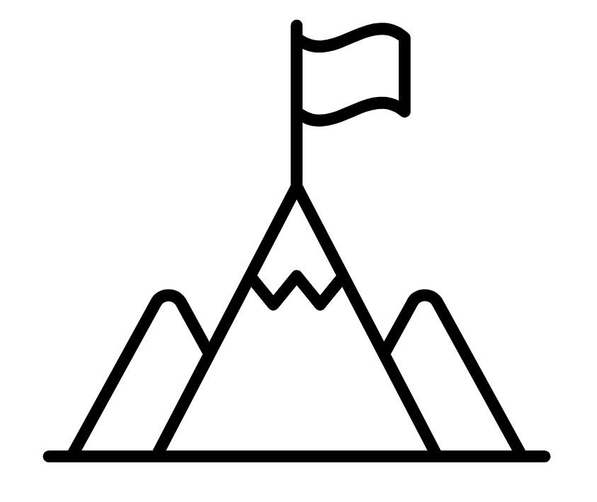
A
B

Slide 4



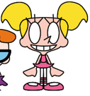




These cartoon characters are stood in a random line.
There is no order to the line so the line doesn’t really tell us anything other than how many people are in it.
If we look at the middle character – is he the middle height?

Slide 5
The characters are now stood in line based on their height.
The middle of the line now represents the middle height – we call this the median.
The first person and the last person in the line have the shortest and tallest heights. The difference between their heights are called the range.

Slide 6
The range of heights
Smallest height
Tallest height
Middle height = Median height
RETRIEVE
INSTRUCT
PRACTISE
SECURE

Slide 7
If data is put in an increasing (or decreasing) order we can quickly identify the median of that data set and the range of that data set.
Why isn’t this set of data ready for us to find the median and range?
4, 10, 2, 1, 7
RETRIEVE
INSTRUCT
PRACTISE
SECURE

Slide 8
I DO:
WE DO:
Find (a) the median and (b) the range of the following set of data:
12, 45, 21, 9, 5, 9, 1
Find (a) the median and (b) the range of the following set of data:
9, 11, 2, 3, 6,
RETRIEVE
INSTRUCT
PRACTISE
SECURE

Slide 9
I DO:
WE DO:
Find (a) the median and (b) the range of the following set of data:
12, 21, 19, 1, 5, 14
Find (a) the median and (b) the range of the following set of data:
9, 5, 1, 7
RETRIEVE
INSTRUCT
PRACTISE
SECURE

Slide 10
Mini WBs:
Write a set of 5 numbers that has a median of 10
RETRIEVE
INSTRUCT
PRACTISE
SECURE

Slide 11
Mini WBs:
Write a set of 5 numbers that has a median of 10 and a range of 4
RETRIEVE
INSTRUCT
PRACTISE
SECURE

Slide 12
Mini WBs:
Write a set of 6 numbers that has a median of 10
RETRIEVE
INSTRUCT
PRACTISE
SECURE

Slide 13
Mini WBs:
Write a set of 6 numbers that has a median of 10 and a range of 5
RETRIEVE
INSTRUCT
PRACTISE
SECURE

Slide 14
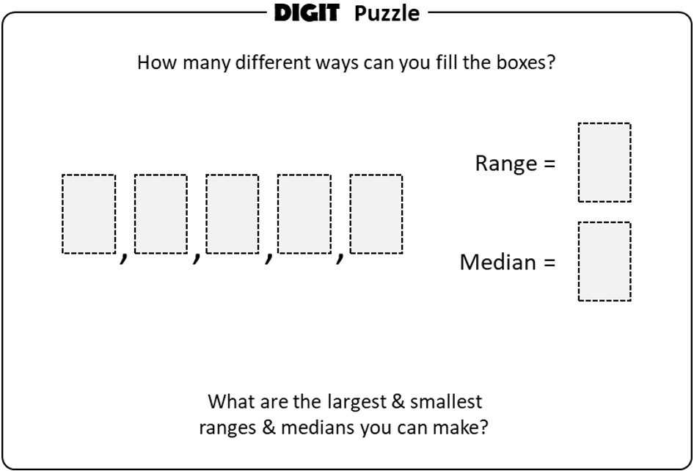
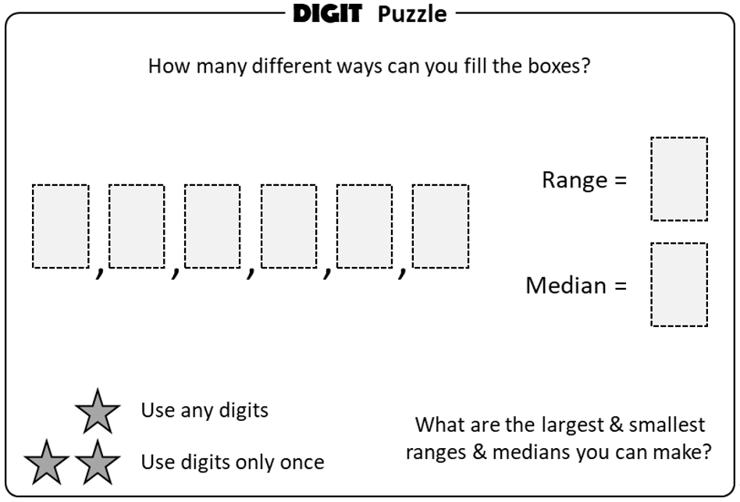
Independent practice:
RETRIEVE
INSTRUCT
PRACTISE
SECURE

Slide 15
For each question fill in the boxes with unique numbers to create a set of data with the statistics given.
Median of 5.
Median of 6.
Median of 4 and range of 10.
Median of 8 and range of 9.
Median of 7.5 and range of 10.
RETRIEVE
INSTRUCT
PRACTISE
SECURE

Slide 16
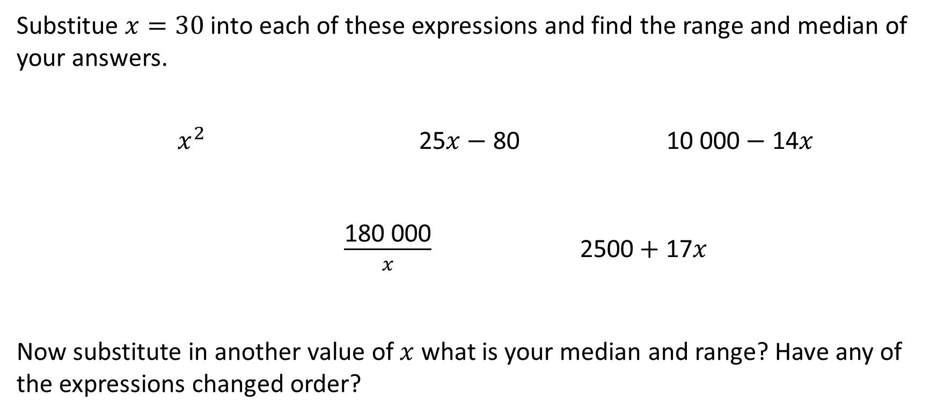
Depth:
Substitue $x=30$ into each of these expressions and find the range and median of your answers.
$x^{2}$ 25$x−$ 80 10 000$−$ 14$x$
$\frac{\text{180 000}}{x}$ 2500$+$ 17$x$
Now substitute in another value of $x$ what is your median and range? Have any of the expressions changed order?
RETRIEVE
INSTRUCT
PRACTISE
SECURE

