Slide 1















Dual coding symbols:
Practise
Explain
Organise
Big Question
Reflect
Present
Compare
Evaluate
Activate
Discuss
Predict
Connect
Summarise
Recall
Vocabulary

Slide 2


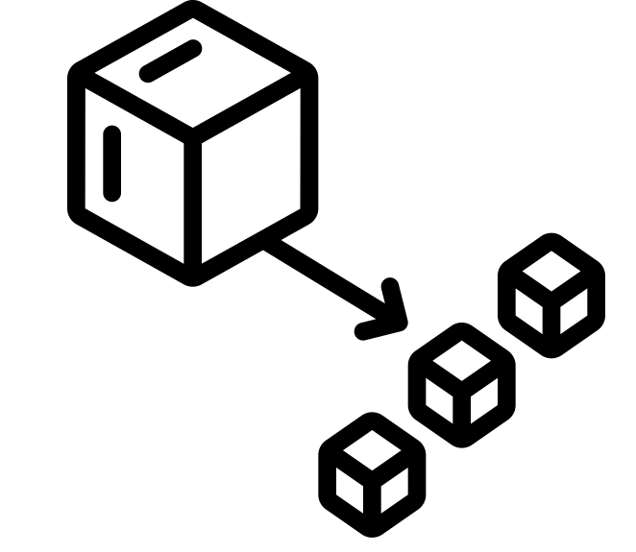





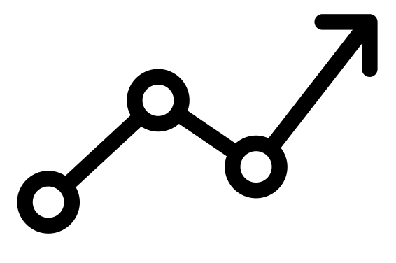

Editable reading ruler
Every child in an Archway school will become a fluent reader
 | RETRIEVE the words or phrases you need from the text | DECODE the words or phrase to address a breakdown | CONNECT with words or phrases you know from the text or your memory | VISUALISE the images in as much detail as possible | SUMMARISE the main ideas of the text in a few words | INFER meanings that might be within the text | PREDICT what might happen next using details from the text | EXAMINE how the writer uses words to construct meaning
 | ASK THOUGHTFUL QUESTIONS TO HELP YOU UNDERSTAND THE TEXT

Slide 3
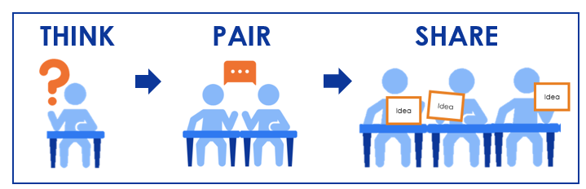
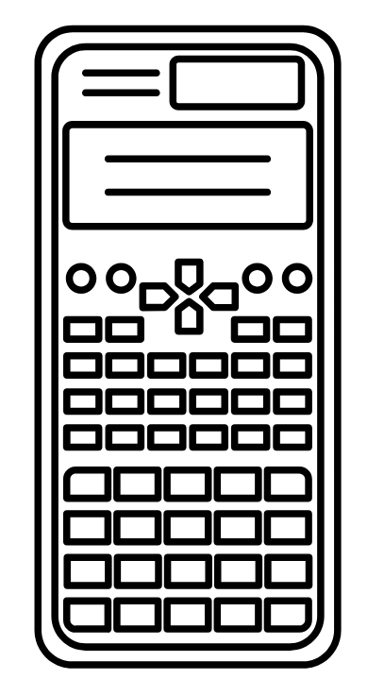

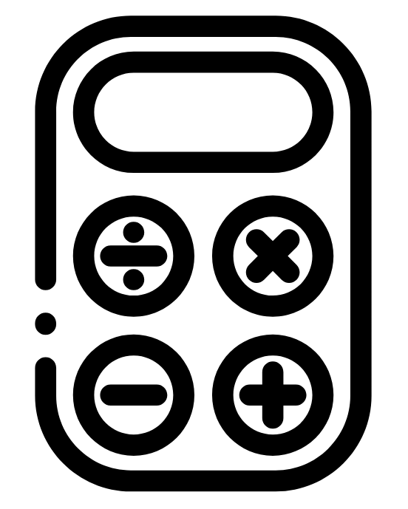

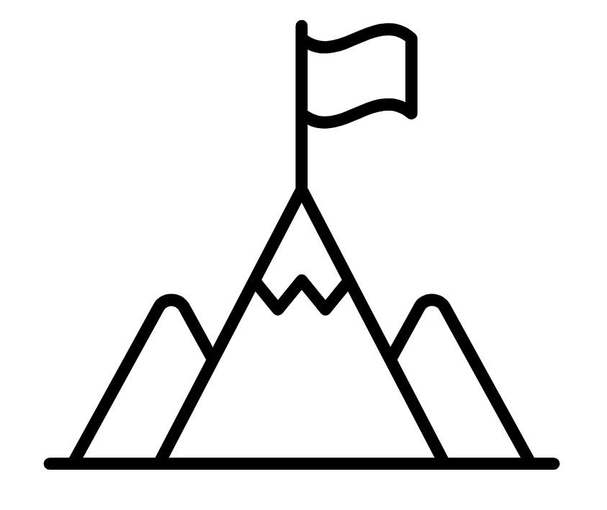
A
B

Slide 4

LO: To recognise and write large numbers
Key vocabulary:
Word | Definition
Number | A number is an idea of a quantity that can be represented in lots of different ways
Numeral | A numeral is the representation of a number using digits 0 – 9
Retrieve from memory without prompts or discussion. You must write something for each.
RETRIEVE
INSTRUCT
PRACTISE
SECURE

Slide 5
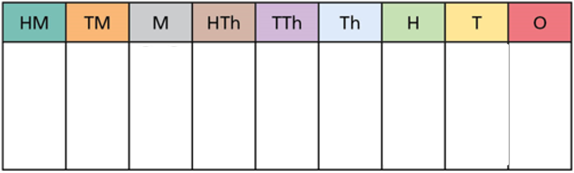
Population of Sweden:
Ten million, one hundred and fifty thousand, and twenty eight.
What does this look like as a numeral?
RETRIEVE
INSTRUCT
PRACTISE
SECURE

Slide 6
Population of Bahrain:
1, 320, 705
What does this look like as in words?
RETRIEVE
INSTRUCT
PRACTISE
SECURE

Slide 7
The population of Latvia is represented below in the place value chart.
What would this look like as a numeral?
Bonus point: What does this sound like when written in words?
RETRIEVE
INSTRUCT
PRACTISE
SECURE

Slide 8
I DO:
WE DO:
Four million, three hundred and seventy five.
Represent the above in the place value chart below.
Write it down as a numeral.
RETRIEVE
INSTRUCT
PRACTISE
SECURE

Slide 9
I DO:
WE DO:
Four million, three hundred and seventy five.
Represent the above in the place value chart below.
Write it down as a numeral.
Four hundred and twenty thousand, three hundred and five.
Represent the above in the place value chart below.
Write it down as a numeral.
RETRIEVE
INSTRUCT
PRACTISE
SECURE

Slide 10
I DO:
YOU DO:
Four million, three hundred and seventy five.
Represent the above in the place value chart below.
Write it down as a numeral.
Seven hundred and thirty thousand, two hundred and sixty one.
Represent the above in the place value chart below.
Write it down as a numeral.
RETRIEVE
INSTRUCT
PRACTISE
SECURE

Slide 11
I DO:
WE DO:
5, 067, 009
Represent the above in the place value chart below.
Write it down in words.
RETRIEVE
INSTRUCT
PRACTISE
SECURE

Slide 12
I DO:
WE DO:
5, 067, 009
Represent the above in the place value chart below.
Write it down in words.
3, 207, 901
Represent the above in the place value chart below.
Write it down in words.
RETRIEVE
INSTRUCT
PRACTISE
SECURE

Slide 13
I DO:
YOU DO:
5, 067, 009
Represent the above in the place value chart below.
Write it down in words.
4, 306, 085
Represent the above in the place value chart below.
Write it down in words.
RETRIEVE
INSTRUCT
PRACTISE
SECURE

Slide 14
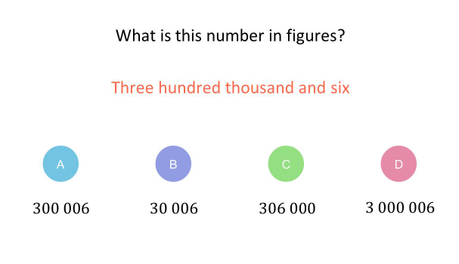
Mini WBs:
RETRIEVE
INSTRUCT
PRACTISE
SECURE

Slide 15
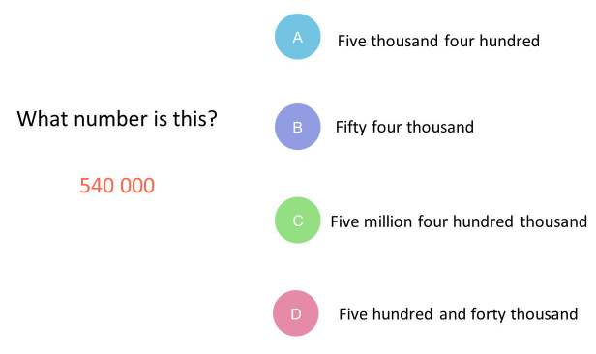
Mini WBs:
RETRIEVE
INSTRUCT
PRACTISE
SECURE

Slide 16
Mini WBs:
RETRIEVE
INSTRUCT
PRACTISE
SECURE

Slide 17
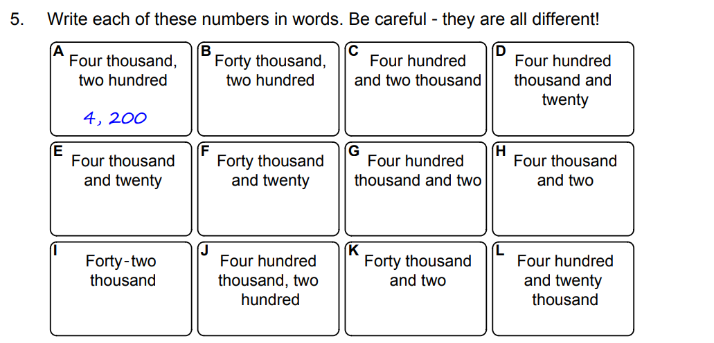
numerals
RETRIEVE
INSTRUCT
PRACTISE
SECURE

Slide 18
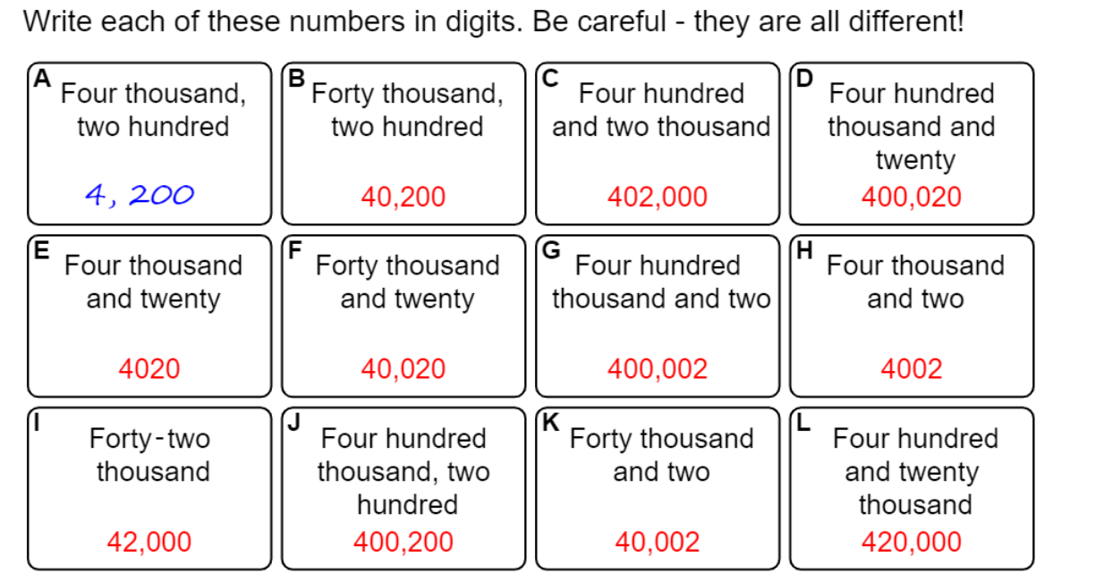
numerals

Slide 19
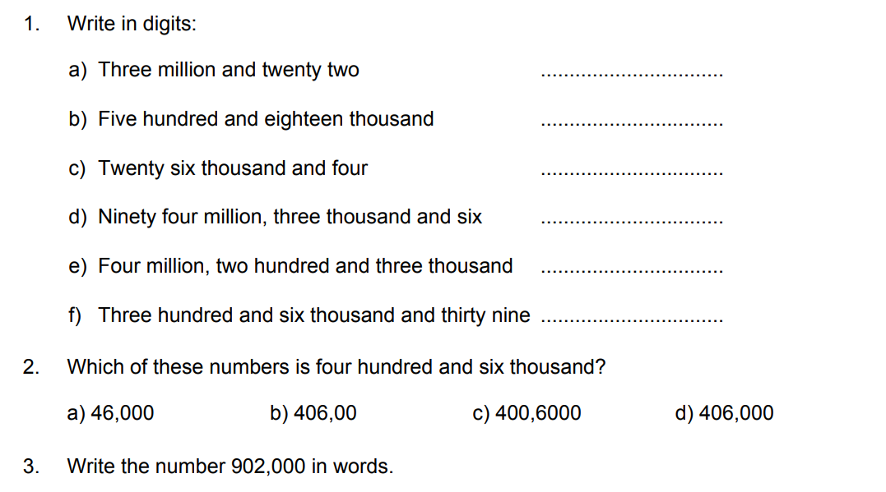
RETRIEVE
INSTRUCT
PRACTISE
SECURE

Slide 20
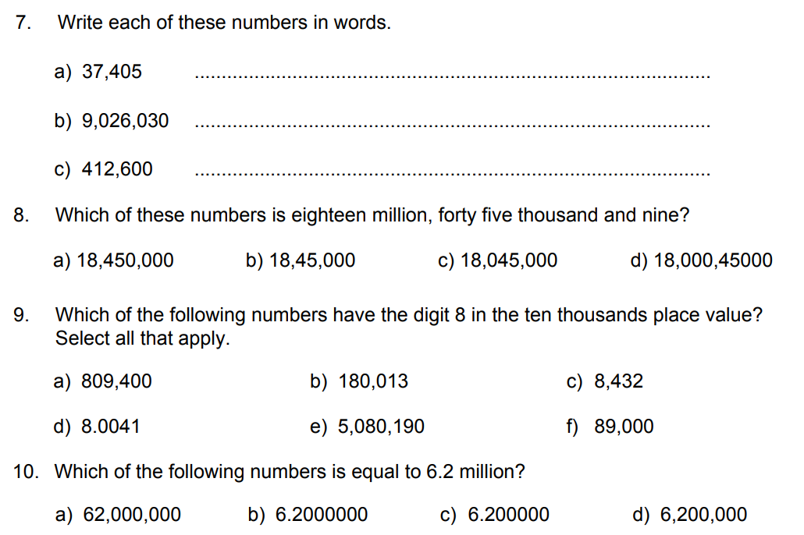
RETRIEVE
INSTRUCT
PRACTISE
SECURE

Slide 21
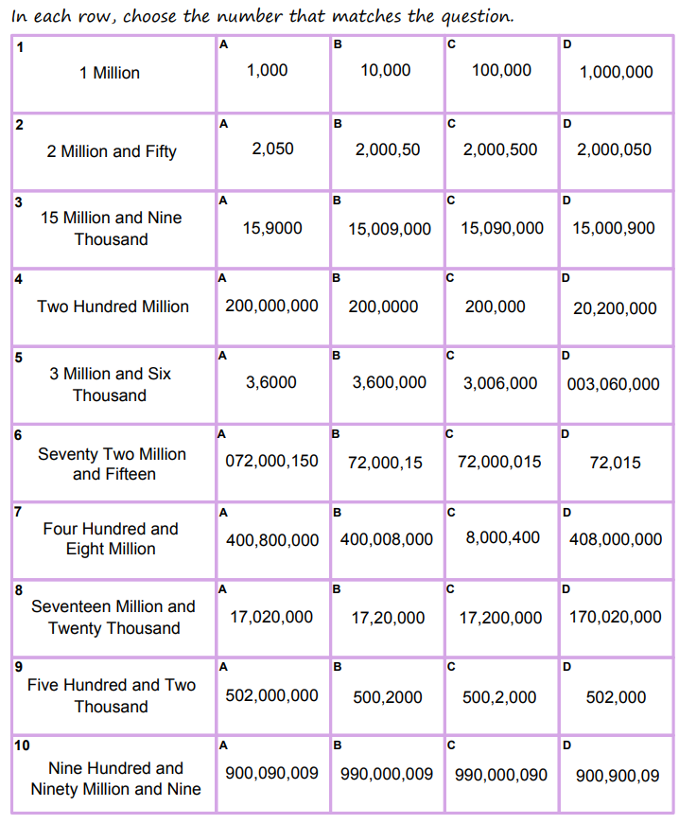
RETRIEVE
INSTRUCT
PRACTISE
SECURE

Slide 22
Depth:
What is the biggest number you can make using the following cards:
Write out your answer in words.
What is the smallest number (not beginning with zero)?
Write out your answer in words.
What is the closest number to half a million?
4
0
9
0
8
1
RETRIEVE
INSTRUCT
PRACTISE
SECURE

