Slide 1















Dual coding symbols:
Practise
Explain
Organise
Big Question
Reflect
Present
Compare
Evaluate
Activate
Discuss
Predict
Connect
Summarise
Recall
Vocabulary

Slide 2


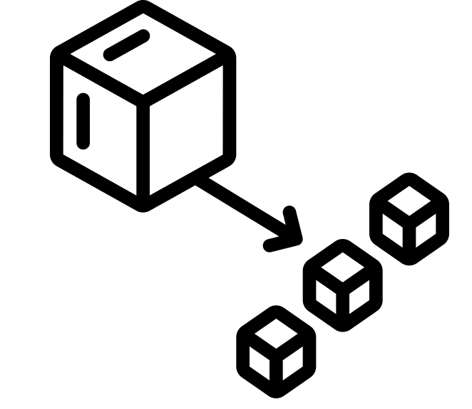





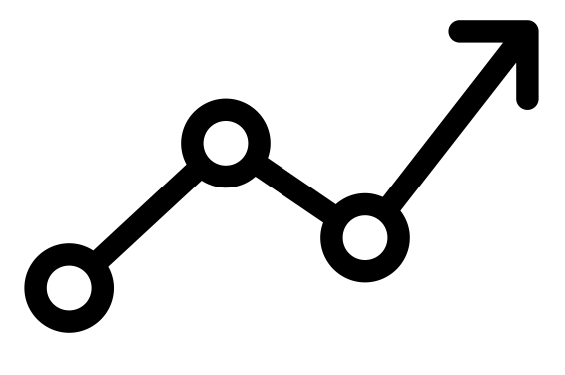

Editable reading ruler
Every child in an Archway school will become a fluent reader
 | RETRIEVE the words or phrases you need from the text | DECODE the words or phrase to address a breakdown | CONNECT with words or phrases you know from the text or your memory | VISUALISE the images in as much detail as possible | SUMMARISE the main ideas of the text in a few words | INFER meanings that might be within the text | PREDICT what might happen next using details from the text | EXAMINE how the writer uses words to construct meaning
 | ASK THOUGHTFUL QUESTIONS TO HELP YOU UNDERSTAND THE TEXT

Slide 3
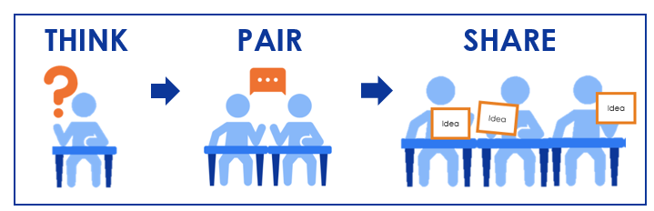
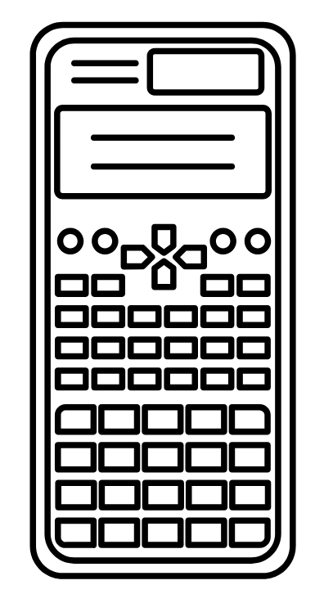

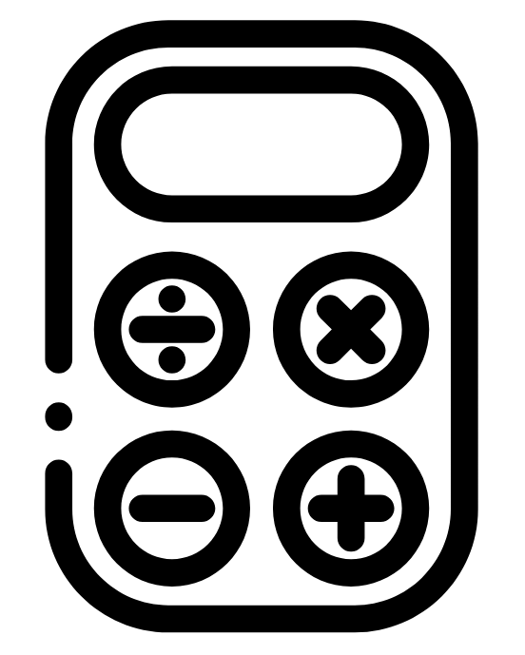

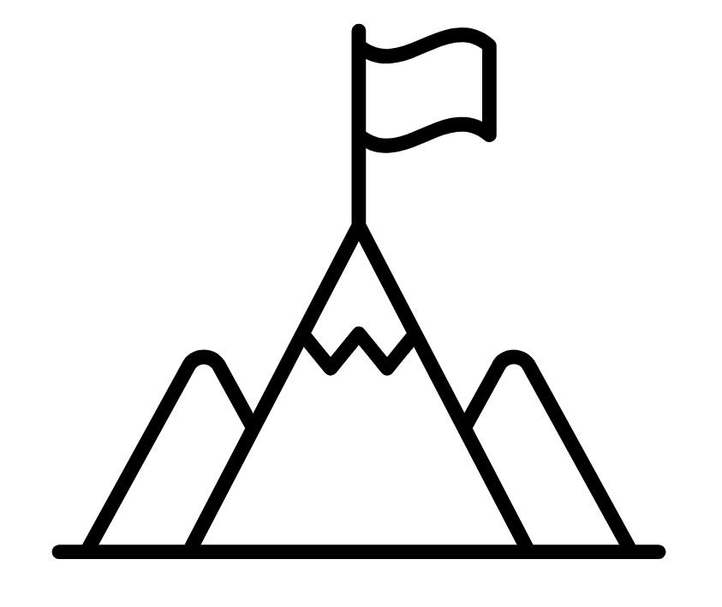
A
B

Slide 4

LO: To round to a given power of ten
Key vocabulary:
Word | Definition
Retrieve from memory without prompts or discussion. You must write something for each.
RETRIEVE
INSTRUCT
PRACTISE
SECURE

Slide 5
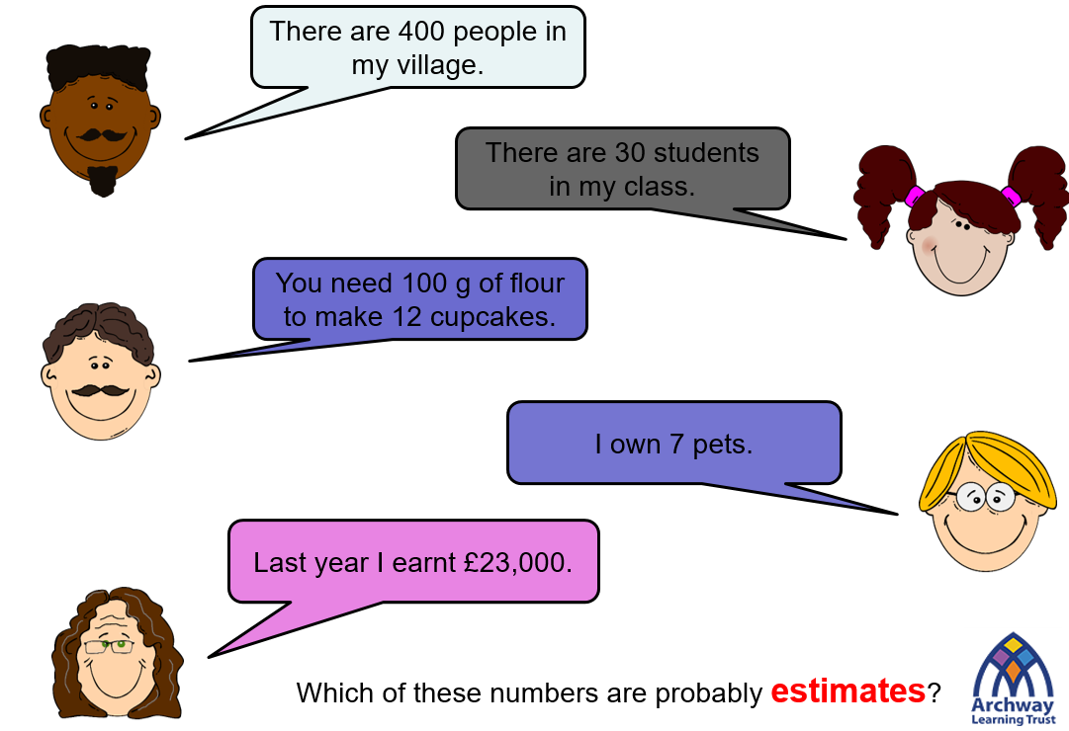

Slide 6

What goes in the middle of all of these number lines?
40
50
120
130
200
300
1000
2000

Slide 7
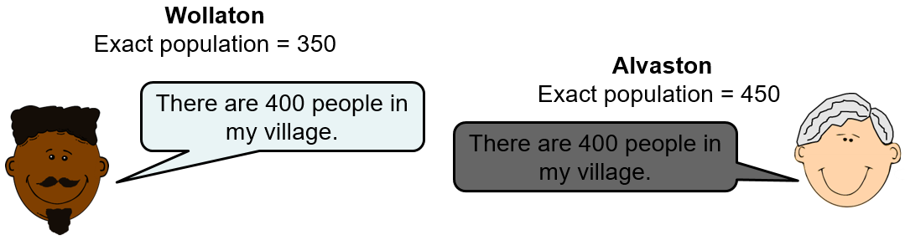
RETRIEVE
INSTRUCT
PRACTISE
SECURE

Slide 8
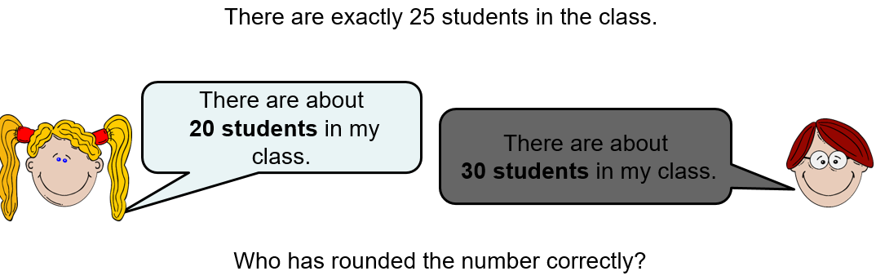
RETRIEVE
INSTRUCT
PRACTISE
SECURE

Slide 9
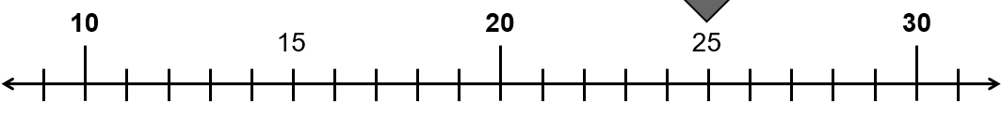
Why does 25 round up to 30 when it is halfway between?
Down
Up
20, 21, 22, 23, 24 round DOWN
25, 26, 27, 28, 29 round UP
The same amount of digits prompt us to round up as down if we use 25 to round up
RETRIEVE
INSTRUCT
PRACTISE
SECURE

Slide 10
I DO:
WE DO:
Round 137 to the nearest 10
Round 291 to the nearest 10
130
RETRIEVE
INSTRUCT
PRACTISE
SECURE

Slide 11
I DO:
WE DO:
Round 137 to the nearest 100
Round 291 to the nearest 100
RETRIEVE
INSTRUCT
PRACTISE
SECURE

Slide 12
I DO:
WE DO:
Round 1 to the nearest 100
Round 999 to the nearest 100
RETRIEVE
INSTRUCT
PRACTISE
SECURE

Slide 13
Mini WBs:
RETRIEVE
INSTRUCT
PRACTISE
SECURE

Slide 14
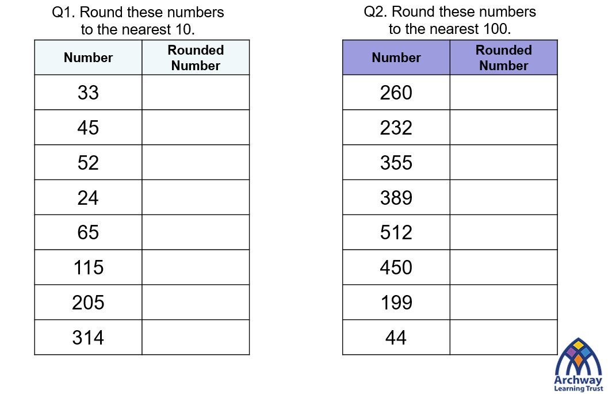
Independent practice:
RETRIEVE
INSTRUCT
PRACTISE
SECURE

Slide 15
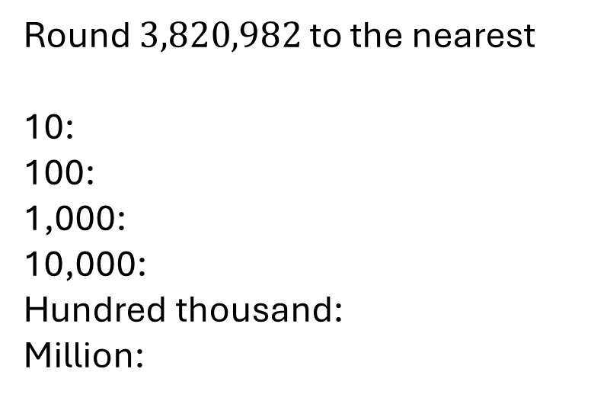
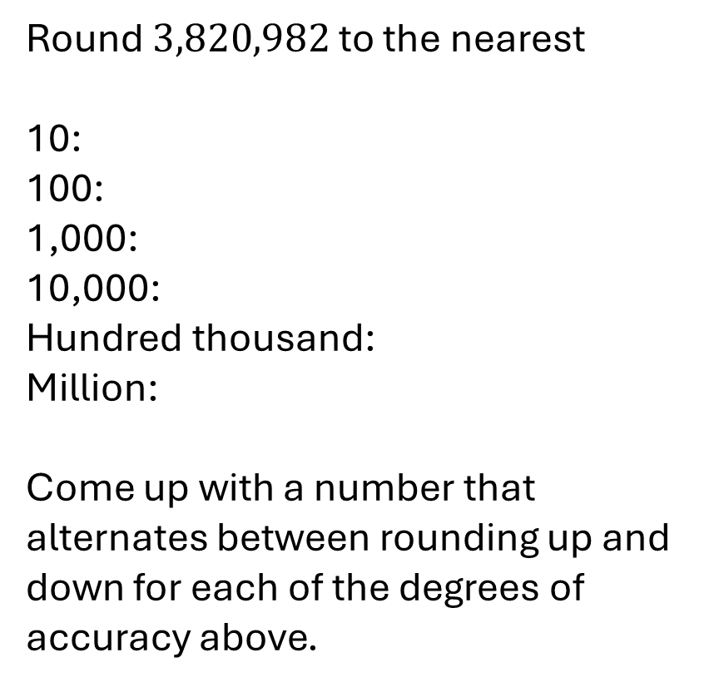
Round $3,820,982$ to the nearest
10:
100:
1,000:
10,000:
Hundred thousand:
Million:
Round $3,820,982$ to the nearest
10:
100:
1,000:
10,000:
Hundred thousand:
Million:
Come up with a number that alternates between rounding up and down for each of the degrees of accuracy above.
RETRIEVE
INSTRUCT
PRACTISE
SECURE

Slide 16
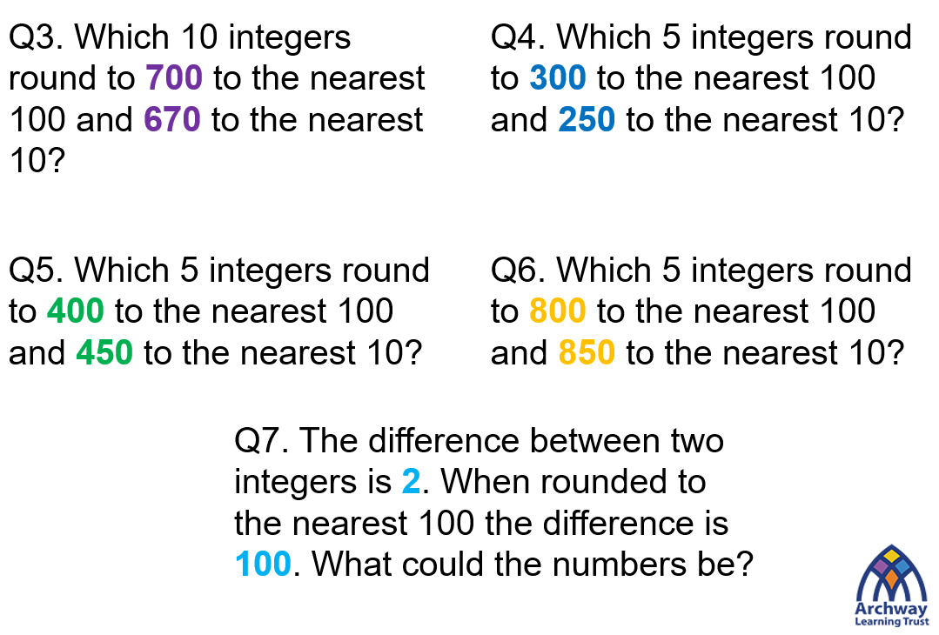
Depth:
RETRIEVE
INSTRUCT
PRACTISE
SECURE

