Slide 1















Dual coding symbols:
Practise
Explain
Organise
Big Question
Reflect
Present
Compare
Evaluate
Activate
Discuss
Predict
Connect
Summarise
Recall
Vocabulary

Slide 2










Editable reading ruler
Every child in an Archway school will become a fluent reader
 | RETRIEVE the words or phrases you need from the text | DECODE the words or phrase to address a breakdown | CONNECT with words or phrases you know from the text or your memory | VISUALISE the images in as much detail as possible | SUMMARISE the main ideas of the text in a few words | INFER meanings that might be within the text | PREDICT what might happen next using details from the text | EXAMINE how the writer uses words to construct meaning
 | ASK THOUGHTFUL QUESTIONS TO HELP YOU UNDERSTAND THE TEXT

Slide 3
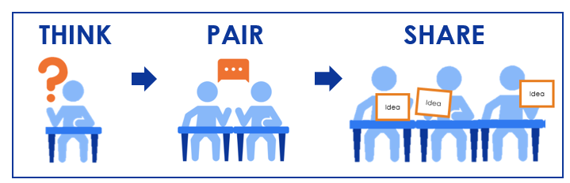





A
B

Slide 4
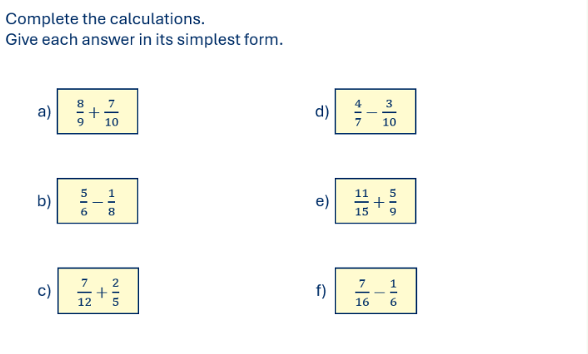
Adding & Subtracting Algebraic Fractions

Slide 5
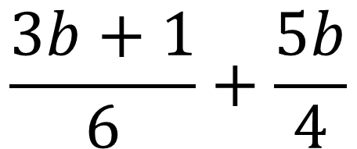
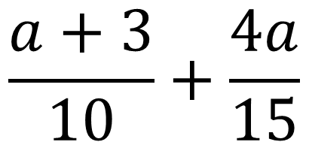
I DO:
WE DO:
Fully simplify
Fully simplify
$$\frac{a+3}{10}+\frac{4a}{15}$$
$$\frac{3b+1}{6}+\frac{5b}{4}$$

Slide 6
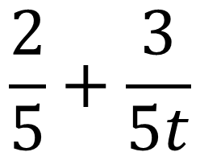
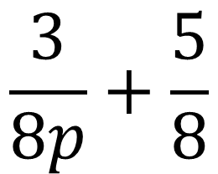
I DO:
WE DO:
Fully simplify
Fully simplify
$$\frac{3}{8p}+\frac{5}{8}$$
$$\frac{2}{5}+\frac{3}{5t}$$

Slide 7
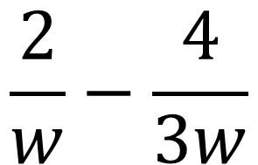
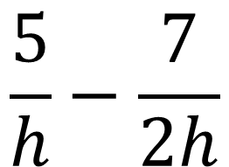
I DO:
WE DO:
Fully simplify
Fully simplify
$$\frac{5}{h}−\frac{7}{2h}$$
$$\frac{2}{w}−\frac{4}{3w}$$

Slide 8
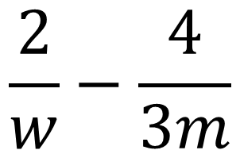
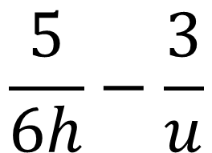
I DO:
WE DO:
Fully simplify
Fully simplify
$$\frac{5}{6h}−\frac{3}{u}$$
$$\frac{2}{w}−\frac{4}{3m}$$

Slide 9
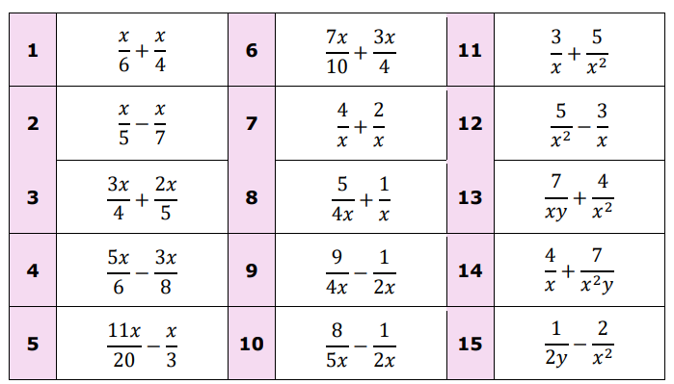
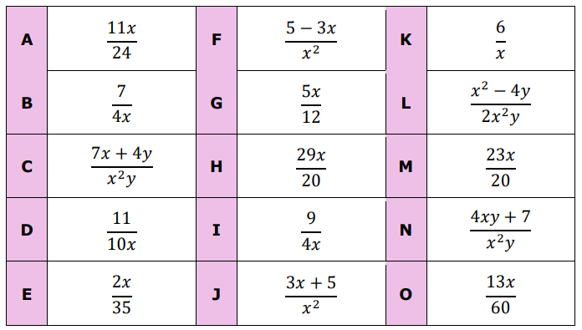
Match Up

Slide 10
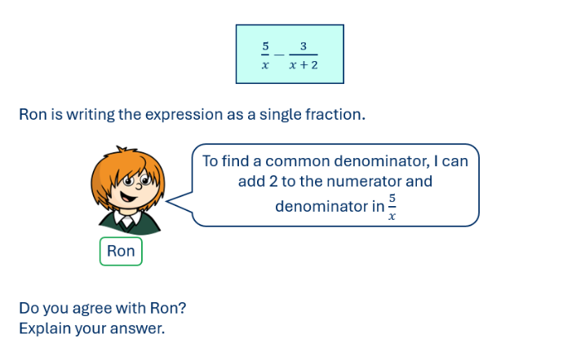

Slide 11
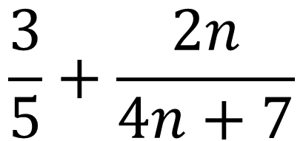
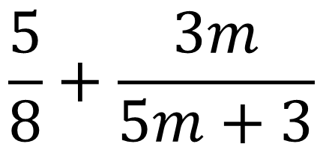
I DO:
WE DO:
Fully simplify the expression to a single fraction
Fully simplify the expression to a single fraction
$$\frac{5}{8}+\frac{3m}{5m+3}$$
$$\frac{3}{5}+\frac{2n}{4n+7}$$

Slide 12
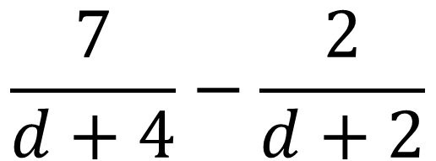
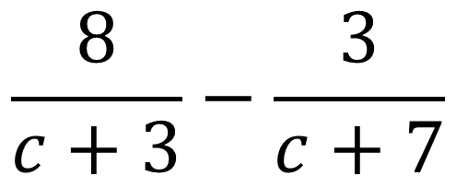
I DO:
WE DO:
Fully simplify the expression to a single fraction
Fully simplify the expression to a single fraction
$$\frac{8}{c+3}−\frac{3}{c+7}$$
$$\frac{7}{d+4}−\frac{2}{d+2}$$

Slide 13
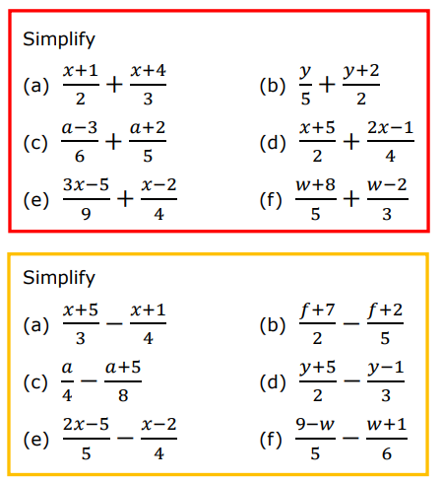
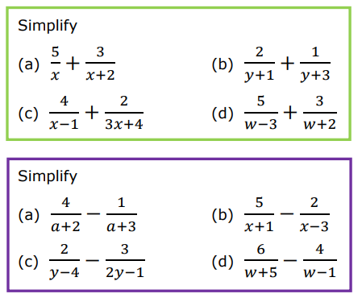
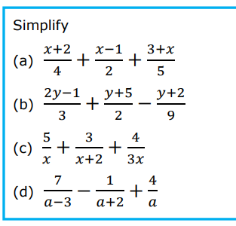
Adding and Subtracting Algebraic Fractions

Slide 14
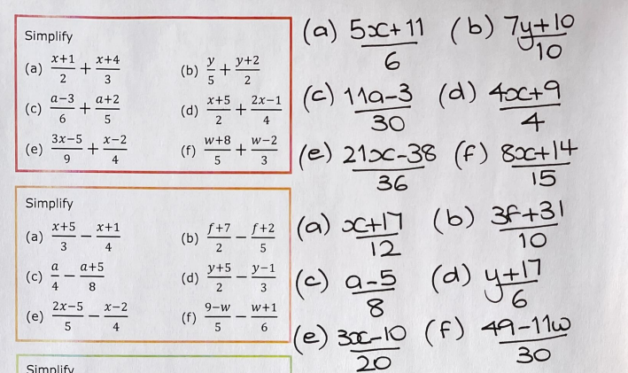
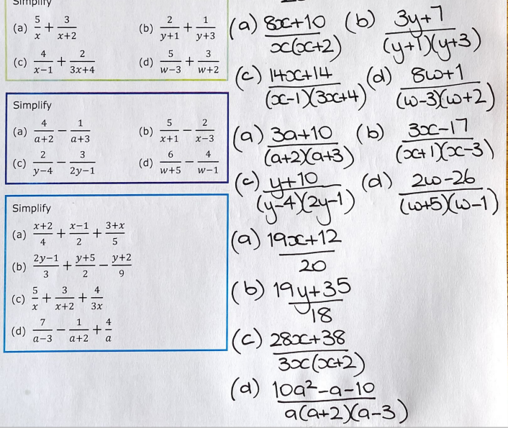

Slide 15
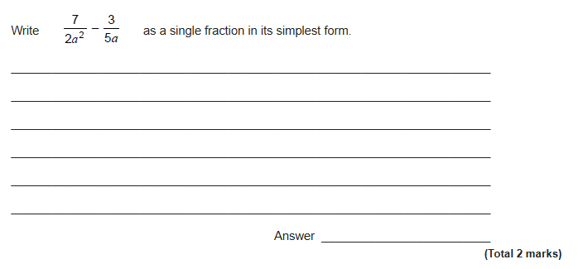
Exam Question 1

Slide 16
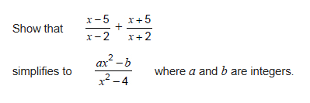
Exam Question 2
3 marks

Slide 17
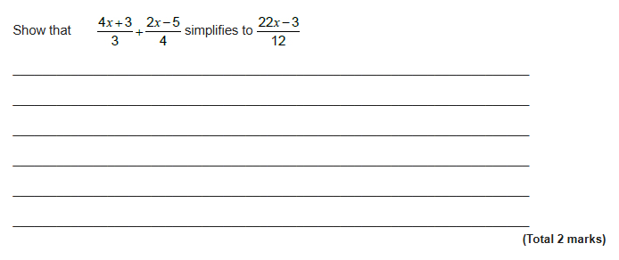
Exam Question 3

