Slide 1















Dual coding symbols:
Practise
Explain
Organise
Big Question
Reflect
Present
Compare
Evaluate
Activate
Discuss
Predict
Connect
Summarise
Recall
Vocabulary

Slide 2


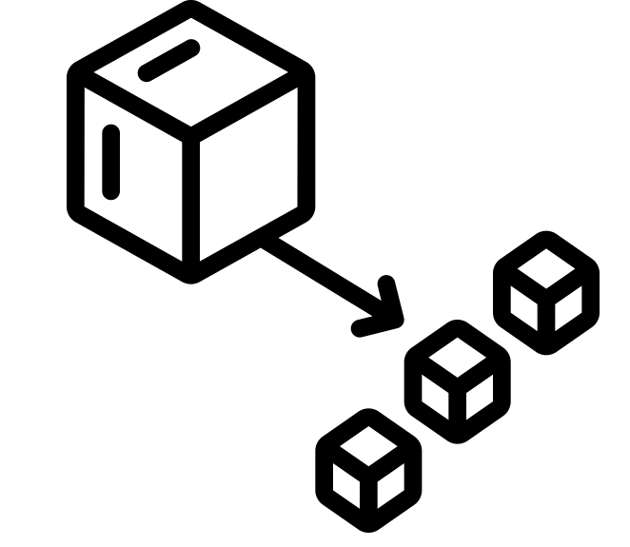





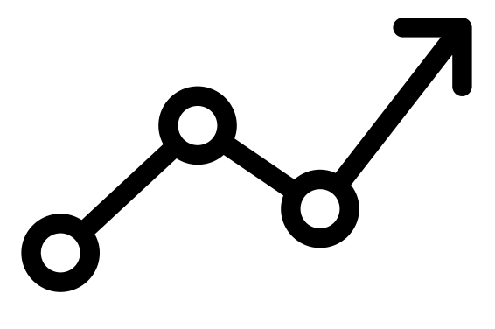

Editable reading ruler
Every child in an Archway school will become a fluent reader
 | RETRIEVE the words or phrases you need from the text | DECODE the words or phrase to address a breakdown | CONNECT with words or phrases you know from the text or your memory | VISUALISE the images in as much detail as possible | SUMMARISE the main ideas of the text in a few words | INFER meanings that might be within the text | PREDICT what might happen next using details from the text | EXAMINE how the writer uses words to construct meaning
 | ASK THOUGHTFUL QUESTIONS TO HELP YOU UNDERSTAND THE TEXT

Slide 3
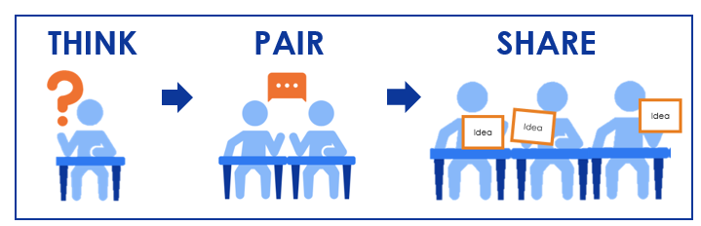
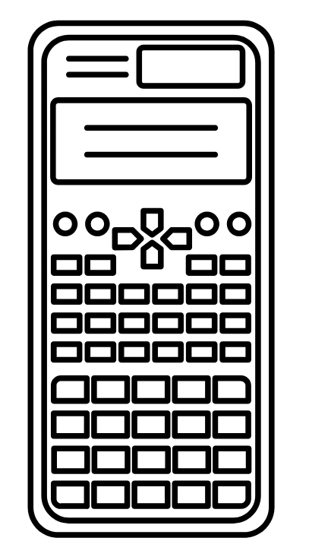



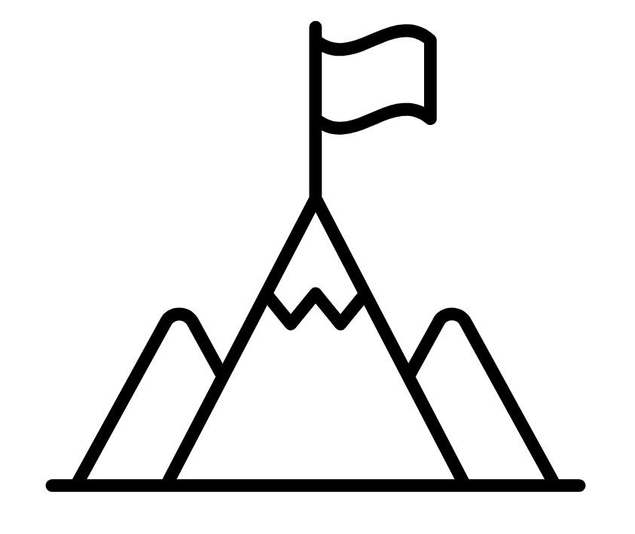
A
B

Slide 4
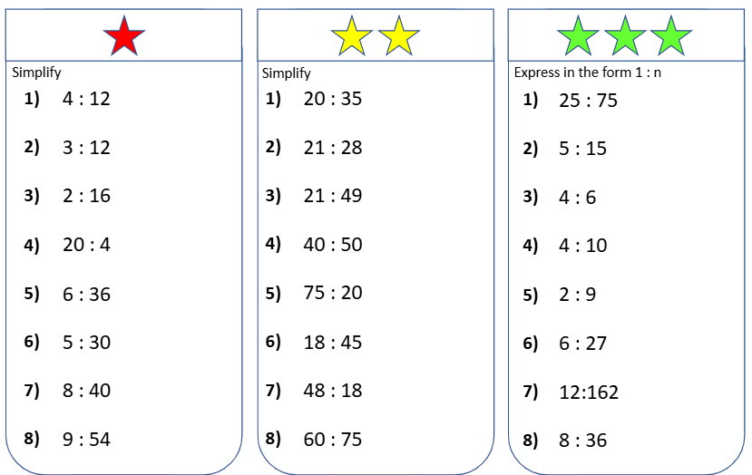
Ratio: Forming equations

Slide 5
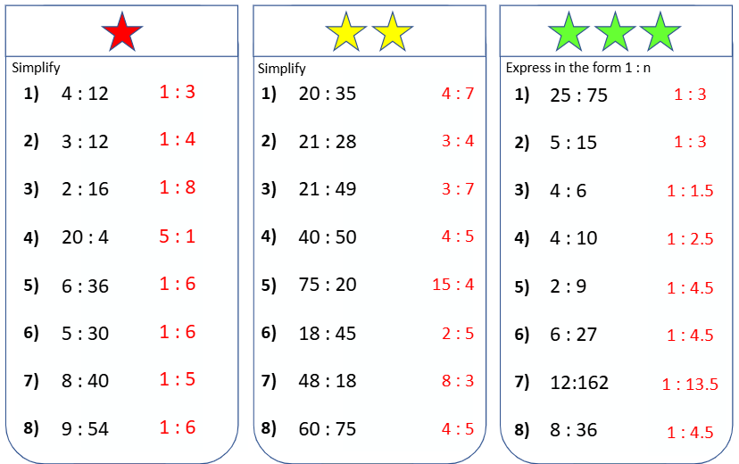

Slide 6
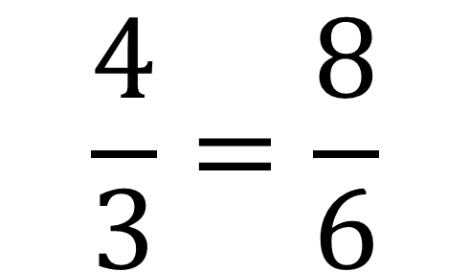

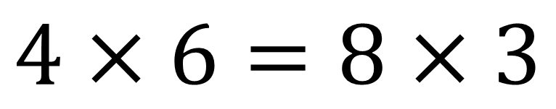
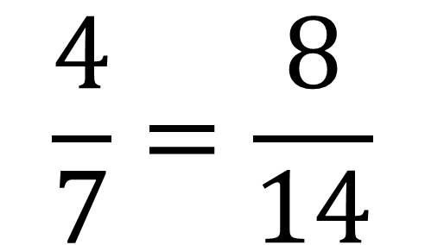
$$4:3=8:6$$
$$\frac{4}{3}=\frac{8}{6}$$
$$\frac{4}{7}=\frac{8}{14}$$
$$4×6=8×3$$

Slide 7

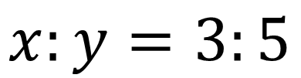

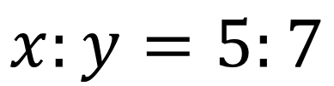
I DO:
WE DO:
Given that:
Given that:
$$x:y=3:5$$
$$x:y=5:7$$
Write an equation linking $x$ and $y$
Write an equation linking $x$ and $y$

Slide 8

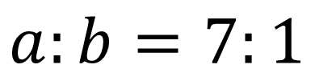

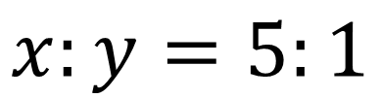
I DO:
WE DO:
Given that:
Given that:
$$a:b=7:1$$
$$x:y=5:1$$
Write an equation for $a$ in terms of $b$
Write an equation for $x$ in terms of $y$

Slide 9

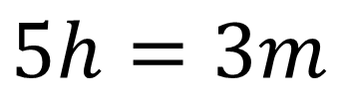

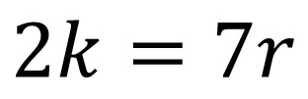
I DO:
WE DO:
Given that:
Given that:
$$5h=3m$$
$$2k=7r$$
Work out the ratio of $h$ to $m$
Work out the ratio of $k$ to $r$

Slide 10

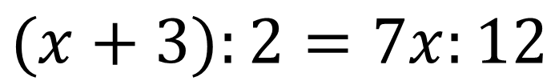

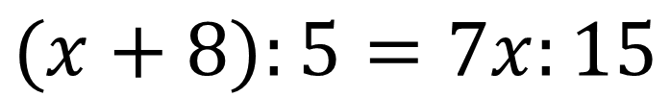
I DO:
WE DO:
Given that:
Given that:
$$(x+3):2=7x:12$$
$$(x+8):5=7x:15$$
Find the value of $x$
Find the value of $x$

Slide 11
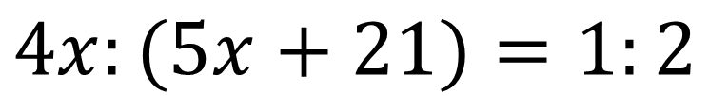
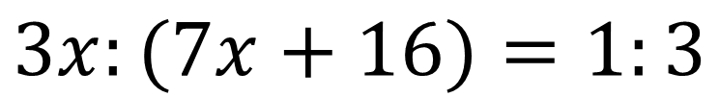
I DO:
WE DO:
Given that:
Given that:
$$4x:(5x+21)=1:2$$
$$3x:(7x+16)=1:3$$
Find the value of $x$
Find the value of $x$

Slide 12
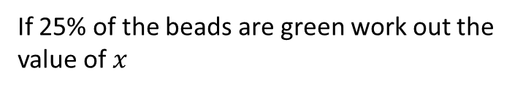
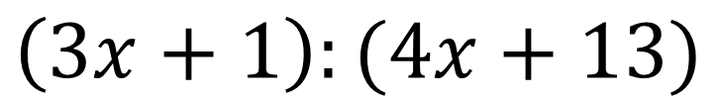
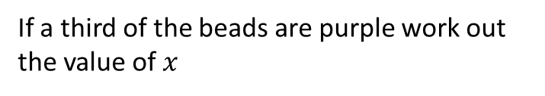
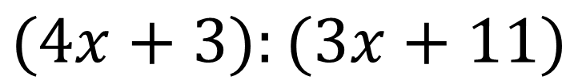
I DO:
WE DO:
The ratio of green to orange beads is:
The ratio of purple to blue beads is:
$$\left(3x+1\right):(4x+13)$$
$$(4x+3):(3x+11)$$
If 25% of the beads are green work out the value of $x$
If a third of the beads are purple work out the value of $x$

Slide 13
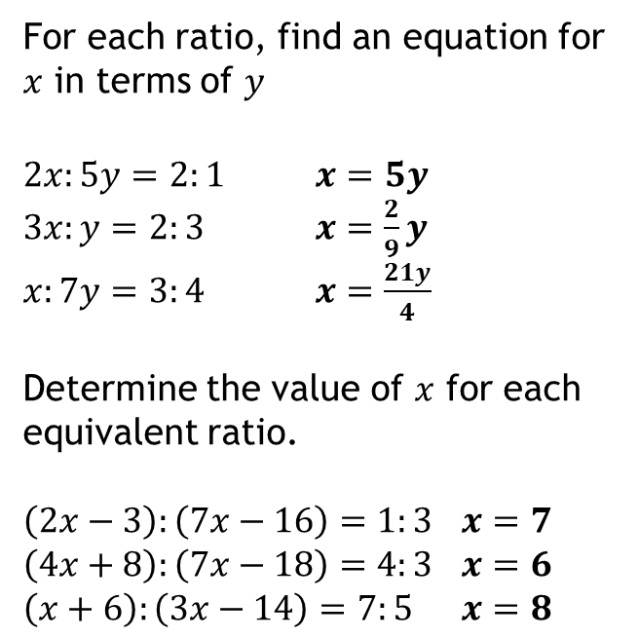
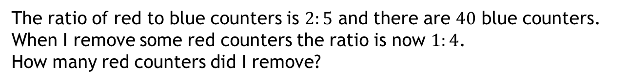
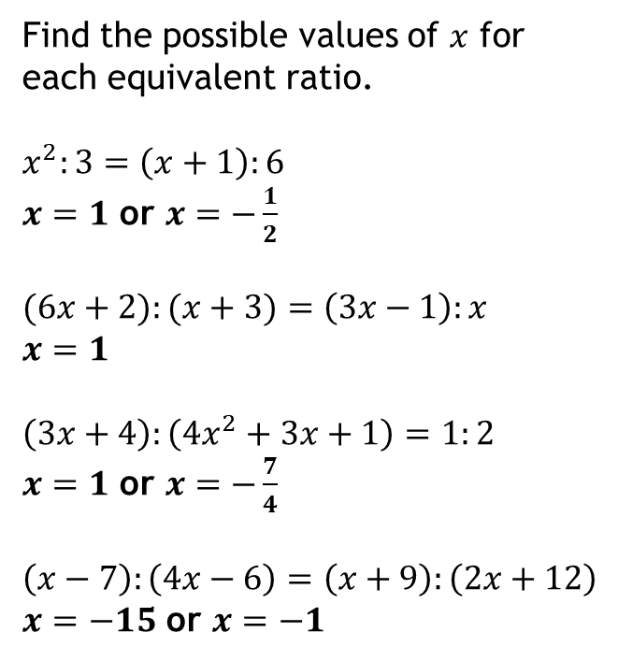
Show all solutions
1
For each ratio, find an equation for $x$ in terms of $y$
$2x:5y=2:1$ $x=5y$
$3x:y=2:3$ $x=\frac{2}{9}y$ $x:7y=3:4$ $x=\frac{21y}{4}$
Determine the value of $x$ for each equivalent ratio.
$\left(2x−3\right):\left(7x−16\right)=1:3$ $x=7$
$\left(4x+8\right):\left(7x−18\right)=4:3$ $x=6$
$\left(x+6\right):\left(3x−14\right)=7:5$ $x=8$
3
Find the possible values of $x$ for each equivalent ratio.
$$x^{2}:3=\left(x+1\right):6$$
$x=1$ or $x=−\frac{1}{2}$
$$(6x+2):(x+3)=\left(3x−1\right):x$$
$$x=1$$
$$\left(3x+4\right):\left(4x^{2}+3x+1\right)=1:2$$
$x=1$ or $x=−\frac{7}{4}$
$$\left(x−7\right):\left(4x−6\right)=\left(x+9\right):\left(2x+12\right)$$
$x=−15$ or $x=−1$
a
?
a
b
?
?
c
?
b
2
?
c
a
?
?
b
?
c
?
d
?
4
The ratio of red to blue counters is $2:5$ and there are $40$ blue counters.
When I remove some red counters the ratio is now $1:4$.
How many red counters did I remove?
6 removed
?
Notes:
From Dr Frost

Slide 14


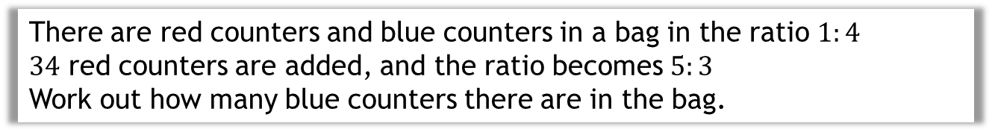






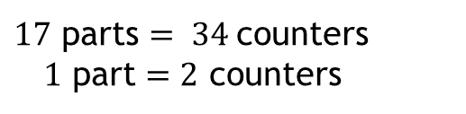



Changing Ratios Where One Quantity Changes
There are red counters and blue counters in a bag in the ratio $1:4$
$34$ red counters are added, and the ratio becomes $5:3$
Work out how many blue counters there are in the bag.
Approach 1
Before
After
$$R:B \\ 1:4$$
$$R:B \\ 5:3$$
Scale the before and after ratios so that the colour that is not changing (here blue counters) has the same number of parts in each ratio.
$$×3↓$$
$$↓ ×3$$
$$×4↓$$
$$↓ ×4$$
$$3:12$$
$$20:12$$
$$+17$$
$17$ parts $= 34$counters
$1$ part $=2$ counters
There are $24$ blue counters.
$∴12$ parts $=24$ counters
Notes:
This approach avoids forming and solving equations.
To find out what 1 part is worth, equate the number of parts the red counters has changed by, with the number of red counters added.

Slide 15

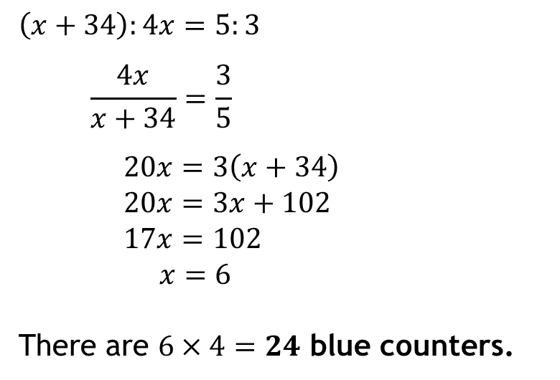




Changing Ratios Where One Quantity Changes
There are red counters and blue counters in a bag in the ratio $1:4$
$34$ red counters are added, and the ratio becomes $5:3$
Work out how many blue counters there are in the bag.
Approach 2
Represent the quantities of each counter algebraically.
$$\left(x+34\right):4x=5:3$$
$$\frac{4x}{x+34}=\frac{3}{5}$$
$$20x=3\left(x+34\right)$$
$$20x=3x+102$$
$$17x=102$$
$x=6$
There are $6×4=24$ blue counters.
 | $$R$$ | $$B$$
Before
After
$$x$$
$$4x$$
$$x+34$$
$$4x$$
Notes:
This second approach is an algebraic approach.
If the ratio of red to blue is $1:4$, we can represent these quantities generically as $x$ and $4x$
In general, $a:b$ can be represented as quantities $ax$ and $bx$

Slide 16
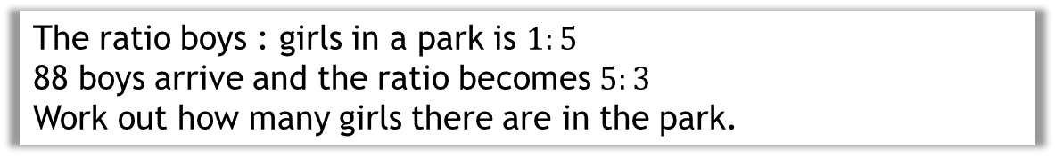
WE DO:
The ratio boys : girls in a park is $1:5$
88 boys arrive and the ratio becomes $5:3$
Work out how many girls there are in the park.

Slide 17
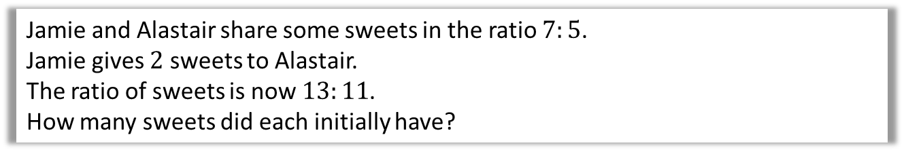
WE DO:
Jamie and Alastair share some sweets in the ratio $7:5$.
Jamie gives $2$ sweets to Alastair.
The ratio of sweets is now $13:11$.
How many sweets did each initially have?

Slide 18
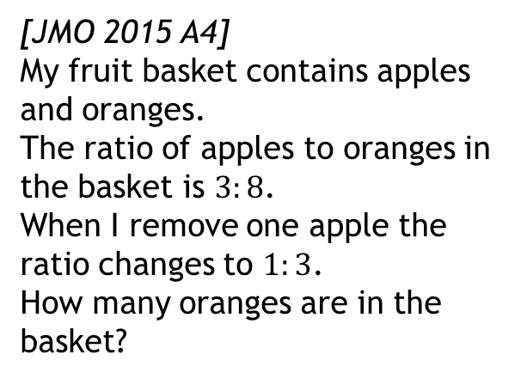
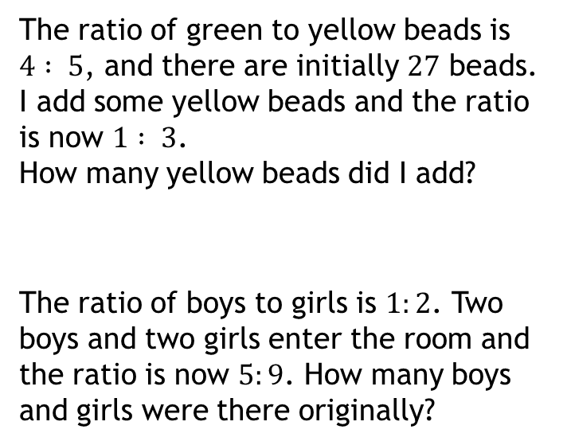
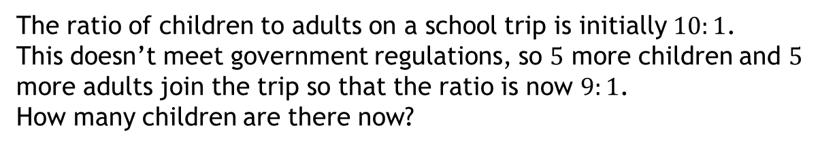
Exercise
Show all solutions
1
The ratio of green to yellow beads is
$4 : 5$, and there are initially $27$ beads.
I add some yellow beads and the ratio is now $1 : 3$.
How many yellow beads did I add?
The ratio of boys to girls is $1:2$. Two boys and two girls enter the room and the ratio is now $5:9$. How many boys and girls were there originally?
4
[JMO 2015 A4]
My fruit basket contains apples and oranges.
The ratio of apples to oranges in the basket is $3:8$.
When I remove one apple the ratio changes to $1:3$.
How many oranges are in the basket?
?
21 beads
2
24 oranges
?
?
8 boys and 16 girls
3
The ratio of children to adults on a school trip is initially $10:1$.
This doesn’t meet government regulations, so $5$ more children and $5$ more adults join the trip so that the ratio is now $9:1$.
How many children are there now?
?
405

Slide 19
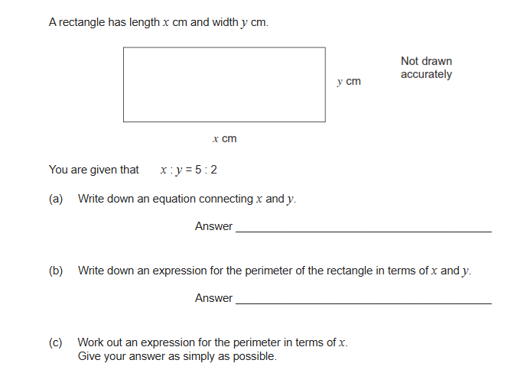
Exam Question 1

Slide 20
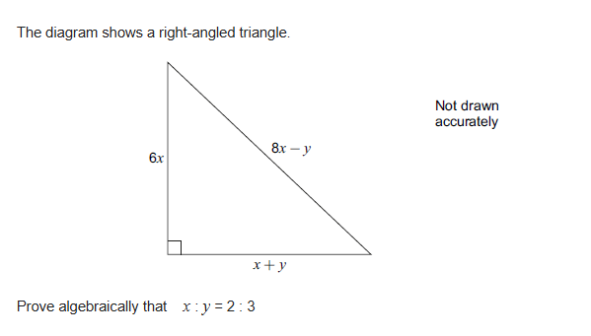
Exam Question 2

Slide 21
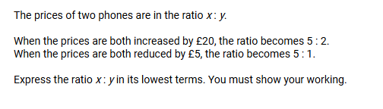
Exam Question 3

Slide 22
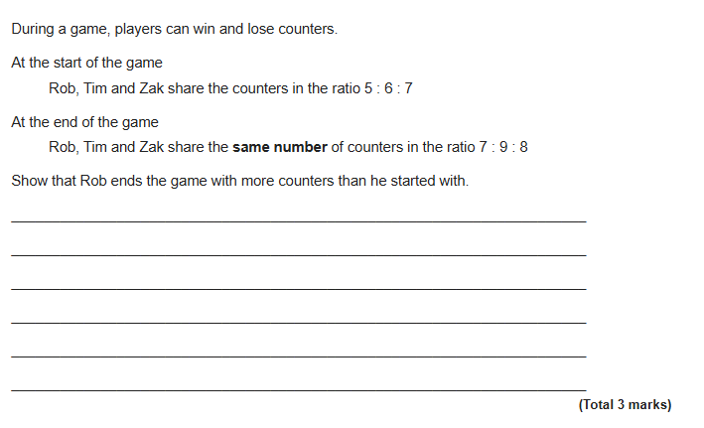
Exam Question 4

