Slide 1















Dual coding symbols:
Practise
Explain
Organise
Big Question
Reflect
Present
Compare
Evaluate
Activate
Discuss
Predict
Connect
Summarise
Recall
Vocabulary

Slide 2










Editable reading ruler
Every child in an Archway school will become a fluent reader
 | RETRIEVE the words or phrases you need from the text | DECODE the words or phrase to address a breakdown | CONNECT with words or phrases you know from the text or your memory | VISUALISE the images in as much detail as possible | SUMMARISE the main ideas of the text in a few words | INFER meanings that might be within the text | PREDICT what might happen next using details from the text | EXAMINE how the writer uses words to construct meaning
 | ASK THOUGHTFUL QUESTIONS TO HELP YOU UNDERSTAND THE TEXT

Slide 3

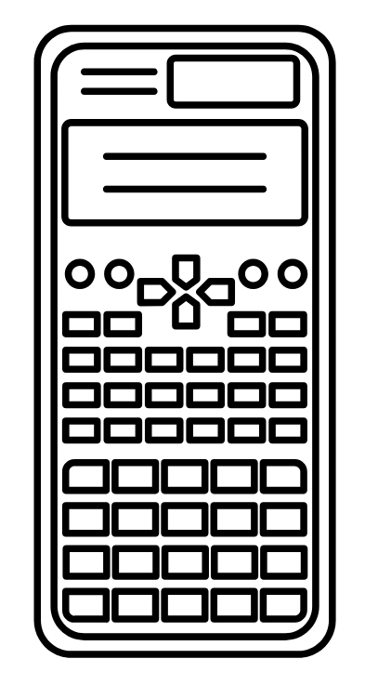



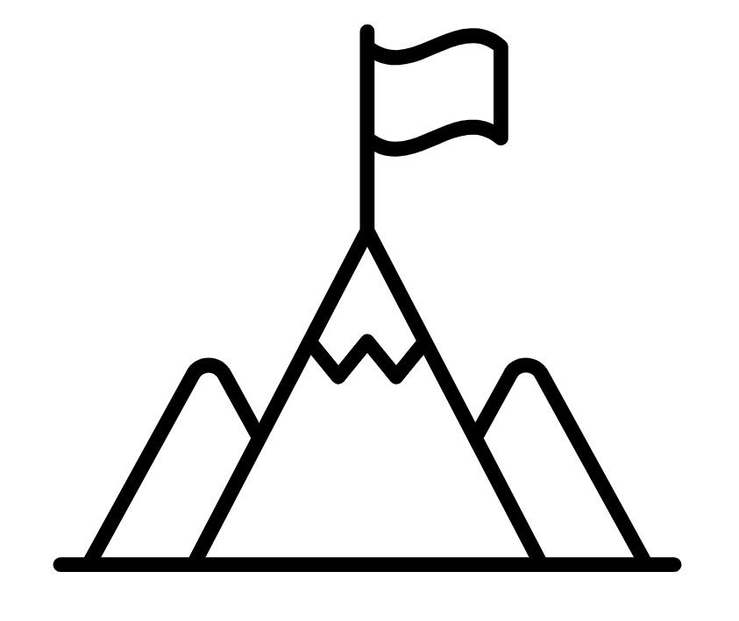
A
B

Slide 4
  Multiplying and Dividing by 10s

Slide 5


$3×10=30$
$30×10=300$
$31×10=310$
$3.1×10= ?$
RETRIEVE
INSTRUCT
PRACTISE
SECURE

Slide 6
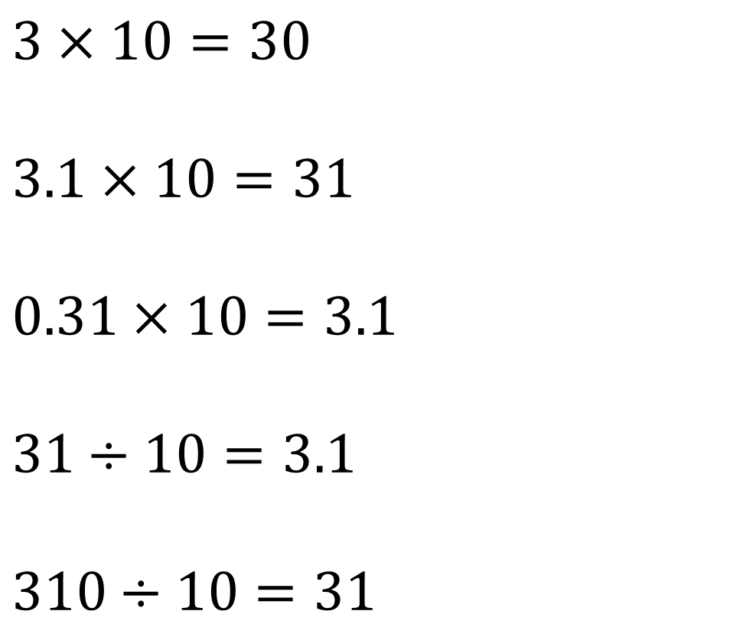
$3×10=30$
$3.1×10=31$
$0.31×10=3.1$
$31÷10=3.1$
$310÷10=31$
When multiplying and dividing by 10/100/1000 the digits do not change, and the order if the digits doesn’t change. The position just changes.
RETRIEVE
INSTRUCT
PRACTISE
SECURE

Slide 7
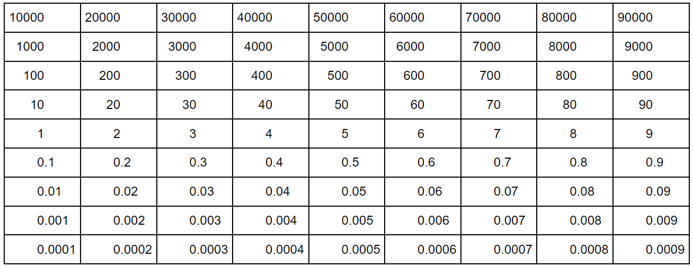


$×10$
$÷10$
$67.5×10=675$

Slide 8
$×10$
$÷10$
$40.52×10=405.2$

Slide 9
$×10$
$÷10$
$41.2×100=4120$

Slide 10
$×10$
$÷10$
$89.06×100=8906$

Slide 11
$×10$
$÷10$
$892× ? =8920$

Slide 12
$×10$
$÷10$
$39.2× ? =3920$

Slide 13
DEMO
Multiplying by 10, 100, 1000
YOUR TURN
Calculate:
2.4 × 100
7 × 100
= 240
= 700
2
4
7
× 10
× 10
2
4
7
0
× 10
× 10
2
4
0
7
0
0

Slide 14
DEMO
Multiplying by 10, 100, 1000
YOUR TURN
Calculate:
2.4 × 100
8.2 × 100
= 240
= 820
2
4
8
2
× 10
× 10
2
4
8
2
× 10
× 10
2
4
0
8
2
0

Slide 15
DEMO
Multiplying by 10, 100, 1000
YOUR TURN
Calculate:
2.4 × 100
0.6 × 1000
= 240
= 600
2
4
0
6
× 10
× 10
2
4
6
× 10
× 10
2
4
0
6
0
× 10
6
0
0

Slide 16
DEMO
Multiplying by 10, 100, 1000
YOUR TURN
Calculate:
2.4 × 100
1.75 × 100
= 240
= 175
2
4
1
7
5
× 10
× 10
2
4
1
7
5
× 10
× 10
2
4
0
1
7
5

Slide 17
DEMO
Multiplying by 10, 100, 1000
YOUR TURN
Calculate:
2.4 × 100
14.5 × 1000
= 240
= 14500
2
4
1
4
5
× 10
× 10
2
4
1
4
5
× 10
× 10
2
4
0
1
4
5
0
× 10
1
4
5
0
0

Slide 18
$×10$
$÷10$
$452÷10=45.2$

Slide 19
$×10$
$÷10$
$6500.3÷10=650.3$

Slide 20
$×10$
$÷10$
$6504÷100=65.04$

Slide 21
DEMO
Dividing by 10, 100, 1000
Calculate:
350 ÷ 100
= 3.5
3
5
0
÷ 10
3
5
0
÷ 10
3
5
0

Slide 22
DEMO
Dividing by 10, 100, 1000
YOUR TURN
Calculate:
Calculate:
350 ÷ 100
75 ÷ 10
= 3.5
= 7.5
3
5
0
7
5
÷ 10
÷ 10
3
5
0
7
5
÷ 10
3
5
0

Slide 23
DEMO
Dividing by 10, 100, 1000
YOUR TURN
Calculate:
Calculate:
350 ÷ 100
5200 ÷ 100
= 3.5
= 52
3
5
0
5
2
0
0
÷ 10
÷ 10
3
5
0
5
2
0
÷ 10
÷ 10
3
5
0
5
2

Slide 24
DEMO
Dividing by 10, 100, 1000
YOUR TURN
Calculate:
Calculate:
350 ÷ 100
180 ÷ 100
= 3.5
= 1.8
3
5
0
1
8
0
÷ 10
÷ 10
3
5
0
1
8
÷ 10
÷ 10
3
5
0
1
8

Slide 25
DEMO
Dividing by 10, 100, 1000
YOUR TURN
Calculate:
Calculate:
350 ÷ 100
126 ÷ 100
= 3.5
= 1.26
3
5
0
1
2
6
÷ 10
÷ 10
3
5
0
1
2
6
÷ 10
÷ 10
3
5
0
1
2
6

Slide 26
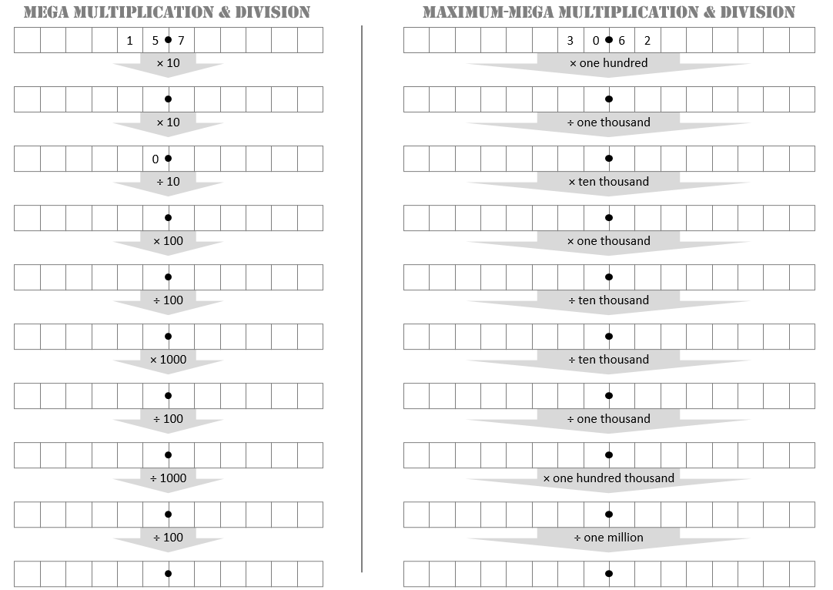

Slide 27
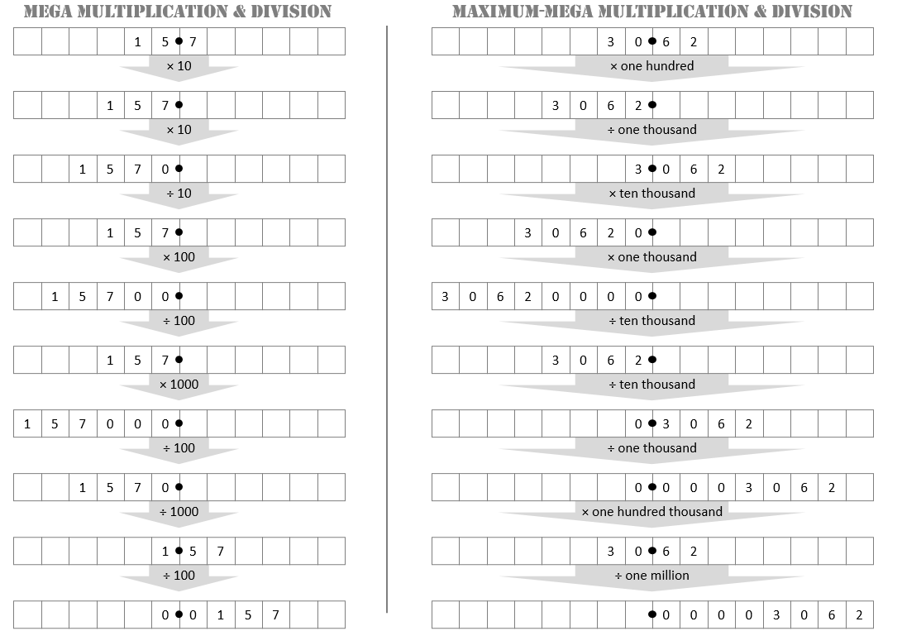

Slide 28
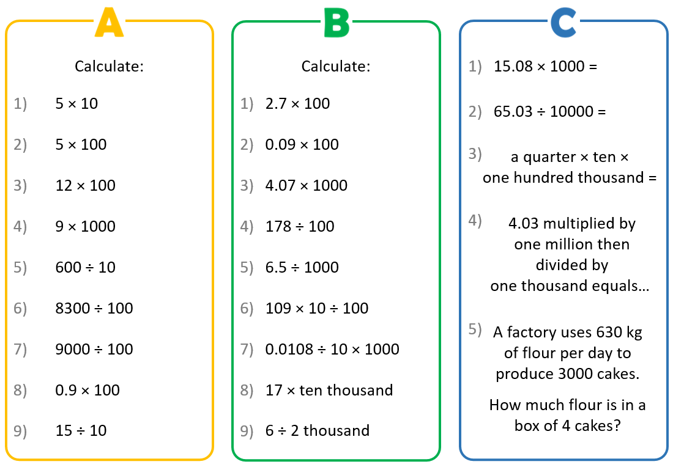

Slide 29
