Slide 1















Dual coding symbols:
Practise
Explain
Organise
Big Question
Reflect
Present
Compare
Evaluate
Activate
Discuss
Predict
Connect
Summarise
Recall
Vocabulary

Slide 2










Editable reading ruler
Every child in an Archway school will become a fluent reader
 | RETRIEVE the words or phrases you need from the text | DECODE the words or phrase to address a breakdown | CONNECT with words or phrases you know from the text or your memory | VISUALISE the images in as much detail as possible | SUMMARISE the main ideas of the text in a few words | INFER meanings that might be within the text | PREDICT what might happen next using details from the text | EXAMINE how the writer uses words to construct meaning
 | ASK THOUGHTFUL QUESTIONS TO HELP YOU UNDERSTAND THE TEXT

Slide 3






A
B

Slide 4
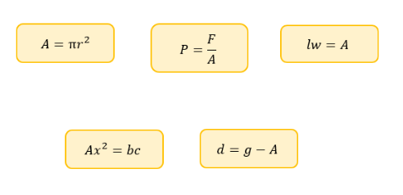
Changing the Subject of Complex Formulae
In which formulae is A the subject?

Slide 5

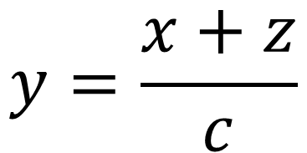

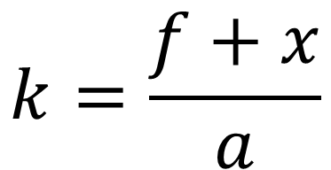
I DO:
WE DO:
Make$x$the subject
Make$x$the subject
$$y=\frac{x+z}{c}$$
$$k=\frac{f+x}{a}$$

Slide 6
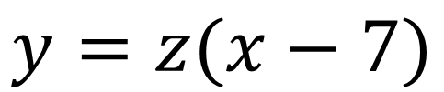
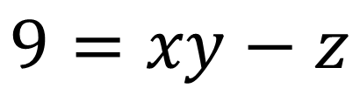
I DO:
WE DO:
Make$x$the subject
Make$x$the subject
$$y=z(x−7)$$
$$9=xy−z$$

Slide 7
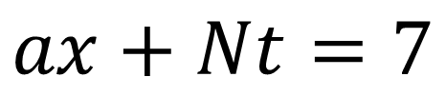
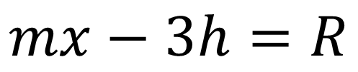
I DO:
WE DO:
Make$x$the subject
Make$x$the subject
$$ax+Nt=7$$
$$mx−3h=R$$

Slide 8
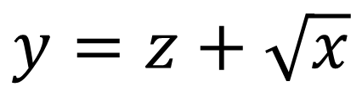
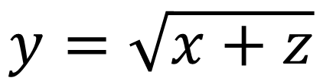
I DO:
WE DO:
Make$x$the subject
Make$x$the subject
$$y=z+\sqrt{x}$$
$$y=\sqrt{x+z}$$

Slide 9
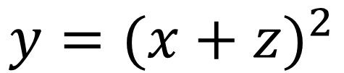
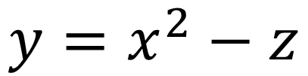
I DO:
WE DO:
Make$x$the subject
Make$x$the subject
$$y=(x+z)^{2}$$
$$y=x^{2}−z$$

Slide 10
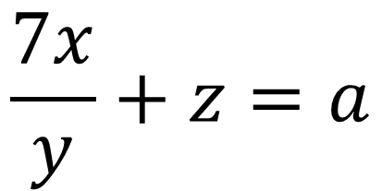
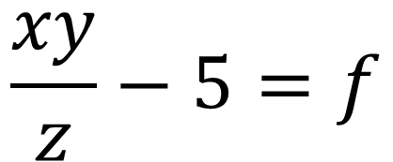
I DO:
WE DO:
Make$x$the subject
Make$x$the subject
$$\frac{7x}{y}+z=a$$
$$\frac{xy}{z}−5=f$$

Slide 11
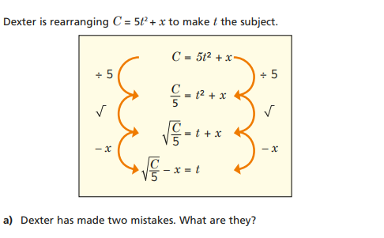

Slide 12
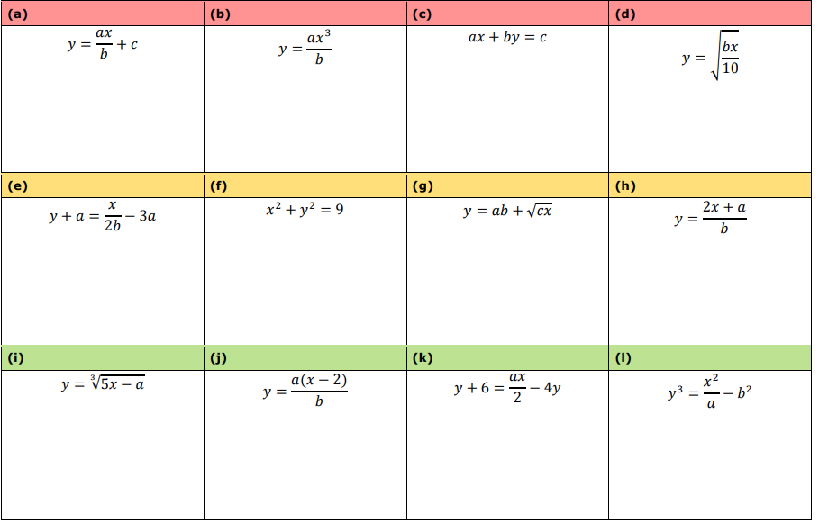
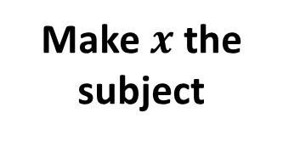
Make $x$ the subject

Slide 13
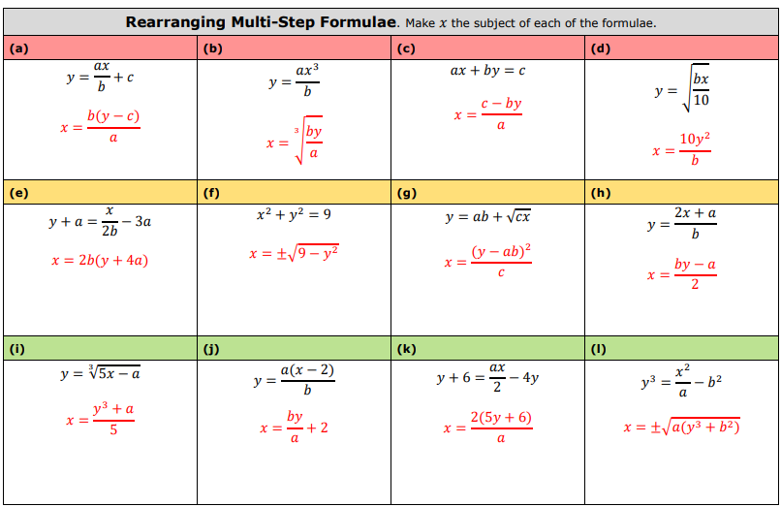

Slide 14
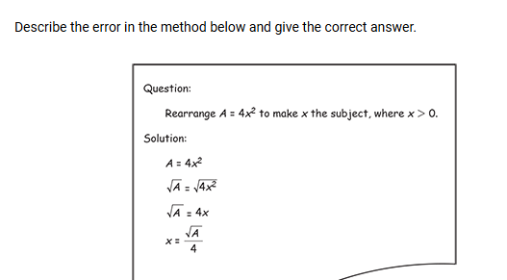
Exam Question 1

Slide 15
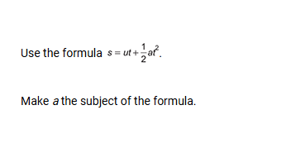
Exam Question 2

Slide 16
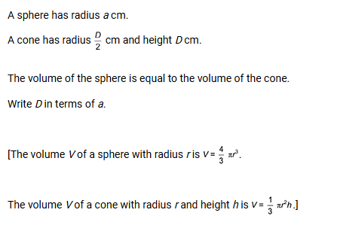
Exam Question 2

