Slide 1















Dual coding symbols:
Practise
Explain
Organise
Big Question
Reflect
Present
Compare
Evaluate
Activate
Discuss
Predict
Connect
Summarise
Recall
Vocabulary

Slide 2










Editable reading ruler
Every child in an Archway school will become a fluent reader
 | RETRIEVE the words or phrases you need from the text | DECODE the words or phrase to address a breakdown | CONNECT with words or phrases you know from the text or your memory | VISUALISE the images in as much detail as possible | SUMMARISE the main ideas of the text in a few words | INFER meanings that might be within the text | PREDICT what might happen next using details from the text | EXAMINE how the writer uses words to construct meaning
 | ASK THOUGHTFUL QUESTIONS TO HELP YOU UNDERSTAND THE TEXT

Slide 3






A
B

Slide 4
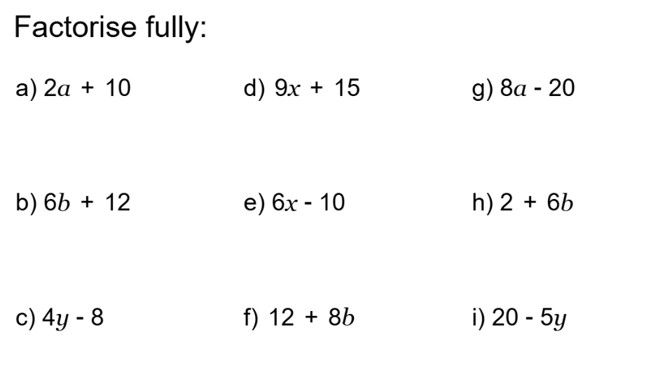
Changing the Subject
(when the subject appears more than once!)

Slide 5
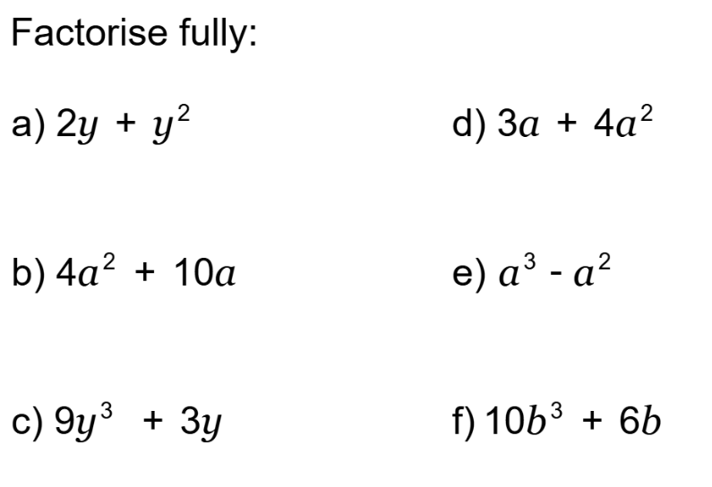
Changing the Subject
(when the subject appears more than once!)

Slide 6

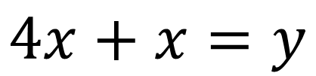

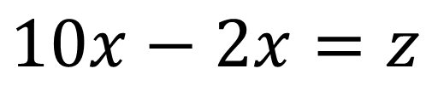
I DO:
WE DO:
Make$x$the subject
Make$x$the subject
$$4x+x=y$$
$$10x−2x=z$$

Slide 7
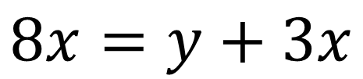
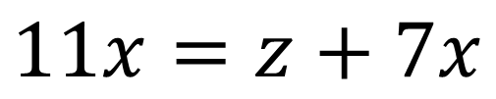
I DO:
WE DO:
Make$x$the subject
Make$x$the subject
$$8x=y+3x$$
$$11x=z+7x$$

Slide 8
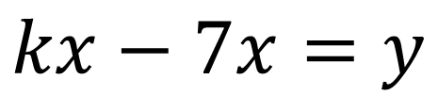
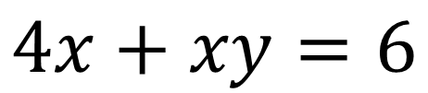
I DO:
WE DO:
Make$x$the subject
Make$x$the subject
$$kx−7x=y$$
$$4x+xy=6$$

Slide 9
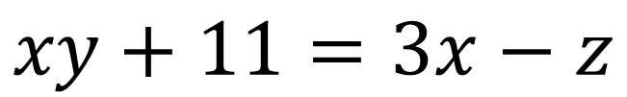
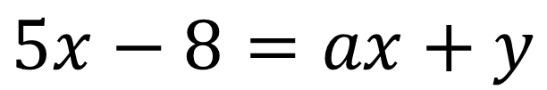
I DO:
WE DO:
Make$x$the subject
Make$x$the subject
$$xy+11=3x−z$$
$$5x−8=ax+y$$

Slide 10
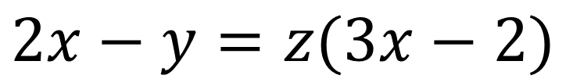

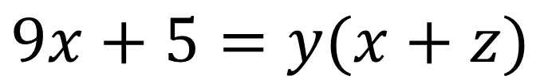
I DO:
WE DO:
Make$x$the subject
Make$x$the subject
$$2x−y=z(3x−2)$$
$$9x+5=y(x+z)$$

Slide 11
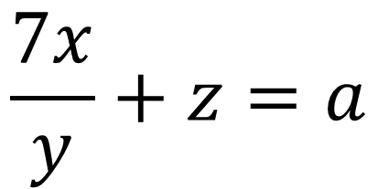
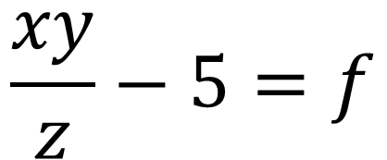
I DO:
WE DO:
Make$x$the subject
Make$x$the subject
$$\frac{7x}{y}+z=a$$
$$\frac{xy}{z}−5=f$$

Slide 12
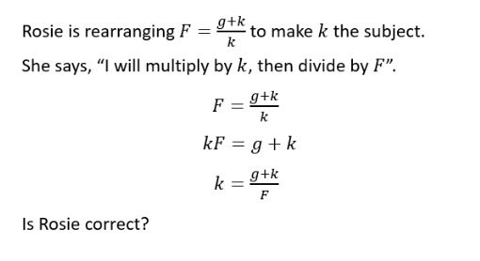
Notes:
Non-example

Slide 13
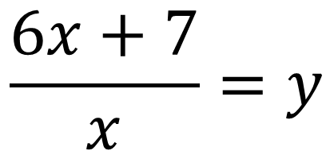
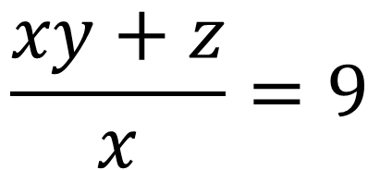
I DO:
WE DO:
Make$x$the subject
Make$x$the subject
$$\frac{6x+7}{x}=y$$
$$\frac{xy+z}{x}=9$$

Slide 14
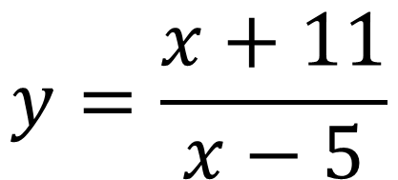
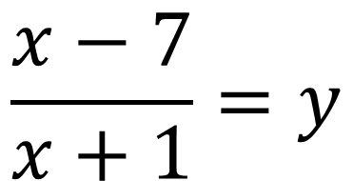
I DO:
WE DO:
Make$x$the subject
Make$x$the subject
$$y=\frac{x+11}{x−5}$$
$$\frac{x−7}{x+1}=y$$

Slide 15
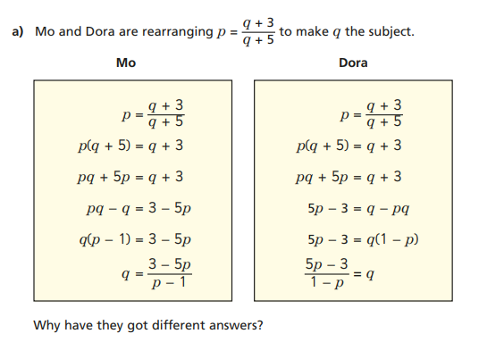

Slide 16
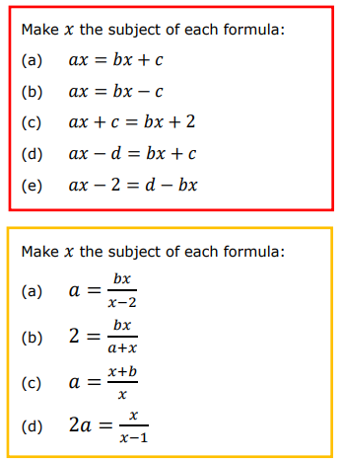
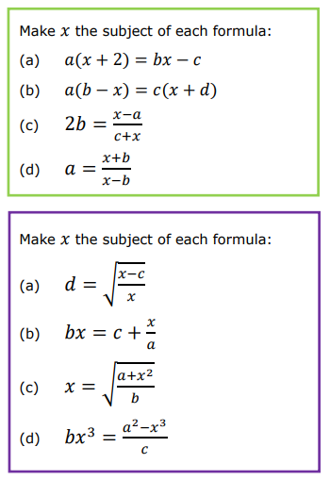

Slide 17
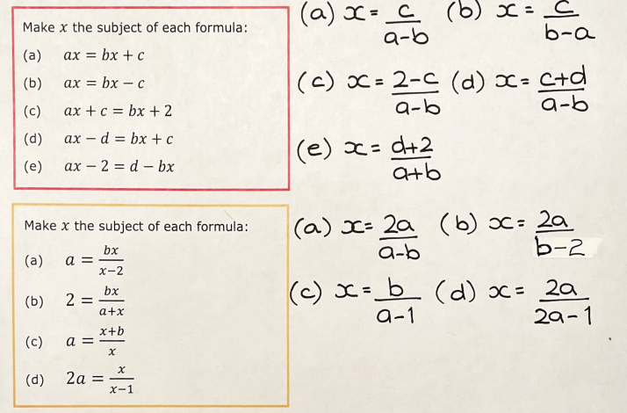
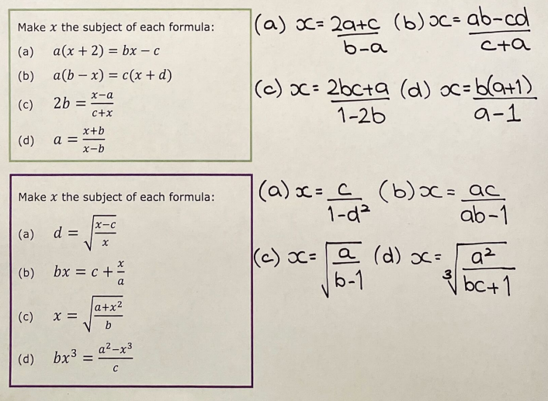

Slide 18

Exam Question 1

Slide 19

Exam Question 2
4 marks
Notes:
From Further Maths

