Slide 1















Dual coding symbols:
Practise
Explain
Organise
Big Question
Reflect
Present
Compare
Evaluate
Activate
Discuss
Predict
Connect
Summarise
Recall
Vocabulary

Slide 2










Editable reading ruler
Every child in an Archway school will become a fluent reader
 | RETRIEVE the words or phrases you need from the text | DECODE the words or phrase to address a breakdown | CONNECT with words or phrases you know from the text or your memory | VISUALISE the images in as much detail as possible | SUMMARISE the main ideas of the text in a few words | INFER meanings that might be within the text | PREDICT what might happen next using details from the text | EXAMINE how the writer uses words to construct meaning
 | ASK THOUGHTFUL QUESTIONS TO HELP YOU UNDERSTAND THE TEXT

Slide 3






A
B

Slide 4
Composite Functions
Notes:
The sky is the limit

Slide 5

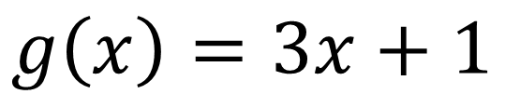
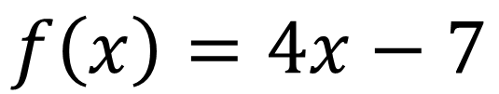
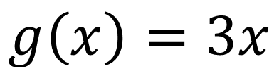

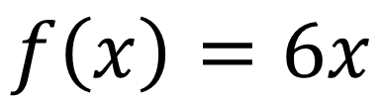
I DO:
WE DO:
Given that:
Given that:
$$f\left(x\right)=4x−7$$
$$f\left(x\right)=6x$$
$$g\left(x\right)=3x$$
$$g\left(x\right)=3x+1$$
Evaluate $fg(9)$
Evaluate $fg(2)$

Slide 6


I DO:
WE DO:
Given that:
Given that:
$$f\left(x\right)=4x−7$$
$$f\left(x\right)=6x$$
$$g\left(x\right)=3x$$
$$g\left(x\right)=3x+1$$
Evaluate $gf(9)$
Evaluate $gf(2)$

Slide 7

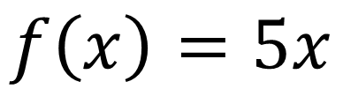
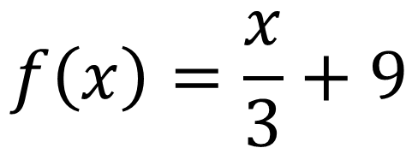
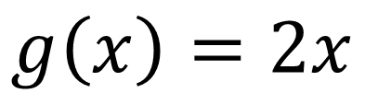

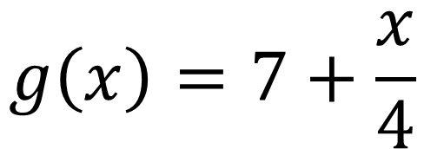
I DO:
WE DO:
Given that:
Given that:
$$f\left(x\right)=\frac{x}{3}+9$$
$$g\left(x\right)=7+\frac{x}{4}$$
$$g\left(x\right)=2x$$
$$f\left(x\right)=5x$$
Evaluate $gf(12)$
Evaluate $fg(20)$

Slide 8
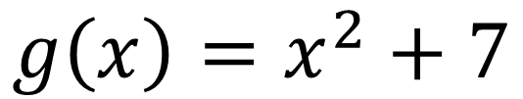
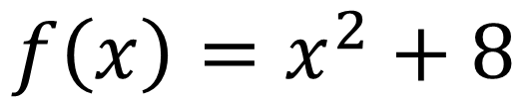
I DO:
WE DO:
Given that:
Given that:
$$f\left(x\right)=4x−7$$
$$f\left(x\right)=x^{2}+8$$
$$g\left(x\right)=x^{2}+7$$
$$g\left(x\right)=3x+1$$
Evaluate $gf(9)$
Evaluate $gf(2)$

Slide 9

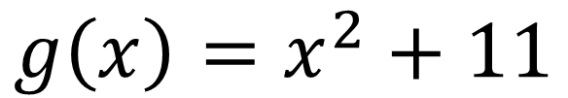

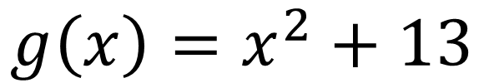
I DO:
WE DO:
Given that:
Given that:
$$g\left(x\right)=x^{2}+11$$
$$g\left(x\right)=x^{2}+13$$
Evaluate $gg(4)$
Evaluate $gg(−2)$

Slide 10


I DO:
WE DO:
Given that:
Given that:
$$f\left(x\right)=4x−7$$
$$f\left(x\right)=x^{2}+8$$
$$g\left(x\right)=x^{2}+7$$
$$g\left(x\right)=3x+1$$
Evaluate $gf(a)$
Evaluate $gf(a)$

Slide 11
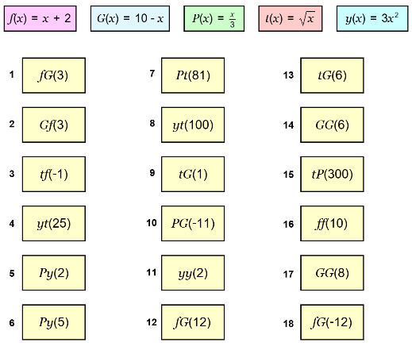
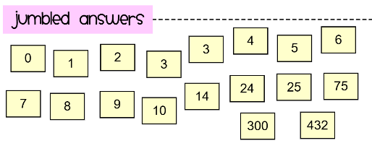
Using the five functions evaluate the composite functions

Slide 12
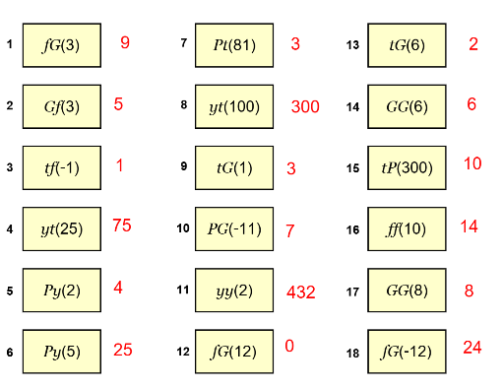

Slide 13

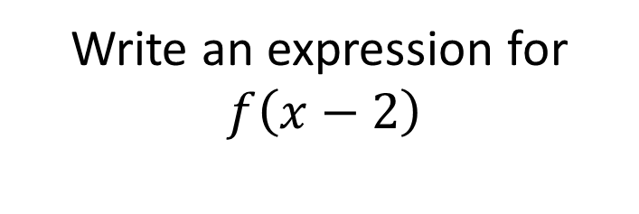
I DO:
WE DO:
Given that:
Given that:
$$f\left(x\right)=4x−7$$
$$f\left(x\right)=6x$$
Write an expression for $f\left(x+3\right)$
Write an expression for
$f\left(x−2\right)$

Slide 14


I DO:
WE DO:
Given that:
Given that:
$$f\left(x\right)=4x−7$$
$$f\left(x\right)=6x$$
$$g\left(x\right)=3x$$
$$g\left(x\right)=3x+1$$
Evaluate $gf(x)$
Evaluate $gf(x)$

Slide 15
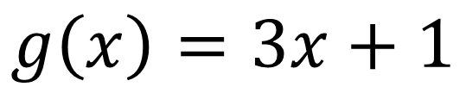
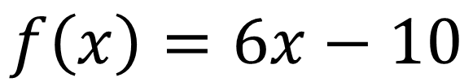
I DO:
WE DO:
Given that:
Given that:
$$f\left(x\right)=4x−7$$
$$f\left(x\right)=6x−10$$
$$g\left(x\right)=3x+1$$
$$g\left(x\right)=3x+1$$
Evaluate $gf(x)$
Evaluate $gf(x)$

Slide 16
I DO:
WE DO:
Given that:
Given that:
$$f\left(x\right)=4x−7$$
$$f\left(x\right)=x^{2}+8$$
$$g\left(x\right)=x^{2}+7$$
$$g\left(x\right)=3x+1$$
Evaluate $gf(x)$
Evaluate $gf(x)$

Slide 17

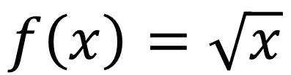
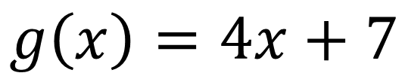

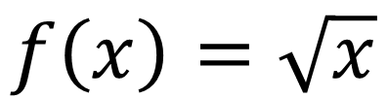
I DO:
WE DO:
Given that:
Given that:
$$f\left(x\right)=\sqrt{x}$$
$$f\left(x\right)=\sqrt{x}$$
$$g\left(x\right)=4x+7$$
$$g\left(x\right)=3x+1$$
Evaluate $fg(x)$
Evaluate $fg(x)$

Slide 18
I DO:
WE DO:
Given that:
Given that:
$$f\left(x\right)=\sqrt{x}$$
$$f\left(x\right)=\sqrt{x}$$
$$g\left(x\right)=4x+7$$
$$g\left(x\right)=3x+1$$
Evaluate $gf(x)$
Evaluate $gf(x)$

Slide 19

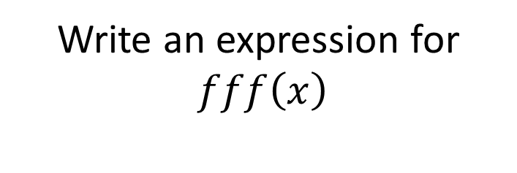
I DO:
WE DO:
Given that:
Given that:
$$f\left(x\right)=4x−7$$
$$f\left(x\right)=6x$$
Write an expression for $ff(x)$
Write an expression for
$fff\left(x\right)$

Slide 20
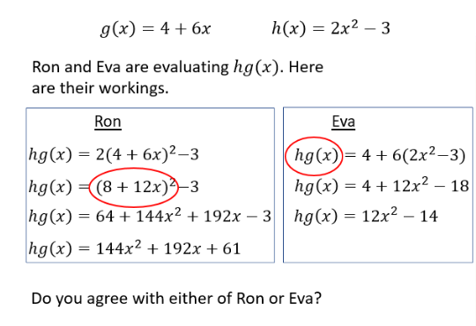
Notes:
Non-example

Slide 21
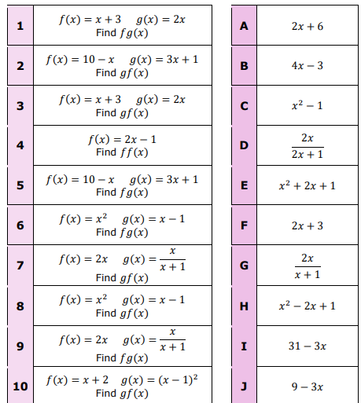

Match the composite functions

Slide 22
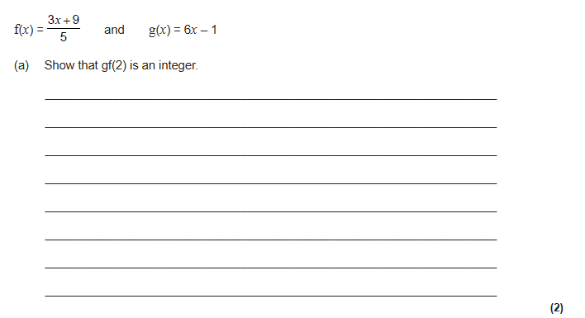
Exam Question 1
Notes:
1.12

Slide 23
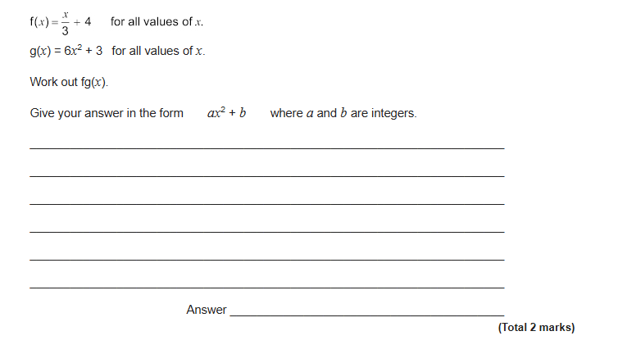
Exam Question 2
Notes:
From Further Maths

Slide 24
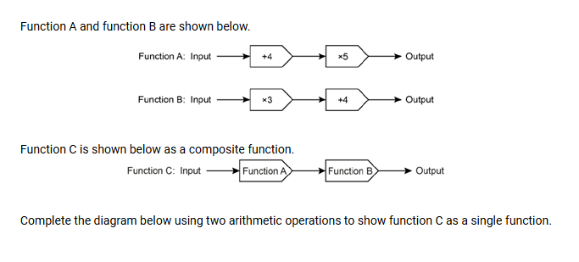
Exam Question 3
Notes:
From Further Maths

Slide 25
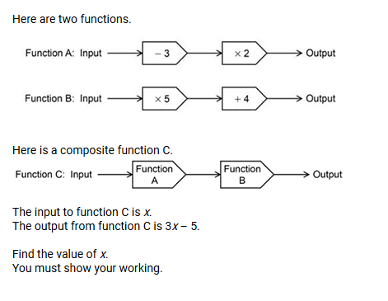
Exam Question 4

