Slide 1















Dual coding symbols:
Practise
Explain
Organise
Big Question
Reflect
Present
Compare
Evaluate
Activate
Discuss
Predict
Connect
Summarise
Recall
Vocabulary

Slide 2










Editable reading ruler
Every child in an Archway school will become a fluent reader
 | RETRIEVE the words or phrases you need from the text | DECODE the words or phrase to address a breakdown | CONNECT with words or phrases you know from the text or your memory | VISUALISE the images in as much detail as possible | SUMMARISE the main ideas of the text in a few words | INFER meanings that might be within the text | PREDICT what might happen next using details from the text | EXAMINE how the writer uses words to construct meaning
 | ASK THOUGHTFUL QUESTIONS TO HELP YOU UNDERSTAND THE TEXT

Slide 3






A
B

Slide 4
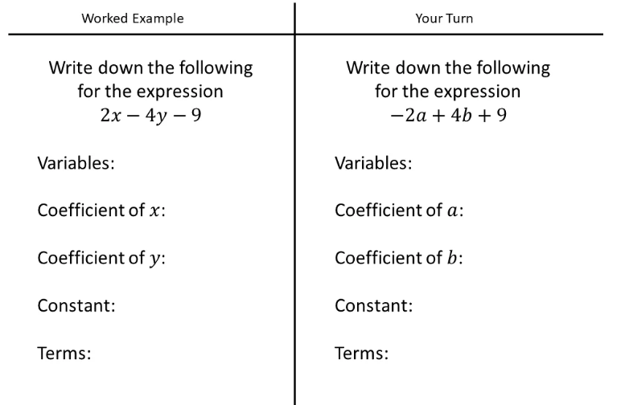
LESSON TITLE: Equating Coefficients

Slide 5
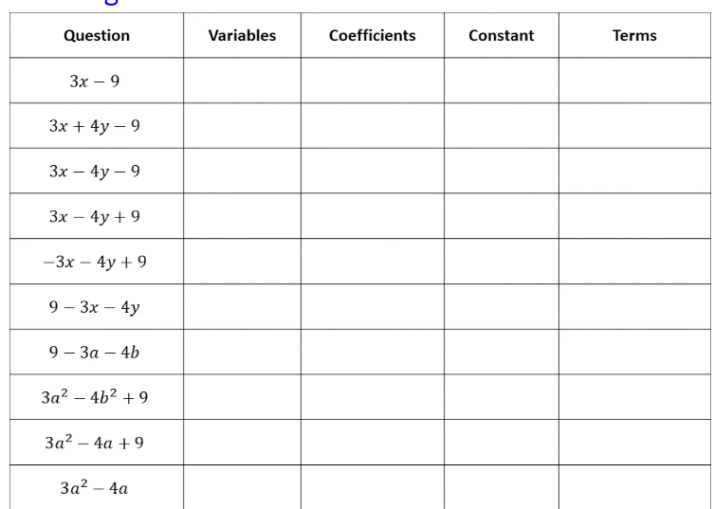

Slide 6
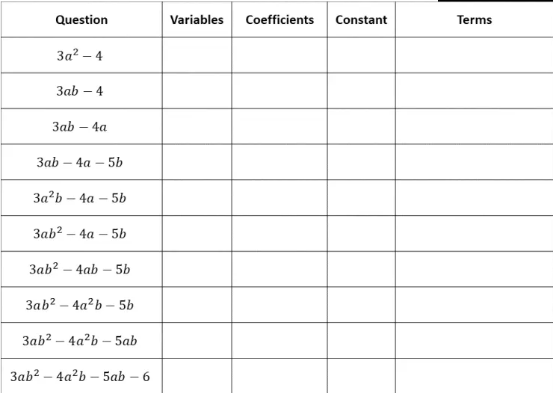
Notes:
From here: Algebraic Expressions Vocabulary – Variation Theory

Slide 7






Key vocabulary:
Decode the word
Definition
.
Identity
Examples
Non-examples

Slide 8

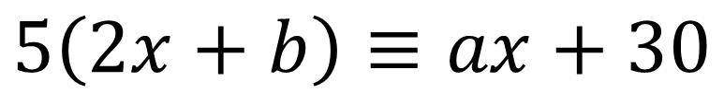

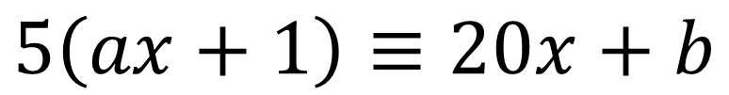
I DO:
WE DO:
Work out the values of $a$ and $b$
Work out the values of $a$ and $b$
$$5\left(2x+b\right)≡ax+30$$
$$5\left(ax+1\right)≡20x+b$$

Slide 9

I DO:
WE DO:
Work out the values of $a$ and $b$
Work out the values of $a$ and $b$
$$\left(x+a\right)\left(x+3a\right)≡x^{2}+bx+75$$
$$\left(x+2a\right)\left(x+a\right)≡x^{2}+bx+18$$

Slide 10


I DO:
WE DO:
Work out the values of $a, b and c$
Work out the values of $a, b and c$
$$\left(3x−1\right)\left(ax+b\right)≡{12x}^{2}−19x+c$$
$$\left(ax+1\right)\left(2x+b\right)≡{12x}^{2}+26x+c$$

Slide 11

WE DO:

Slide 12
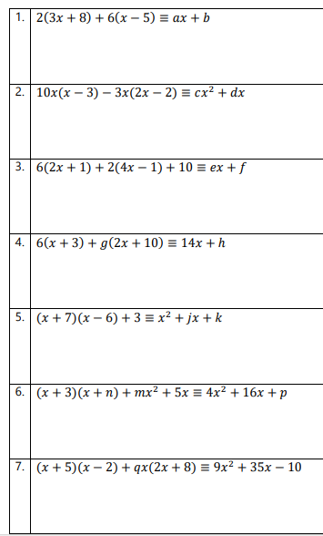
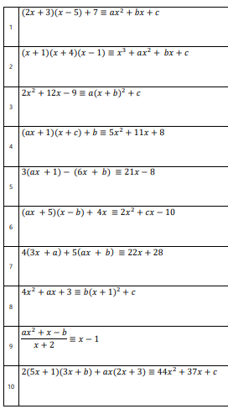

Slide 13

Exam Question

Slide 14
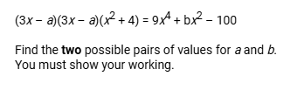
Exam Question
Notes:
A = +/-5 b = 11

Slide 15
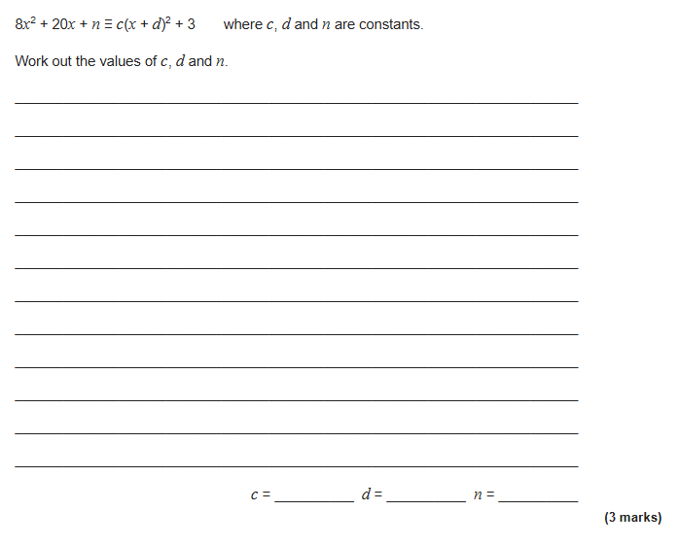
Exam Question
Notes:
From Further maths c = 8, d = 1.25, n = 15.5

