Slide 1















Dual coding symbols:
Practise
Explain
Organise
Big Question
Reflect
Present
Compare
Evaluate
Activate
Discuss
Predict
Connect
Summarise
Recall
Vocabulary

Slide 2










Editable reading ruler
Every child in an Archway school will become a fluent reader
 | RETRIEVE the words or phrases you need from the text | DECODE the words or phrase to address a breakdown | CONNECT with words or phrases you know from the text or your memory | VISUALISE the images in as much detail as possible | SUMMARISE the main ideas of the text in a few words | INFER meanings that might be within the text | PREDICT what might happen next using details from the text | EXAMINE how the writer uses words to construct meaning
 | ASK THOUGHTFUL QUESTIONS TO HELP YOU UNDERSTAND THE TEXT

Slide 3






A
B

Slide 4
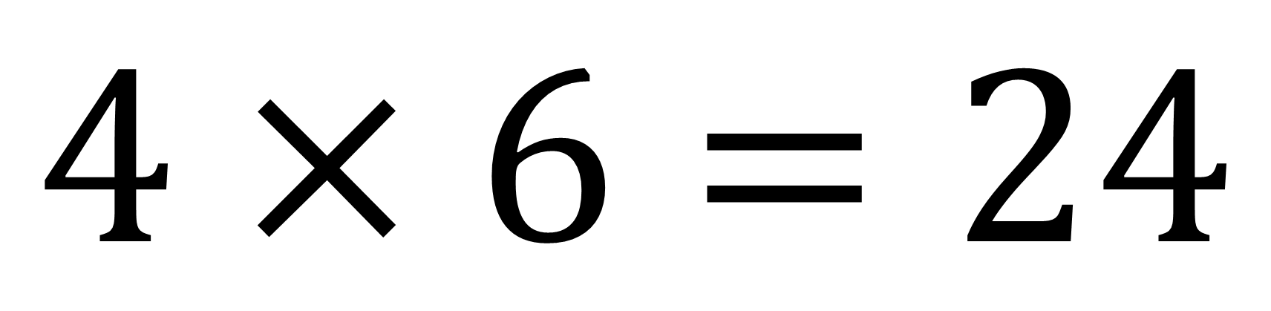
Factors
$$4×6=24$$
?
?
Complete this calculation in as many ways as possible

Slide 5






Key vocabulary:
Decode the word
Definition
.
Factors
Examples
Non-examples
Notes:
Emphasis factor come in pairs and factors are integers
Factor x Factor = Product

Slide 6
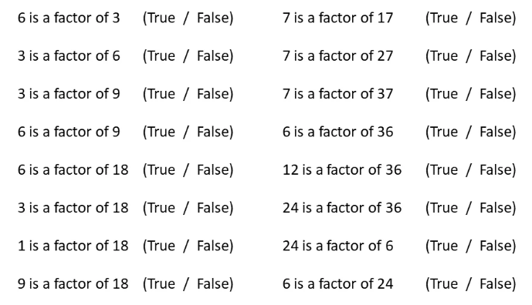

RETRIEVE
PRACTISE
SECURE
Notes:
I do

Slide 7
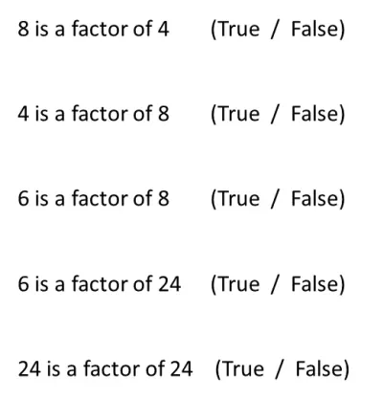
Notes:
Your turn

Slide 8
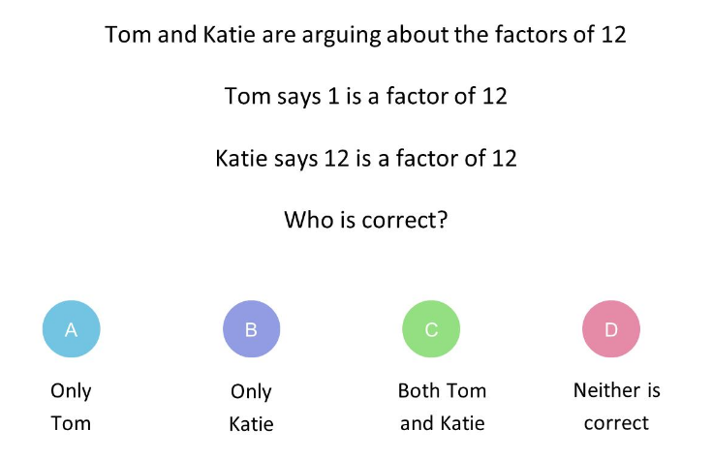
Mini WBs:

Slide 9
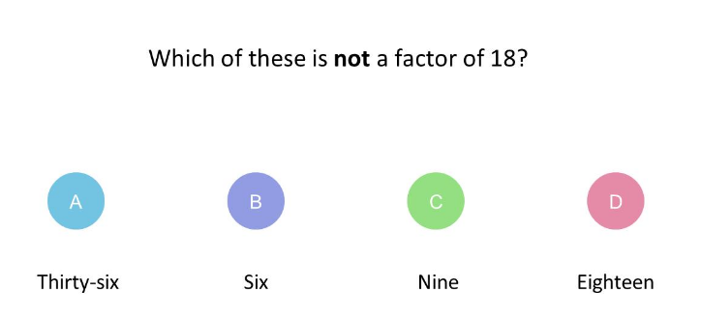
Mini WBs:

Slide 10
I DO:
WE DO:
Find the factors of 20.
Find the factors of 15.

Slide 11
I DO:
WE DO:
Find the factors of 13.
Find the factors of 23.

Slide 12
I DO:
WE DO:
Find the factors of 25.
Find the factors of 16.

Slide 13
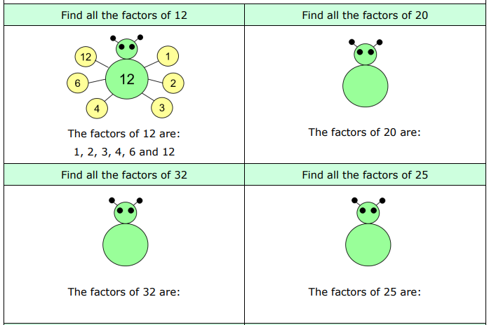
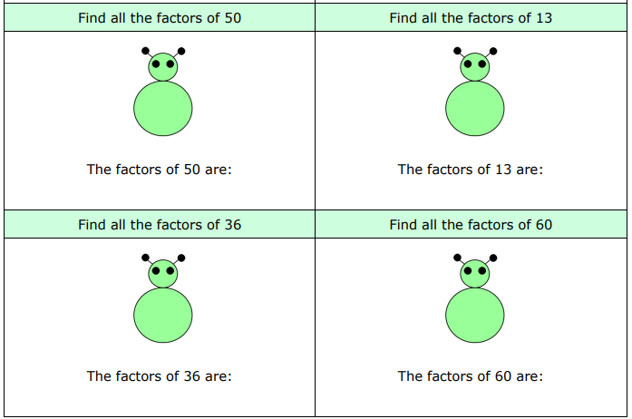
Copy and complete these factor bugs in your Maths book

Slide 14
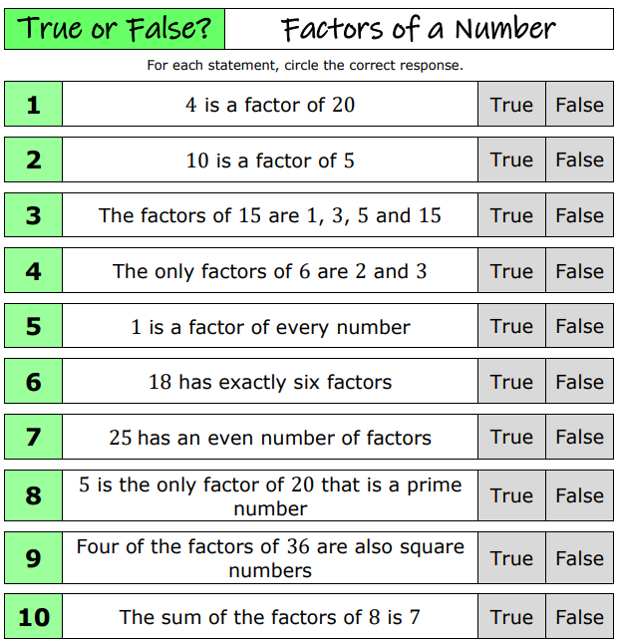
Give reasons for
each answer

