Slide 1















Dual coding symbols:
Practise
Explain
Organise
Big Question
Reflect
Present
Compare
Evaluate
Activate
Discuss
Predict
Connect
Summarise
Recall
Vocabulary

Slide 2










Editable reading ruler
Every child in an Archway school will become a fluent reader
 | RETRIEVE the words or phrases you need from the text | DECODE the words or phrase to address a breakdown | CONNECT with words or phrases you know from the text or your memory | VISUALISE the images in as much detail as possible | SUMMARISE the main ideas of the text in a few words | INFER meanings that might be within the text | PREDICT what might happen next using details from the text | EXAMINE how the writer uses words to construct meaning
 | ASK THOUGHTFUL QUESTIONS TO HELP YOU UNDERSTAND THE TEXT

Slide 3






A
B

Slide 4
Inverse Functions
Notes:
The sky is the limit

Slide 5
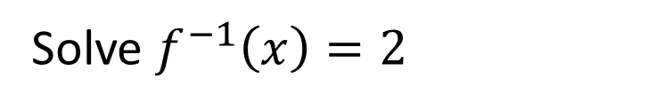
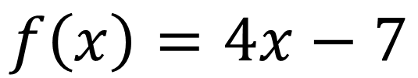
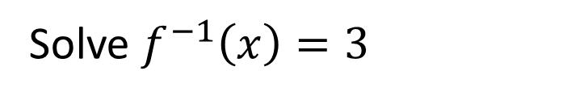
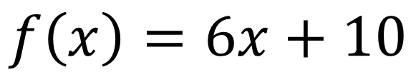
I DO:
WE DO:
Given that:
Given that:
$$f\left(x\right)=4x−7$$
$$f\left(x\right)=6x+10$$
Solve $f^{−1}\left(x\right)=2$
Solve $f^{−1}\left(x\right)=3$

Slide 6
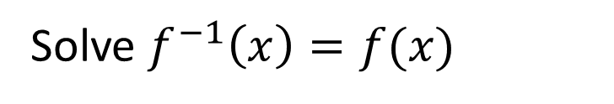
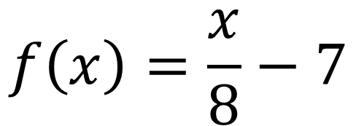
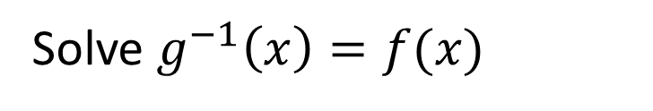
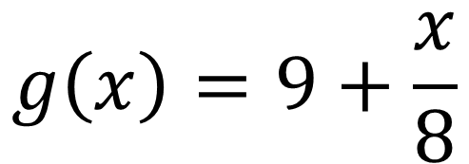
I DO:
WE DO:
Given that:
Given that:
$$f\left(x\right)=\frac{x}{8}−7$$
$$g\left(x\right)=9+\frac{x}{8}$$
Solve $f^{−1}\left(x\right)=f(x)$
Solve $g^{−1}\left(x\right)=f(x)$

Slide 7
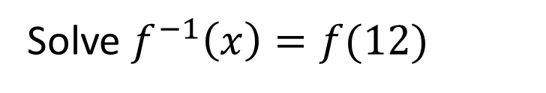
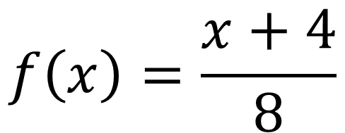
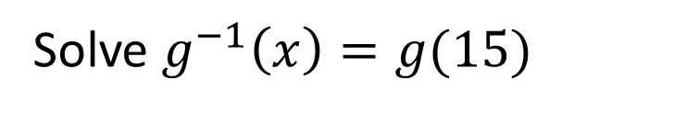
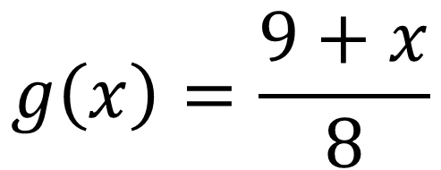
I DO:
WE DO:
Given that:
Given that:
$$f\left(x\right)=\frac{x+4}{8}$$
$$g\left(x\right)=\frac{9+x}{8}$$
Solve $f^{−1}\left(x\right)=f(12)$
Solve $g^{−1}\left(x\right)=g(15)$

Slide 8
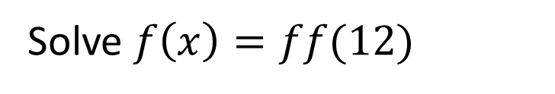
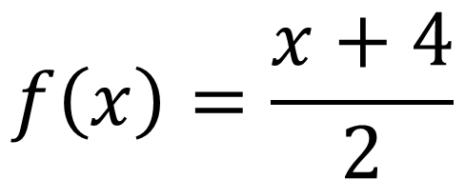

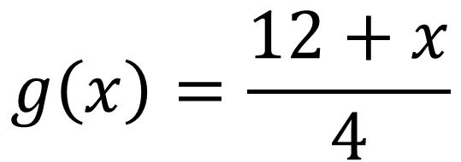
I DO:
WE DO:
Given that:
Given that:
$$f\left(x\right)=\frac{x+4}{2}$$
$$g\left(x\right)=\frac{12+x}{4}$$
Solve $f\left(x\right)=ff(12)$
Solve $g^{−1}\left(x\right)=gg(10)$

Slide 9
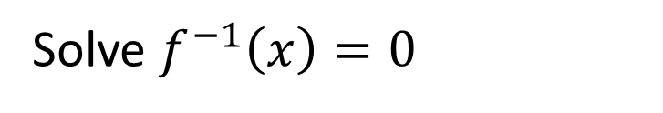
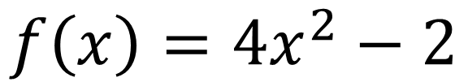
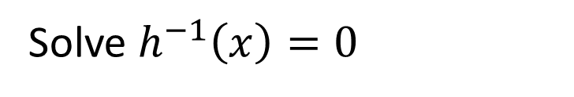
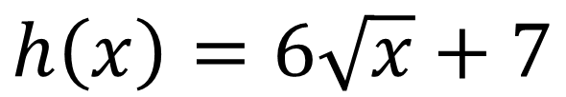
I DO:
WE DO:
Given that:
Given that:
$$f\left(x\right)=4x^{2}−2$$
$$h\left(x\right)=6\sqrt{x}+7$$
Solve $f^{−1}\left(x\right)=0$
Solve $h^{−1}\left(x\right)=0$

Slide 10
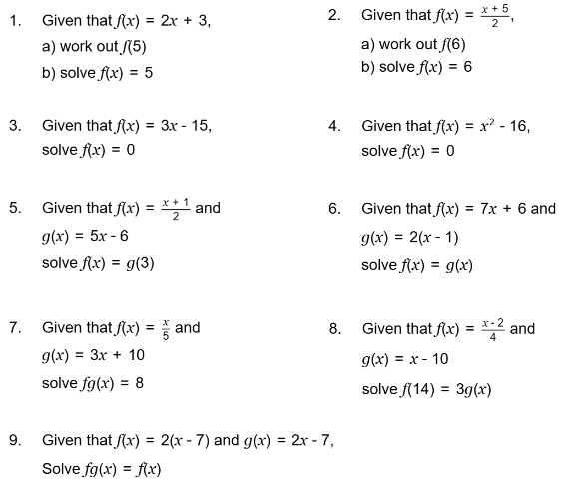

Slide 11
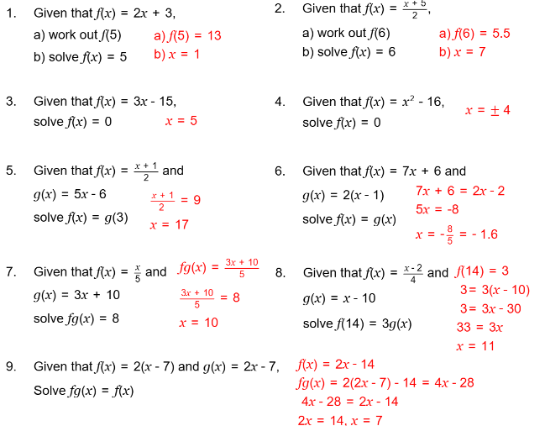

Slide 12
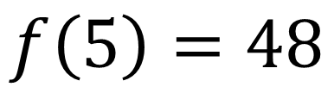
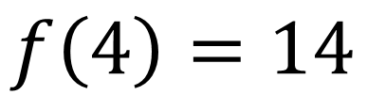
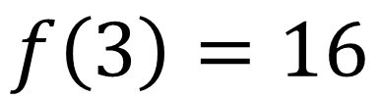
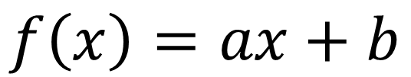
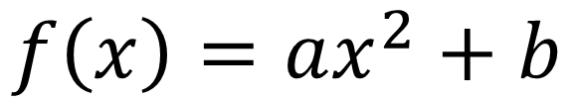

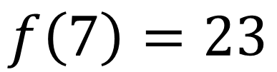

I DO:
WE DO:
Given that:
Given that:
$$f\left(x\right)=ax+b$$
$$f\left(x\right)=ax^{2}+b$$
$$f\left(4\right)=14$$
$$f\left(3\right)=16$$
$$f\left(7\right)=23$$
$$f\left(5\right)=48$$
Work out $a$ and $b$
Work out $a$ and $b$

Slide 13
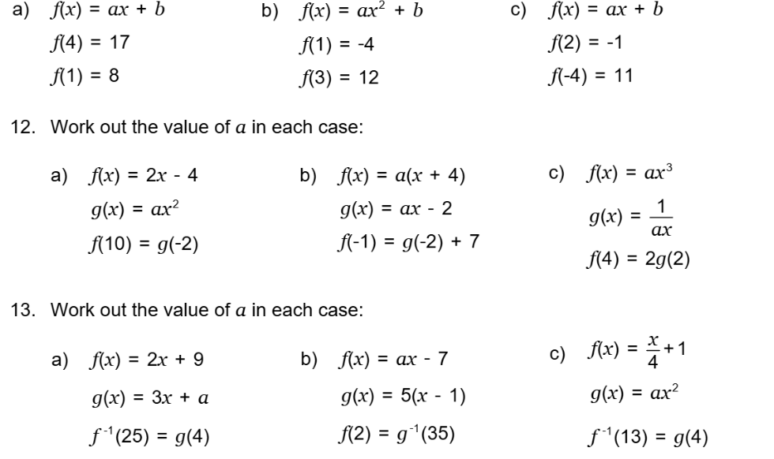
2.
3.

Slide 14
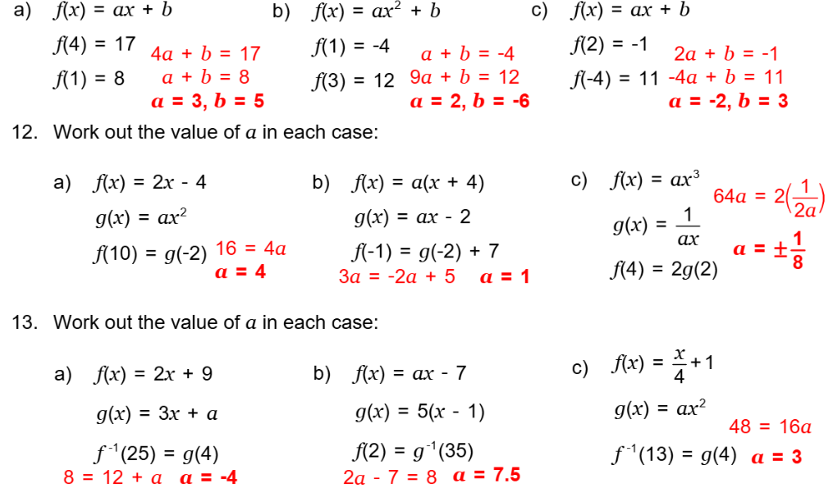
2.
3.

Slide 15
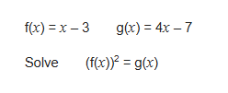
Exam Question 1
Notes:
1.12

Slide 16
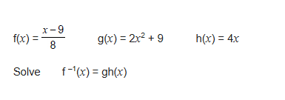
Exam Question 2
Notes:
From Further Maths

Slide 17
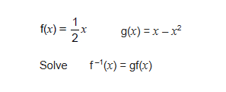
Exam Question 3
Notes:
From Further Maths

