Slide 1















Dual coding symbols:
Practise
Explain
Organise
Big Question
Reflect
Present
Compare
Evaluate
Activate
Discuss
Predict
Connect
Summarise
Recall
Vocabulary

Slide 2










Editable reading ruler
Every child in an Archway school will become a fluent reader
 | RETRIEVE the words or phrases you need from the text | DECODE the words or phrase to address a breakdown | CONNECT with words or phrases you know from the text or your memory | VISUALISE the images in as much detail as possible | SUMMARISE the main ideas of the text in a few words | INFER meanings that might be within the text | PREDICT what might happen next using details from the text | EXAMINE how the writer uses words to construct meaning
 | ASK THOUGHTFUL QUESTIONS TO HELP YOU UNDERSTAND THE TEXT

Slide 3






A
B

Slide 4
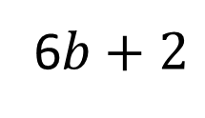
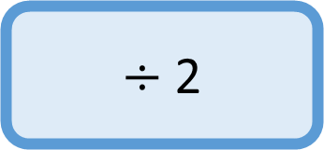
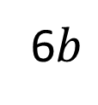
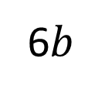
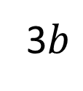
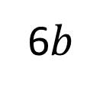
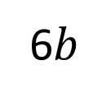
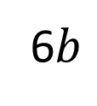
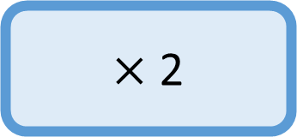
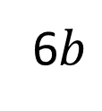
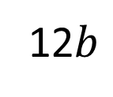
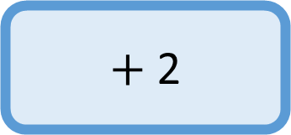
Functions
$×$ 2
6$b$
12$b$
6$b$
$÷$ 2
6$b$
3$b$
6$b$
$+$ 2
6$b$
6$b+2$
6$b$
What are the outputs?

Slide 5
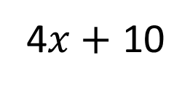
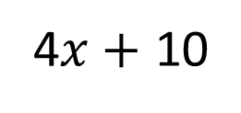
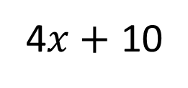

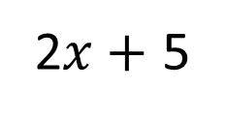

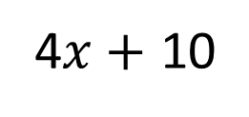
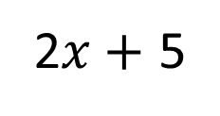
I DO: Find the OUTPUT
$÷$ 2
4$x+$ 10
4$x+$ 10
2$x+$ 5
WE DO: Find the OUTPUT
$×$ 2
4$x+$ 10
4$x+$ 10
2$x+$ 5

Slide 6
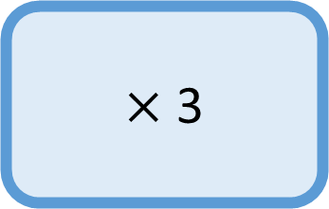
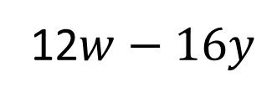
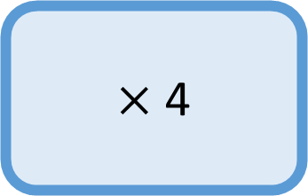
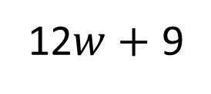
I DO: Find the INPUT
$×$ 3
12$w+$ 9
WE DO: Find the INPUT
$×$ 4
12$w−16y$

Slide 7
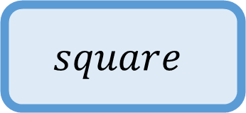

I DO: Find the OUTPUT
$$square$$
5y
2$x+$ 5
WE DO: Find the OUTPUT
$$square$$
y+5
2$x+$ 5

Slide 8
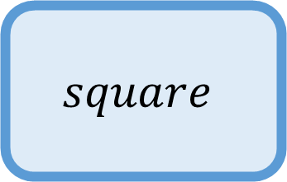

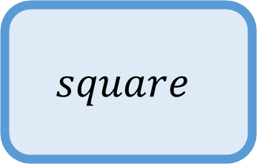

I DO: Find the INPUT
$$square$$
$${64w}^{2}$$
WE DO: Find the INPUT
$$square$$
$$x^{2}+16x+64$$

Slide 9
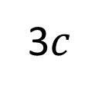
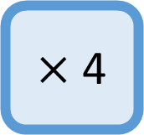
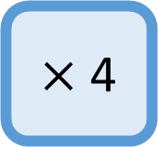
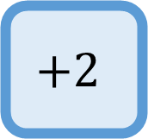
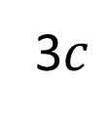
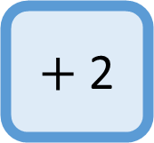
I DO: Find the OUTPUT
$×$ 4
$+$ 2
3$c$
WE DO: Find the OUTPUT
$$+2$$
$×$ 4
3$c$

Slide 10
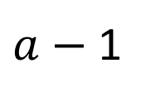
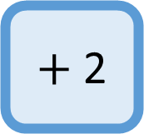
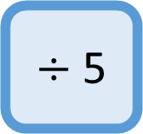

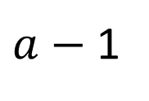
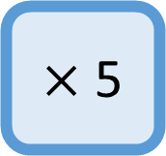
I DO: Find the OUTPUT
$+$ 2
$×$ 5
$a−$ 1
WE DO: Find the OUTPUT
$+$ 2
$÷$ 5
$a−$ 1

Slide 11


I DO: Write the FUNCTION
WE DO: Write the FUNCTION
Notes:
AQA only

Slide 12
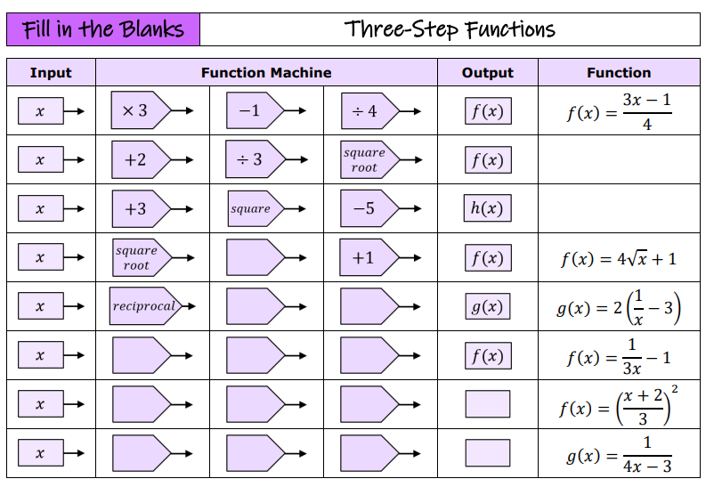

Slide 13
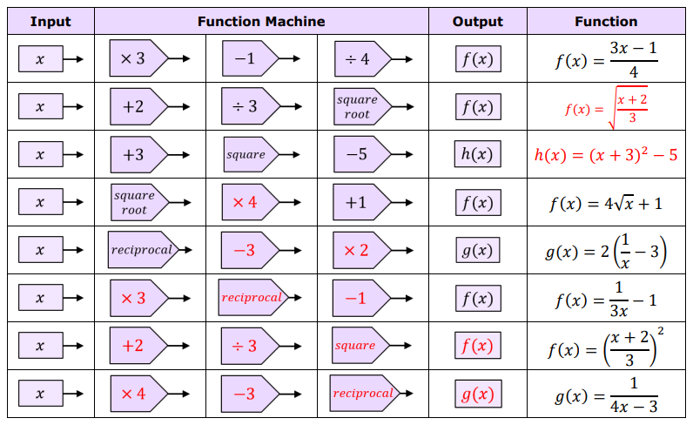

Slide 14
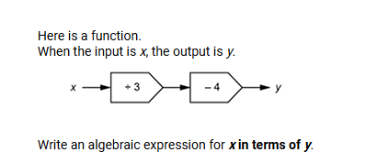
Exam Question 1
Notes:
1.12

Slide 15
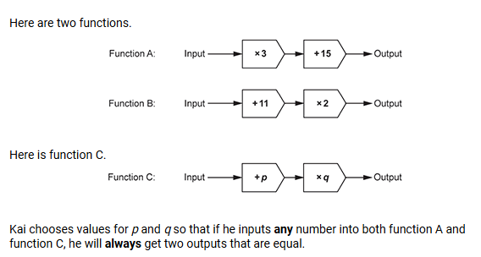
Exam Question 2
Notes:
From Further Maths

