Slide 1















Dual coding symbols:
Practise
Explain
Organise
Big Question
Reflect
Present
Compare
Evaluate
Activate
Discuss
Predict
Connect
Summarise
Recall
Vocabulary

Slide 2










Editable reading ruler
Every child in an Archway school will become a fluent reader
 | RETRIEVE the words or phrases you need from the text | DECODE the words or phrase to address a breakdown | CONNECT with words or phrases you know from the text or your memory | VISUALISE the images in as much detail as possible | SUMMARISE the main ideas of the text in a few words | INFER meanings that might be within the text | PREDICT what might happen next using details from the text | EXAMINE how the writer uses words to construct meaning
 | ASK THOUGHTFUL QUESTIONS TO HELP YOU UNDERSTAND THE TEXT

Slide 3






A
B

Slide 4
Inverse Functions
Notes:
The sky is the limit

Slide 5

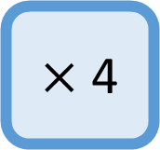
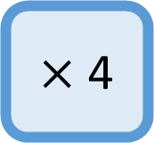
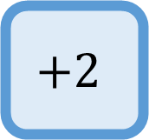

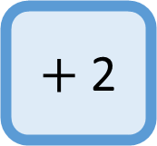
I DO: Write the FUNCTION
$×$ 4
$+$ 2
$$x$$
WE DO: Write the FUNCTION
$$+2$$
$×$ 4
$$x$$

Slide 6


I DO: Write the INVERSE FUNCTION
$×$ 4
$+$ 2
$$x$$
$$f\left(x\right)$$
WE DO: Write the INVERSE FUNCTION
$$+2$$
$×$ 4
$$x$$
$$f\left(x\right)$$

Slide 7

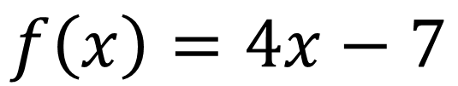

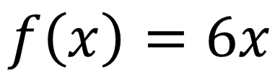
I DO:
WE DO:
Given that:
Given that:
$$f\left(x\right)=4x−7$$
$$f\left(x\right)=6x$$
Work out $f^{−1}(x)$
Work out $f^{−1}(x)$

Slide 8
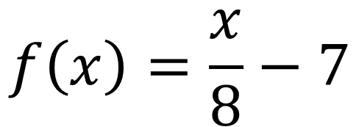

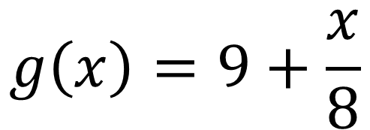
I DO:
WE DO:
Given that:
Given that:
$$f\left(x\right)=\frac{x}{8}−7$$
$$g\left(x\right)=9+\frac{x}{8}$$
Work out $f^{−1}(x)$
Work out $g^{−1}(x)$

Slide 9
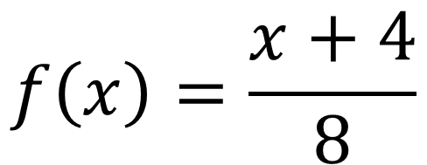
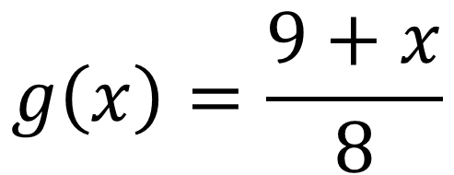
I DO:
WE DO:
Given that:
Given that:
$$f\left(x\right)=\frac{x+4}{8}$$
$$g\left(x\right)=\frac{9+x}{8}$$
Work out $f^{−1}(x)$
Work out $g^{−1}(x)$

Slide 10


I DO:
WE DO:
Given that:
Given that:
$$f\left(x\right)=\frac{x+4}{8}$$
$$g\left(x\right)=\frac{9+x}{8}$$
Work out $f^{−1}(20)$
Work out $g^{−1}(23)$

Slide 11
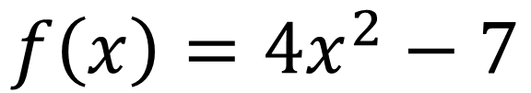

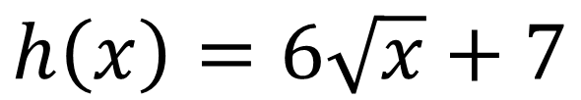
I DO:
WE DO:
Given that:
Given that:
$$f\left(x\right)=4x^{2}−7$$
$$h\left(x\right)=6\sqrt{x}+7$$
Work out $f^{−1}(x)$
Work out $h^{−1}(x)$

Slide 12

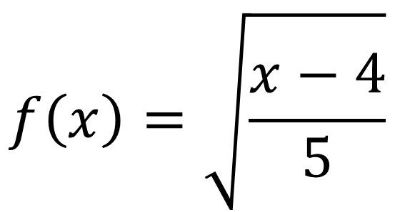

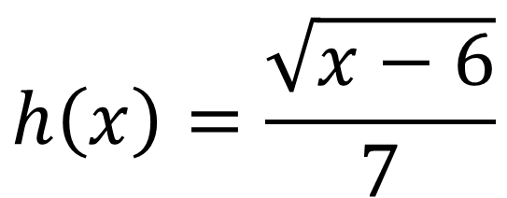
I DO:
WE DO:
Given that:
Given that:
$$f\left(x\right)=\sqrt{\frac{x−4}{5}}$$
$$h\left(x\right)=\frac{\sqrt{x−6}}{7}$$
Work out $f^{−1}(x)$
Work out $h^{−1}(x)$

Slide 13
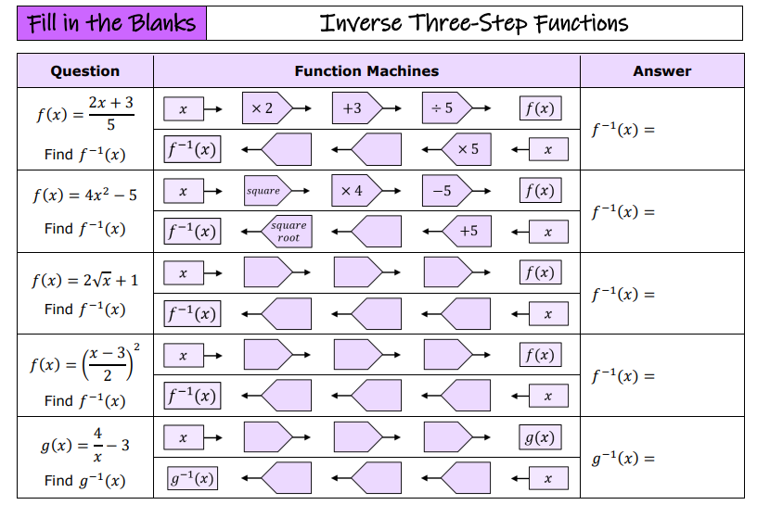

Slide 14
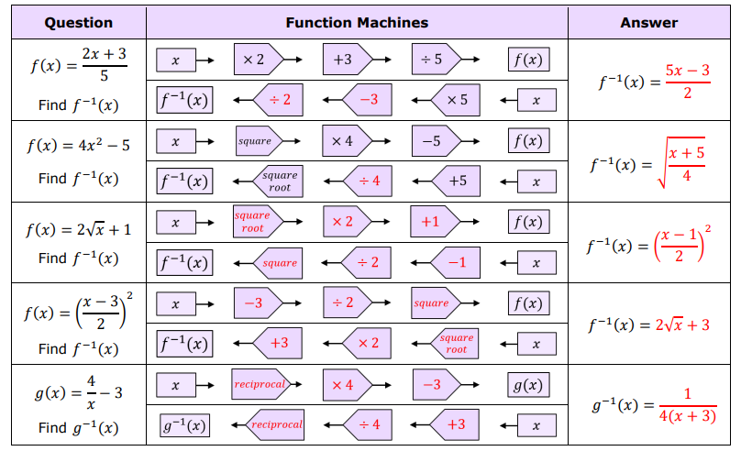

Slide 15

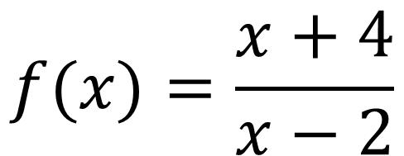

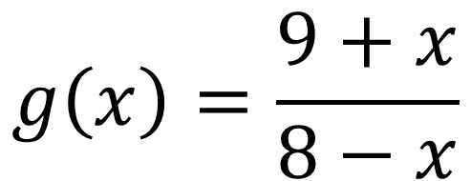
I DO:
WE DO:
Given that:
Given that:
$$f(x)=\frac{x+4}{x−2}$$
$$g\left(x\right)=\frac{9+x}{8−x}$$
Work out $f^{−1}(x)$
Work out $g^{−1}(x)$

Slide 16
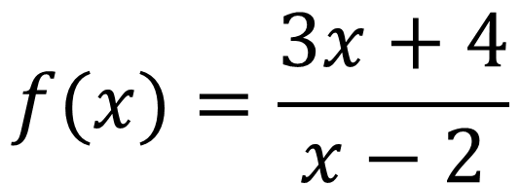
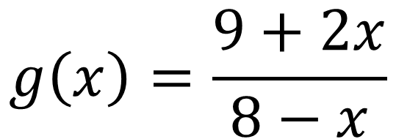
I DO:
WE DO:
Given that:
Given that:
$$f(x)=\frac{3x+4}{x−2}$$
$$g\left(x\right)=\frac{9+2x}{8−x}$$
Work out $f^{−1}(x)$
Work out $g^{−1}(x)$

Slide 17
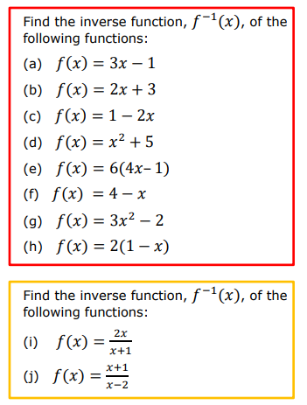
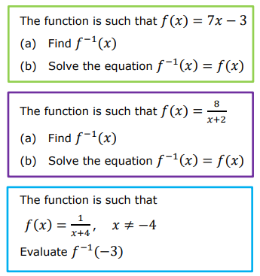

Slide 18
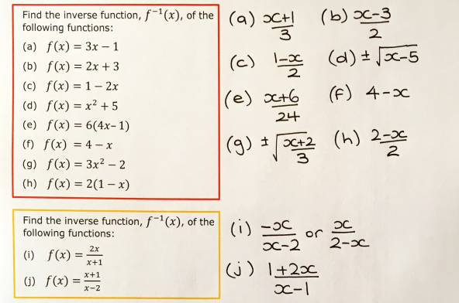
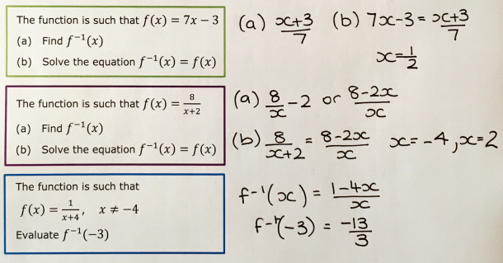

Slide 19
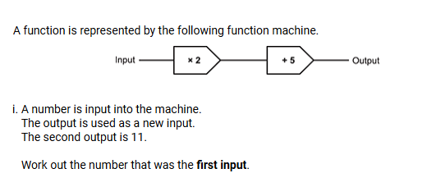
Exam Question 1
Notes:
1.12

Slide 20


Exam Question 2
Notes:
From Further Maths

Slide 21

Exam Question 3
Notes:
From Further Maths

Slide 22
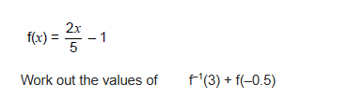
Exam Question 4

