Slide 1















Dual coding symbols:
Practise
Explain
Organise
Big Question
Reflect
Present
Compare
Evaluate
Activate
Discuss
Predict
Connect
Summarise
Recall
Vocabulary

Slide 2


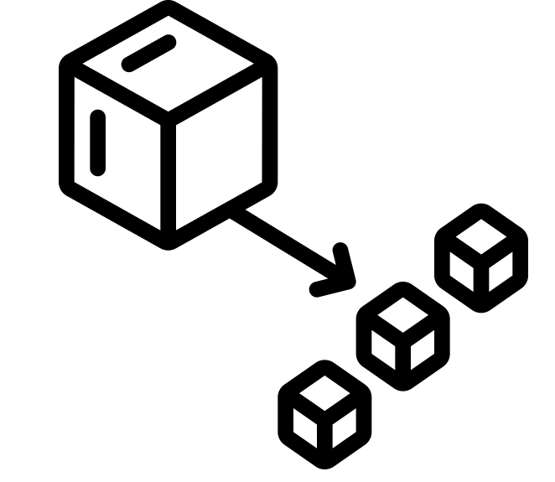





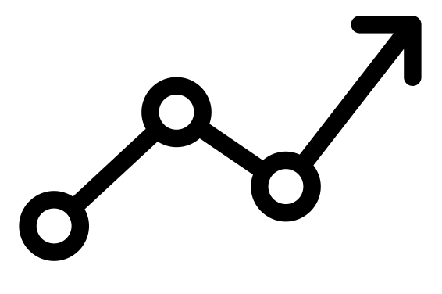

Editable reading ruler
Every child in an Archway school will become a fluent reader
 | RETRIEVE the words or phrases you need from the text | DECODE the words or phrase to address a breakdown | CONNECT with words or phrases you know from the text or your memory | VISUALISE the images in as much detail as possible | SUMMARISE the main ideas of the text in a few words | INFER meanings that might be within the text | PREDICT what might happen next using details from the text | EXAMINE how the writer uses words to construct meaning
 | ASK THOUGHTFUL QUESTIONS TO HELP YOU UNDERSTAND THE TEXT

Slide 3





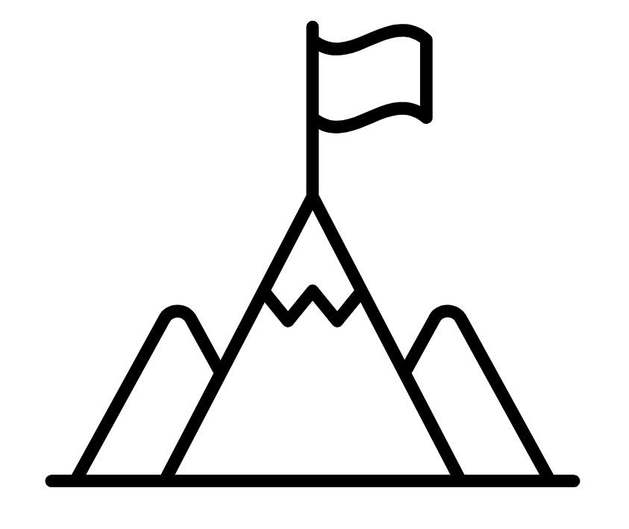
A
B

Slide 4
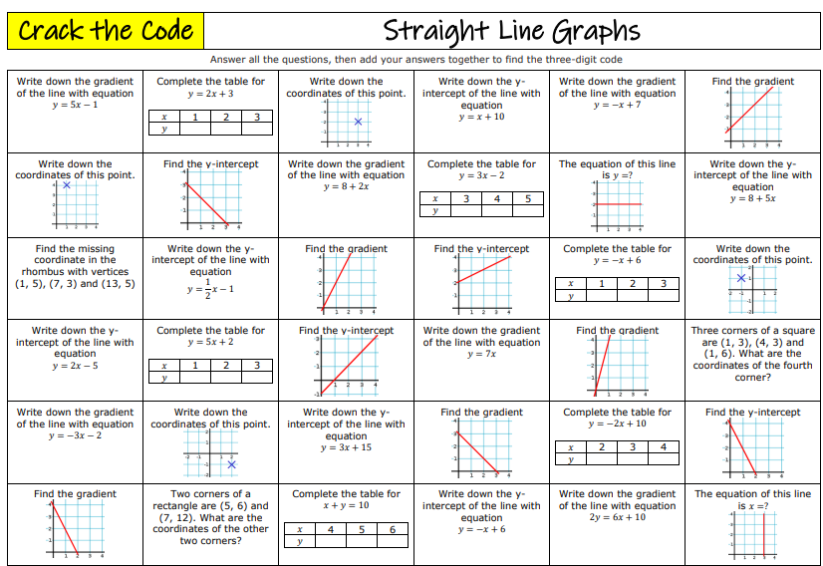
Working with Linear Graphs
Notes:
7ac124_c111bd483c994fa8ac534e6dde817d1e.pdf

Slide 5
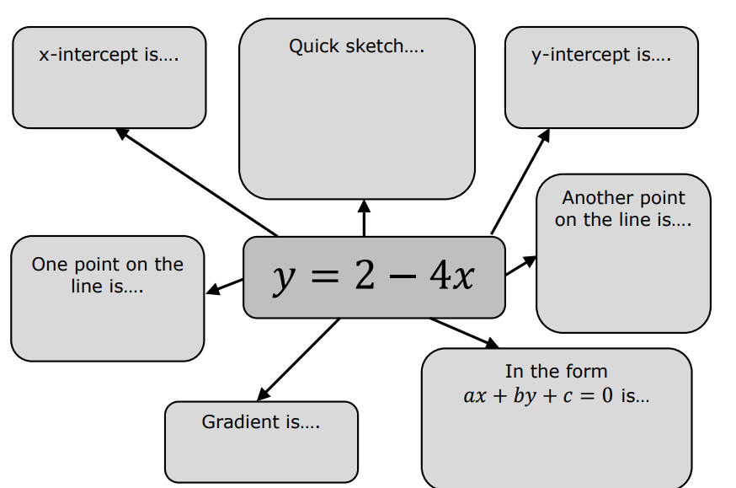

Slide 6
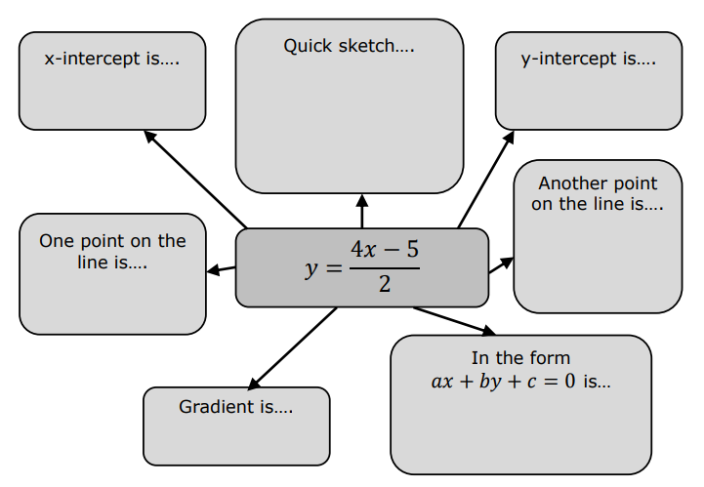

Slide 7
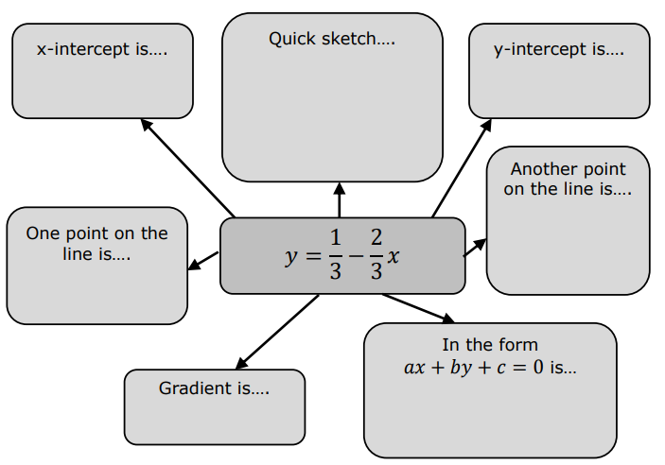

Slide 8
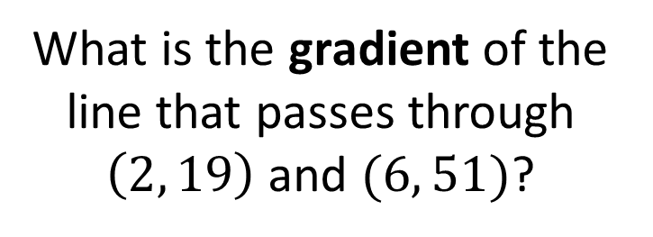
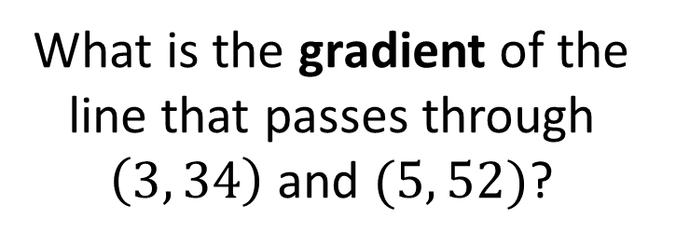
I DO:
WE DO:
What is the gradient of the line that passes through $\left(3, 34\right)$ and $(5, 52)$?
What is the gradient of the line that passes through $\left(2, 19\right)$ and $(6, 51)$?

Slide 9
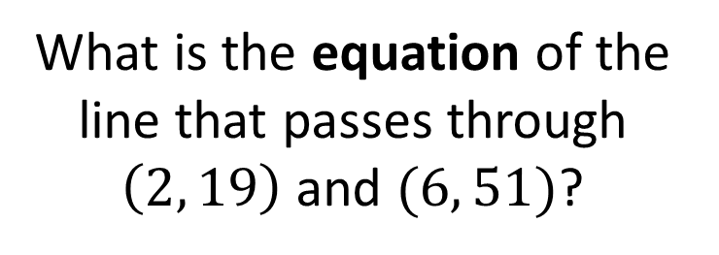
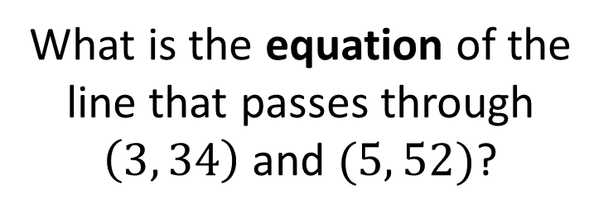
I DO:
WE DO:
What is the equation of the line that passes through $\left(3, 34\right)$ and $(5, 52)$?
What is the equation of the line that passes through $\left(2, 19\right)$ and $(6, 51)$?

Slide 10
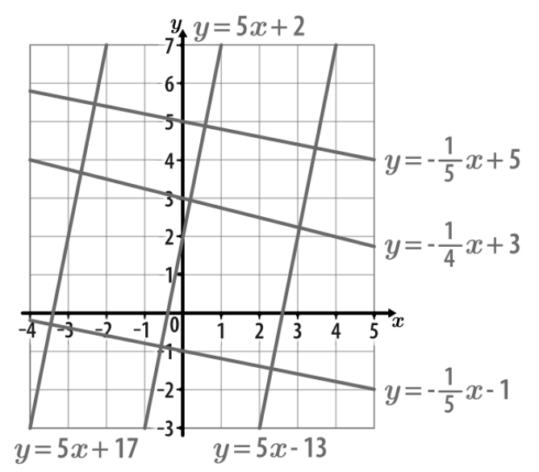
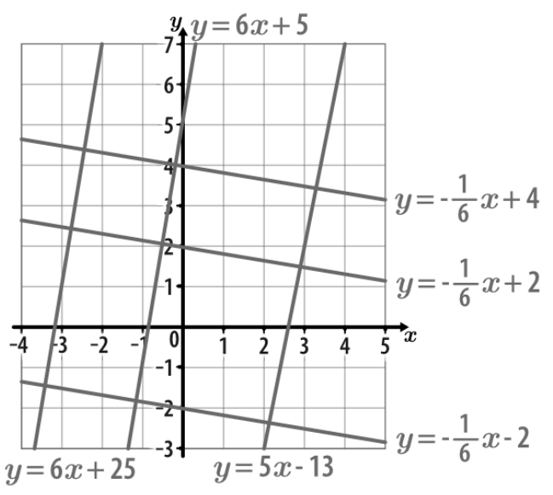
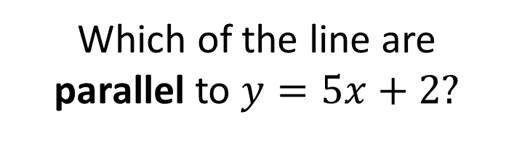
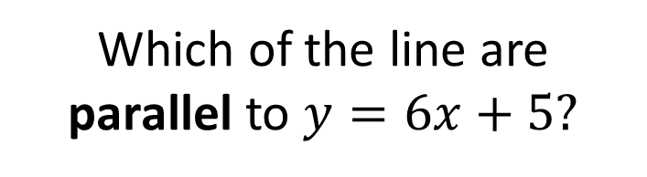
I DO:
WE DO:
Which of the line are parallel to $y=5x+2?$
Which of the line are parallel to $y=6x+5?$

Slide 11
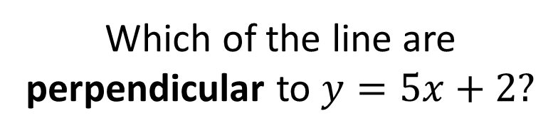
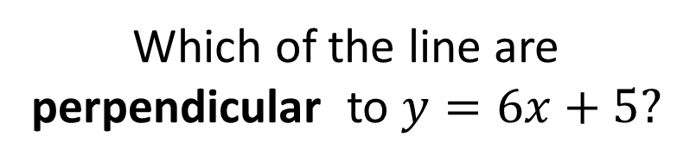
I DO:
WE DO:
Which of the line are perpendicular to $y=5x+2?$
Which of the line are perpendicular to $y=6x+5?$

Slide 12
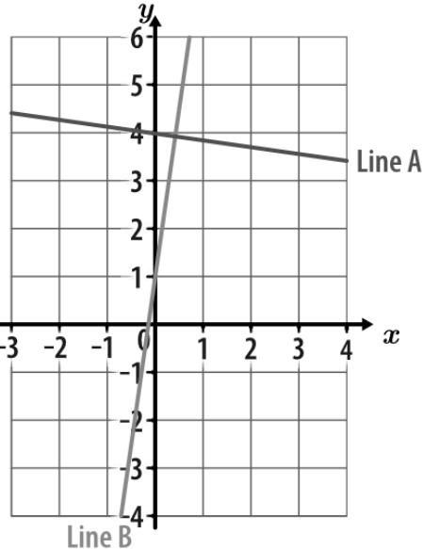
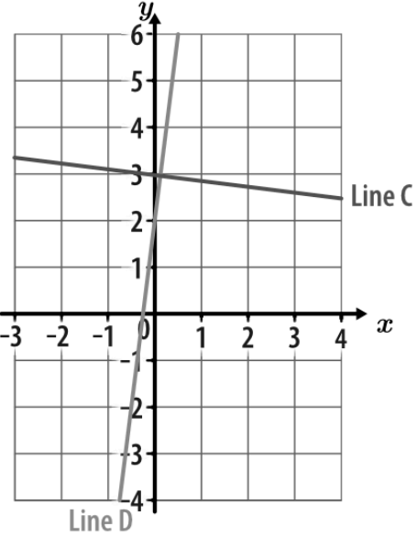
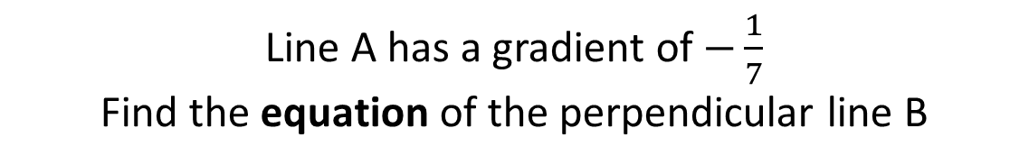
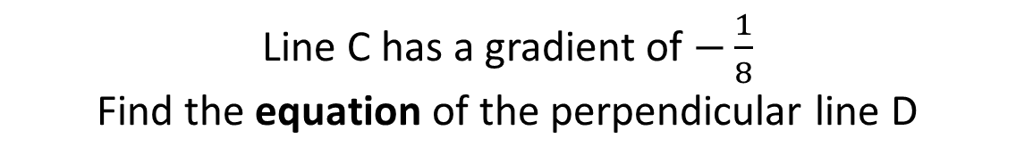
I DO:
WE DO:
Line A has a gradient of $−\frac{1}{7}$
Find the equation of the perpendicular line B
Line C has a gradient of $−\frac{1}{8}$
Find the equation of the perpendicular line D

Slide 13
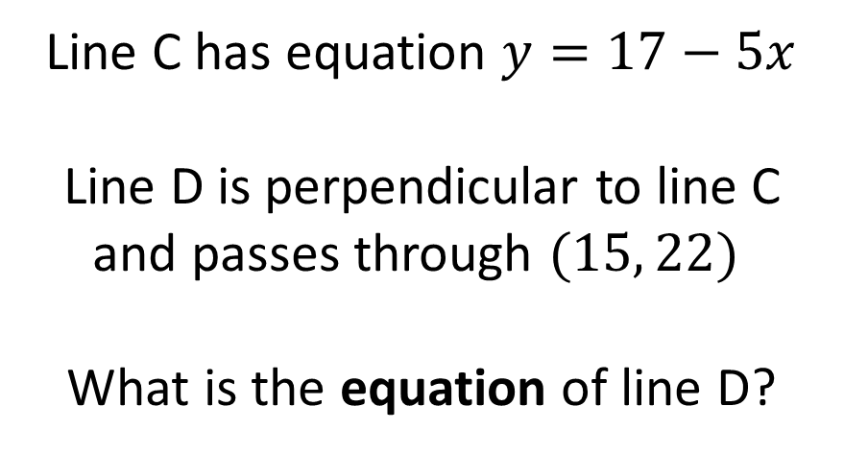
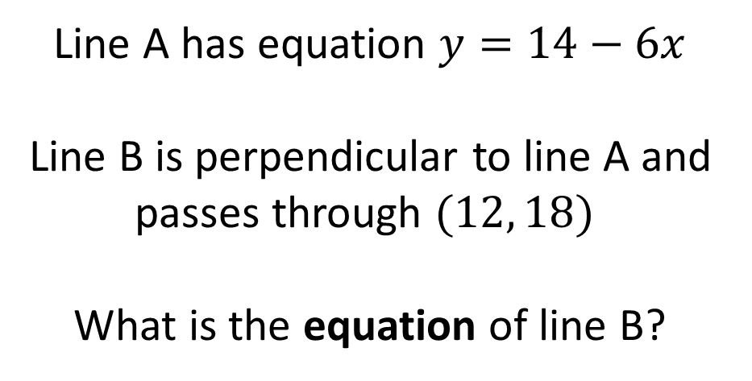
I DO:
WE DO:
Line A has equation $y=14−6x$
Line B is perpendicular to line A and passes through $(12, 18)$
What is the equation of line B?
Line C has equation $y=17−5x$
Line D is perpendicular to line C and passes through $(15, 22)$
What is the equation of line D?

Slide 14
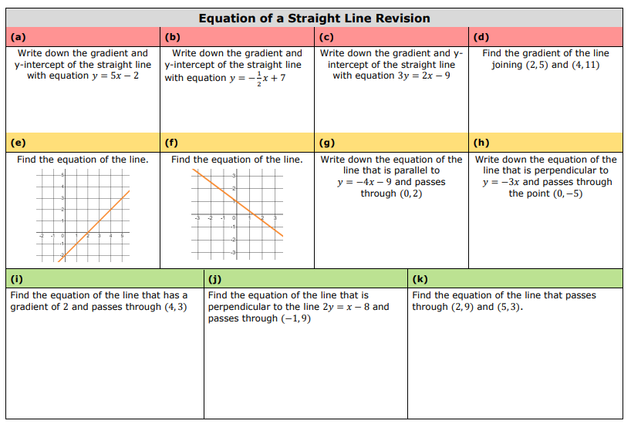
Notes:
7ac124_46dfdaeba3cf4b21ae0d02a1e5c29454.pdf

Slide 15
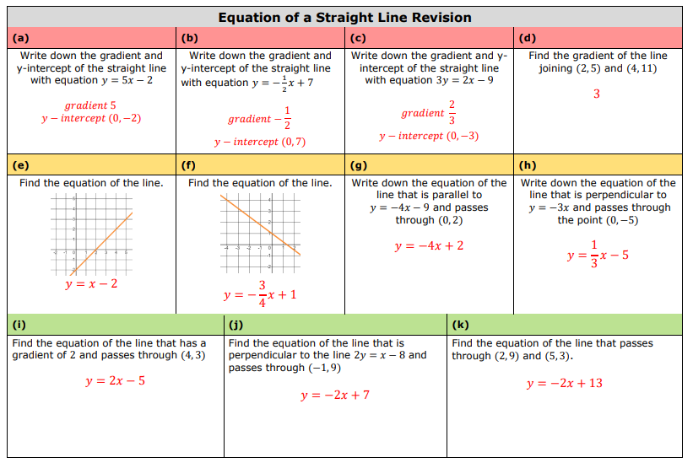

Slide 16

Exam Question

Slide 17
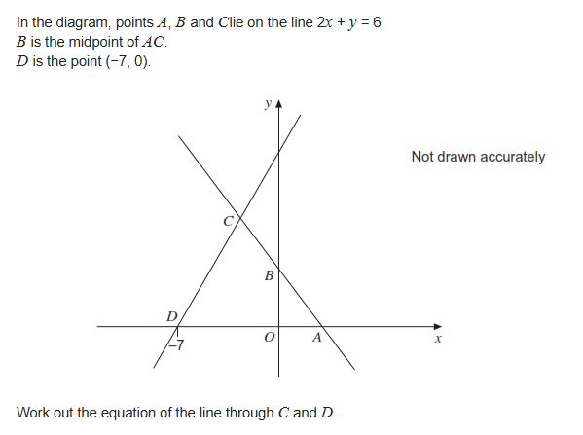
Exam Question
Notes:
Y = 3x + 21

Slide 18
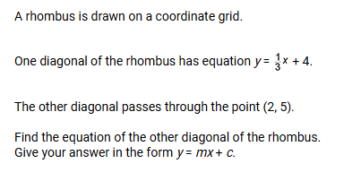
Exam Question
Notes:
Y = -3x + 11

Slide 19
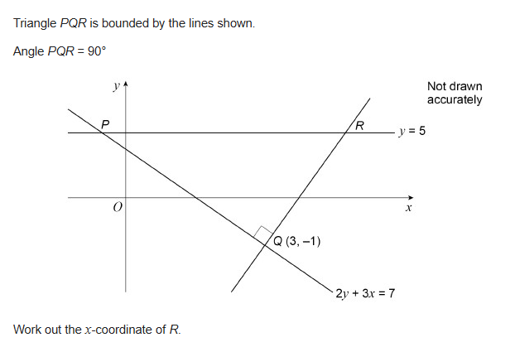
Exam Question (Further Maths)
Notes:
12

Slide 20
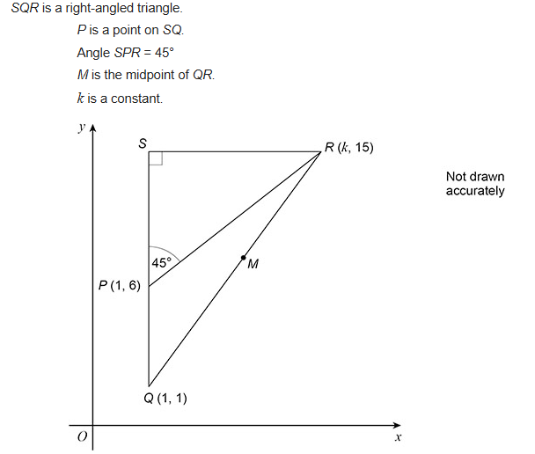

Exam Question (Further Maths)
Notes:
(5.5, 8)

