Slide 1















Dual coding symbols:
Practise
Explain
Organise
Big Question
Reflect
Present
Compare
Evaluate
Activate
Discuss
Predict
Connect
Summarise
Recall
Vocabulary

Slide 2










Editable reading ruler
Every child in an Archway school will become a fluent reader
 | RETRIEVE the words or phrases you need from the text | DECODE the words or phrase to address a breakdown | CONNECT with words or phrases you know from the text or your memory | VISUALISE the images in as much detail as possible | SUMMARISE the main ideas of the text in a few words | INFER meanings that might be within the text | PREDICT what might happen next using details from the text | EXAMINE how the writer uses words to construct meaning
 | ASK THOUGHTFUL QUESTIONS TO HELP YOU UNDERSTAND THE TEXT

Slide 3






A
B

Slide 4
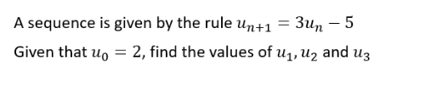
Finding approximate solutions to equations using Iteration

Slide 5
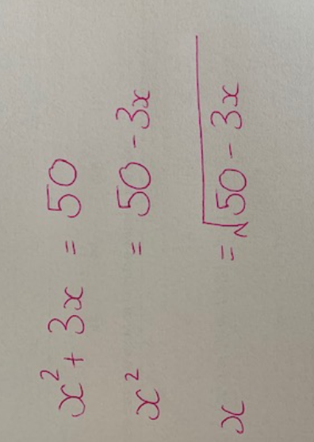

A student tries to solve $x^{2}+3x=50$ as follows
The solution will be a value of $x$ that when substituted into the equation gives the value of $x$ used

Slide 6
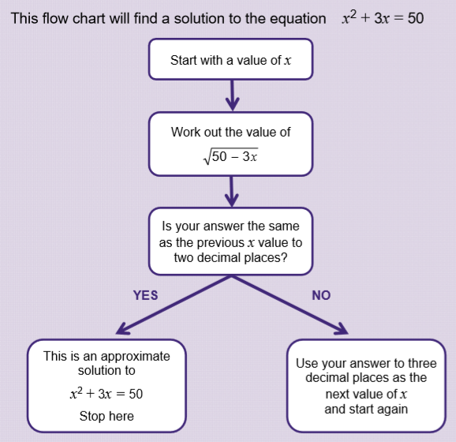
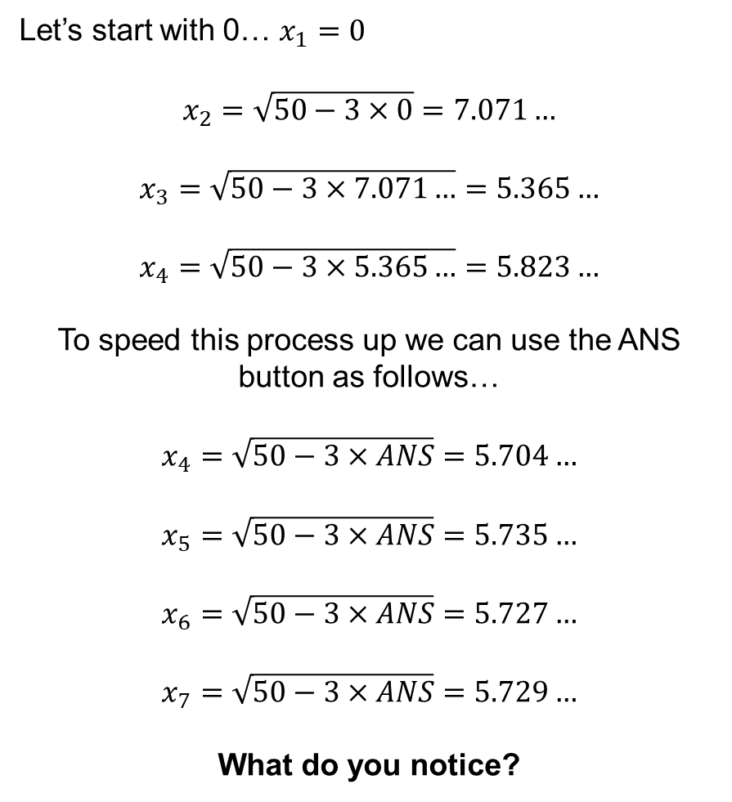
Let’s start with 0… $x_{1}=0$
$$x_{2}=\sqrt{50−3×0}=7.071…$$
$$x_{3}=\sqrt{50−3×7.071…}=5.365…$$
$$x_{4}=\sqrt{50−3×5.365…}=5.823…$$
To speed this process up we can use the ANS button as follows…
$$x_{4}=\sqrt{50−3×ANS}=5.704…$$
$$x_{5}=\sqrt{50−3×ANS}=5.735…$$
$$x_{6}=\sqrt{50−3×ANS}=5.727…$$
$$x_{7}=\sqrt{50−3×ANS}=5.729…$$
What do you notice?

Slide 7
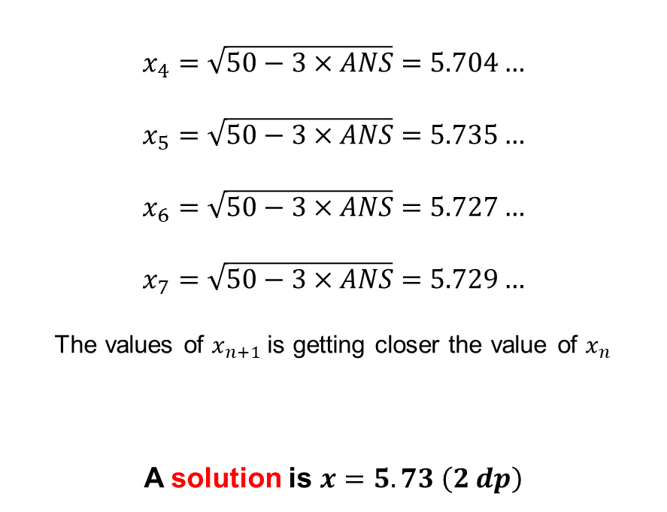
$$x_{4}=\sqrt{50−3×ANS}=5.704…$$
$$x_{5}=\sqrt{50−3×ANS}=5.735…$$
$$x_{6}=\sqrt{50−3×ANS}=5.727…$$
$$x_{7}=\sqrt{50−3×ANS}=5.729…$$
The values of $x_{n+1}$is getting closer the value of $x_{n}$
A solution is $x=5.73 \left(2 dp\right)$

Slide 8
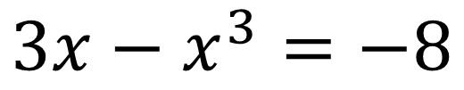
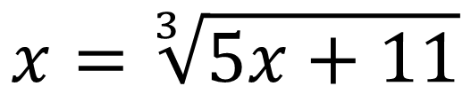
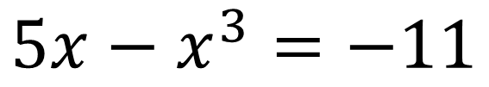
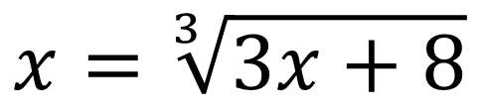
I DO:
WE DO:
Show that
Show that
$$3x−x^{3}=−8$$
$$5x−x^{3}=−11$$
can be rearranged to give
can be rearranged to give
$$x=\sqrt[3]{3x+8}$$
$$x=\sqrt[3]{5x+11}$$

Slide 9
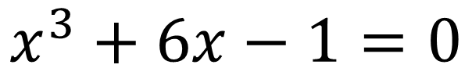
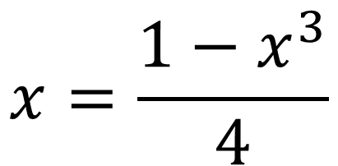
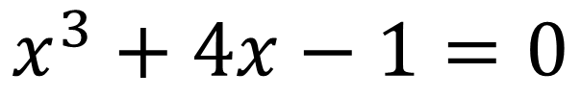
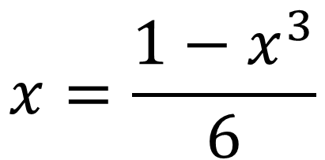
I DO:
WE DO:
Show that the equation
Show that
$$x^{3}+6x−1=0$$
$$x^{3}+4x−1=0$$
can be rearranged to give
can be rearranged to give
$$x=\frac{1−x^{3}}{6}$$
$$x=\frac{1−x^{3}}{4}$$

Slide 10
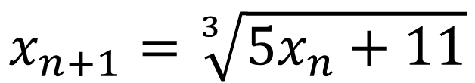
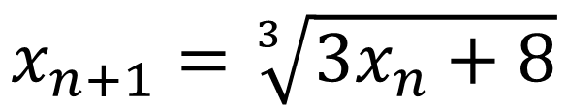
I DO:
WE DO:
Starting with $x_{1}=2$, use the iterative formula:
Starting with $x_{1}=3$, use the iterative formula:
$$x_{n+1}=\sqrt[3]{3x_{n}+8}$$
$$x_{n+1}=\sqrt[3]{5x_{n}+11}$$
To find an estimate for the solution to $3x−x^{3}=−8$ to 2 dp
To find an estimate for the solution to $5x−x^{3}=−11$ to 2 dp

Slide 11
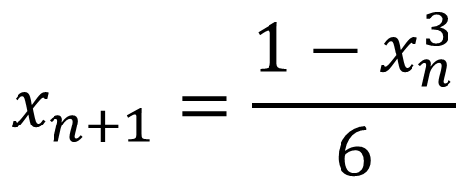
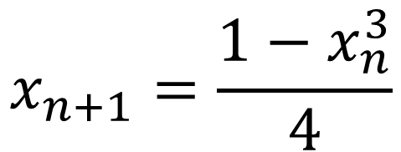
I DO:
WE DO:
Use the iterative formula:
Use the iterative formula:
$$x_{n+1}=\frac{1−x_{n}^{3}}{6}$$
$$x_{n+1}=\frac{1−x_{n}^{3}}{4}$$
To find an estimate for the solution to $x^{3}+6x−1=0$ to 3 dp
To find an estimate for the solution to $x^{3}+4x−1=0$ to 3 dp

Slide 12
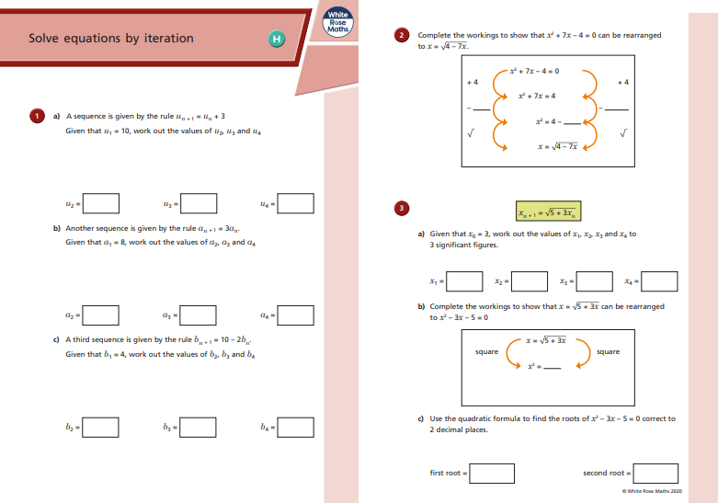
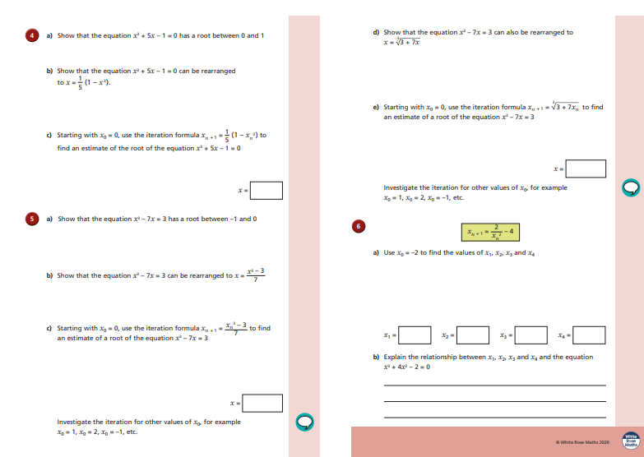

Slide 13
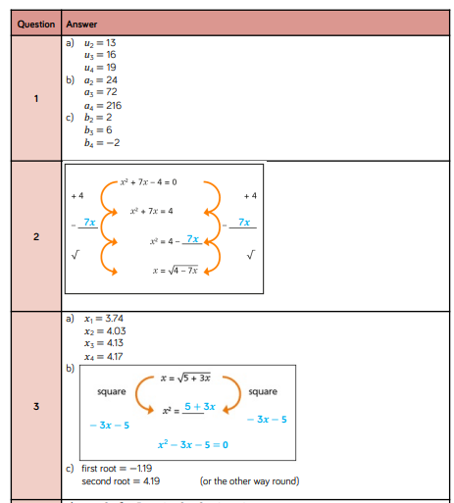
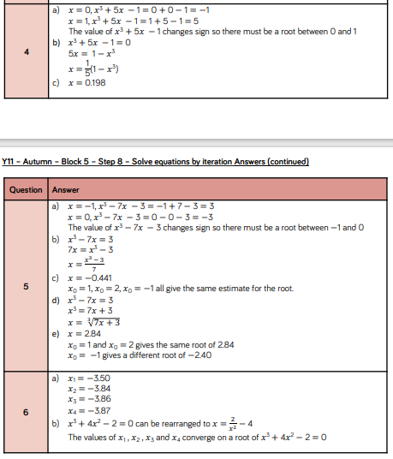

Slide 14
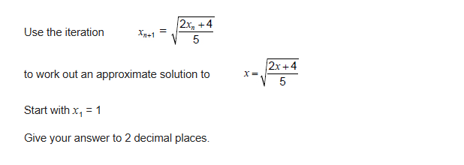
Exam Question 1
Notes:
1.12

Slide 15
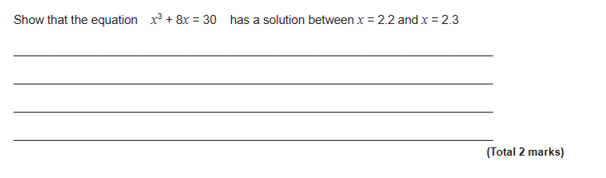
Exam Question 2
4 marks
Notes:
From Further Maths

Slide 16
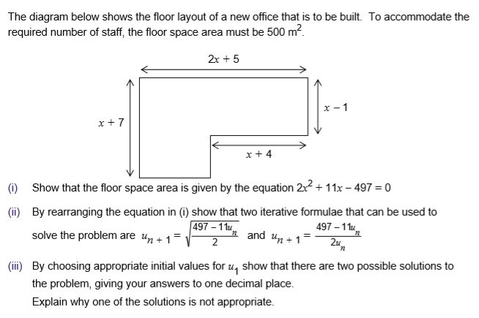
Exam Question 3

