Slide 1















Dual coding symbols:
Practise
Explain
Organise
Big Question
Reflect
Present
Compare
Evaluate
Activate
Discuss
Predict
Connect
Summarise
Recall
Vocabulary

Slide 2










Editable reading ruler
Every child in an Archway school will become a fluent reader
 | RETRIEVE the words or phrases you need from the text | DECODE the words or phrase to address a breakdown | CONNECT with words or phrases you know from the text or your memory | VISUALISE the images in as much detail as possible | SUMMARISE the main ideas of the text in a few words | INFER meanings that might be within the text | PREDICT what might happen next using details from the text | EXAMINE how the writer uses words to construct meaning
 | ASK THOUGHTFUL QUESTIONS TO HELP YOU UNDERSTAND THE TEXT

Slide 3
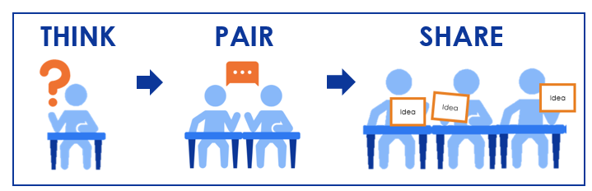
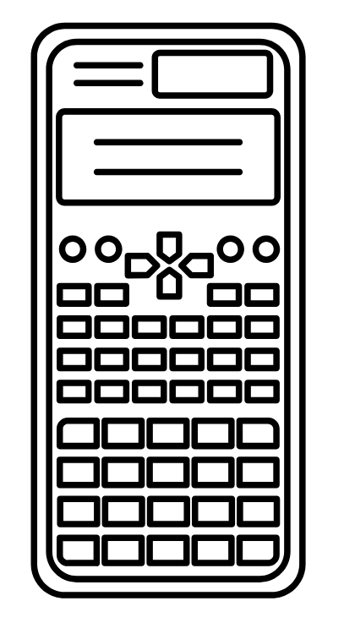




A
B

Slide 4
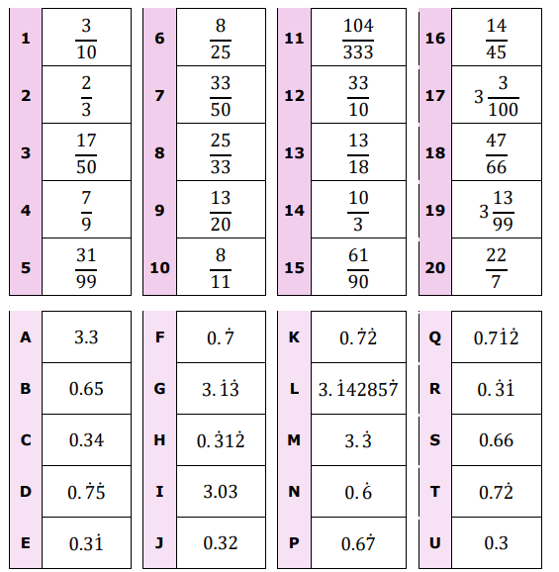
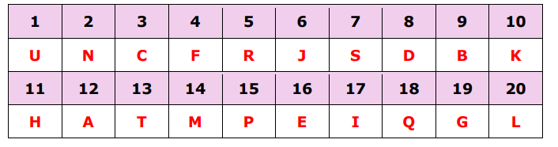
Writing fractions as recurring decimals
Match the fraction to the decimal
Can you tell which fractions are equivalent recurring decimals without a calculator?

Slide 5
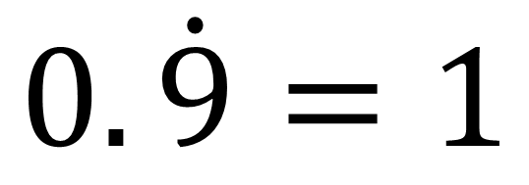
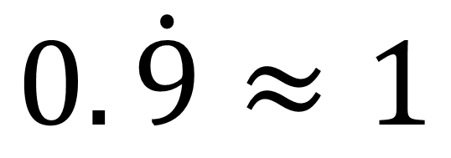
$$0.\dot{9}≈1$$
$$0.\dot{9}=1$$
Which statement is correct? How do you know?

Slide 6
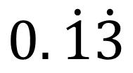
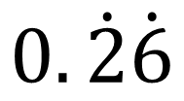
I DO:
WE DO:
Convert to a fraction in its simplest form
Convert to a fraction in its simplest form
$$0.\dot{2}\dot{6}$$
$$0.\dot{1}\dot{3}$$

Slide 7
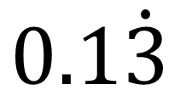
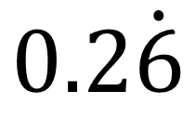
I DO:
WE DO:
Convert to a fraction in its simplest form
Convert to a fraction in its simplest form
$$0.2\dot{6}$$
$$0.1\dot{3}$$

Slide 8
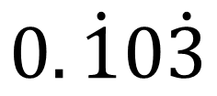
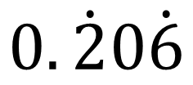
I DO:
WE DO:
Convert to a fraction in its simplest form
Convert to a fraction in its simplest form
$$0.\dot{2}0\dot{6}$$
$$0.\dot{1}0\dot{3}$$

Slide 9
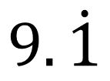
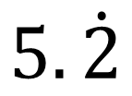
I DO:
WE DO:
Convert to a fraction in its simplest form
Convert to a fraction in its simplest form
$$5.\dot{2}$$
$$9.\dot{1}$$

Slide 10
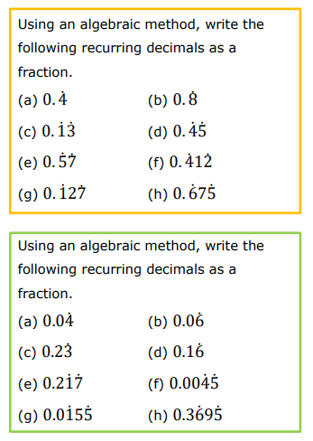
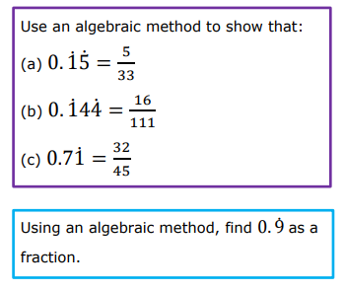

Slide 11
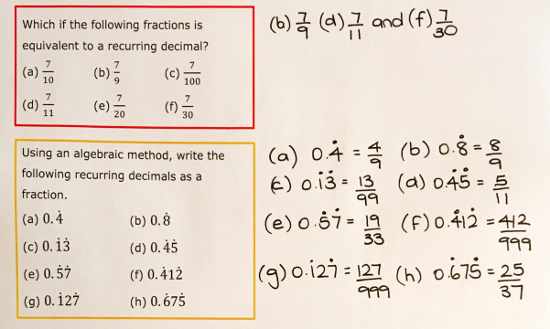
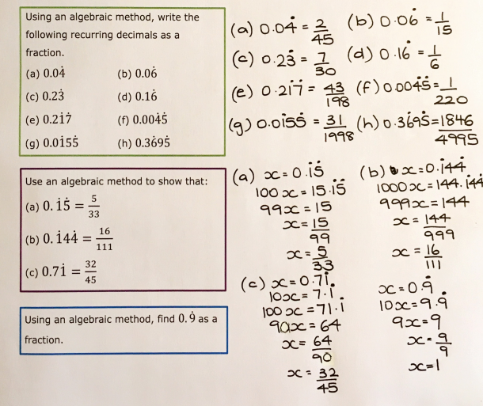

Slide 12
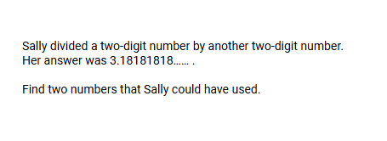
Exam Question 1

Slide 13
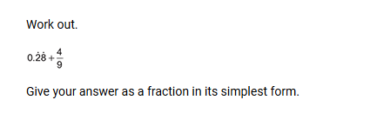
Exam Question 2

Slide 14
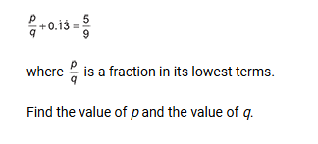
Exam Question 3

