Slide 1















Dual coding symbols:
Practise
Explain
Organise
Big Question
Reflect
Present
Compare
Evaluate
Activate
Discuss
Predict
Connect
Summarise
Recall
Vocabulary

Slide 2










Editable reading ruler
Every child in an Archway school will become a fluent reader
 | RETRIEVE the words or phrases you need from the text | DECODE the words or phrase to address a breakdown | CONNECT with words or phrases you know from the text or your memory | VISUALISE the images in as much detail as possible | SUMMARISE the main ideas of the text in a few words | INFER meanings that might be within the text | PREDICT what might happen next using details from the text | EXAMINE how the writer uses words to construct meaning
 | ASK THOUGHTFUL QUESTIONS TO HELP YOU UNDERSTAND THE TEXT

Slide 3






A
B

Slide 4
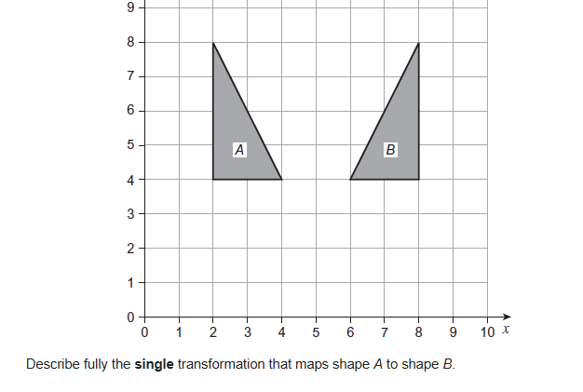
Reflecting Functions
Notes:
The sky is the limit

Slide 5
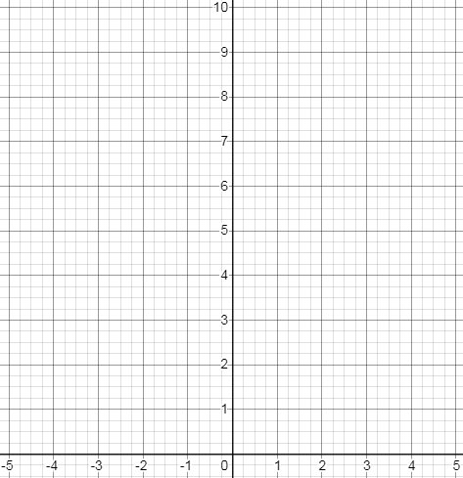
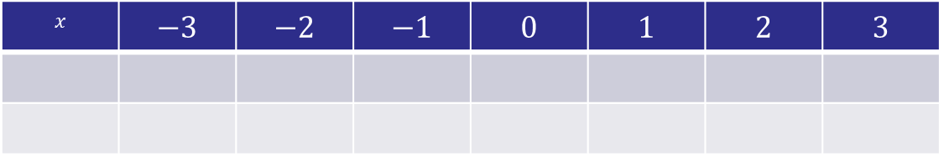
$$x$$ | $$−3$$ | $$−2$$ | $$−1$$ | $$0$$ | $$1$$ | $$2$$ | $$3$$
Notes:
Print out these axes and put in plastic wallets (using these from the previous lesson)

Slide 6






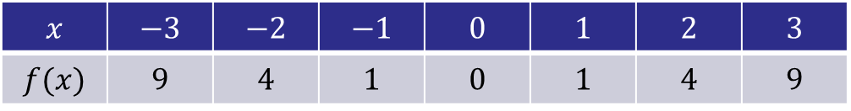

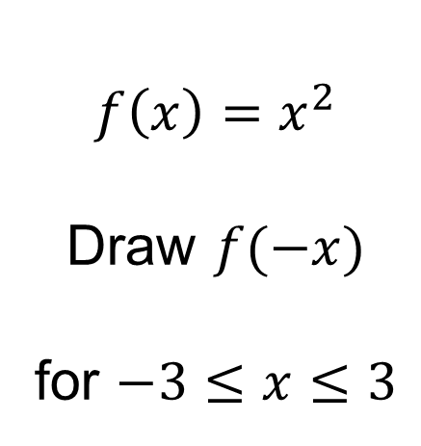

$$f\left(x\right)=x^{2}$$
Draw $f(−x)$
for $−3≤x≤3$
What do you notice?
$$x$$ | $$−3$$ | $$−2$$ | $$−1$$ | $$0$$ | $$1$$ | $$2$$ | $$3$$
$$f(x)$$ | $$9$$ | $$4$$ | $$1$$ | $$0$$ | $$1$$ | $$4$$ | $$9$$
$$−x$$
$$3$$
$$2$$
$$1$$
$$0$$
$$−1$$
$$−2$$
$$−3$$
?
?
?
?
?
?
?

Slide 7
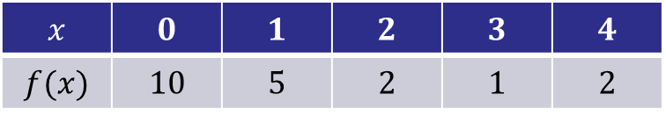
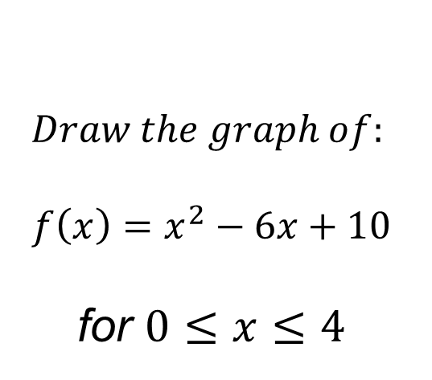
$$Draw the graph of:$$
$$f\left(x\right)=x^{2}−6x+10$$
for $0≤x≤4$
$$x$$ | $$0$$ | $$1$$ | $$2$$ | $$3$$ | $$4$$
$$f(x)$$ | $$10$$ | $$5$$ | $$2$$ | $$1$$ | $$2$$
?
?
?
?
?

Slide 8


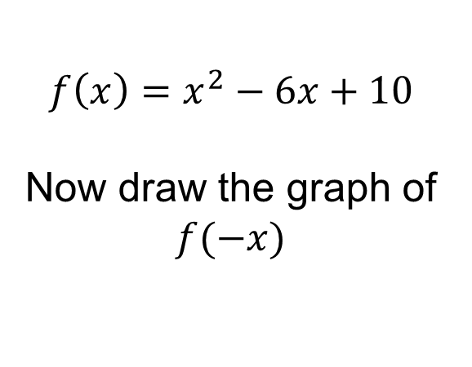
$$f\left(x\right)=x^{2}−6x+10$$
Now draw the graph of $f(−x)$
$$0≤−x≤4$$
How else can we write this inequality?
$$−4≤x≤0$$

Slide 9


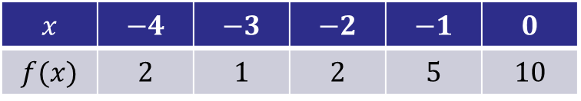
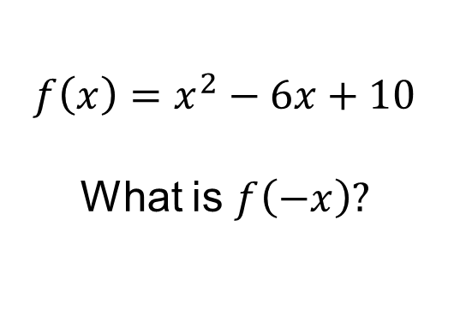
$$f\left(x\right)=x^{2}−6x+10$$
What is $f\left(−x\right)?$
$$f\left(−x\right)={(−x)}^{2}−6(−x)+10$$
$$f\left(−x\right)=x^{2}+6x+10$$
$$x$$ | $$−4$$ | $$−3$$ | $$−2$$ | $$−1$$ | $$0$$
$$f(x)$$ | $$2$$ | $$1$$ | $$2$$ | $$5$$ | $$10$$
?
?
?
?
?

Slide 10


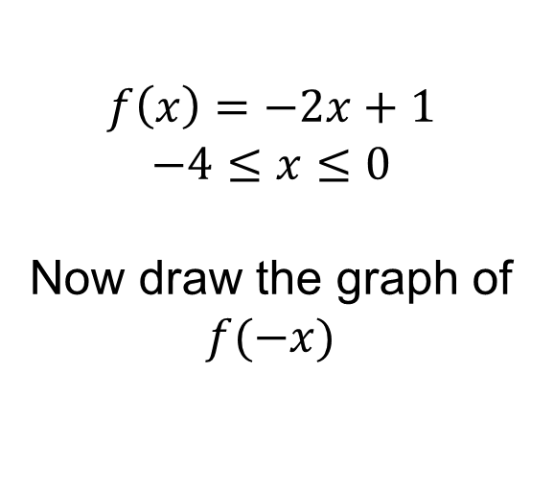
$$f\left(x\right)=−2x+1$$
$$−4≤x≤0$$
Now draw the graph of $f(−x)$
$$−4≤−x≤0$$
How else can we write this inequality?
$$0≤x≤4$$

Slide 11


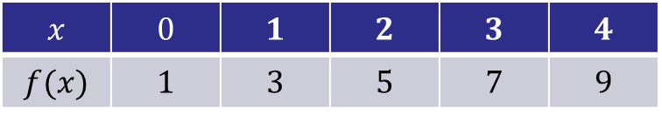

$$f\left(x\right)=−2x+1$$
What is $f\left(−x\right)?$
$$f\left(−x\right)=−2\left(−x\right)+1$$
$$f\left(−x\right)=2x+1$$
$$x$$ | $$0$$ | $$1$$ | $$2$$ | $$3$$ | $$4$$
$$f(x)$$ | $$1$$ | $$3$$ | $$5$$ | $$7$$ | $$9$$
?
?
?
?
?

Slide 12
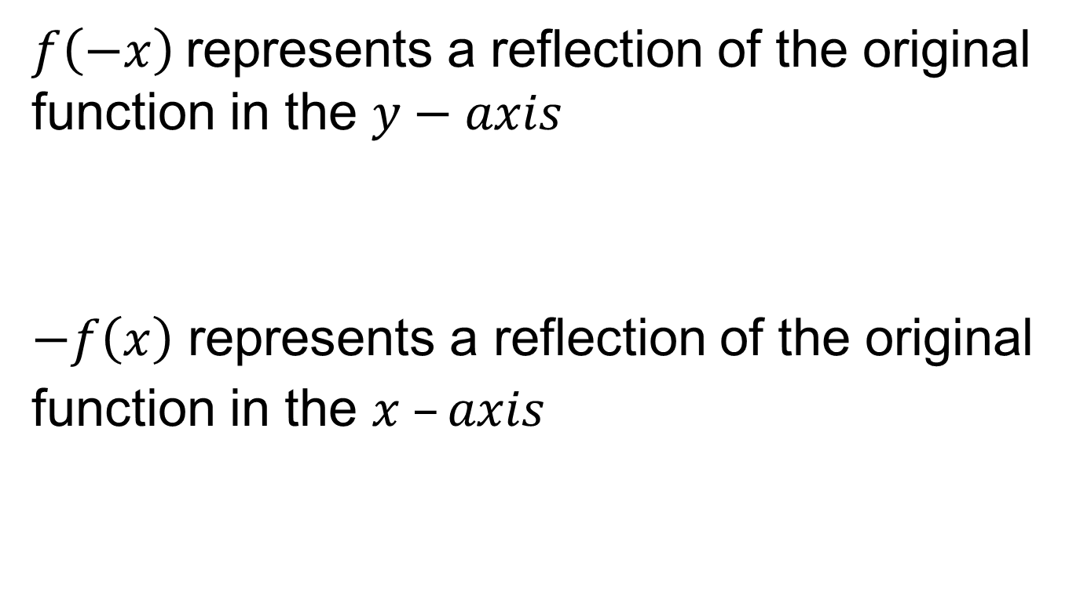
Reflecting Functions
$f\left(−x\right)$represents a reflection of the original function in the $y−axis$
$−f\left(x\right)$ represents a reflection of the original function in the $x –axis$

Slide 13
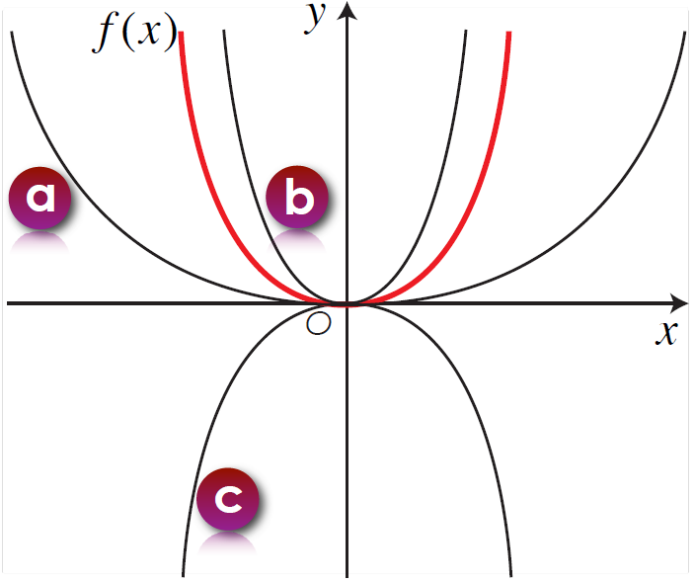
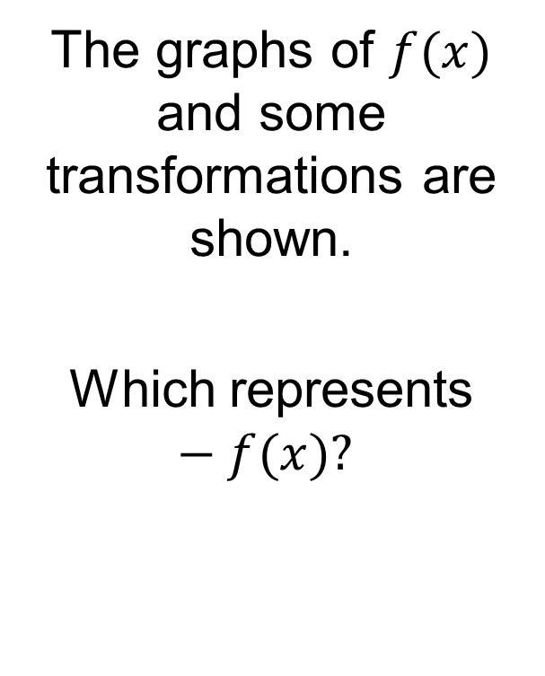
On your whiteboards:
The graphs of $f(x)$ and some transformations are shown.
Which represents $−f(x)?$

Slide 14
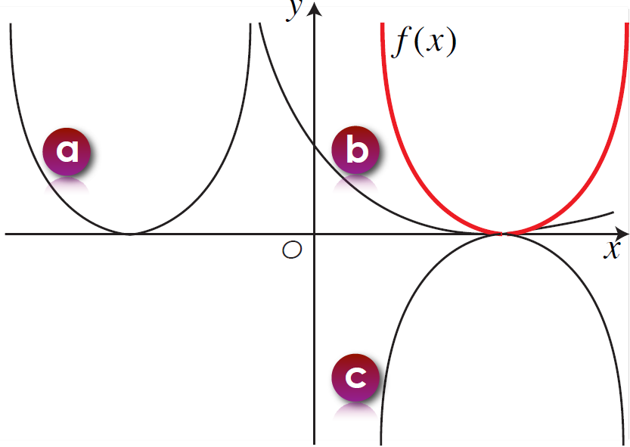
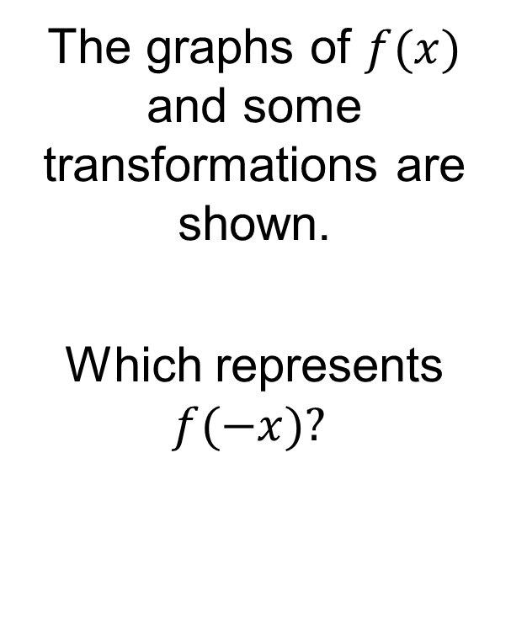
On your whiteboards:
The graphs of $f(x)$ and some transformations are shown.
Which represents $f(−x)?$

Slide 15
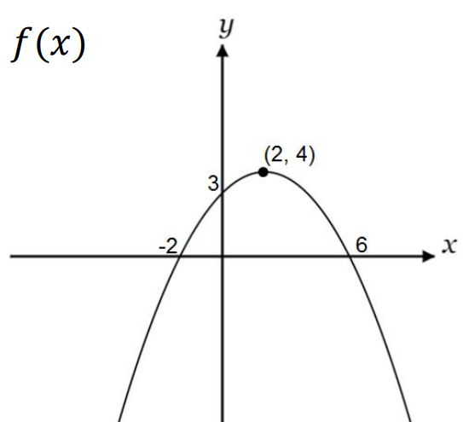
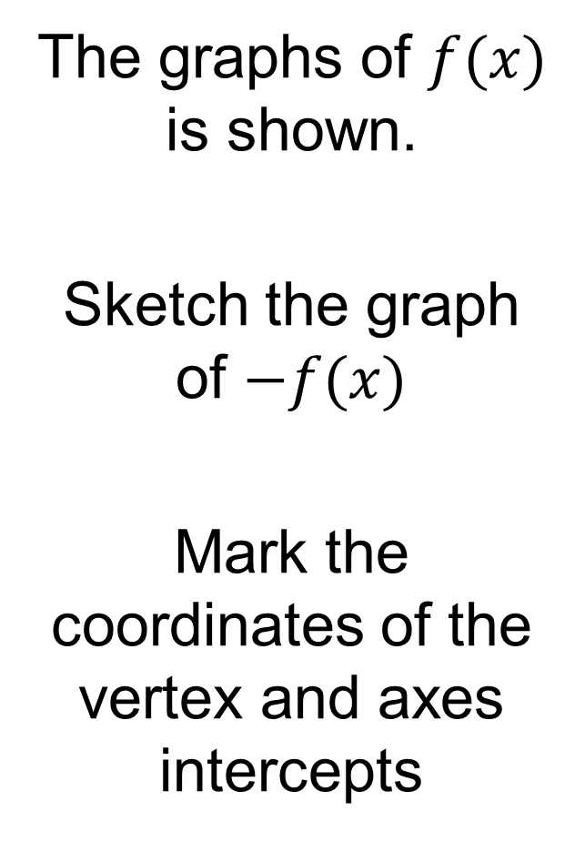
On your whiteboards:
The graphs of $f(x)$ is shown.
Sketch the graph of $−f(x)$
Mark the coordinates of the vertex and axes intercepts

Slide 16
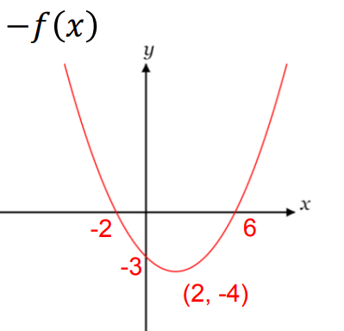
On your whiteboards:
The graphs of $f(x)$ is shown.
Sketch the graph of $−f(x)$
Mark the coordinates of the vertex and axes intercepts

Slide 17
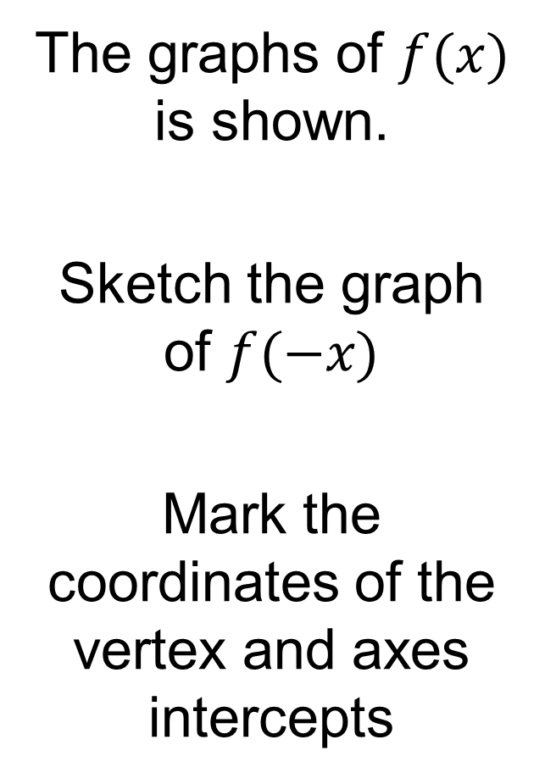
On your whiteboards:
The graphs of $f(x)$ is shown.
Sketch the graph of $f(−x)$
Mark the coordinates of the vertex and axes intercepts

Slide 18
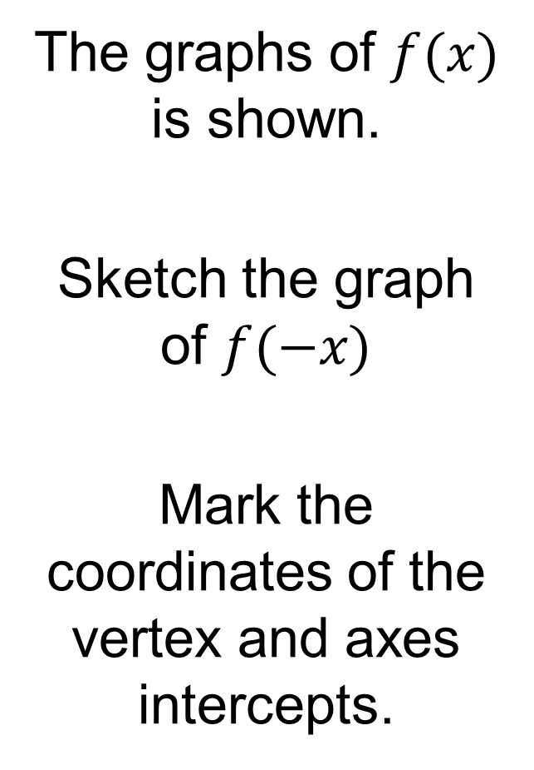
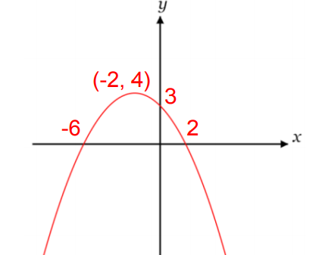
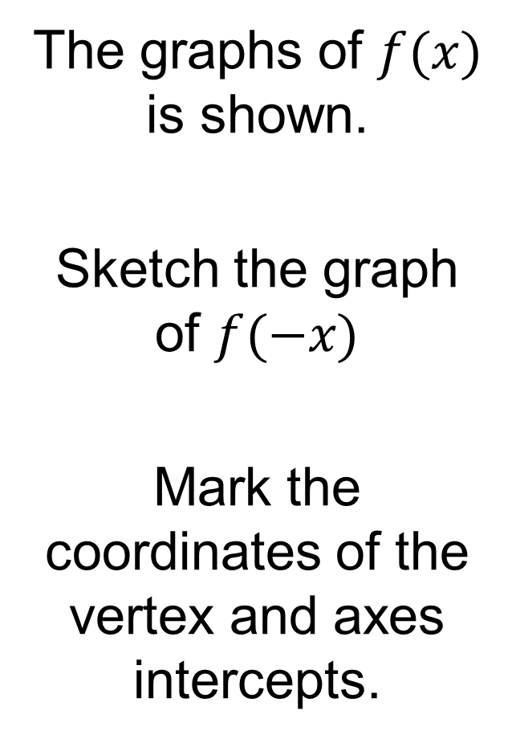
On your whiteboards:
The graphs of $f(x)$ is shown.
Sketch the graph of $f(−x)$
Mark the coordinates of the vertex and axes intercepts.

Slide 19
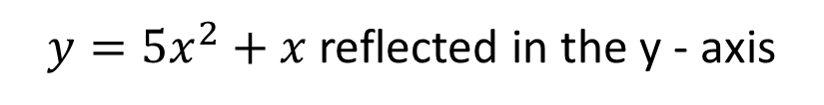
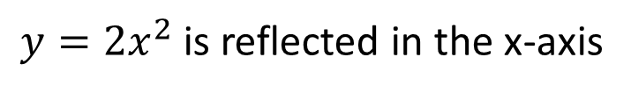
I DO:
WE DO:
$y={2x}^{2}$ is reflected in the x-axis
$y={5x}^{2}+x$ reflected in the y - axis
Work out the equation of the new curve
Work out the equation of the new curve

Slide 20
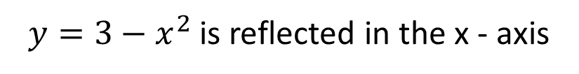
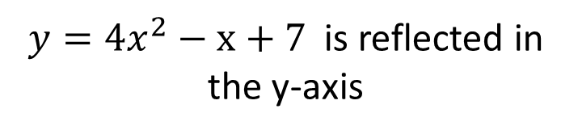
I DO:
WE DO:
$y={4x}^{2}−x+7$ is reflected in the y-axis
$y=3−x^{2}$ is reflected in the x - axis
Work out the equation of the new curve
Work out the equation of the new curve

Slide 21
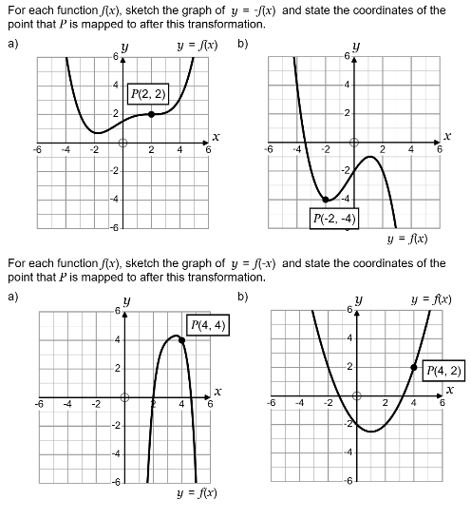
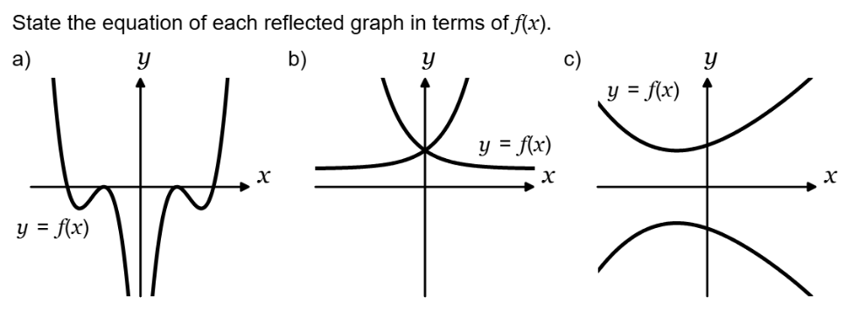

Slide 22
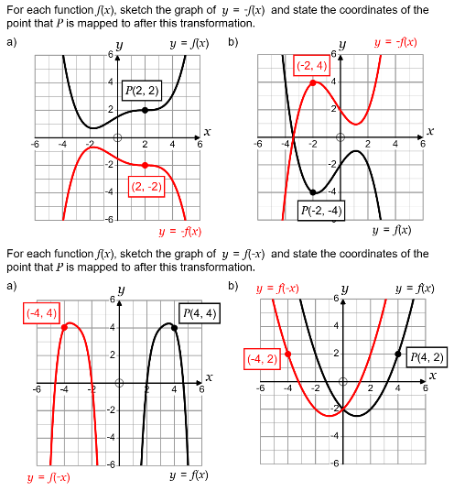
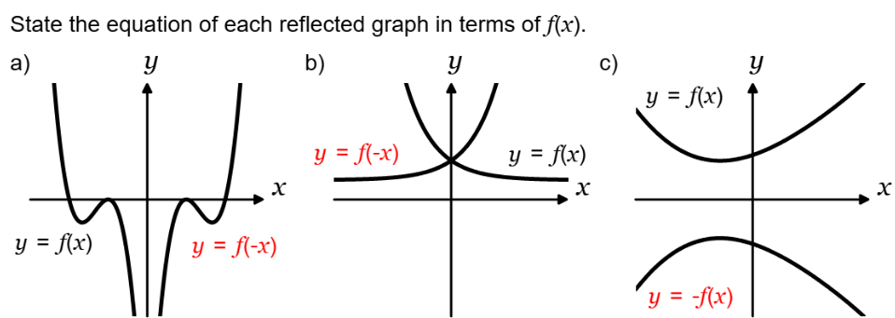

Slide 23
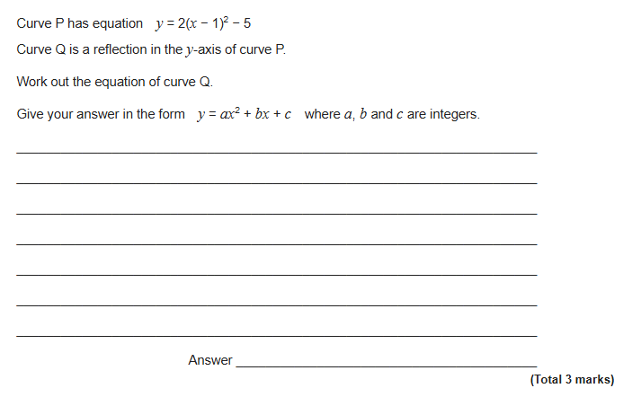
Exam Question 1
Notes:
1.12

Slide 24
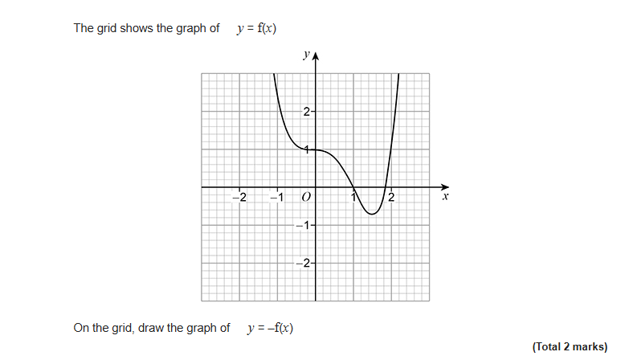
Exam Question 2
Notes:
1.12

Slide 25
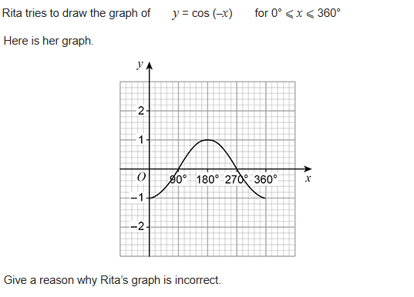
Exam Question 3
Notes:
From Further Maths

Slide 26
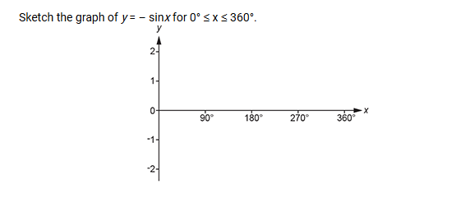
Exam Question 4
Notes:
From Further Maths

