Slide 1















Dual coding symbols:
Practise
Explain
Organise
Big Question
Reflect
Present
Compare
Evaluate
Activate
Discuss
Predict
Connect
Summarise
Recall
Vocabulary

Slide 2










Editable reading ruler
Every child in an Archway school will become a fluent reader
 | RETRIEVE the words or phrases you need from the text | DECODE the words or phrase to address a breakdown | CONNECT with words or phrases you know from the text or your memory | VISUALISE the images in as much detail as possible | SUMMARISE the main ideas of the text in a few words | INFER meanings that might be within the text | PREDICT what might happen next using details from the text | EXAMINE how the writer uses words to construct meaning
 | ASK THOUGHTFUL QUESTIONS TO HELP YOU UNDERSTAND THE TEXT

Slide 3






A
B

Slide 4
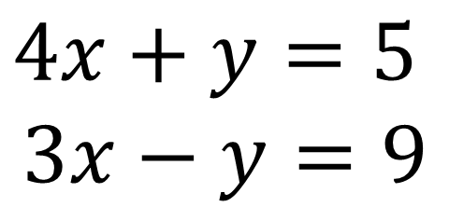

Solving simultaneous equations graphically
SOLVE
SOLVE
$$4x+y=5$$
$$3x−y=9$$
$$x+4y=18$$
$$3x+4y=14$$
Notes:
7ac124_c111bd483c994fa8ac534e6dde817d1e.pdf

Slide 5
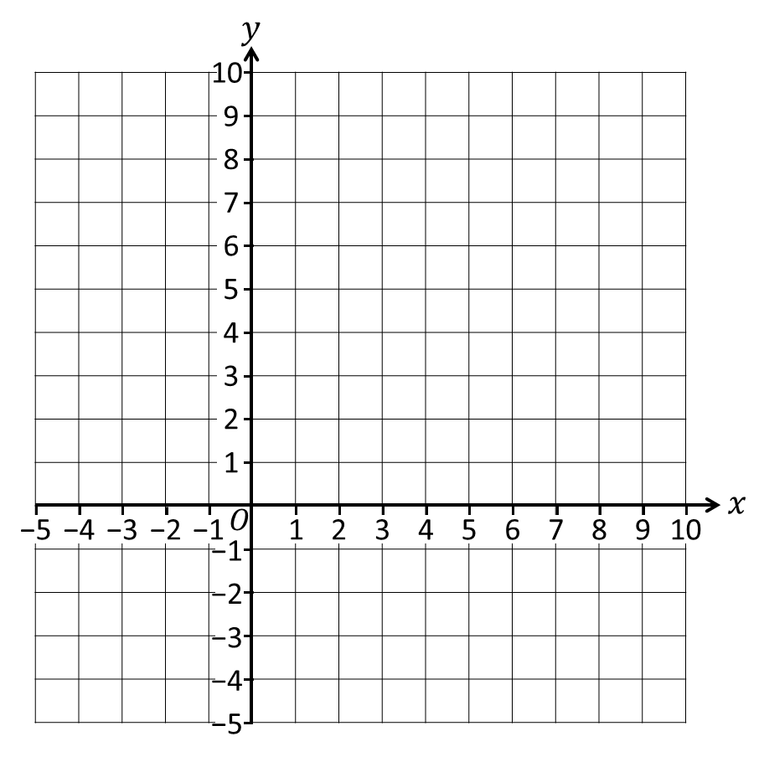

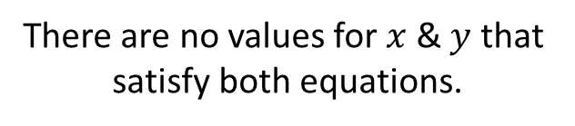

Solve these simultaneous equations
by graphing.
Parallel lines will
never intersect.
$$y=2x−3$$
$$y=2x+2$$
What’s the problem?
There are no values for $x$ & $y$ that
satisfy both equations.
There is no solution.

Slide 6
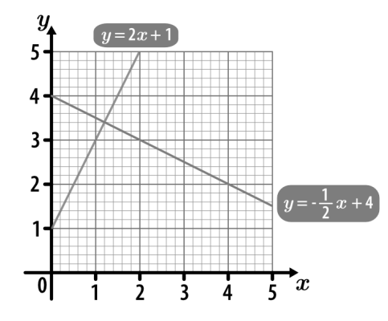
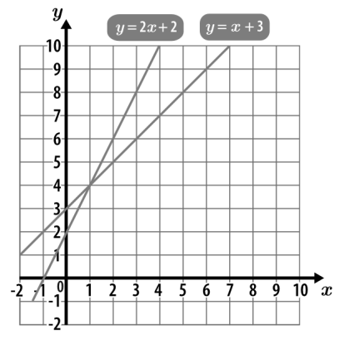
I DO:
WE DO:
Use the graph to solve the simultaneous equations
Use the graph to solve the simultaneous equations

Slide 7
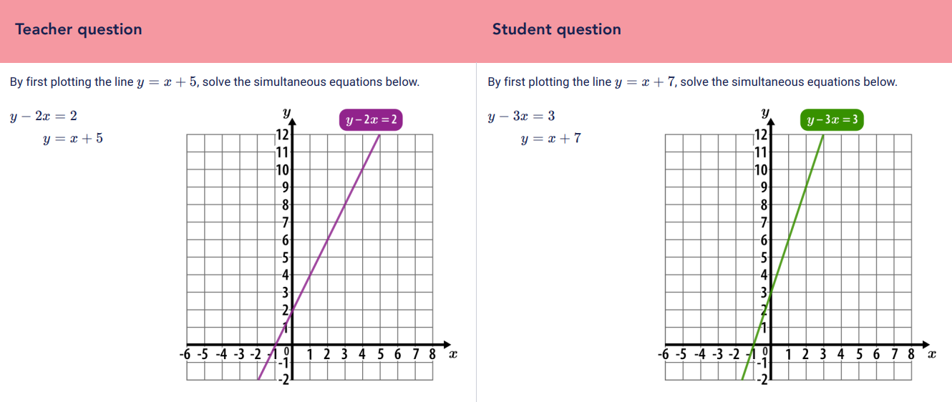
Notes:
From Sparx Maths Resources

