Slide 1















Dual coding symbols:
Practise
Explain
Organise
Big Question
Reflect
Present
Compare
Evaluate
Activate
Discuss
Predict
Connect
Summarise
Recall
Vocabulary

Slide 2










Editable reading ruler
Every child in an Archway school will become a fluent reader
 | RETRIEVE the words or phrases you need from the text | DECODE the words or phrase to address a breakdown | CONNECT with words or phrases you know from the text or your memory | VISUALISE the images in as much detail as possible | SUMMARISE the main ideas of the text in a few words | INFER meanings that might be within the text | PREDICT what might happen next using details from the text | EXAMINE how the writer uses words to construct meaning
 | ASK THOUGHTFUL QUESTIONS TO HELP YOU UNDERSTAND THE TEXT

Slide 3






A
B

Slide 4
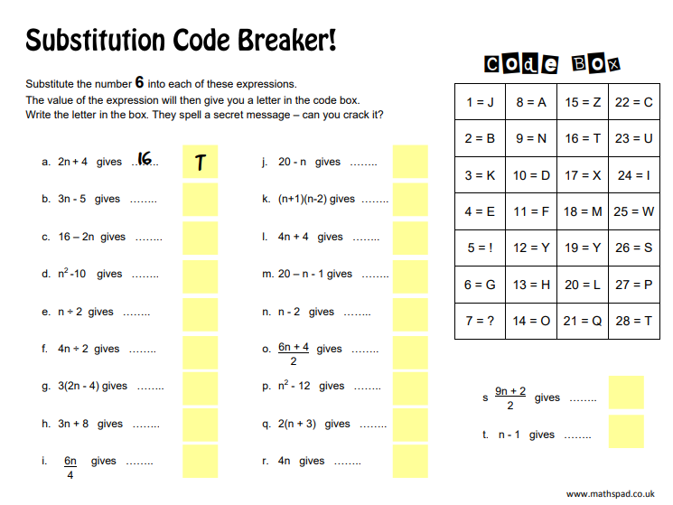
  Substituting into Functions
Notes:
The sky is the limit

Slide 5
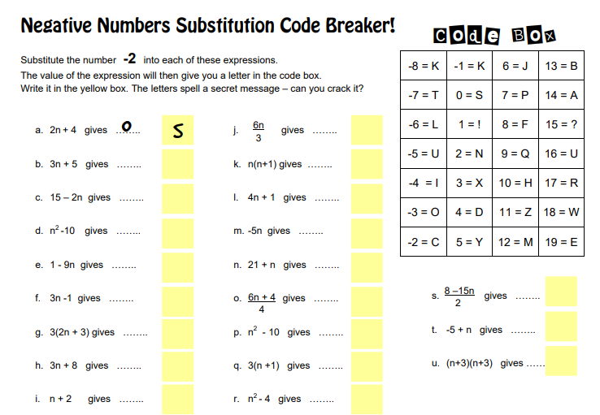
Notes:
Skeletons in the closet

Slide 6
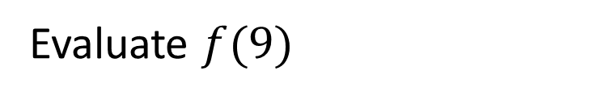
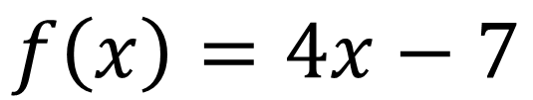
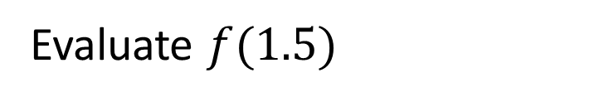
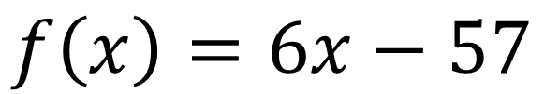
I DO:
WE DO:
Given that:
Given that:
$$f\left(x\right)=4x−7$$
$$f\left(x\right)=6x−57$$
Evaluate $f(9)$
Evaluate $f(1.5)$

Slide 7
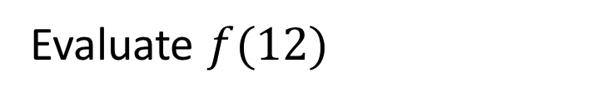
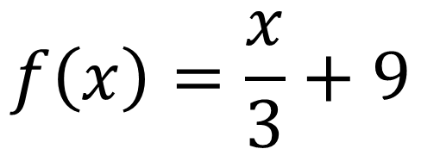

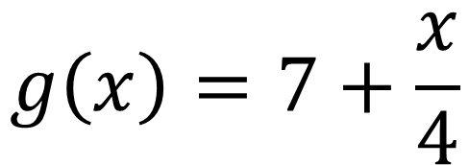
I DO:
WE DO:
Given that:
Given that:
$$f\left(x\right)=\frac{x}{3}+9$$
$$g\left(x\right)=7+\frac{x}{4}$$
Evaluate $f(12)$
Evaluate $g(20)$

Slide 8
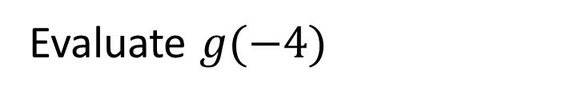
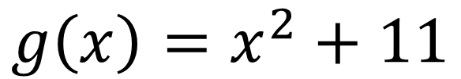
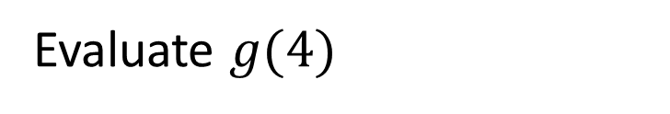
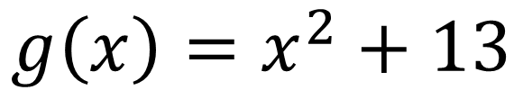
I DO:
WE DO:
Given that:
Given that:
$$g\left(x\right)=x^{2}+11$$
$$g\left(x\right)=x^{2}+13$$
Evaluate $g(−4)$
Evaluate $g(4)$

Slide 9
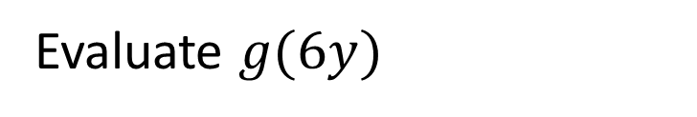
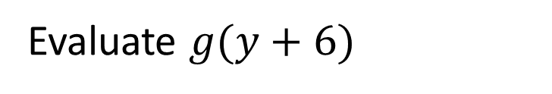
I DO:
WE DO:
Given that:
Given that:
$$g\left(x\right)=x^{2}+11$$
$$g\left(x\right)=x^{2}+13$$
Evaluate $g(6y)$
Evaluate $g(y+6)$

Slide 10
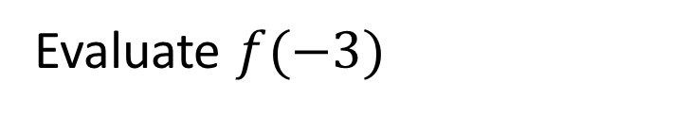
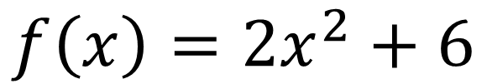
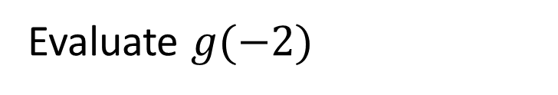
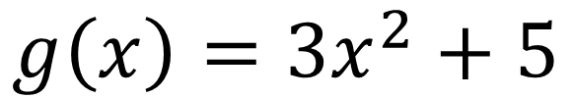
I DO:
WE DO:
Given that:
Given that:
$$f\left(x\right)=2x^{2}+6$$
$$g\left(x\right)={3x}^{2}+5$$
Evaluate $f(−3)$
Evaluate $g(−2)$

Slide 11
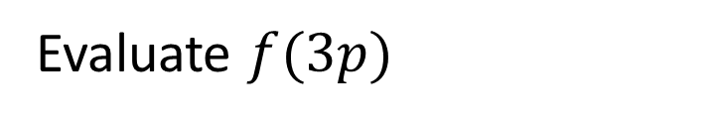
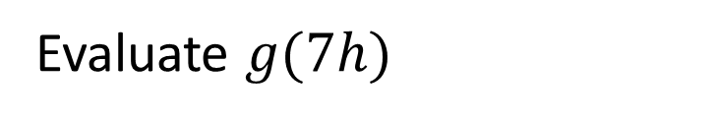
I DO:
WE DO:
Given that:
Given that:
$$f\left(x\right)=2x^{2}+6$$
$$g\left(x\right)={3x}^{2}+5$$
Evaluate $f(3p)$
Evaluate $g(7h)$

Slide 12
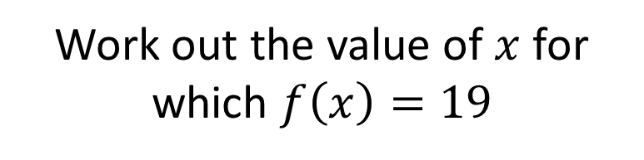
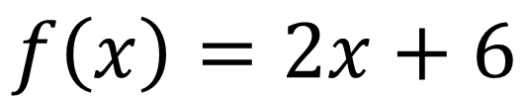
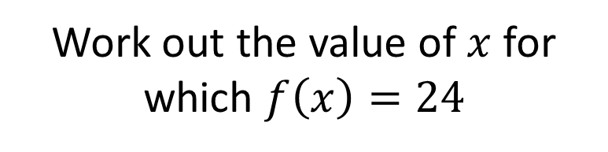
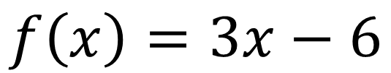
I DO:
WE DO:
$$f\left(x\right)=2x+6$$
$$f\left(x\right)=3x−6$$
Work out the value of $x$ for which $f\left(x\right)=19$
Work out the value of $x$ for which $f\left(x\right)=24$

Slide 13
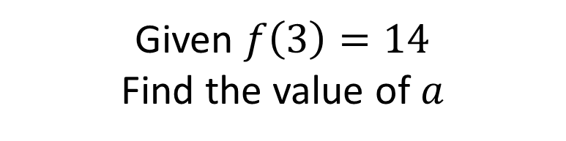
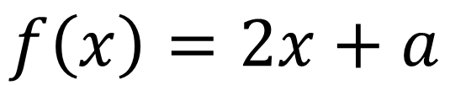
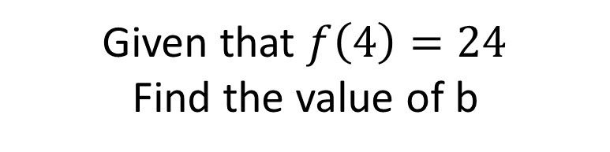
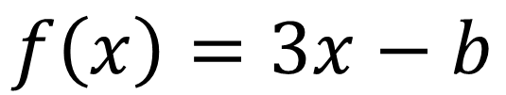
I DO:
WE DO:
$$f\left(x\right)=2x+a$$
$$f\left(x\right)=3x−b$$
Given $f\left(3\right)=14$
Find the value of $a$
Given that $f\left(4\right)=24$
Find the value of b

Slide 14
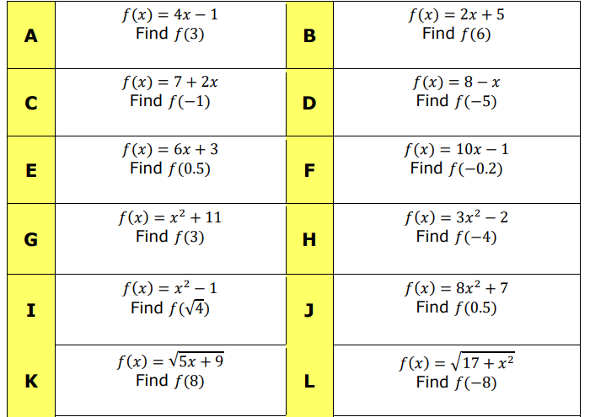
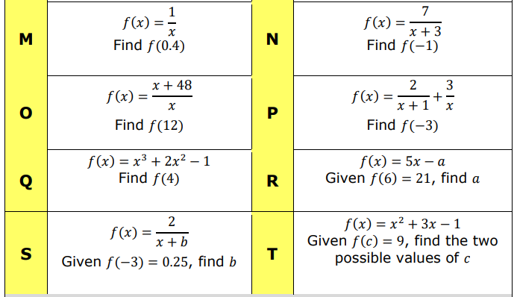
CRACK THE CODE: Add your answers together to get the three digit code!

Slide 15
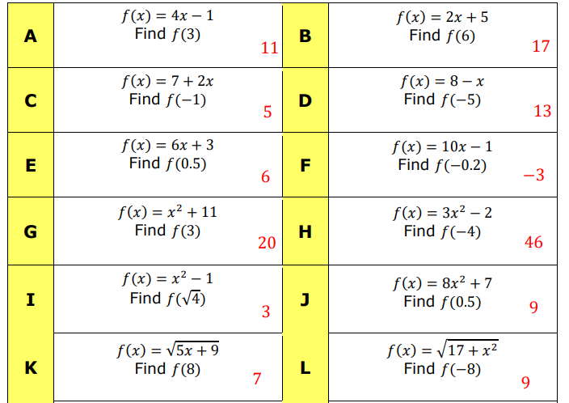
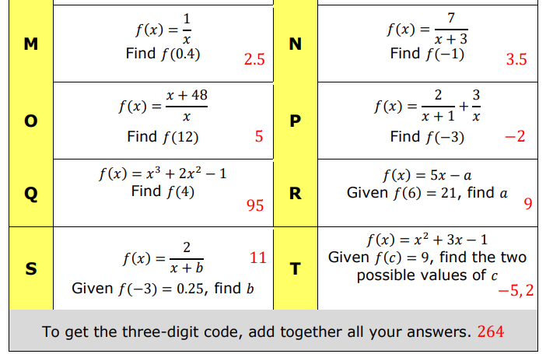

Slide 16
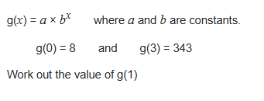
Exam Question 1
Notes:
1.12

Slide 17
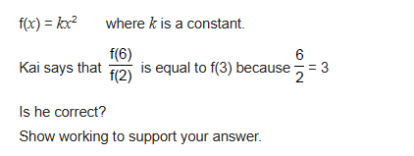
Exam Question 2
Notes:
From Further Maths

