Slide 1















Dual coding symbols:
Practise
Explain
Organise
Big Question
Reflect
Present
Compare
Evaluate
Activate
Discuss
Predict
Connect
Summarise
Recall
Vocabulary

Slide 2










Editable reading ruler
Every child in an Archway school will become a fluent reader
 | RETRIEVE the words or phrases you need from the text | DECODE the words or phrase to address a breakdown | CONNECT with words or phrases you know from the text or your memory | VISUALISE the images in as much detail as possible | SUMMARISE the main ideas of the text in a few words | INFER meanings that might be within the text | PREDICT what might happen next using details from the text | EXAMINE how the writer uses words to construct meaning
 | ASK THOUGHTFUL QUESTIONS TO HELP YOU UNDERSTAND THE TEXT

Slide 3






A
B

Slide 4
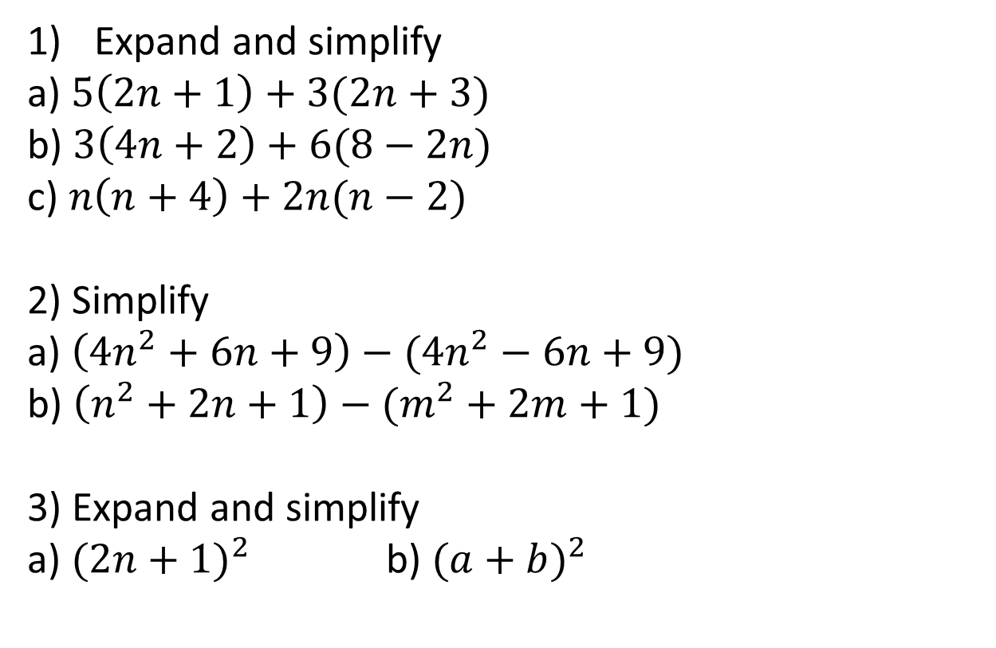
Expand and simplify
a) $5\left(2n+1\right)+3(2n+3)$
b) $3\left(4n+2\right)+6(8−2n)$
c) $n\left(n+4\right)+2n(n−2)$
2) Simplify
a) $\left(4n^{2}+6n+9\right)−({4n}^{2}−6n+9)$
b) $\left(n^{2}+2n+1\right)−(m^{2}+2m+1)$
3) Expand and simplify
a) ${(2n+1)}^{2}$ b) ${(a+b)}^{2}$

Slide 5






Expand and simplify
a) $5\left(2n+1\right)+3(2n+3)$
b) $3\left(4n+2\right)+6(8−2n)$
c) $n\left(n+4\right)+2n(n−2)$
2) Simplify
a) $\left(4n^{2}+6n+9\right)−({4n}^{2}−6n+9)$
2) b) $\left(n^{2}+2n+1\right)−(m^{2}+2m+1)$
3) Expand and simplify
a) ${(2n+1)}^{2}$ b) ${(a+b)}^{2}$
$$n^{2}+2n+1−m^{2}−2m−1$$
$$10n+5+6n+9≡16n+14$$
$${≡n}^{2}−{ m}^{2}+2n−2m+1−1$$
$${≡n}^{2}−{ m}^{2}+2n−2m$$
$$12n+6+48−12n≡54$$
$$n^{2}+4n+{2n}^{2}−4n≡{3n}^{2}$$
$$≡(2n+1)(2n+1)$$
$$≡(a+b)(a+b)$$
$${4n}^{2}+6n+9−{4n}^{2}+6n−9$$
$$≡{4n}^{2}+4n+1$$
$$≡a^{2}+b^{2}+2ab$$
$${≡4n}^{2}−{ 4n}^{2}+6n+6n+9−9$$

Slide 6







I do, we do
Show that $6n+4$ is divisible by 2.
Show that $15n+20$ is divisible by 5.
$$6n+4$$
$$15n+20$$
Factorise
Factorise
$$2(3n+2)$$
$$5(3n+4)$$
Make sure the divisor is on the outside of the bracket and everything else is inside the brackets.

Slide 7



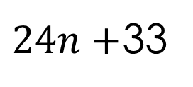






I do, we do
Show that $2(n+3)+6(n+3)$ is divisible by 4.
Show that $6(n+4)+9(2n+1)$ is divisible by 3.
$$2(n+3)+6(n+3)$$
$$6(n+4)+9(2n+1)$$
Expand
Expand
$$2n+6+6n+18$$
$$6n+24+18n+9$$
Simplify
Simplify
$$8n+24$$
$24n+$33
Factorise
Factorise
$$4(2n+6)$$
$$3(8n+11)$$
Make sure the divisor is on the outside of the bracket and everything else is inside the brackets.
Make sure the divisor is on the outside of the bracket and everything else is inside the brackets.

Slide 8
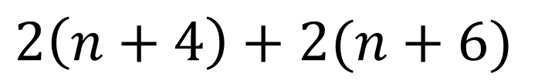



On your whiteboard prove
$$2\left(n+4\right)+2(n+6)$$
is divisible by 4
$$2n+8+2n+12$$
$$4n+20$$
$$4(n+5)$$

Slide 9




On your whiteboard prove
$$6\left(2n−1\right)+4(n−3)$$
is divisible by 2
$$12n−6+4n−12$$
$$16n−18$$
$$2(8n−9)$$

Slide 10
On your whiteboard prove
$$2\left(n+4\right)+2(n+6)$$
is divisible by 4
$$2n+8+2n+12$$
$$4n+20$$
$$4(n+5)$$

Slide 11
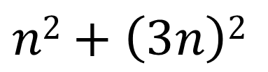



On your whiteboard prove
$$n2+\left(3n\right)2$$
is divisible by 5
$$n2+9n2$$
$$10n2$$
$$5(2n2)$$

Slide 12
Prove that when n is an integer (n + 8)² − (n + 2)² is a multiple of 12
1
Take all numbers of the form (n + 8)² − (n + 2)² where n is an integer.
2
These can also be written n² + 8n + 8n + 64 − (n² + 2n + 2n + 4).
3
≡ n² + 16n + 64 − (n² + 4n + 4)
4
≡ n² + 16n + 64 − n² − 4n − 4
5
≡ 12n + 60
6
≡ 12(n + 5) this is an integer multiplied by 12 so must be a multiple of 12.
7
∴ all numbers of the form (n + 8)² − (n + 2)² where n is an integer are multiples of 12.

Slide 13
On your whiteboard
Prove that if n is an integer then
(2n + 6)² − (2n + 3)² is a multiple of 3
≡ 4n² + 12n + 12n + 36 − (4n² + 6n + 6n + 9)
≡ 4n² + 24n + 36 − (4n² + 12n + 9)
≡ 4n² + 24n + 36 − 4n² − 12n − 9
≡ 12n + 27
≡ 3(4n + 9).
∴ all numbers of the form (2n + 6)² − (2n + 3)² where n is an integer are multiples of 3.

Slide 14
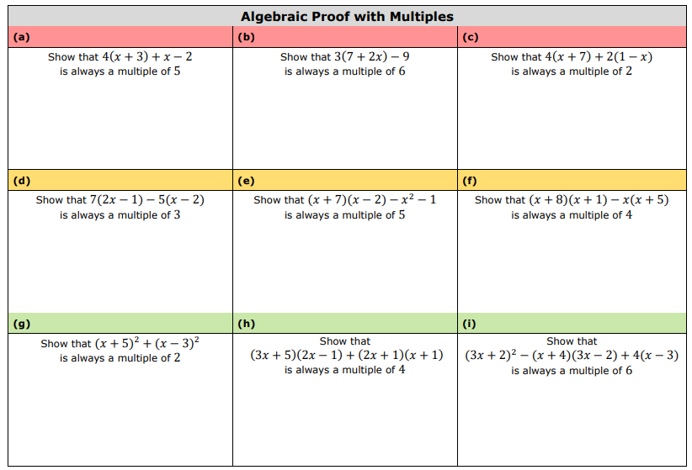
2

Slide 15
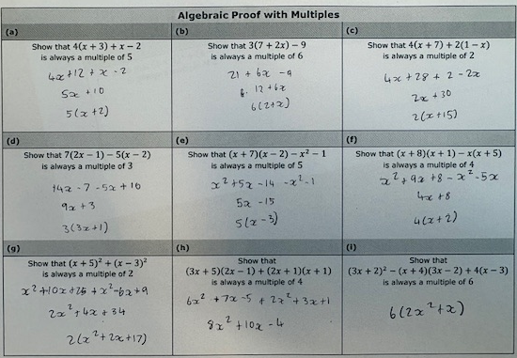

2
$$2(4x^{2}+5x−2)$$

