Slide 1















Dual coding symbols:
Practise
Explain
Organise
Big Question
Reflect
Present
Compare
Evaluate
Activate
Discuss
Predict
Connect
Summarise
Recall
Vocabulary

Slide 2










Editable reading ruler
Every child in an Archway school will become a fluent reader
 | RETRIEVE the words or phrases you need from the text | DECODE the words or phrase to address a breakdown | CONNECT with words or phrases you know from the text or your memory | VISUALISE the images in as much detail as possible | SUMMARISE the main ideas of the text in a few words | INFER meanings that might be within the text | PREDICT what might happen next using details from the text | EXAMINE how the writer uses words to construct meaning
 | ASK THOUGHTFUL QUESTIONS TO HELP YOU UNDERSTAND THE TEXT

Slide 3






A
B

Slide 4
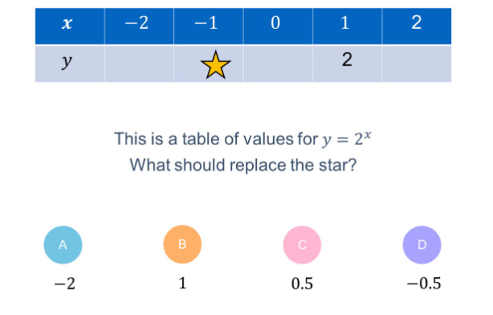

Slide 5
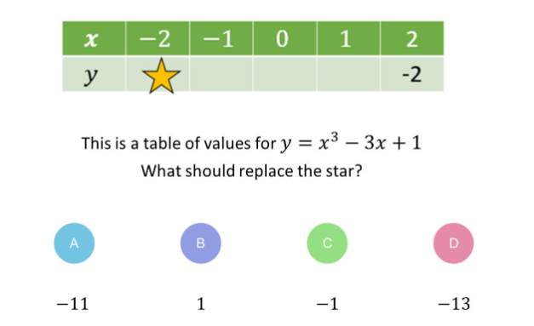

Slide 6
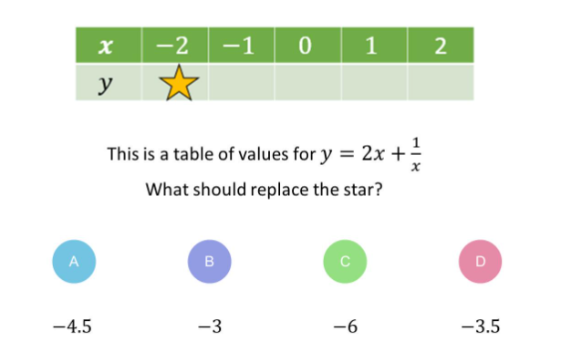

Slide 7
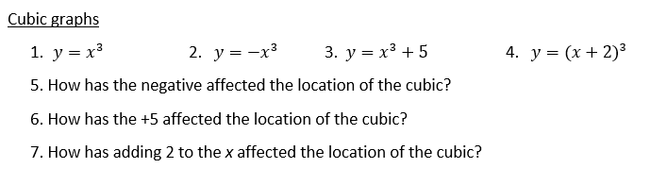
Task
Go to https://www.desmos.com/calculator
Use the graphing software to see the graphs and sketch them into your books. Label each graph with the equation and use a ruler and pencil for the axes then answer the questions about how the graphs are transformed compared to each question 1.

Slide 8
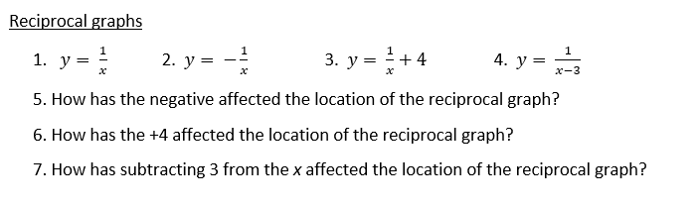

Slide 9
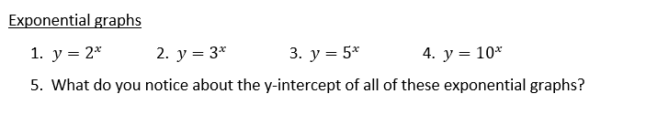

Slide 10
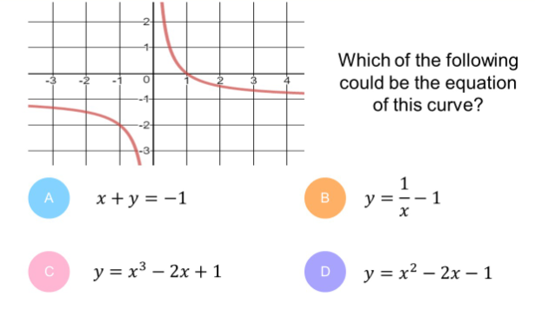

Slide 11
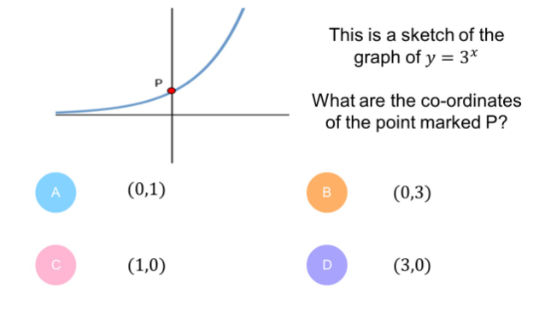

Slide 12
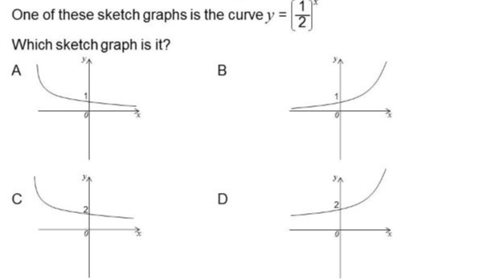

Slide 13
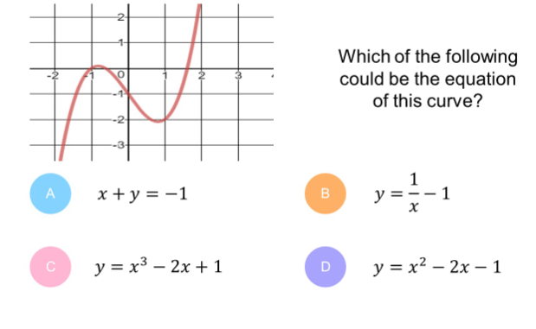

Slide 14
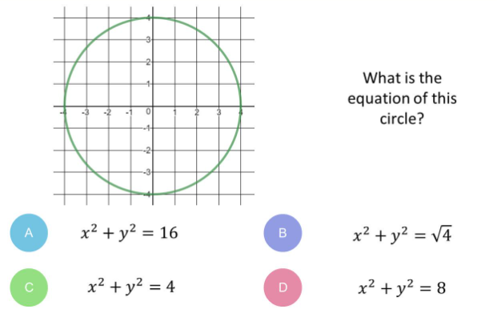

Slide 15
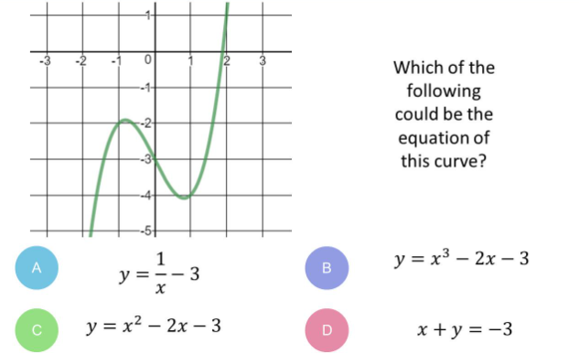

Slide 16
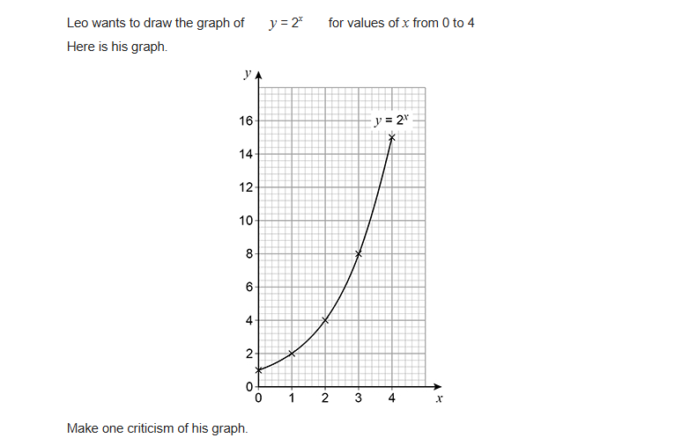
Exam Question 1
Notes:
1.12

Slide 17
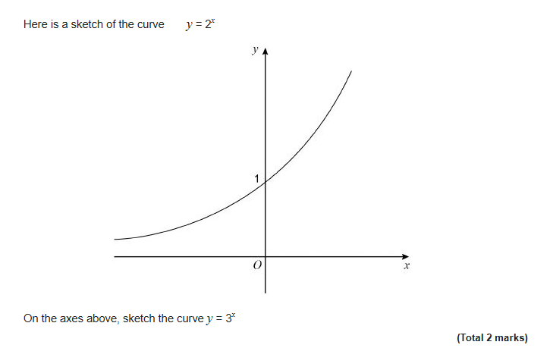
Exam Question 2
Notes:
From Further Maths

