Slide 1















Dual coding symbols:
Practise
Explain
Organise
Big Question
Reflect
Present
Compare
Evaluate
Activate
Discuss
Predict
Connect
Summarise
Recall
Vocabulary

Slide 2










Editable reading ruler
Every child in an Archway school will become a fluent reader
 | RETRIEVE the words or phrases you need from the text | DECODE the words or phrase to address a breakdown | CONNECT with words or phrases you know from the text or your memory | VISUALISE the images in as much detail as possible | SUMMARISE the main ideas of the text in a few words | INFER meanings that might be within the text | PREDICT what might happen next using details from the text | EXAMINE how the writer uses words to construct meaning
 | ASK THOUGHTFUL QUESTIONS TO HELP YOU UNDERSTAND THE TEXT

Slide 3






A
B

Slide 5
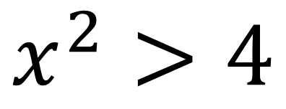

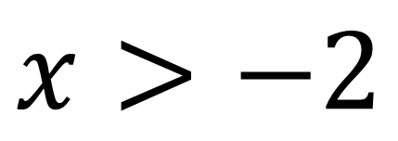
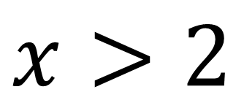
Solve $x^{2}−4>0$
$$x^{2}>4$$
$$x>2$$
$$x>−2$$
This is an incorrect solution
Why is this incorrect?

Slide 6
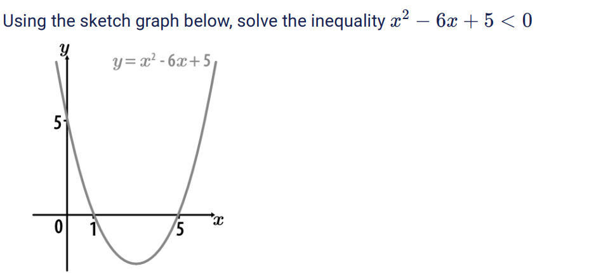

Slide 7
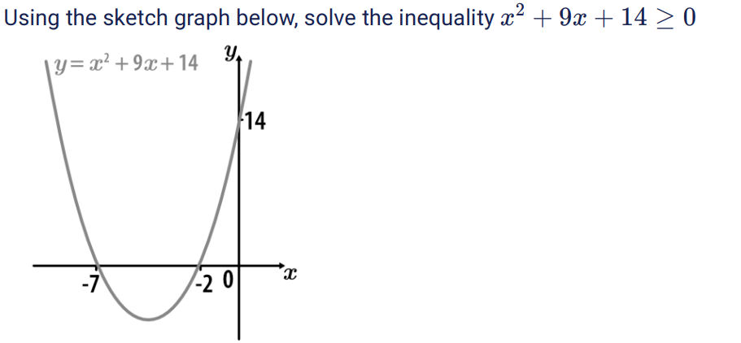

Slide 8
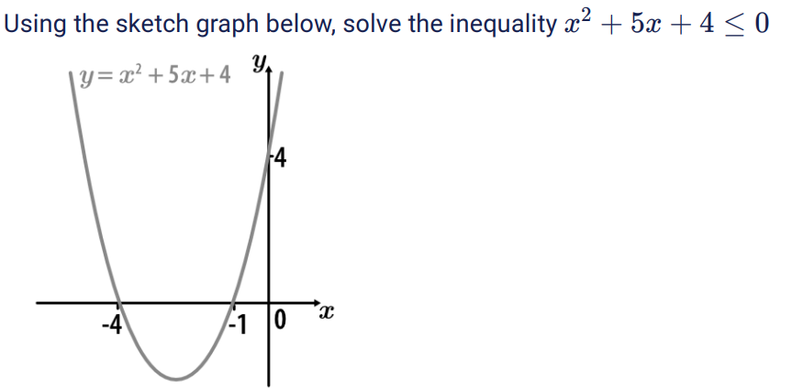

Slide 9
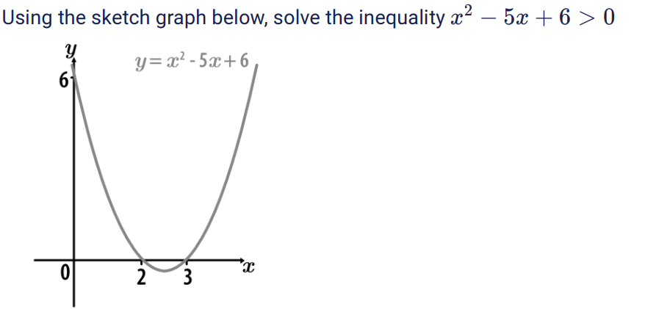

Slide 10
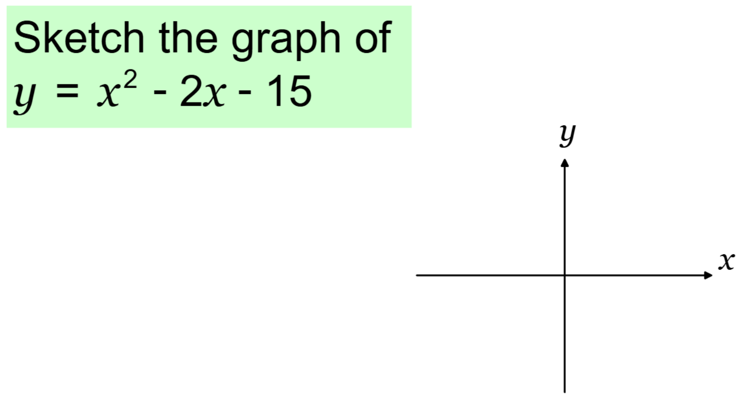
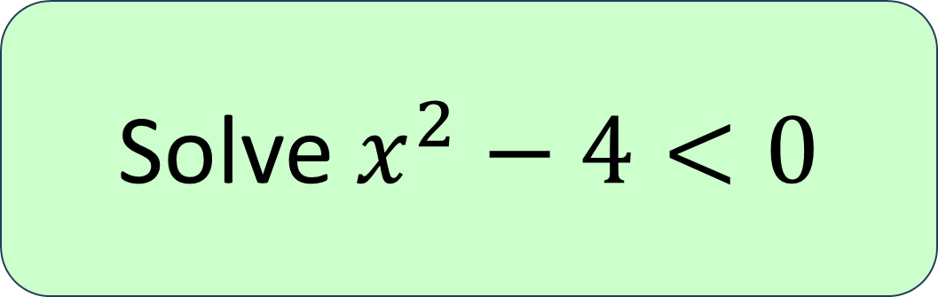
Solve $x^{2}−4<0$

Slide 11
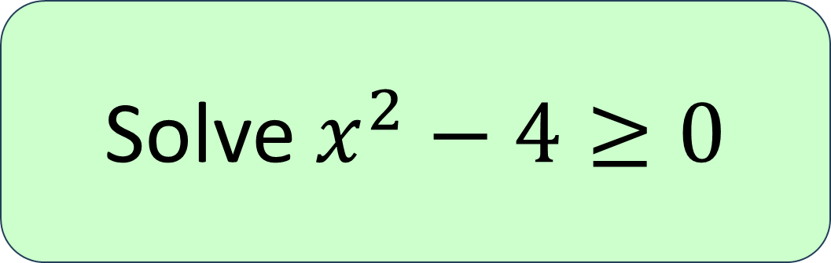
Solve $x^{2}−4≥0$

Slide 12
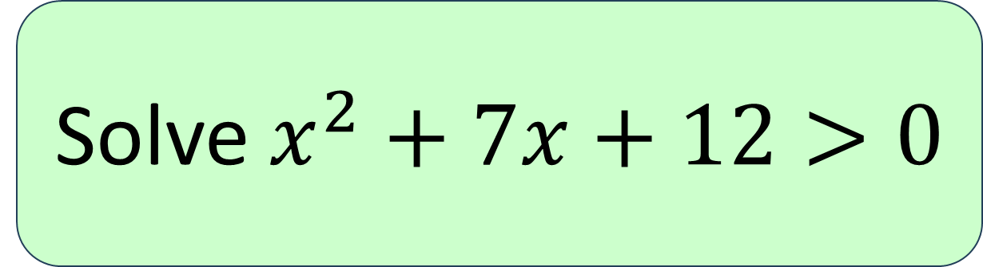
Solve $x^{2}+7x+12>0$

Slide 13
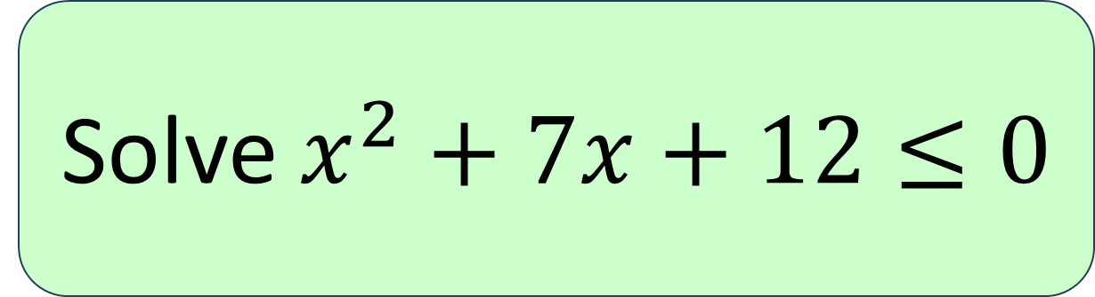
Solve $x^{2}+7x+12≤0$

Slide 14
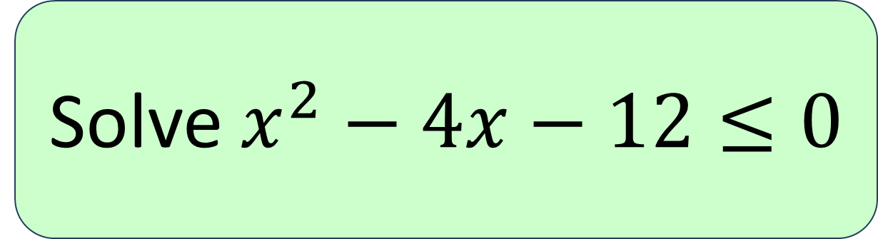
Solve $x^{2}−4x−12≤0$

Slide 15
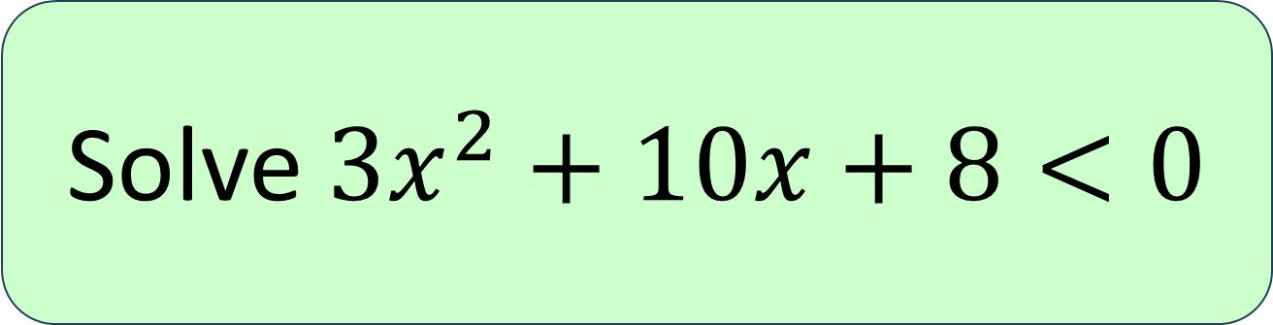
Solve $3x^{2}+10x+8<0$

Slide 16
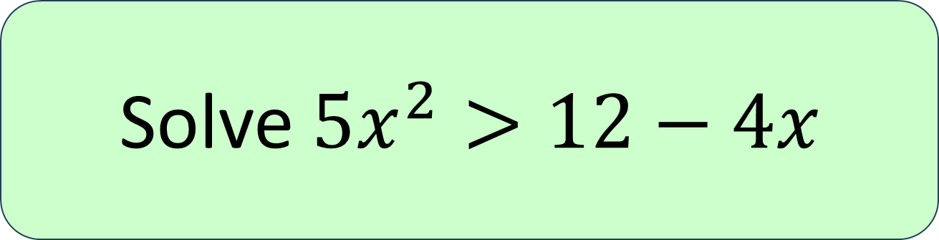
Solve $5x^{2}>12−4x$

Slide 17
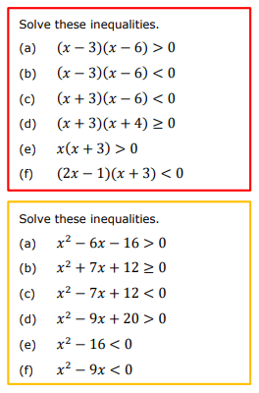
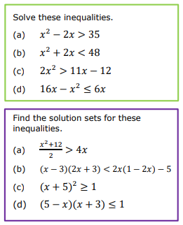

Slide 18
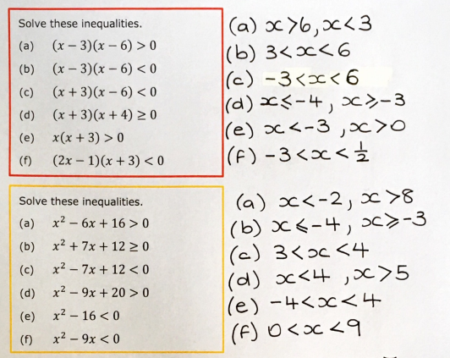
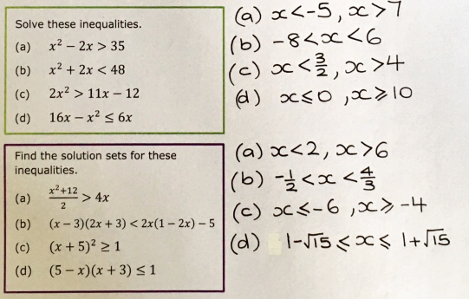

Slide 19
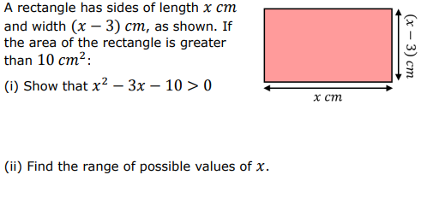
Exam Question 1
Notes:
1.12

Slide 20
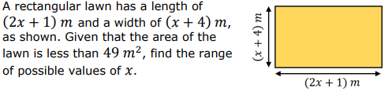
Exam Question 2
Notes:
From Further Maths

Slide 21
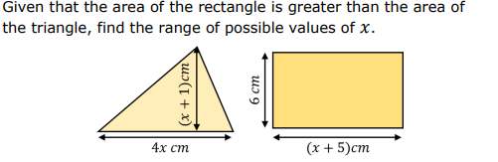
Exam Question 3
Notes:
1.12

