Slide 1















Dual coding symbols:
Practise
Explain
Organise
Big Question
Reflect
Present
Compare
Evaluate
Activate
Discuss
Predict
Connect
Summarise
Recall
Vocabulary

Slide 2








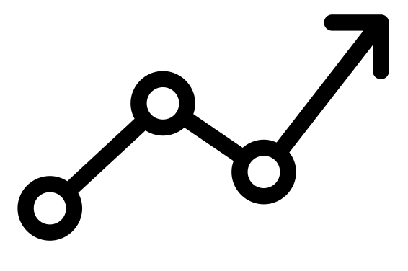

Editable reading ruler
Every child in an Archway school will become a fluent reader
 | RETRIEVE the words or phrases you need from the text | DECODE the words or phrase to address a breakdown | CONNECT with words or phrases you know from the text or your memory | VISUALISE the images in as much detail as possible | SUMMARISE the main ideas of the text in a few words | INFER meanings that might be within the text | PREDICT what might happen next using details from the text | EXAMINE how the writer uses words to construct meaning
 | ASK THOUGHTFUL QUESTIONS TO HELP YOU UNDERSTAND THE TEXT

Slide 3





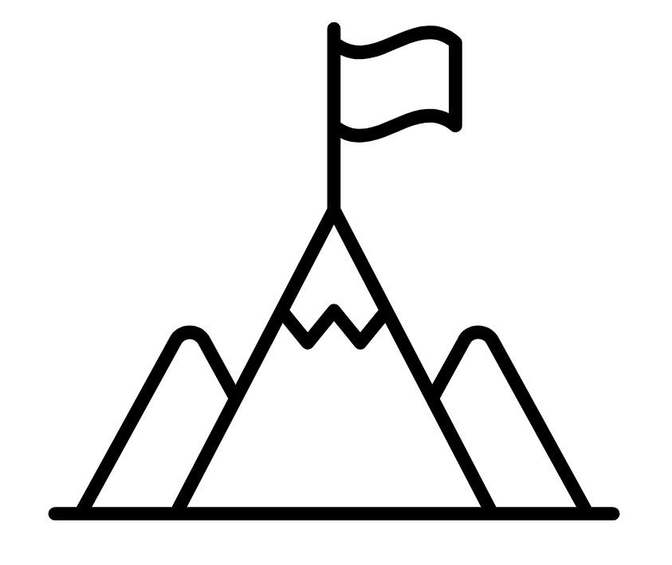
A
B

Slide 4
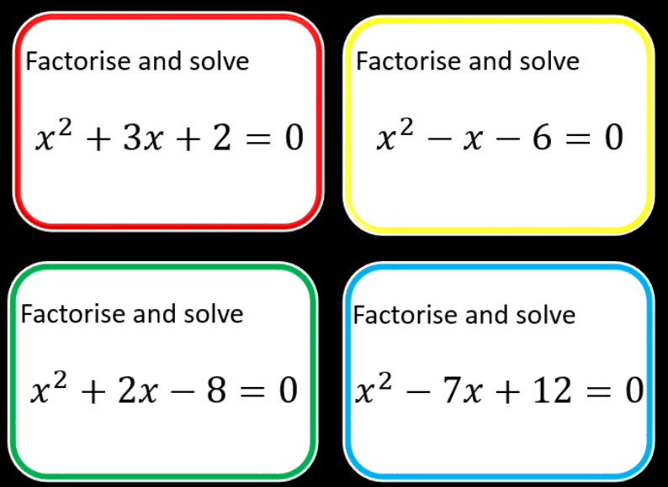
Notes:
Focus on monic quadratics only initially

Slide 5
y
3 features needed in sketch?
Roots
?
x
?
General shape: Smiley face or hill?
y-intercept
?
Notes:
Only monic quadratics

Slide 6
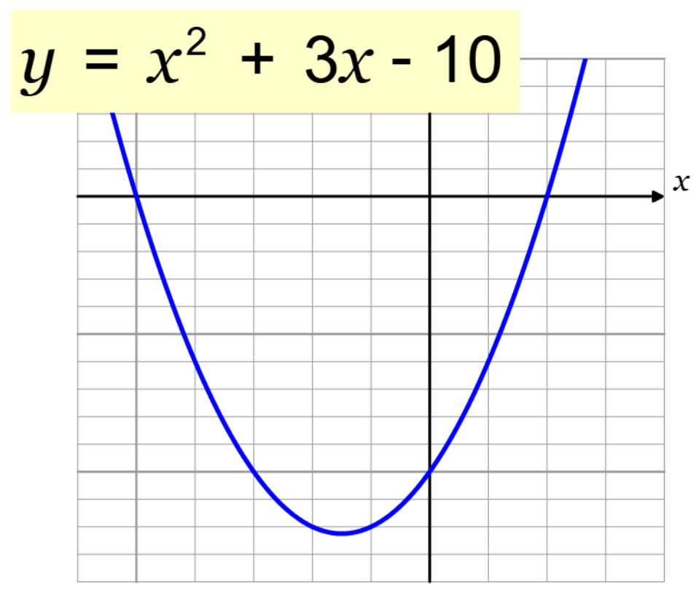
What is the y – intercept?
How do you know?

Slide 7
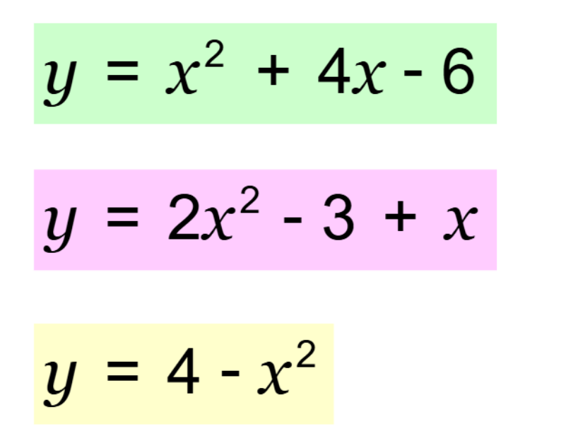
What is the y – intercept?

Slide 8
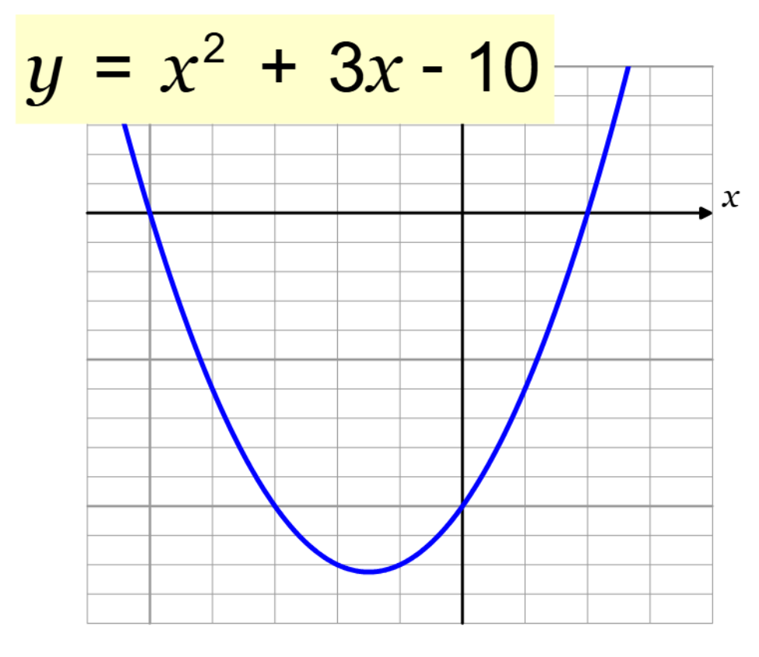
What are the roots?
How do you know?

Slide 9
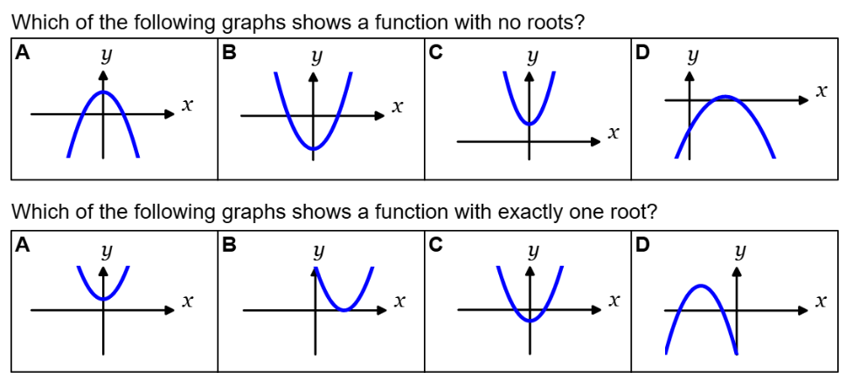

Slide 10
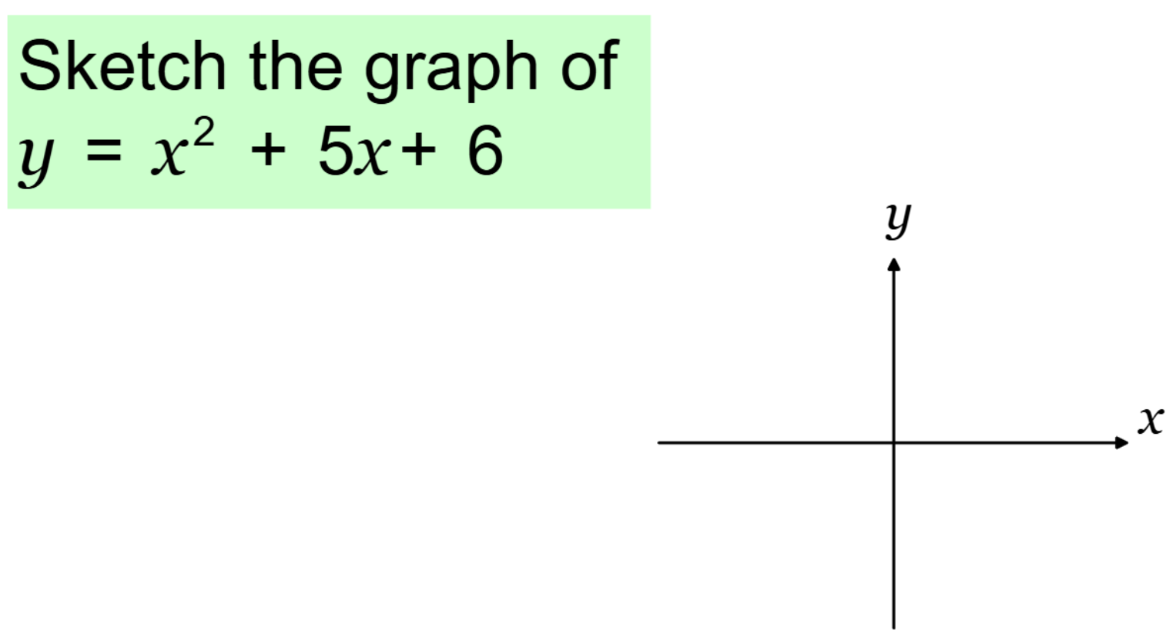

Slide 11
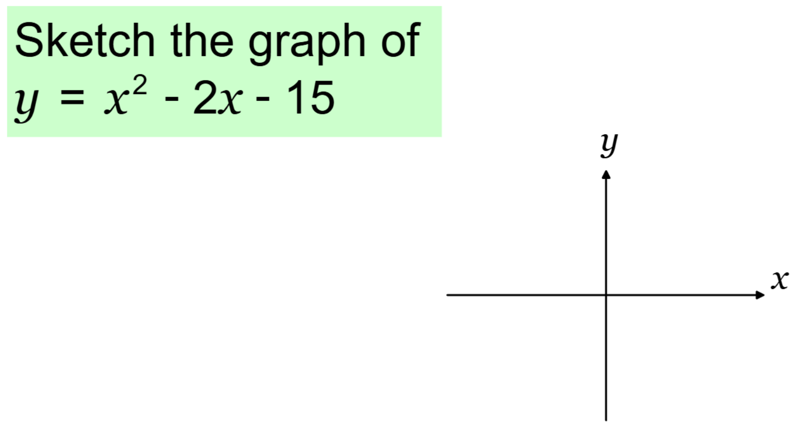

Slide 12
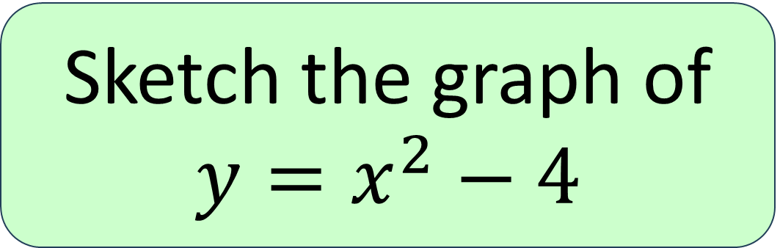
Sketch the graph of $y=x^{2}−4$

Slide 13
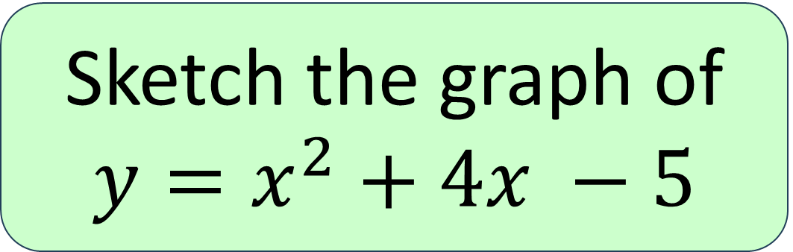
Sketch the graph of $y=x^{2}+4x −5$

Slide 14
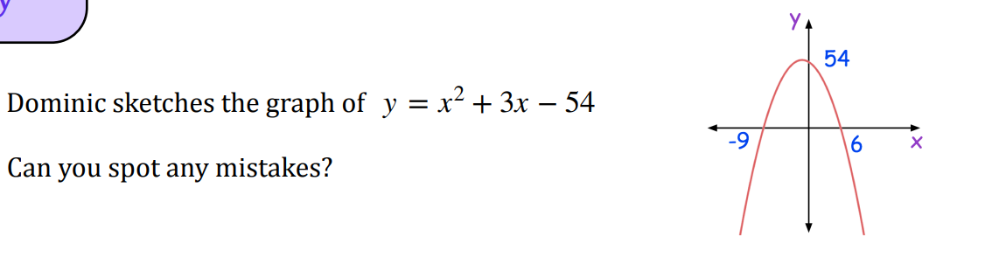

Slide 15






Sketch the following, ensuring you indicate where the curve intercepts either of the axes.
1
$$y=x^{2}+x−2$$
5
$$y=4−x^{2}$$
2
$$y=x^{2}−10x+24$$
6
$$y=10+3x−x^{2}$$
$$y=x^{2}−4x−5$$
3
4
$$y=x^{2}−25$$

Slide 16

Notes:
Mark student work with visualiser

Slide 17
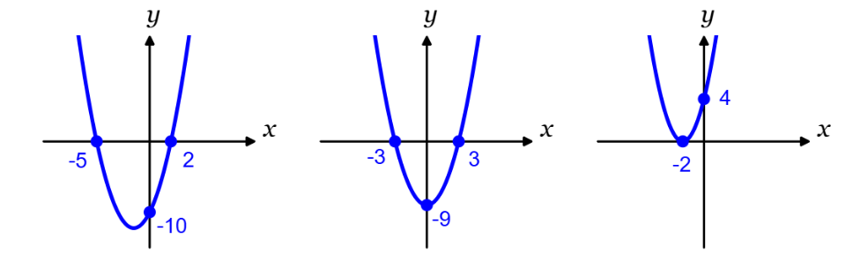
What is the equation?

Slide 18
What is the equation?

Slide 19
What is the equation?

Slide 20
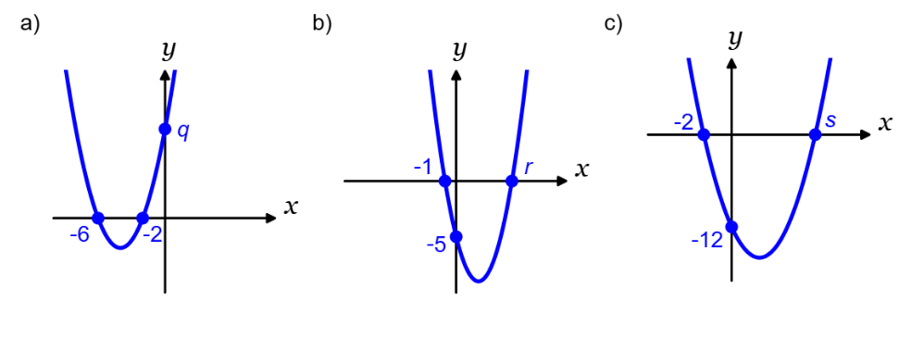
What is the equation?

Slide 21
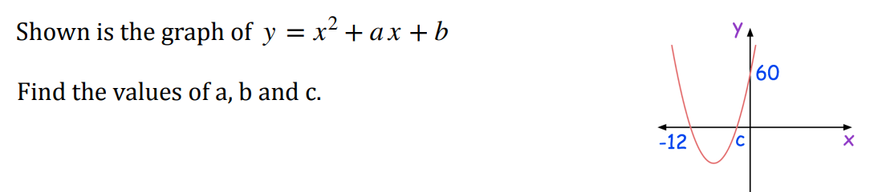

Slide 22
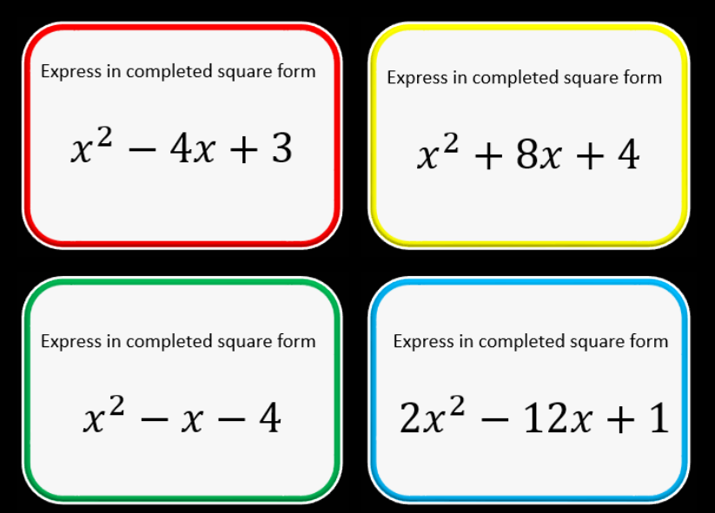
Notes:
Monic quadratics only

Slide 23



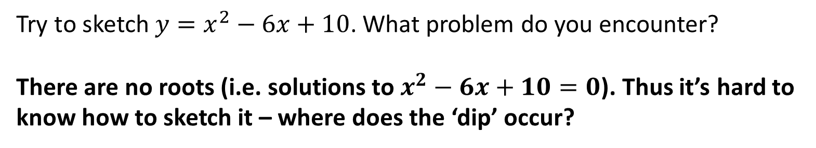



Try to sketch $y=x^{2}−6x+10$. What problem do you encounter?
There are no roots (i.e. solutions to $x^{2}−6x+10=0$). Thus it’s hard to know how to sketch it – where does the ‘dip’ occur?
?
$$y$$
$$y$$
?
?
$$10$$
$$10$$
$$x$$
$$x$$
Completing the square allows us to find where the minimum or maximum point on the graph is…

Slide 24
Sketch the graph of $y=x^{2}+4x −5$
Label the coordinates of the turning point
Notes:
Emphasis that the symmetry of the curve enables us also to find the coordinates of the vertex

Slide 25
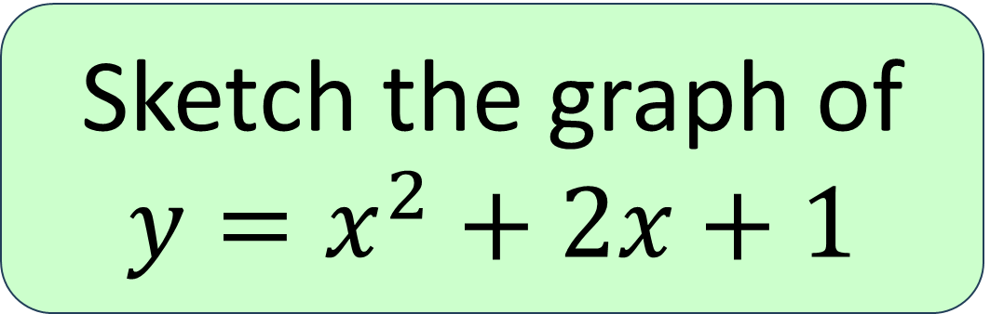
Sketch the graph of $y=x^{2}+2x+1$
Label the coordinates of the turning point
Notes:
Emphasis that the symmetry of the curve enables us also to find the coordinates of the vertex

Slide 26
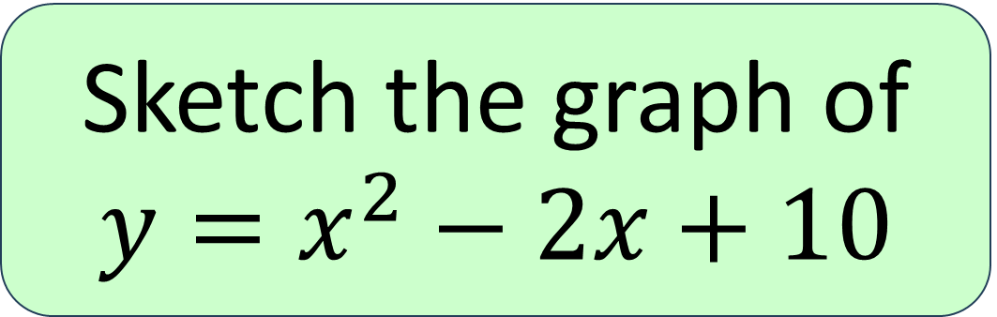
Sketch the graph of $y=x^{2}−2x+10$
Label the coordinates of the turning point
Notes:
Emphasis that the symmetry of the curve enables us also to find the coordinates of the vertex

Slide 27
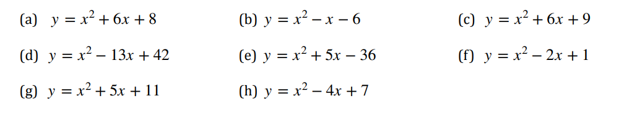
Sketch the following, ensuring you indicate where the curve intercepts either of the axes and the coordinates of the turning point

Slide 28
Notes:
Mark student work with visualiser

Slide 29
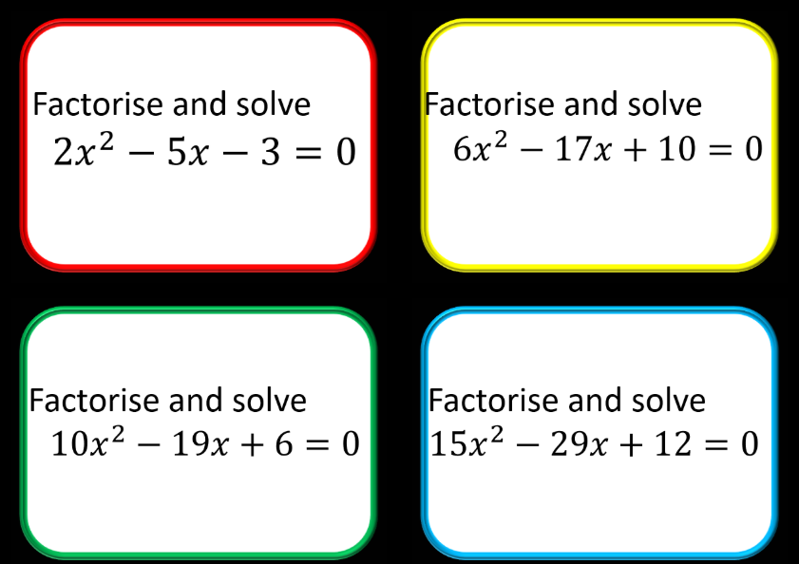
Notes:
Monic quadratics only

Slide 30
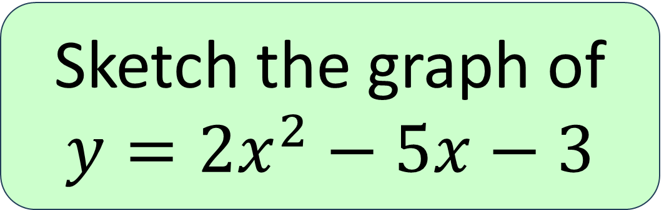
Sketch the graph of $y={2x}^{2}−5x−3$

Slide 31
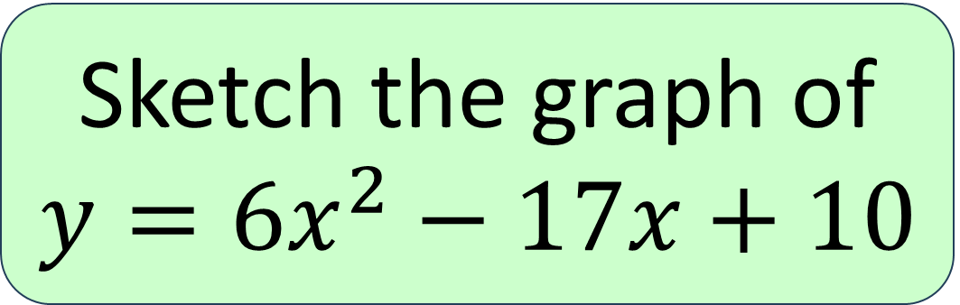
Sketch the graph of $y={6x}^{2}−17x+10$

Slide 32
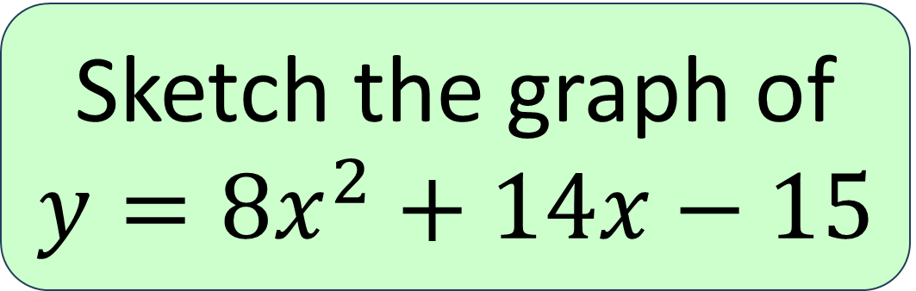
Sketch the graph of $y={8x}^{2}+14x−15$

Slide 33

Sketch the following, ensuring you indicate where the curve intercepts either of the axes and the coordinates of the turning point

Slide 34
Notes:
Mark student work with visualiser

Slide 35
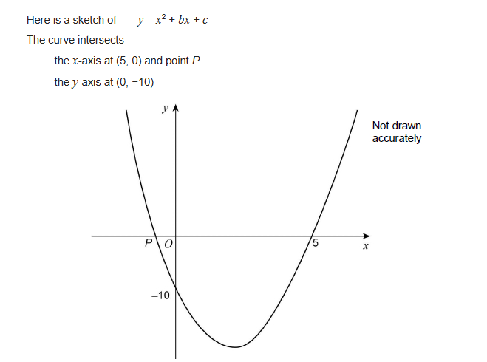
Exam Question

Slide 36
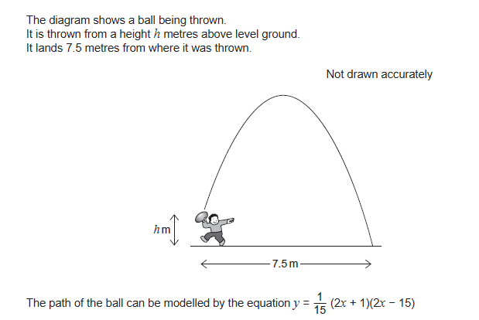
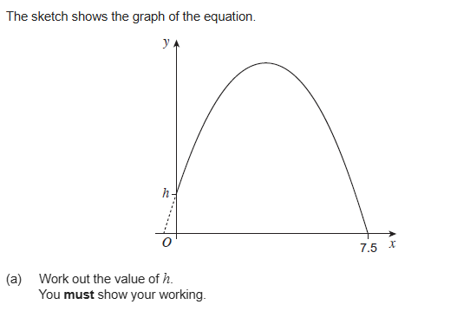
Exam Question
Notes:
A = +/-5 b = 11

