Slide 1
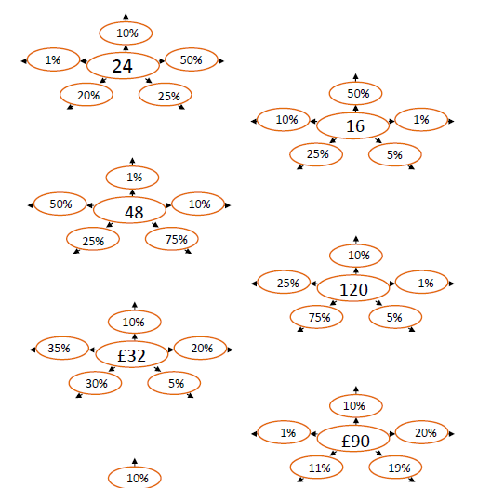
Fill in the missing values

Slide 2
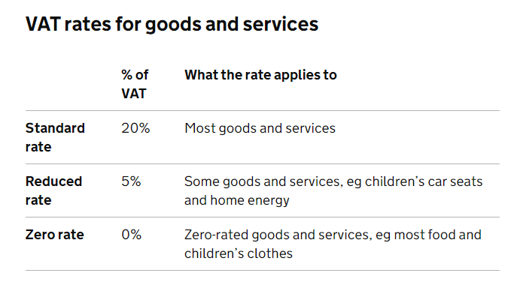
VAT (Value Added Tax) is a tax added to most products and services sold by VAT-registered businesses.
There are three rates of VAT:

Slide 3
Sophie bought a handbag for £250 plus VAT at 20%
Calculate the VAT.

Slide 4
A new bicycle costs £300 plus VAT at 20%
Work out the total cost of the bicycle.

Slide 5
A watch costs £42 including VAT at a rate of 20%.
How much is the watch without VAT?

Slide 6
A watch costs £50 including VAT at a rate of 20%.
How much is the watch without VAT?

Slide 7
A TV costs £500 including VAT.
Calculate the VAT

Slide 8
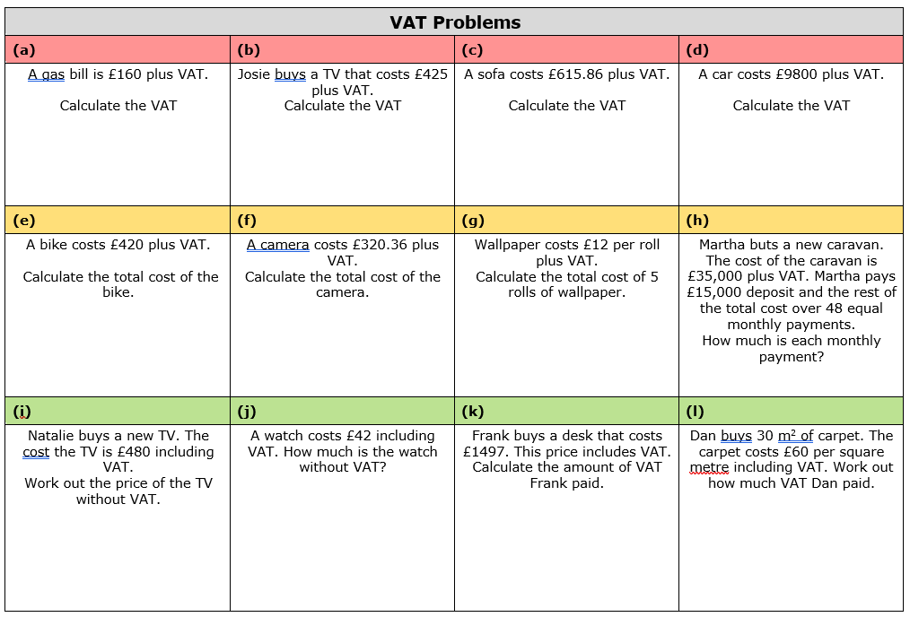

Slide 9
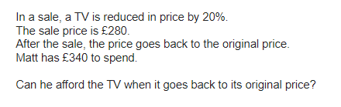
Problem 1
Notes:
350 no

Slide 10
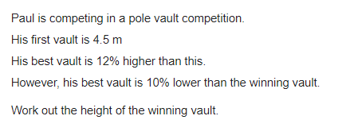
Problem 2
Notes:
5.6

Slide 11
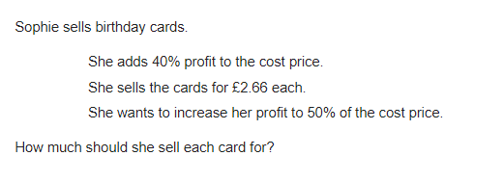
Problem 3
Notes:
2.85

