Slide 2
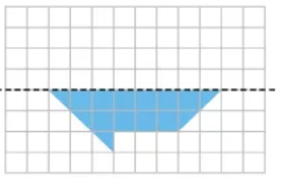
Lines of Symmetry
Find the area of a circle with a diameter of 10cm. Give your answer in terms of pi and 2 decimal places.
Sketch this shape and its reflection
Solve
2x – 10 > 22
Now represent this on a number line
Line
of
reflection

Slide 3


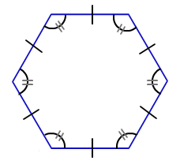
Which of these shapes are polygons?
Which of these polygons are regular?
Name each polygon in question 2
Parallelogram
Hexagon
Equilateral Triangle

Slide 4
Which of the shapes have a line of symmetry?
A
B

Slide 5
For each question, what is the correct line of symmetry?
1)
A
B
2)
A
B

Slide 6
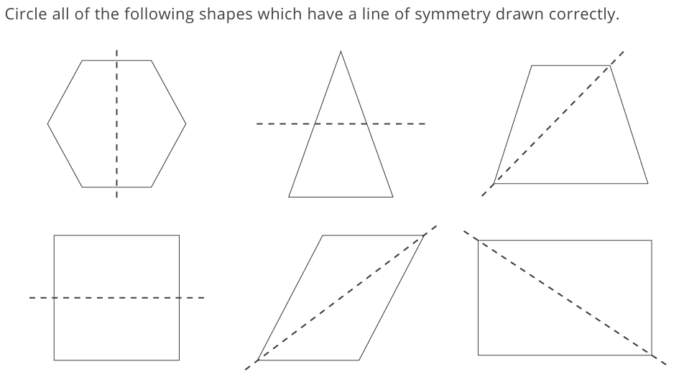
Name the shapes where the line of symmetry has been drawn correctly
A B C
D E F
Stretch : can you correct the lines of symmetry?

Slide 7
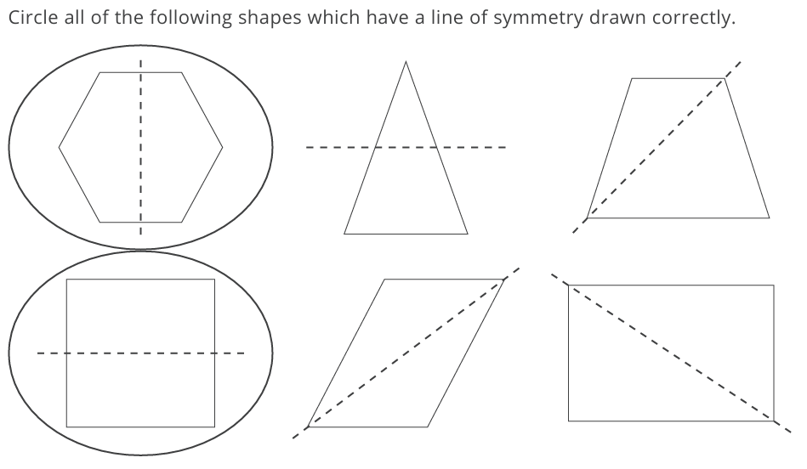
A B C
D E F

Slide 8

Do you agree with Dora.
This rectangle has 4 lines of symmetry.
THINK
PAIR
SHAIR
Hint :

Slide 9
Do you agree with Dora.
How many lines of symmetry does a rectangle have?
This rectangle has 4 lines of symmetry.
2 lines of symmetry
Notes:
Better to demonstrate this with pieces of paper

Slide 10
How many lines of symmetry does a parallelogram have?
A parallelogram has no lines of symmetry.
“Remember trace and fold”
Notes:
Better to demonstrate this with pieces of paper

Slide 11
Write the name of the shape with
no lines of symmetry
1 line of symmetry
2 lines of symmetry
5 lines of symmetry

Slide 12
a) 1 line
b) 2 lines
c) 5 lines
d) 0 lines
Kite
Rhombus
Pentagon
Trapezium

Slide 13
Look at the two shapes.
What’s the same? What’s different?
Do all pentagons have at least one line of symmetry?
No, some irregular pentagons have no lines of symmetry

Slide 14
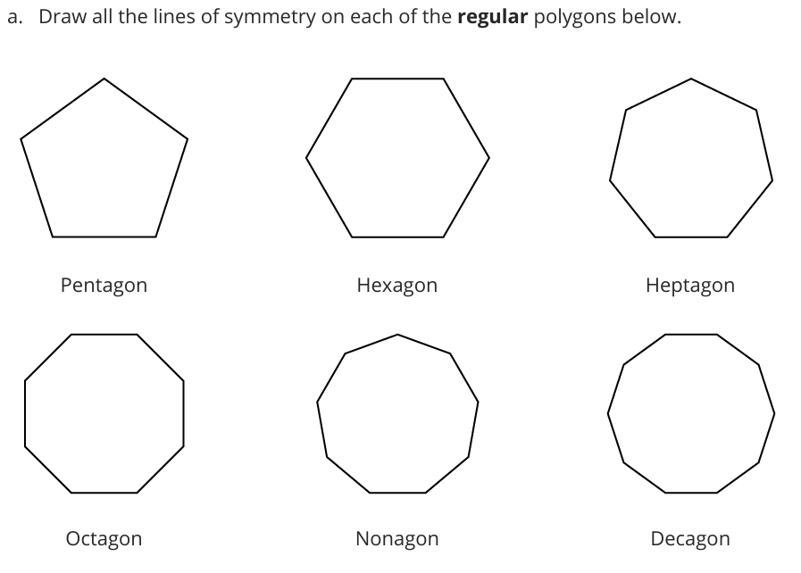
Notes:
Print 2 to a page for students to complete in their books

Slide 15
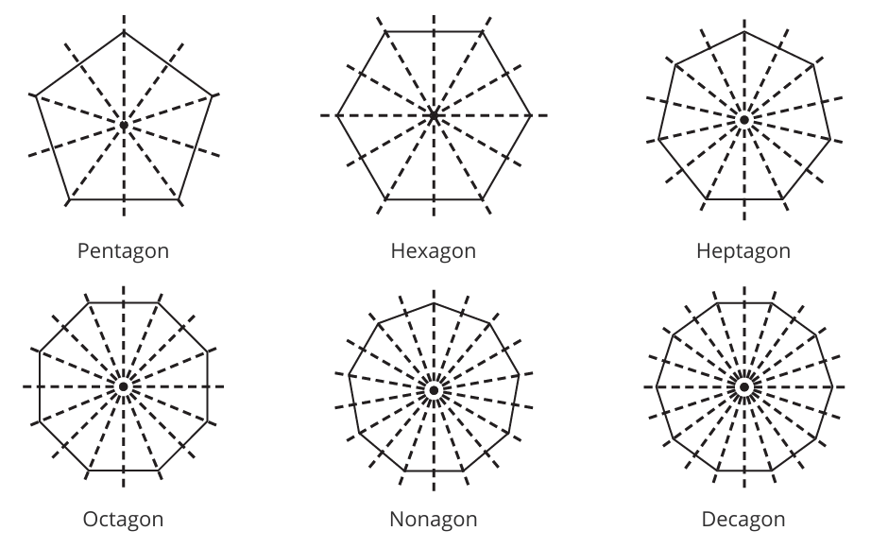

Slide 16
THINK. PAIR. SHARE
Explain what you notice about the relationship between the lines of symmetry and the number of sides

Slide 17
Consider each of the following statements and decide whether they are always, sometimes or never true.
Explain each of your answers
A pentagon has five lines of symmetry.

Slide 18
Consider each of the following statements and decide whether they are always, sometimes or never true.
Explain each of your answers
A square has four lines of symmetry.

Slide 19
Consider each of the following statements and decide whether they are always, sometimes or never true.
Explain each of your answers
A scalene triangle has three lines of symmetry.

Slide 20
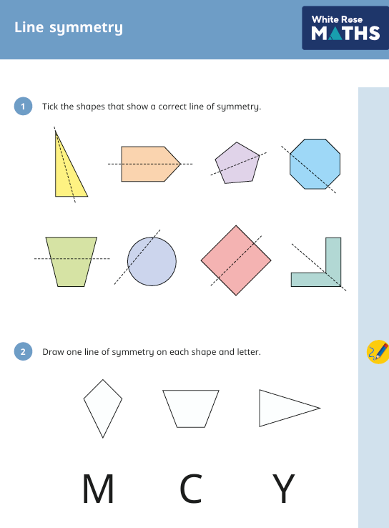
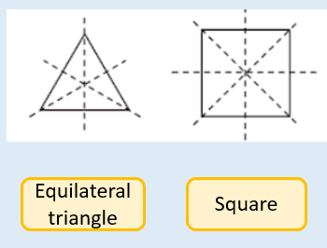
TITLE: Line Symmetry
For a regular polygon, the number of sides is equal to the number of lines of symmetry.

Slide 21
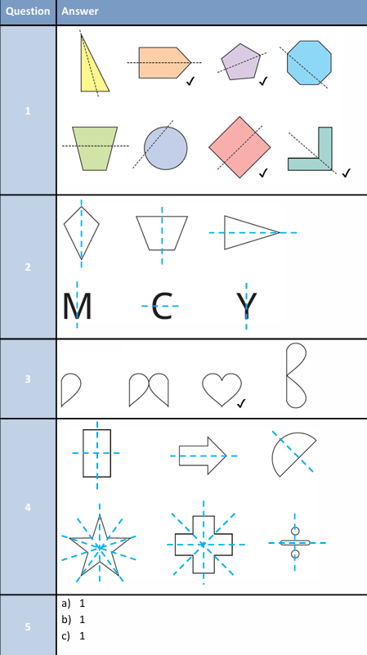
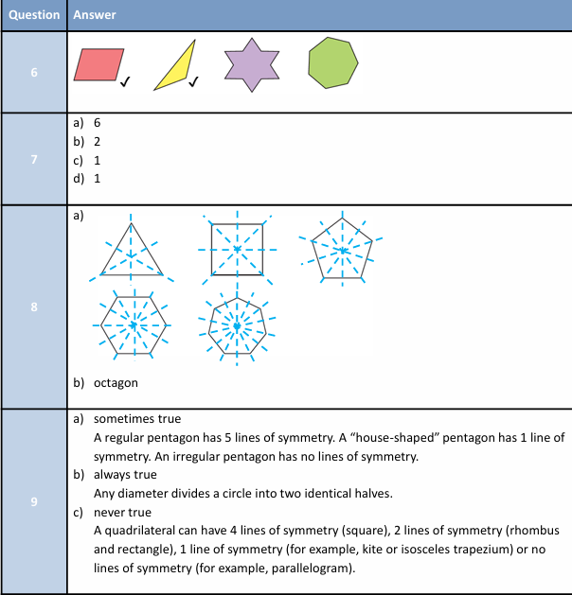

Slide 22
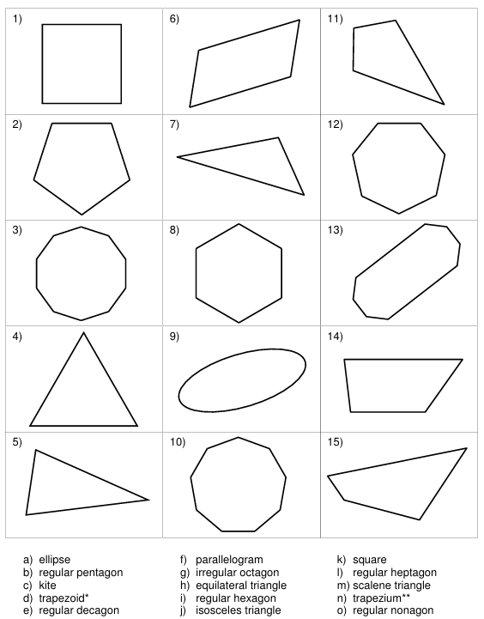
What is the name of each shape?
How many lines of symmetry does each one have?

Slide 23
What is the name of each shape?
How many lines of symmetry does each shape have?
Notes:
Printable extra worksheet for students to practice

