Slide 1
Title: Increase and Decrease by Using a Multiplier
Learning Objective
To be able to use a suitable multiplier to increase or decrease an amount by a given percentage.
Keywords:
Percentage, Multiplier, Increase, Decrease
Notes:
This lesson combines the learning acquired from Lesson 2 (Non calculator percentage increase and decrease) and Lesson 4 (Finding the multiplier).

Slide 2

Enterprise Account Director
Speaking to different companies
Helping security and technology advance
Budgets
Strategy
Risk
Interest Rates
Market changes
Calculating bonuses / commissions
£94, 616 + bonuses
GCSEs
Alevels
Degree
For this role just needed GCSEs and work your way up

Slide 3

Title: Increase and Decrease by Using a Multiplier
Solve:
4(2x + 3) = 20
and
$−5$(3x $−$ 1) = 65
Write down the value of the gradient and the coordinates of the y-intercept for the line:
y = -0.25x – 4.5
Express 140 as the product of its prime factors.

Slide 4

Title: Increase and Decrease by Using a Multiplier
Solve:
4(2x + 3) = 20 x = 2
and
$−5$(3x $−$ 1) = 65 x = -4
Write down the value of the gradient and the coordinates of the y-intercept for the line:
y = -0.25x – 4.5
Gradient = -0.25
Y-intercept at (0,-4.5)
Express 140 as the product of its prime factors.
2 x 2 x 5 x 7
= 2² x 5 x 7

Slide 6
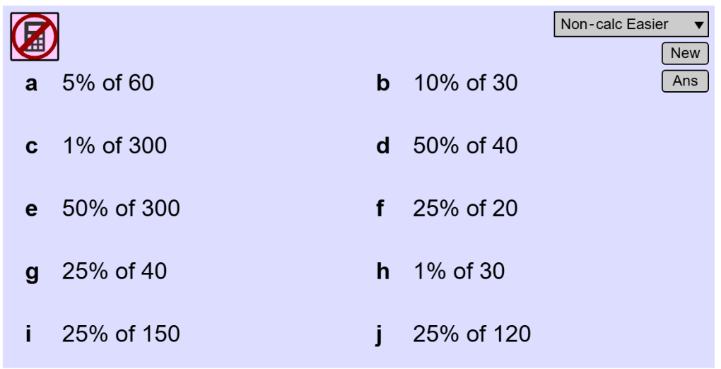
Title: Increase and Decrease by Using a Multiplier
Connecting Back:

Slide 7
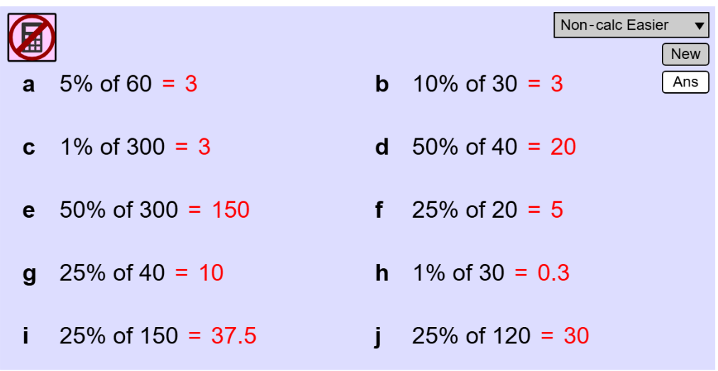
Title: Increase and Decrease by Using a Multiplier
Connecting Back:

Slide 8
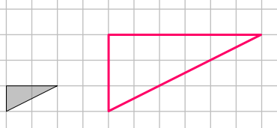
To linearly enlarge triangle A to triangle B we must multiply by a Scale Factor. What is that Scale Factor?
How did you find it?
How do you know that it is correct?
x Scale Factor
B
A

Slide 9
To enlarge the AREA of triangle A to triangle B we must multiply by a Scale Factor. What is that Scale Factor?
How did you find it?
How do you know that it is correct?
Was the AREA Scale Factor the same as the LINEAR Scale Factor ?
If not, why not?
x Scale Factor
B
A
Notes:
This is an optional slide to extend the concept from the previous slide,

Slide 10
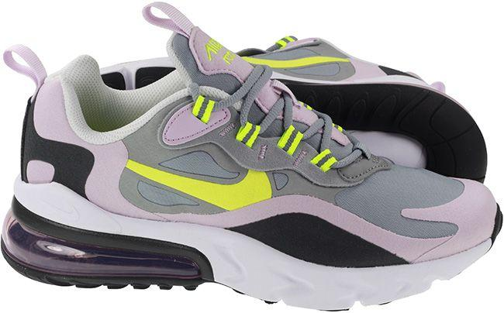

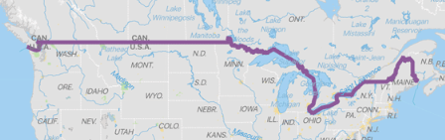
Donald Trump has introduced a 25% tariff on all goods coming into the US from Canada.
For a pair of Nike trainers made in Canada, bound for the US market the manufacturing cost price is $30 (USD). What is price that the importer will pay once the goods are received by the US?
How did you calculate this?
Extension:
The importer will charge the wholesaler a standard 40% profit margin on top, what is the new cost to the wholesaler?
How did you calculate this?
Notes:
This is an optional slide to extend the concept from the previous slide.
Price to Importer = $30 x 1.25 = $37.50
Price to wholesaler = 37.5 x 1.40 = $52.50.
Overall multiplier = 1.25 x 1.40 = 1.75

Slide 11
Donald Trump has introduced a 25% tariff on all goods coming into the US from Canada.
For a pair of Nike trainers made in Canada, bound for the US market the manufacturing cost price is $30 (USD). What is price that the importer will pay once the goods are received by the US?
Price to Importer = $30 x 1.25 = $37.50
Extension:
Price to wholesaler = 37.5 x 1.40 = $52.50.
Overall multiplier = 1.25 x 1.40 = 1.75
Dose this work on $30?
Notes:
This is an optional slide to extend the concept from the previous slide.
Price to Importer = $30 x 1.25 = $37.50
Price to wholesaler = 37.5 x 1.40 = $52.50.
Overall multiplier = 1.25 x 1.40 = 1.75

Slide 12
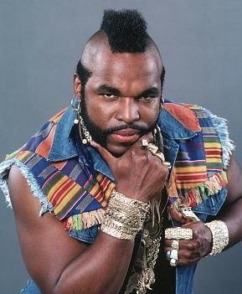
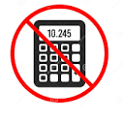
On your whiteboards
Mr T says, “You cannot have a percentage greater than 100% fool!”
Is he right?
Why?
Now, who’s the fool?
Notes:
Demonstrate simplifying fractional answers in terms of pi

Slide 13


On your whiteboards
Further thinking
What does the 1 in 1.35 mean?
What does the 0.35 in 1.35 mean?
Notes:
Demonstrate simplifying fractional answers in terms of pi

Slide 14
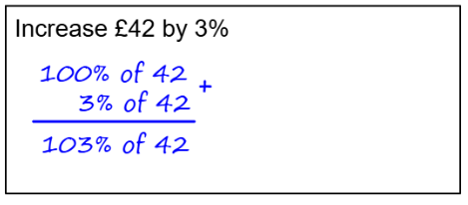
On your whiteboards
Further thinking
What is the multiplier?
Is it greater than 1?
Why?
Notes:
Demonstrate simplifying fractional answers in terms of pi

Slide 15
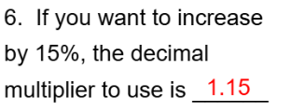
I do
We do
What multiplier are you going to use?
1.2
So: 45 x 1.2 = 54
Notes:
Demonstrate simplifying fractional answers in terms of pi

Slide 16



On your whiteboards
What was your multiplier?
What was your multiplier?
What was your multiplier?
£708.00
£81.54
£94.34

Slide 17
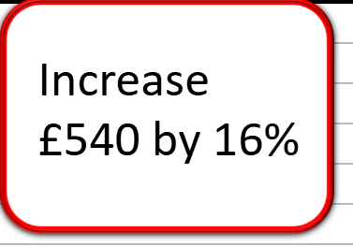
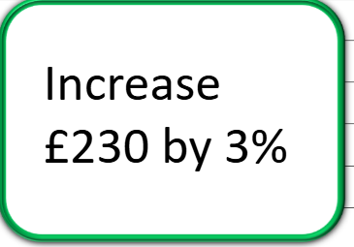
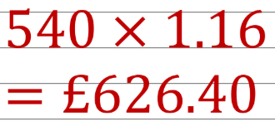
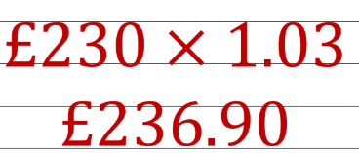
On your whiteboards

Slide 18
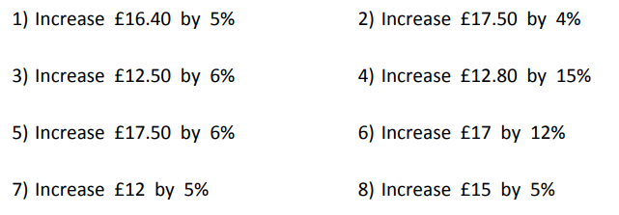
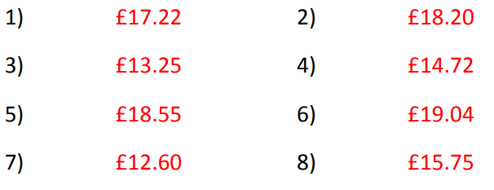
On your whiteboards
Think: What was your multiplier?
Answers:

Slide 19
On your whiteboards
What do you get when you multiply 50 by 1?
What do you get when you multiply 50 by 1.5?
What do you get when you multiply 50 by 0.5?
TRUE or FALSE:
When a number is multiplied by a decimal less than 1, it gets smaller?
Notes:
Demonstrate simplifying fractional answers in terms of pi

Slide 20
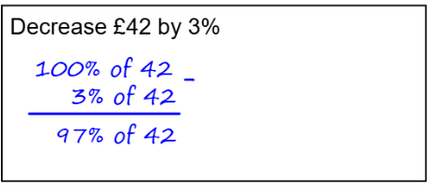
I do
Further thinking
What is the multiplier?
Is it STILL greater than 1?
Why not?
Notes:
Demonstrate simplifying fractional answers in terms of pi

Slide 21
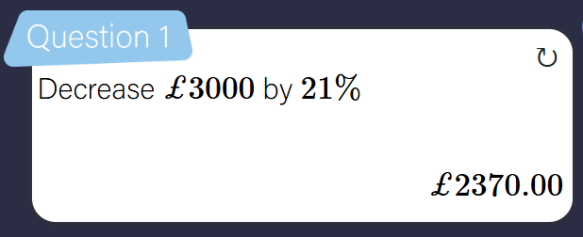
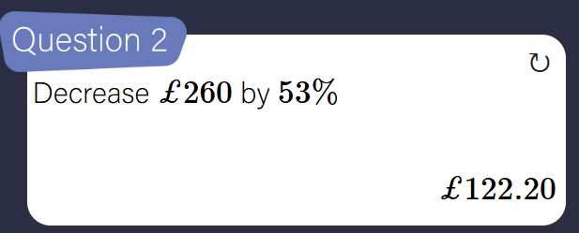
I do
We do
Notes:
Demonstrate simplifying fractional answers in terms of pi

Slide 22
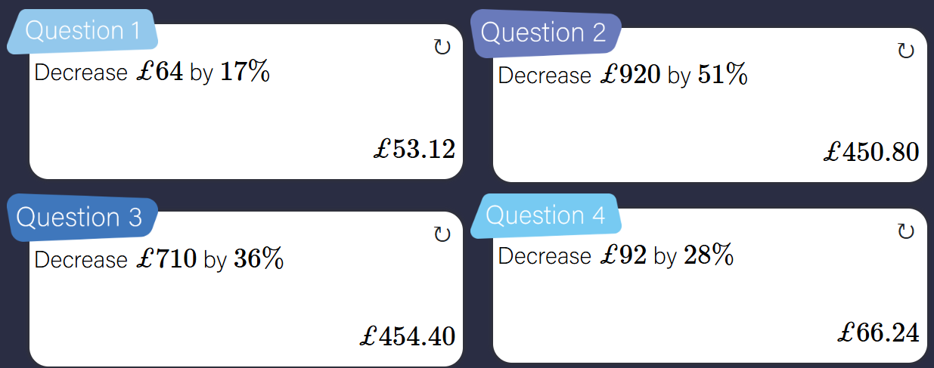
On your whiteboards
Further thinking: What is the multiplier for each?

Slide 23
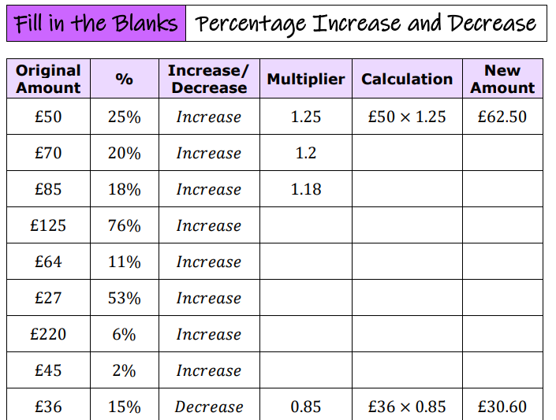
Working on the worksheet…

Slide 24
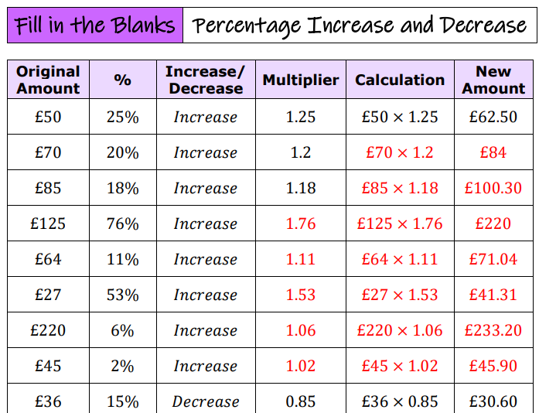
Answers

Slide 25
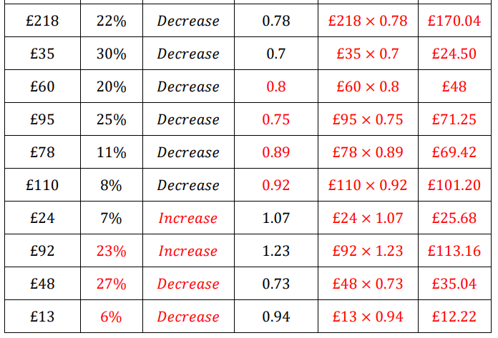
Answers

Slide 26
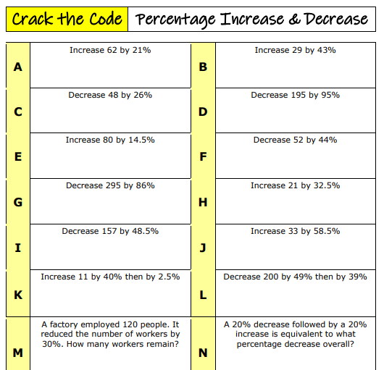
Challenge

Slide 27
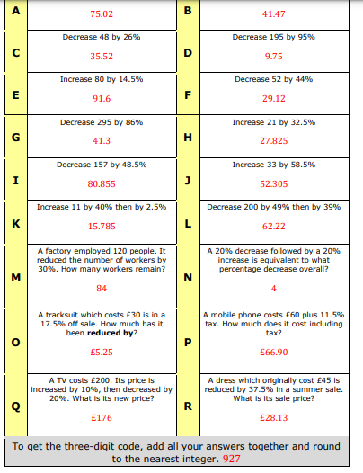
Challenge
Answers

