Slide 2
Repeated Percentage Change

Slide 3
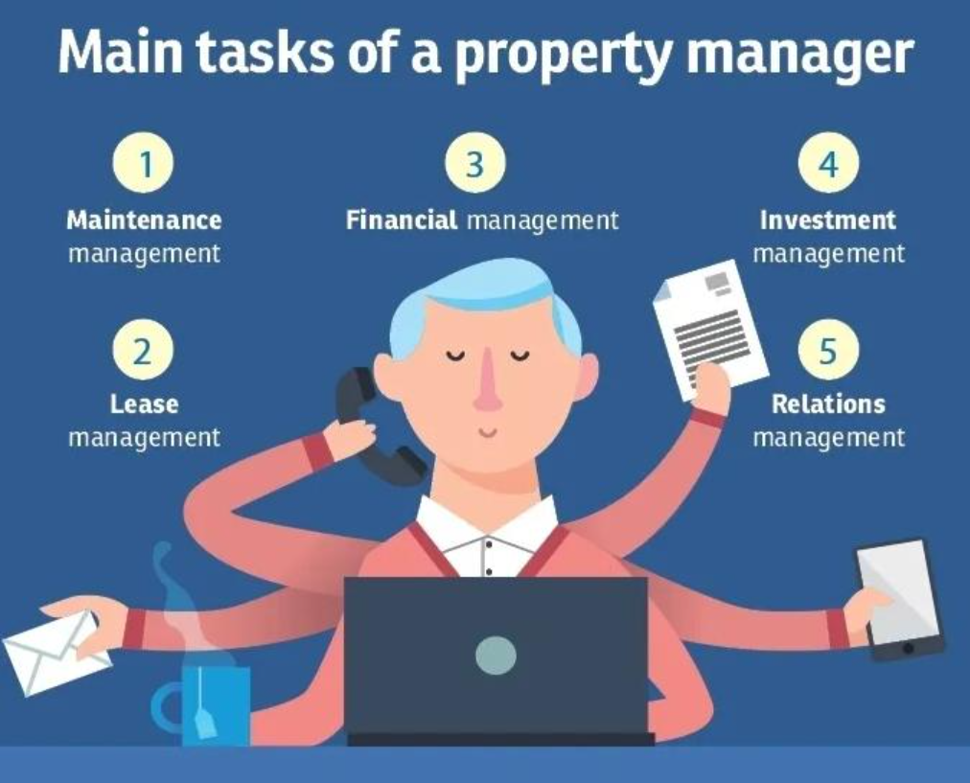
Property Manager
Being a Business Owner
Providing high-quality service to ensure clients are satisfied with their rented properties
Calculating arrears
Drawing up rent schedules
Loan negotiations
Monitoring interest payments
£55, 000
GCSEs
A-levels
University Degree
Experience in Law and Admin

Slide 4
Recap From Previous Lessons
Increase 120 by 15%
Carl invests £120 into an account. Every year his investment increases by 15%. How much is the investment worth after 2 years?
100% | 120
115%
100% | 120
115%
x 1.15
x 1.15
x 1.15
138
x 1.15
138
100% | 138
115%
x 1.15
x 1.15
158.7
What is the same and what is different about each question?
How is the method for working it out different?

Slide 5
Consider this problem
100% | 4243.60
103%
x 1.03
4370.91
x 1.03
Debbie invests £4000 into an account. Every year his investment increases by 3%. How much is the investment worth after 5 years?
100% | 4370.91
103%
x 1.03
x 1.03
100% | 4000
103%
4502.04
x 1.03
4120
x 1.03
100% | 4502.04
103%
x 1.03
x 1.03
100% | 4120
103%
4637.10
x 1.03
x 1.03
4243.60
There must be an easier way!
What about if the question said 25 years instead of 5 years?

Slide 6
Consider this problem
Debbie invests £4000 into an account. Every year his investment increases by 3%. How much is the investment worth after 5 years?
There is an easier way!
4000 x 1.03 x 1.03 x 1.03 x 1.03 x 1.03 = 4637.10 (2dp)
4000 x 1.03⁵ = 4637.10 (2dp)
The investment is worth £4367.10 after 5 years.
What would change if the question said 25 years instead of 5 years?

Slide 7
I DO:
YOU DO:
Noor invests £2000 into an account at 6% compound interest per annum. How much is the investment worth after 11 years?
Kaszia invests £3000 into an account at 2% compound interest per annum. How much is the investment worth after 8 years?
2000 x 1.06¹¹ = £3796.60
3000 x 1.02⁸ = £3514.98
Notes:
Discuss what is meant by compound interest, and per annum.
Also 2dp as we are dealing with money.

Slide 8
Diagnostic Questions
Answer the following questions and then feedback your answers as requested by your teacher.
DON’T GIVE YOUR ANSWER UNTIL YOUR TEACHER ASKS.

Slide 9
Diagnostic Questions
£8000 is invested into an account at 6% compound interest. How much is in the account after 4 years?
£52,428.80
£33,920.00
£10,099.82
£9,920.00

Slide 10
Diagnostic Questions
Which multiplier represents a percentage increase of 12.4%
1.124
0.124
1.0124
1.24

Slide 11
Diagnostic Questions
A house worth £200,000 increases in value by 6.3% each year for 4 years. Which calculation represents the correct way to calculate the value of the house after 4 years?
200000 x 1.63⁴
200000 x 1.063⁴
200000 x 0.063⁴
200000 x 1.063 x 4

Slide 12
Diagnostic Questions
The price of a Freddo in a shop was initially 10p. The price increased by 4% in the first year, then by 15% each year after that. Which calculation shows how much was the Freddo worth, in pounds, after 11 years?
10 x 1.04¹¹ x 1.15¹¹
0.1 x 1.04 x 1.15¹⁰
0.1 x 1.04 x 1.15 x 10
10 x 1.04 x 1.15¹¹

Slide 13
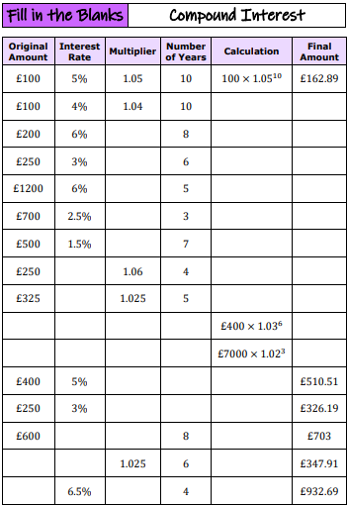
Complete the worksheet
Notes:
Worksheet - 7ac124_98c36c131a3642b1b4b8ced34834fa1c.pdf
Answers - 7ac124_272e127c6a7546cc963b3b172047b88b.pdf

Slide 14
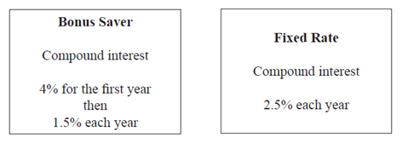

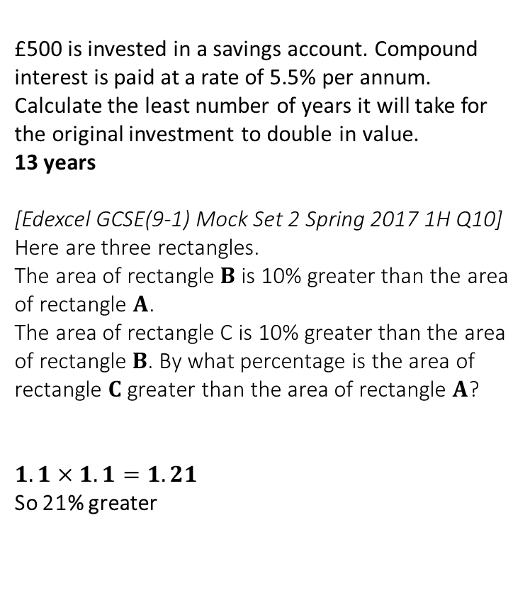

3
You have £1000 to save. Bank Frost offers 2% interest on your savings in the first year followed by 4% the second. Bank Cheeseright offers 3% both years. Which bank would be better to save with?
£1060.80 vs £1060.90, so bank Cheeseright better.
[Edexcel GCSE Nov2014-2H Q14] Peter has £20000 to invest in a savings account for 2 years. He finds information about two savings accounts.
Peter wants to have as much money as possible in his savings account at the end of 2 years. Which of these savings accounts should he choose?
Bonus: $20000×1.04×1.015=£21112$
Fixed Rate: $20000×{1.025}^{2}=£21012.50$
Bonus is better.
Extension Questions
£500 is invested in a savings account. Compound interest is paid at a rate of 5.5% per annum. Calculate the least number of years it will take for the original investment to double in value.
13 years
[Edexcel GCSE(9-1) Mock Set 2 Spring 2017 1H Q10] Here are three rectangles.
The area of rectangle $B$ is 10% greater than the area of rectangle $A$.
The area of rectangle C is 10% greater than the area of rectangle $B$. By what percentage is the area of rectangle $C$ greater than the area of rectangle $A$?
$1.1×1.1=1.21$
So 21% greater
1
?
?
4
2
?
?
Notes:
Click the boxes to reveal the answers

Slide 15
Consider this problem
Alex’s car depreciates in value by 12% each year. If Alex bought the car for £18,000 how much is it worth after 6 years?
18000 x 0.88⁶ = 8359.27 (2dp)
The car is worth £8359.27 after 6 years.
What is different about this problem compared to the other problems we have seen today?

