Slide 1
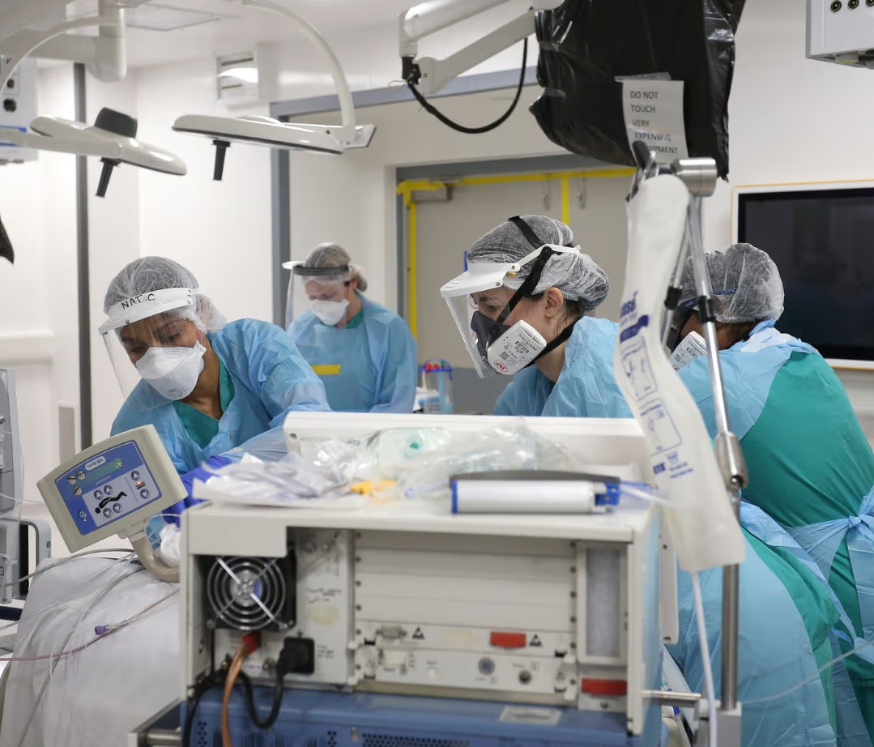
Intensive Care Consultant & Deputy Medical Director
Healing people
Treatments for patients
Does of medications
Review of charts & graphs
Statistics to understand research
Spending and forecasting of multimillion pound budgets
£86, 427
Top Grades at GCSE
Top A-levels
(inc biology & chemistry)
Post Graduate Training
Medical Degree
Notes:
Neighbour

Slide 2

06 September 2026
Percentage of a Quantity
(Non Calculator)

Slide 3
We can use the common percentages to find percentages of amounts.
Calculate the missing percentages.
100% | 1200
50%
25%
20%
10%
5%
1%
0.5%
Notes:
Left

Slide 4







We can use the common percentages to find percentages of amounts.
100% | 1200
50% | 600
25% | 300
20% | 240
10% | 120
5% | 60
1% | 12
0.5% | 6
$$÷2$$
$$÷2$$
$$÷4$$
$$÷5$$
$$÷2$$
$$÷2$$
$$÷5$$
Notes:
Questioning students
Making links between the different percentages – look at multiple ways of finding percentages from other percentages

Slide 5






Sam stole 60% of
the money from the safe!
$440
How can we calculate how much that is?
Addtion
Multiplication
100% | 440
10% | 44
50% | 220
60% | 264
100% | 440
10% | 44
60% | 264
$$÷10$$
$$÷5$$
$$÷10$$
$$×6$$
What is the same and what is different about each question?
Which is more efficient?

Slide 6





Sam stole 35% of
the money from the safe!
$440
Addition
Multiplication
100% | 440
10% | 44
20% | 88
5% | 22
35% | 154
100% | 450
5% | 22
35% | $154
$$÷10$$
$$÷20$$
$$×2$$
$$×7$$
$$÷2$$
Notes:
Question prompts: How is this different to the last slide? How is 5% calculated differently?

Slide 7




Sam stole 15% of
the money from the safe!
$440
Addition
Multiplication
100% | 440
10% | 44
5% | 22
15% | 66
100% | 440
5% | 22
15% | 66
$$÷10$$
$$÷5$$
$$÷20$$
$$×3$$

Slide 8
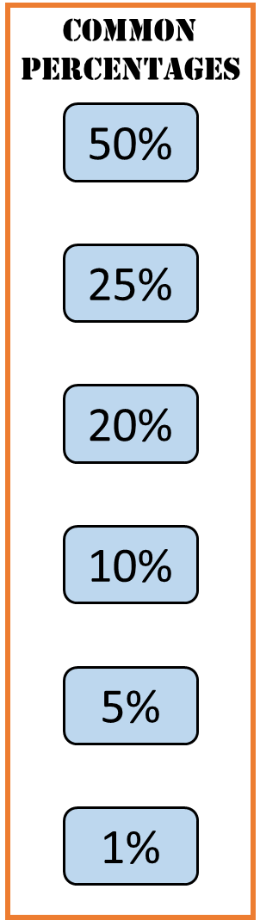
Sam stole 11% of
the money from the safe!
$440
Addition
Multiplication
100%
11%
100%
11%
Fill in the boxes yourself using the common percentages.
Notes:
Slide left blank for flexibility in annotation

Slide 9
Below are three methods for calculating 40% of 400.
Method 1
Method 2
Method 3
100% | 400
10% | 40
40% | 160
100% | 400
5% | 20
40% | 160
100% | 400
1% | 4
40% | 160
What do you notice about the percentages highlighted in red?

Slide 10
Below are three methods for calculating 40% of 400.
Method 1
Method 2
Method 3
100% | 400
10% | 40
40% | 160
100% | 400
5% | 20
40% | 160
100% | 400
1% | 4
40% | 160
The middle percentage must be a factor of both 100 and 40.

Slide 11

A full bag of rice weighs 320g.
It is 15% full.
How much does it weigh?
320g
What values can we put into the ratio table?
(you don’t have to use this many rows..!)
100% | 320
15% | 48g
Notes:
Slide left blank for annotation

Slide 12
A full bag of rice weighs 320g.
It is 26% full.
How much does it weigh?
320g
What values can we put into the ratio table?
(you don’t have to use this many rows..!)
100% | 320
26% | 83.20g
Notes:
Slide left blank for annotation

Slide 13
A full bag of rice weighs 320g.
It is 31% full.
How much does it weigh?
320g
Use a ratio table to calculate this value.
100% | 320
31% | 99.20g
Notes:
Slide left blank for annotation

Slide 14

Aisha makes $120 in one week.
She donates 1.5% of her weekly earnings
to charity.
How much does she donate?
100% | $120
1.5% | 1.8
Notes:
Slide left blank for annotation

Slide 15
25%+1%+1%
Find 27%
of $3200.
How many different ways can you calculate the answer?

Slide 16
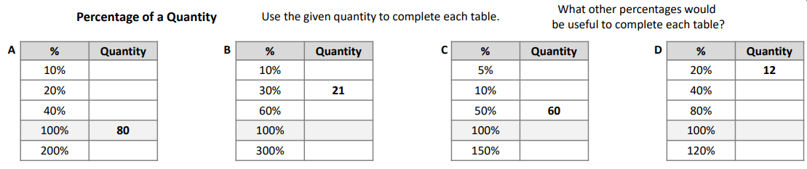

Slide 18
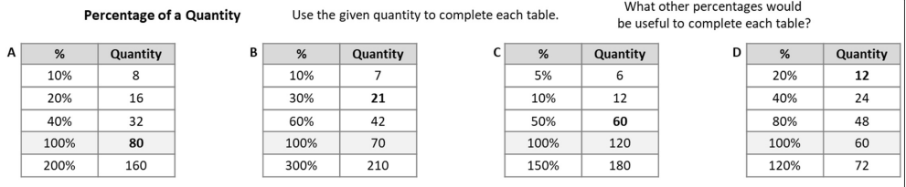
Answers

Slide 19
Checkpoint 2: Sponsored walk
Students in a school are doing a sponsored walk. Everyone walks the same distance at their own pace.
After one hour, Mo is 40% of the way through the walk. He has walked 600 m, so far.
Nick is 20% of the way through the walk. How far has Nick walked, so far?
Olga is 4% of the way through the walk. How far has Olga walked, so far?
How long is the sponsored walk?
Notes:
Adapted checkpoint from NCETM
This slide is animated. Each question will appear separately so you can choose the pace at which to work with your class.
Answers
Nick has walked half as far as Mo, 300 m
Olga has walked one-tenth of the distance of Mo, 40 m
1500 m
? Izzy has walked m in 30 minutes.
Suggested questioning
Can you think of a different way to work that out?
How can you use what you’ve already worked out to help you?
Things to think about
Multiple methods are likely to be used by students to work on this task – for some examples, see the Guidance slide. If you plan to use these methods as a discussion point with the class, think about which you’ll share, and which order you and the class will explore them in.

Slide 20
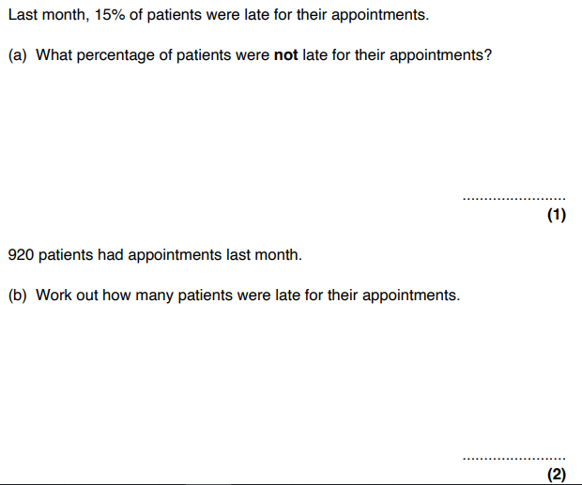
Exam questions
85%
138

Slide 21
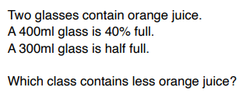
Exam questions
Notes:
Slide left blank for annotation

Slide 22
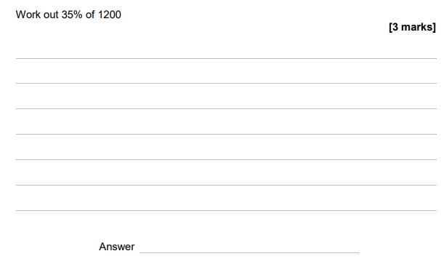
Exit ticket

