Slide 1

Working for Charities
Helping people
Collating Statistics to lobby the government funding
Budgeting & allocating spending of grants
Help people with household budgets
£35, 000
GCSEs
Alevels inc. Maths
Maths & Psychology Degree
Notes:
Neighbour

Slide 2

A museum owner says that less people visit the museum when it is sunny.
What do you think?
How could you check?

Slide 3
The table below shows the number of people who visited a museum over a 10 day period last summer together with the daily sunshine totals.
Plot a scatter graph for this data.
Hours Sunshine
6
0.5
8
3
8
10
7
5
3
2
Visitors
300
475
100
390
200
50
175
220
350
320
500
450
400
350
300
Number of Visitors
250
200
150
100
0
1
2
3
4
5
6
7
8
9
10
Hours of Sunshine

Slide 4
The table below shows the number of people who visited a museum over a 10 day period last summer together with the daily sunshine totals.
Plot a scatter graph for this data.
Hours Sunshine
6
0.5
8
3
8
10
7
5
3
2
Visitors
300
475
100
390
200
50
175
220
350
320
500
450
400
350
300
Number of Visitors
250
200
150
100
0
1
2
3
4
5
6
7
8
9
10
Hours of Sunshine

Slide 5
The table below shows the number of people who visited a museum over a 10 day period last summer together with the daily sunshine totals.
Plot a scatter graph for this data.
Hours Sunshine
6
0.5
8
3
8
10
7
5
3
2
Visitors
300
475
100
390
200
50
175
220
350
320
500
450
400
350
300
Number of Visitors
250
200
150
100
0
1
2
3
4
5
6
7
8
9
10
Hours of Sunshine

Slide 6
The table below shows the number of people who visited a museum over a 10 day period last summer together with the daily sunshine totals.
Plot a scatter graph for this data.
Hours Sunshine
6
0.5
8
3
8
10
7
5
3
2
Visitors
300
475
100
390
200
50
175
220
350
320
500
450
400
350
300
Number of Visitors
250
200
150
100
0
1
2
3
4
5
6
7
8
9
10
Hours of Sunshine

Slide 7
The table below shows the number of people who visited a museum over a 10 day period last summer together with the daily sunshine totals.
Plot a scatter graph for this data.
Hours Sunshine
6
0.5
8
3
8
10
7
5
3
2
Visitors
300
475
100
390
200
50
175
220
350
320
500
450
400
350
300
Number of Visitors
250
200
150
100
0
1
2
3
4
5
6
7
8
9
10
Hours of Sunshine

Slide 8
The table below shows the number of people who visited a museum over a 10 day period last summer together with the daily sunshine totals.
Plot a scatter graph for this data.
Hours Sunshine
6
0.5
8
3
8
10
7
5
3
2
Visitors
300
475
100
390
200
50
175
220
350
320
500
450
400
350
300
Number of Visitors
250
200
150
100
0
1
2
3
4
5
6
7
8
9
10
Hours of Sunshine

Slide 9
The table below shows the number of people who visited a museum over a 10 day period last summer together with the daily sunshine totals.
Plot a scatter graph for this data.
Hours Sunshine
6
0.5
8
3
8
10
7
5
3
2
Visitors
300
475
100
390
200
50
175
220
350
320
500
450
400
350
300
Number of Visitors
250
200
150
100
0
1
2
3
4
5
6
7
8
9
10
Hours of Sunshine

Slide 10
The table below shows the number of people who visited a museum over a 10 day period last summer together with the daily sunshine totals.
Plot a scatter graph for this data.
Hours Sunshine
6
0.5
8
3
8
10
7
5
3
2
Visitors
300
475
100
390
200
50
175
220
350
320
500
450
400
350
300
Number of Visitors
250
200
150
100
0
1
2
3
4
5
6
7
8
9
10
Hours of Sunshine

Slide 11
The table below shows the number of people who visited a museum over a 10 day period last summer together with the daily sunshine totals.
Plot a scatter graph for this data.
Hours Sunshine
6
0.5
8
3
8
10
7
5
3
2
Visitors
300
475
100
390
200
50
175
220
350
320
500
450
400
350
300
Number of Visitors
250
200
150
100
0
1
2
3
4
5
6
7
8
9
10
Hours of Sunshine

Slide 12
The table below shows the number of people who visited a museum over a 10 day period last summer together with the daily sunshine totals.
Plot a scatter graph for this data.
Hours Sunshine
6
0.5
8
3
8
10
7
5
3
2
Visitors
300
475
100
390
200
50
175
220
350
320
500
450
400
What does the graph show?
Do less people visit the museum when it is sunny?
350
300
Number of Visitors
250
200
150
100
0
1
2
3
4
5
6
7
8
9
10
Hours of Sunshine

Slide 13

Are people with bigger feet heavier than those with smaller feet?
What do you think?
How could you check?

Slide 14
The table below shows the shoe size and mass of 10 men.
Plot a scatter graph for this data.
Size
5
12
12
10
10
9
8
11
6
8
Mass
65
97
68
92
78
78
76
88
74
80
100
95
90
85
80
Mass (kg)
75
70
65
60
4
5
6
7
8
9
10
11
12
13
Shoe Size

Slide 15
The table below shows the shoe size and mass of 10 men.
Plot a scatter graph for this data.
Size
5
12
12
10
10
9
8
11
6
8
Mass
65
97
68
92
78
78
76
88
74
80
100
95
90
85
80
Mass (kg)
75
70
65
60
4
5
6
7
8
9
10
11
12
13
Shoe Size

Slide 16
The table below shows the shoe size and mass of 10 men.
Plot a scatter graph for this data.
Size
5
12
12
10
10
9
8
11
6
8
Mass
65
97
68
92
78
78
76
88
74
80
100
95
90
85
80
Mass (kg)
75
70
65
60
4
5
6
7
8
9
10
11
12
13
Shoe Size

Slide 17
The table below shows the shoe size and mass of 10 men.
Plot a scatter graph for this data.
Size
5
12
12
10
10
9
8
11
6
8
Mass
65
97
68
92
78
78
76
88
74
80
100
95
90
85
80
Mass (kg)
75
70
65
60
4
5
6
7
8
9
10
11
12
13
Shoe Size

Slide 18
The table below shows the shoe size and mass of 10 men.
Plot a scatter graph for this data.
Size
5
12
12
10
10
9
8
11
6
8
Mass
65
97
68
92
78
78
76
88
74
80
100
95
90
85
80
Mass (kg)
75
70
65
60
4
5
6
7
8
9
10
11
12
13
Shoe Size

Slide 19
The table below shows the shoe size and mass of 10 men.
Plot a scatter graph for this data.
Size
5
12
12
10
10
9
8
11
6
8
Mass
65
97
68
92
78
78
76
88
74
80
100
95
90
85
80
Mass (kg)
75
70
65
60
4
5
6
7
8
9
10
11
12
13
Shoe Size

Slide 20
The table below shows the shoe size and mass of 10 men.
Plot a scatter graph for this data.
Size
5
12
12
10
10
9
8
11
6
8
Mass
65
97
68
92
78
78
76
88
74
80
100
95
90
85
80
Mass (kg)
75
70
65
60
4
5
6
7
8
9
10
11
12
13
Shoe Size

Slide 21
The table below shows the shoe size and mass of 10 men.
Plot a scatter graph for this data.
Size
5
12
12
10
10
9
8
11
6
8
Mass
65
97
68
92
78
78
76
88
74
80
100
95
90
85
80
Mass (kg)
75
70
65
60
4
5
6
7
8
9
10
11
12
13
Shoe Size

Slide 22
The table below shows the shoe size and mass of 10 men.
Plot a scatter graph for this data.
Size
5
12
12
10
10
9
8
11
6
8
Mass
65
97
68
92
78
78
76
88
74
80
100
95
90
85
80
Mass (kg)
75
70
65
60
4
5
6
7
8
9
10
11
12
13
Shoe Size

Slide 23
The table below shows the shoe size and mass of 10 men.
Plot a scatter graph for this data.
Size
5
12
12
10
10
9
8
11
6
8
Mass
65
97
68
92
78
78
76
88
74
80
100
95
90
What does the graph show?
Are people with larger feet heavier than those with smaller feet?
What about this man?
85
80
Mass (kg)
75
70
65
60
4
5
6
7
8
9
10
11
12
13
Shoe Size

Slide 24
Worksheet
Write the answers to the questions in the booklet.
Answer all the questions.
Stick the booklet into your books.

Slide 25
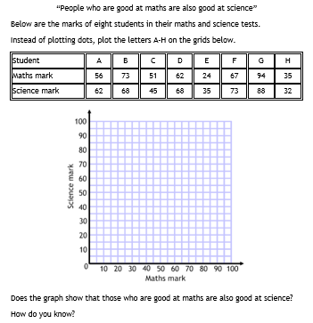

Slide 26
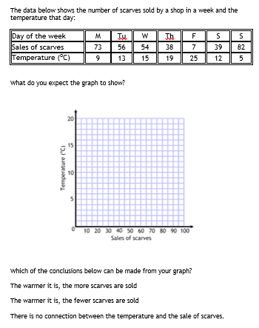

Slide 27
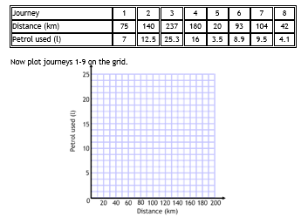
Notes:
Mark with a visualiser

Slide 28
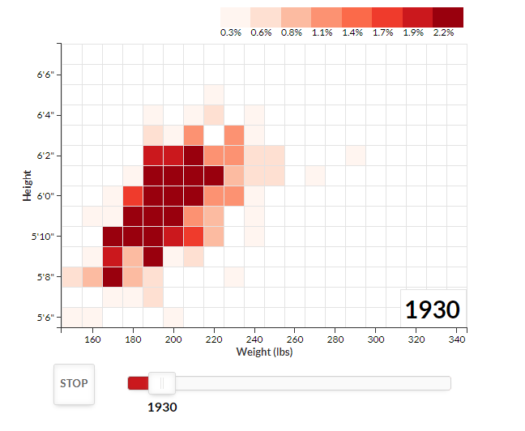
A moving Scatter Graph – Click me
What do you notice?

Slide 29
For printing

Slide 30
Question2
The table below shows the number of people who visited a museum over a 10 day period last summer together with the daily sunshine totals.
Plot a scatter graph for this data.
Hours Sunshine
6
0.5
8
3
8
10
7
5
3
2
Visitors
300
475
100
390
200
50
175
220
350
320
500
450
400
350
300
Number of Visitors
250
200
150
100
0
6
1
2
3
4
5
7
8
9
10
Hours of Sunshine

Slide 31
The table below shows the shoe size and mass of 10 men.
Plot a scatter graph for this data.
Size
5
12
12
10
10
9
8
11
6
8
Mass
65
97
68
92
78
78
76
88
74
80
100
95
90
85
80
Mass (kg)
75
70
65
60
4
5
6
7
8
9
10
11
12
13
Shoe Size

