Slide 1
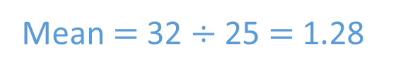
TITLE: Averages from grouped frequency tables
The table shows the numbers of pets owned by a group of students. Find the mean number of pets owned.
Find the number halfway between each pair of numbers.
Number of pets | 0 | 1 | 2 | 3 | 4
Frequency | 5 | 12 | 5 | 2 | 1
Totals
25
Sub-totals | 0 | 12 | 10 | 6 | 4
32
Mean $=$ 32 $÷$ 25 $=$ 1.28
0 and 10
11 and 20
21 and 40
5
15.5
30.5

Slide 2
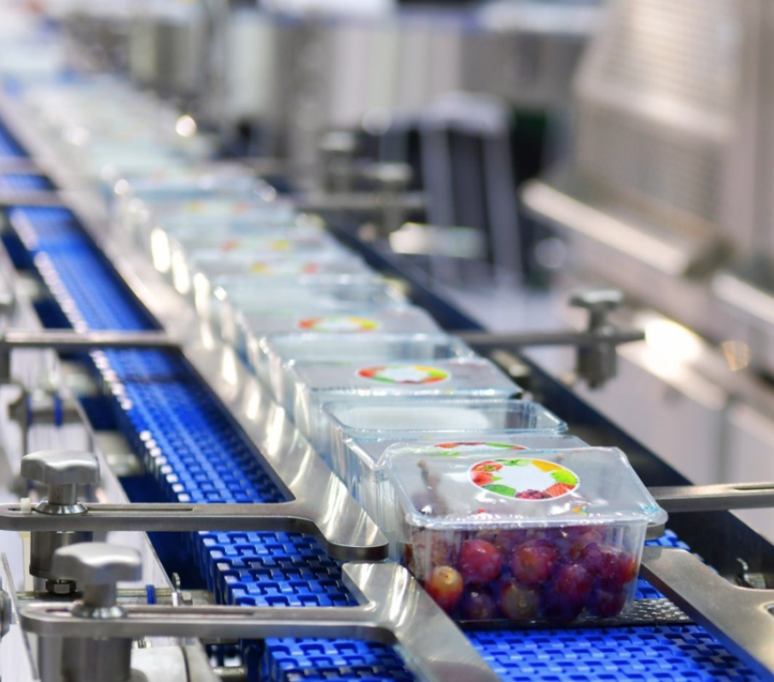
Research & Development Manager
Budgeting and forecasting
Modelling Systems
Heat & Mass processes
Thermal design
Business evaluations (investments, returns, paybacks)
Analysis of statistical results
Make healthier products and process for consumers
Travel
£71, 571
A-levels (maths, further maths, chemistry, physics)
Masters Degree in Chemical Engineering (Cambridge)
30 years experience in food production research & development
GCSEs
Notes:
Friends have known for 20years

Slide 3
Here are the ages of 30 people in a park.
1 | 51 | 53 | 15 | 26 | 32 | 19 | 7 | 11 | 34
45 | 21 | 19 | 17 | 15 | 25 | 32 | 17 | 18 | 11
12 | 15 | 18 | 36 | 44 | 9 | 22 | 30 | 41 | 16
Work out the mean of the ages.
Why would this be difficult and time consuming?
Lots of different values
An ungrouped frequency table would have too many rows.

Slide 4
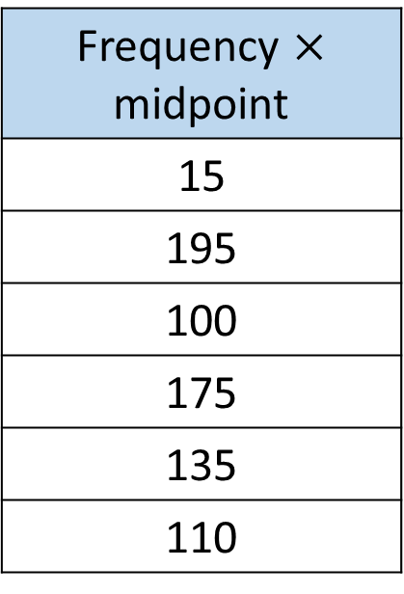
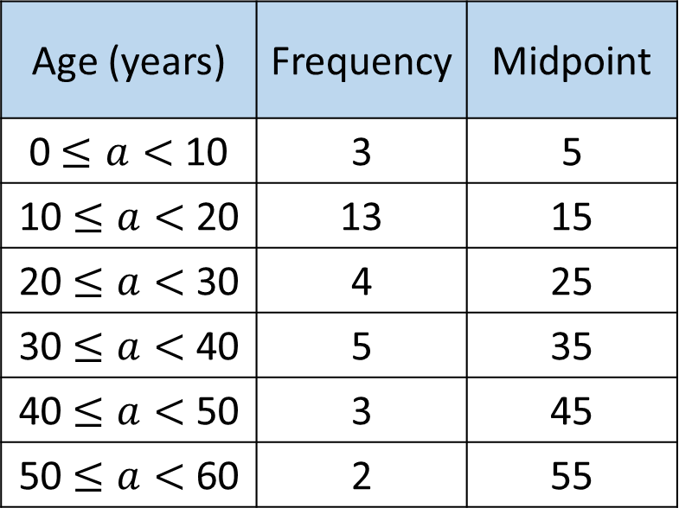
1 | 51 | 53 | 15 | 26 | 32 | 19 | 7 | 11 | 34
45 | 21 | 19 | 17 | 15 | 25 | 32 | 17 | 18 | 11
12 | 15 | 18 | 36 | 44 | 9 | 22 | 30 | 41 | 16
The midpoint is used as a ‘best estimate’ of the ages in that group.
Age (years) | Frequency | Midpoint
0 $≤a<$ 10 | 3 | 5
10 $≤a<$ 20 | 13 | 15
20 $≤a<$ 30 | 4 | 25
30 $≤a<$ 40 | 5 | 35
40 $≤a<$ 50 | 3 | 45
50 $≤a<$ 60 | 2 | 55
Frequency $×$ midpoint
15
195
100
175
135
110
Notes:
Discuss why the midpoint is used and how this links to the estimate of the mean

Slide 5
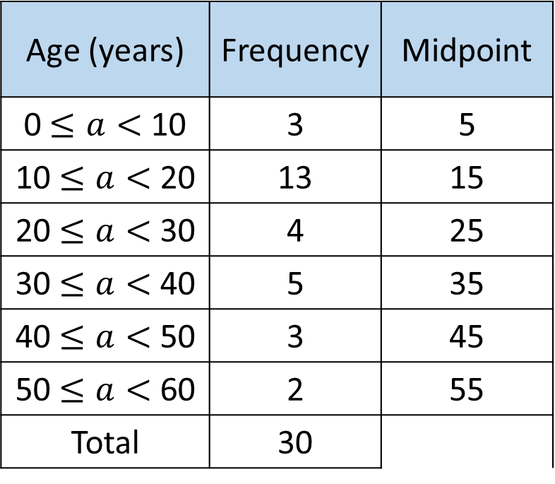

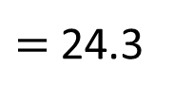
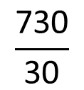
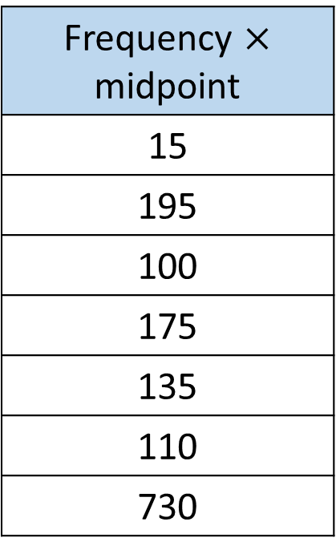
Age (years) | Frequency | Midpoint
0 $≤a<$ 10 | 3 | 5
10 $≤a<$ 20 | 13 | 15
20 $≤a<$ 30 | 4 | 25
30 $≤a<$ 40 | 5 | 35
40 $≤a<$ 50 | 3 | 45
50 $≤a<$ 60 | 2 | 55
Total | 30
Frequency $×$ midpoint
15
195
100
175
135
110
730
$$Mean=\frac{Total estimate of age}{Total number of people}$$
$$\frac{\text{730}}{\text{30}}$$
The estimated mean age of the people in the park is 24.3 years.
$=$ 24.3

Slide 6

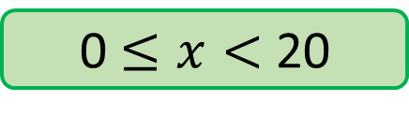
What would the midpoints be for each of these class intervals?
0 $≤x<$ 20
10

Slide 7
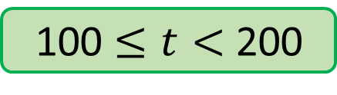
What would the midpoints be for each of these class intervals?
100 $≤t<$ 200
150

Slide 8
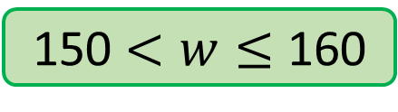
What would the midpoints be for each of these class intervals?
150 $<w≤$ 160
155

Slide 9
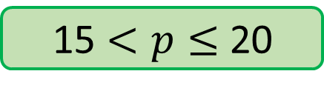
What would the midpoints be for each of these class intervals?
15 $<p≤$ 20
17.5

Slide 10
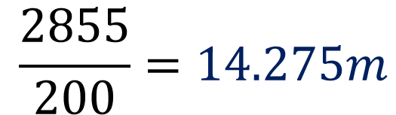

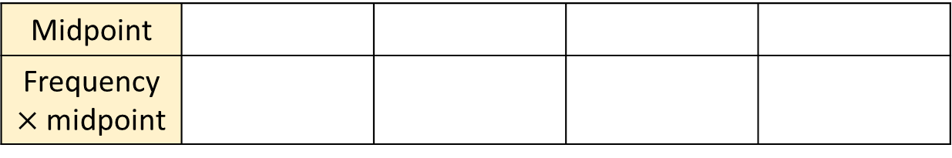
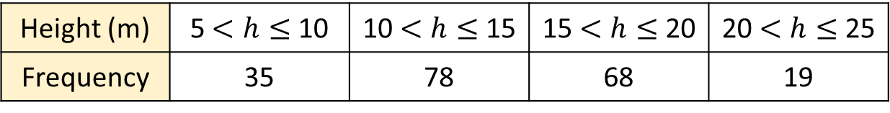
The table shows information about the heights, in m, of some trees.
Height (m) | 5 $<h≤$ 10 | 10 $<h≤$ 15 | 15 $<h≤$ 20 | 20 $<h≤$ 25
Frequency | 35 | 78 | 68 | 19
Midpoint
Frequency $×$ midpoint
7.5
12.5
17.5
22.5
262.5
975
1190
427.5
Work out an estimate of the mean
$$\frac{2855}{200}=14.275m$$
$$Mean≈ \frac{Total height}{Total number of trees}$$
Is this a sensible answer? Why?
Notes:
Variation of a horizontal table
Can use MWB to show answers 1 by 1 to CFU

Slide 11

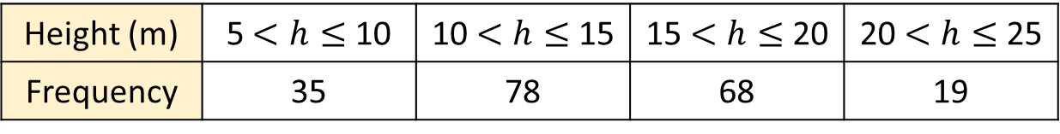

The table shows information about the heights, in m, of some trees.
Height (m) | 5 $<h≤$ 10 | 10 $<h≤$ 15 | 15 $<h≤$ 20 | 20 $<h≤$ 25
Frequency | 35 | 78 | 68 | 19
Midpoint | 7.5 | 12.5 | 17.5 | 22.5
Frequency $×$ midpoint | 262.5 | 975 | 1,190 | 427.5
Can you work out the modal height of the trees?
The modal class is 10 $<h≤$ 15
The estimated mean was $14.275m$ which also falls into the modal class.

Slide 12
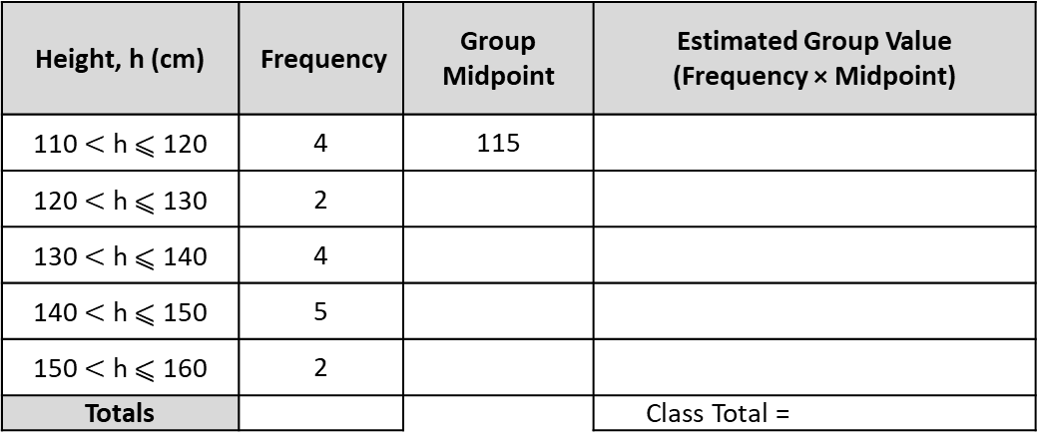
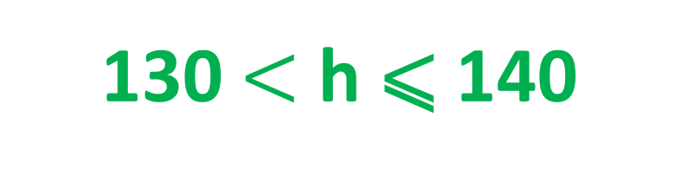
Amelle’s tallest friend is 140 cm tall. Her shortest friend is 120 cm tall.
Amelle and her four other friends are between these heights.
Height, h (cm) | Frequency | Group Midpoint | Estimated Group Value (Frequency × Midpoint)
110 $<$ h ⩽ 120 | 4 | 115
120 $<$ h ⩽ 130 | 2
130 $<$ h ⩽ 140 | 4
140 $<$ h ⩽ 150 | 5
150 $<$ h ⩽ 160 | 2
Totals |  |  | Class Total =
Alice is 132 cm tall, which group is she in?
130 $<$ h ⩽ 140

Slide 13
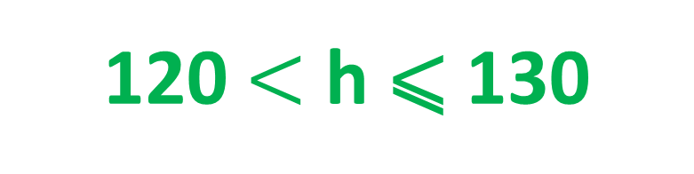
Amelle’s tallest friend is 140 cm tall. Her shortest friend is 120 cm tall.
Amelle and her four other friends are between these heights.
Height, h (cm) | Frequency | Group Midpoint | Estimated Group Value (Frequency × Midpoint)
110 $<$ h ⩽ 120 | 4 | 115
120 $<$ h ⩽ 130 | 2
130 $<$ h ⩽ 140 | 4
140 $<$ h ⩽ 150 | 5
150 $<$ h ⩽ 160 | 2
Totals |  |  | Class Total =
Arjun is 130 cm tall, which group is he in?
120 $<$ h ⩽ 130

Slide 14
Amelle’s tallest friend is 140 cm tall. Her shortest friend is 120 cm tall.
Amelle and her four other friends are between these heights.
Height, h (cm) | Frequency | Group Midpoint | Estimated Group Value (Frequency × Midpoint)
110 $<$ h ⩽ 120 | 4 | 115
120 $<$ h ⩽ 130 | 2
130 $<$ h ⩽ 140 | 4
140 $<$ h ⩽ 150 | 5
150 $<$ h ⩽ 160 | 2
Totals |  |  | Class Total =
Andy is 140 cm tall, which group is he in?
130 $<$ h ⩽ 140

Slide 15
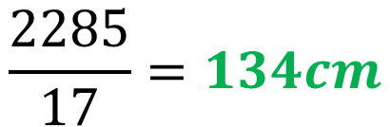
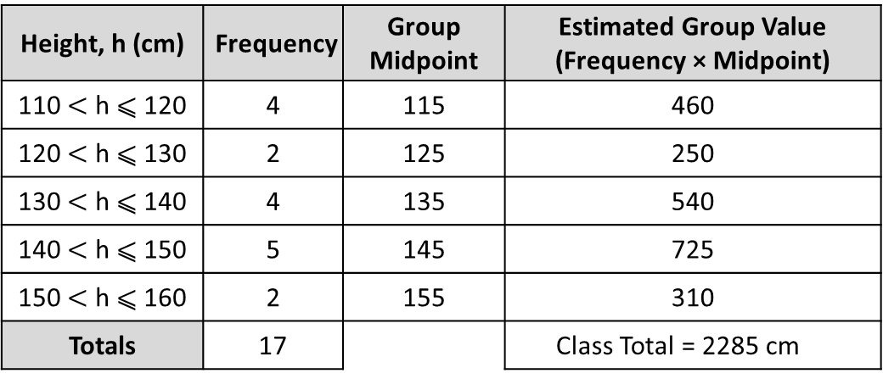
Amelle’s tallest friend is 140 cm tall. Her shortest friend is 120 cm tall.
Amelle and her four other friends are between these heights.
Height, h (cm) | Frequency | Group Midpoint | Estimated Group Value (Frequency × Midpoint)
110 $<$ h ⩽ 120 | 4 | 115 | 460
120 $<$ h ⩽ 130 | 2 | 125 | 250
130 $<$ h ⩽ 140 | 4 | 135 | 540
140 $<$ h ⩽ 150 | 5 | 145 | 725
150 $<$ h ⩽ 160 | 2 | 155 | 310
Totals | 17 |  | Class Total = 2285 cm
Height, h (cm) | Frequency | Group Midpoint | Estimated Group Value (Frequency × Midpoint)
110 $<$ h ⩽ 120 | 4 | 115
120 $<$ h ⩽ 130 | 2
130 $<$ h ⩽ 140 | 4
140 $<$ h ⩽ 150 | 5
150 $<$ h ⩽ 160 | 2
Totals |  |  | Class Total =
Find an estimate for the mean
$$\frac{2285}{17}=134cm$$

Slide 16
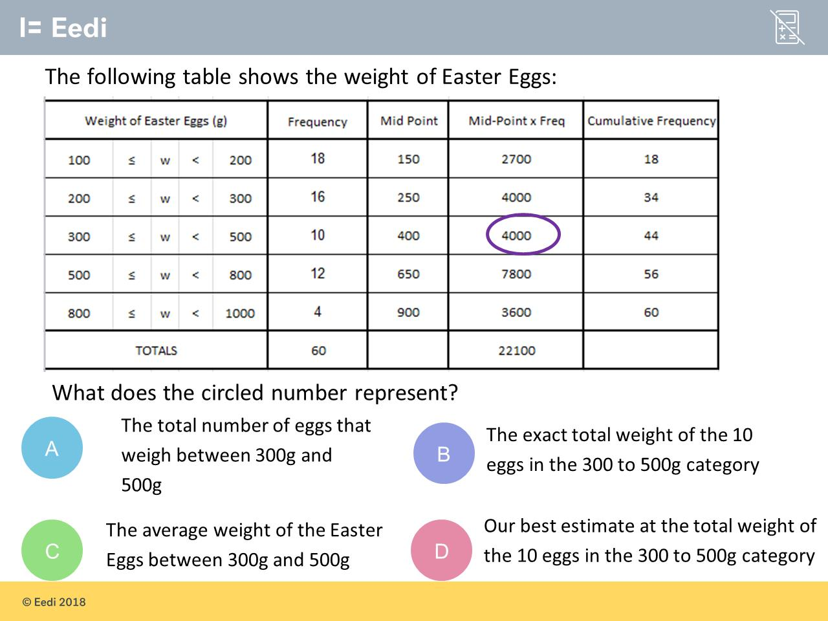

Slide 17
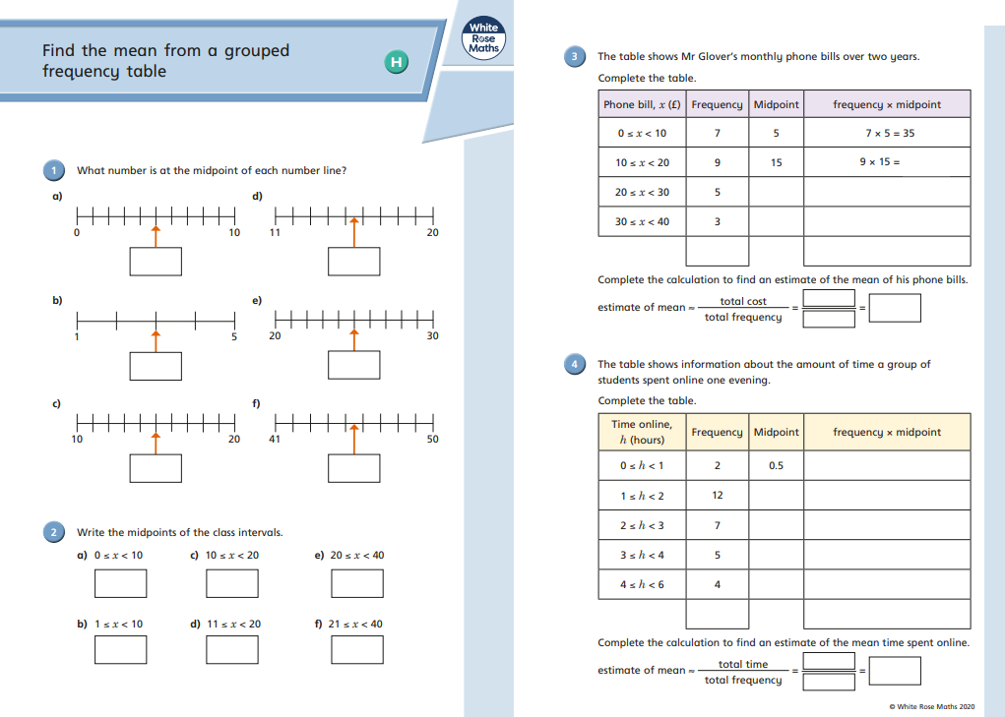
Independent practice
Notes:
Some students may only need page 1

Slide 18
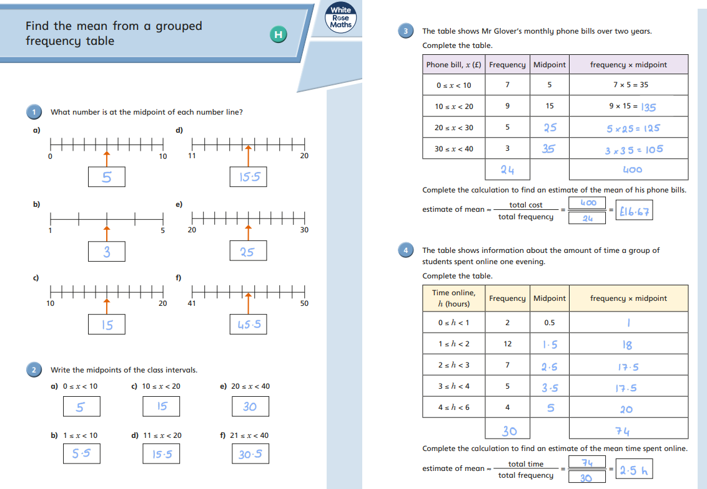
Mark your work in green pen

Slide 19
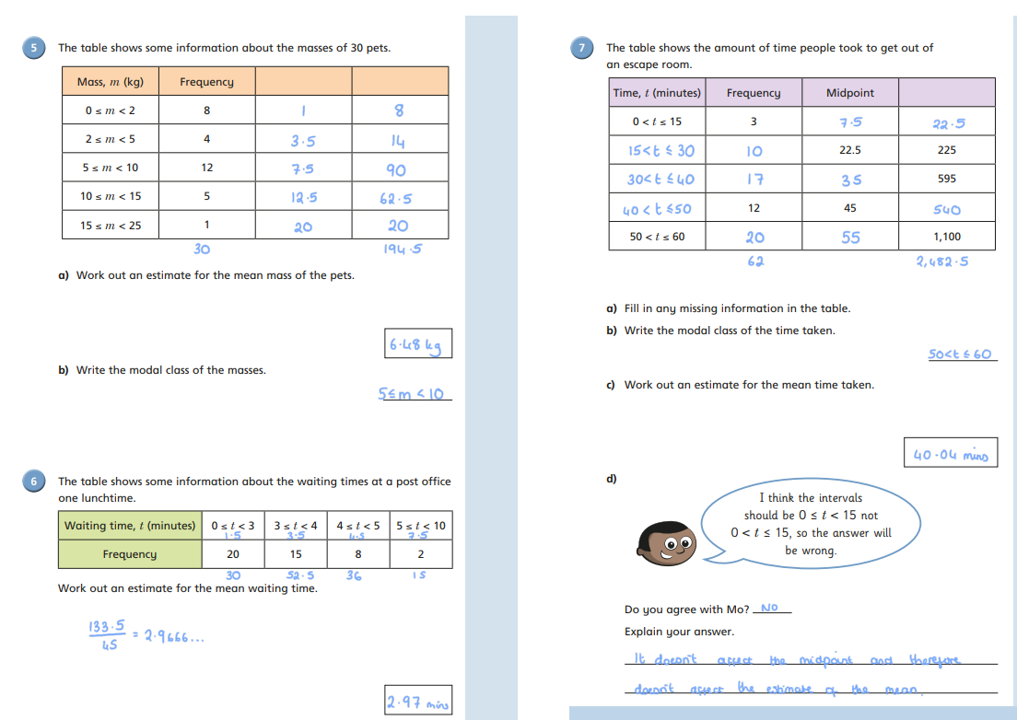
Mark your work in green pen

Slide 20
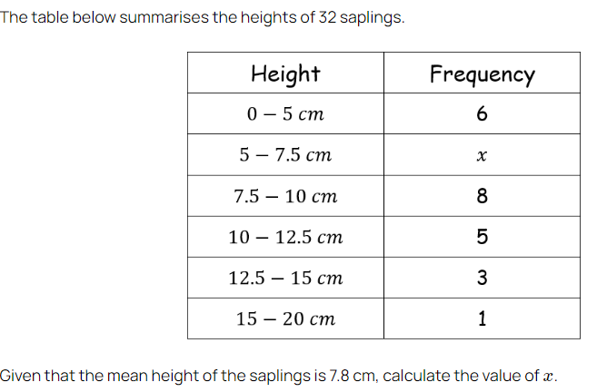
Problem 1

Slide 21
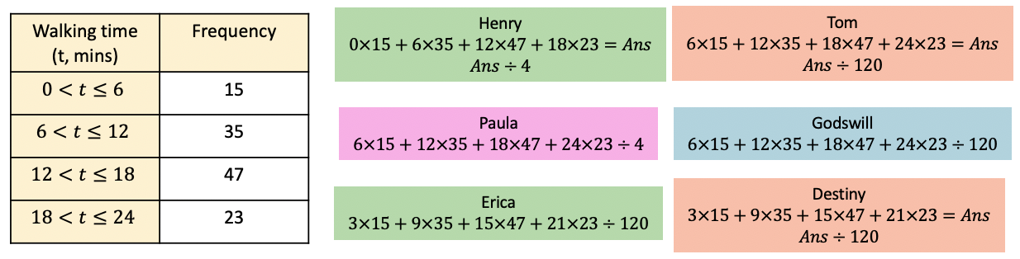
Problem 2
A group of children are asked how long they walk for on their way home from school.
The information is shown in the table. Henry, Tom, Paula, Godswill, Erica and Destiny are finding the estimated mean.
Whose calculations will find the correct answer?
Destiny because she has used the midpoints and divides by 120 separately after adding the midpoint x frequencies together.

Slide 22
Problem 3
For each of their statements, decide whether they are always true, sometimes true or never true.
Mbongeni says that the estimated mean is a decimal.
Fabian says that the estimated mean is in the interval with the highest frequency.
Nic says that the estimated mean is not in the first or last interval
a) Sometimes true b) Sometimes true c) Sometimes true

Slide 23
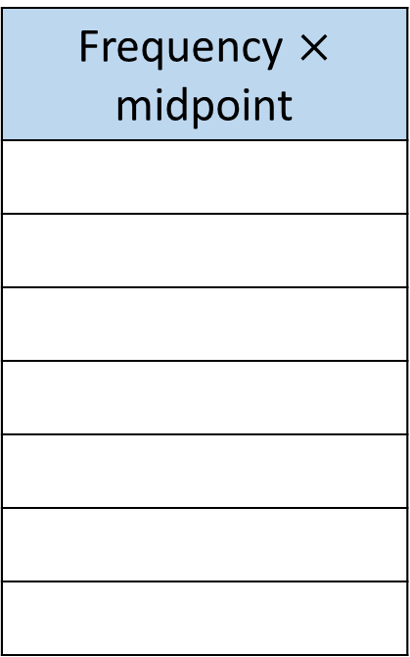
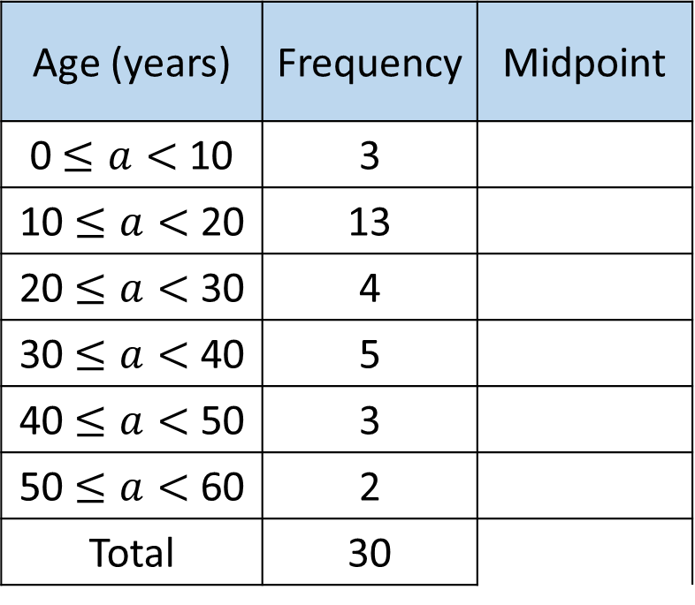
Example 1 - Ages of 30 people in a park
Age (years) | Frequency | Midpoint
0 $≤a<$ 10 | 3
10 $≤a<$ 20 | 13
20 $≤a<$ 30 | 4
30 $≤a<$ 40 | 5
40 $≤a<$ 50 | 3
50 $≤a<$ 60 | 2
Total | 30
Frequency $×$ midpoint
Notes:
Print 2 to a page for students to follow worked examples

Slide 24
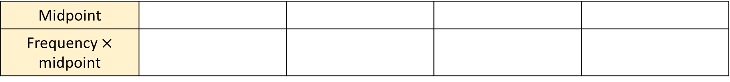
Example 2 - Information about the heights, in m, of some trees.
Height (m) | 5 $<h≤$ 10 | 10 $<h≤$ 15 | 15 $<h≤$ 20 | 20 $<h≤$ 25
Frequency | 35 | 78 | 68 | 19
Midpoint
Frequency $×$ midpoint

Slide 25
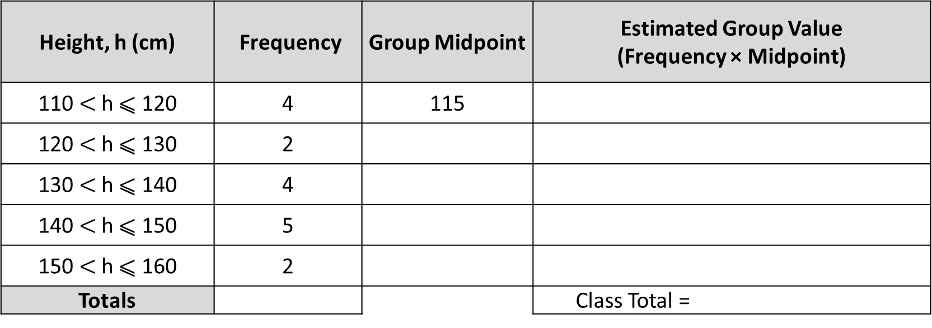
Example 3 - Information about the heights, in cm, of Amelle’s friends
Height, h (cm) | Frequency | Group Midpoint | Estimated Group Value (Frequency × Midpoint)
110 $<$ h ⩽ 120 | 4 | 115
120 $<$ h ⩽ 130 | 2
130 $<$ h ⩽ 140 | 4
140 $<$ h ⩽ 150 | 5
150 $<$ h ⩽ 160 | 2
Totals |  |  | Class Total =

