Slide 1
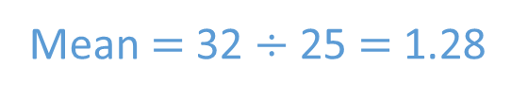
The table shows the numbers of pets owned by a group of students. Find the mean number of pets owned.
Number of pets | 0 | 1 | 2 | 3 | 4
Frequency | 5 | 12 | 5 | 2 | 1
Totals
25
Sub-totals | 0 | 12 | 10 | 6 | 4
32
Mean $=$ 32 $÷$ 25 $=$ 1.28

Slide 2
Find the number halfway between each pair of numbers.
0 and 10
11 and 20
21 and 40
5
15.5
30.5

Slide 3
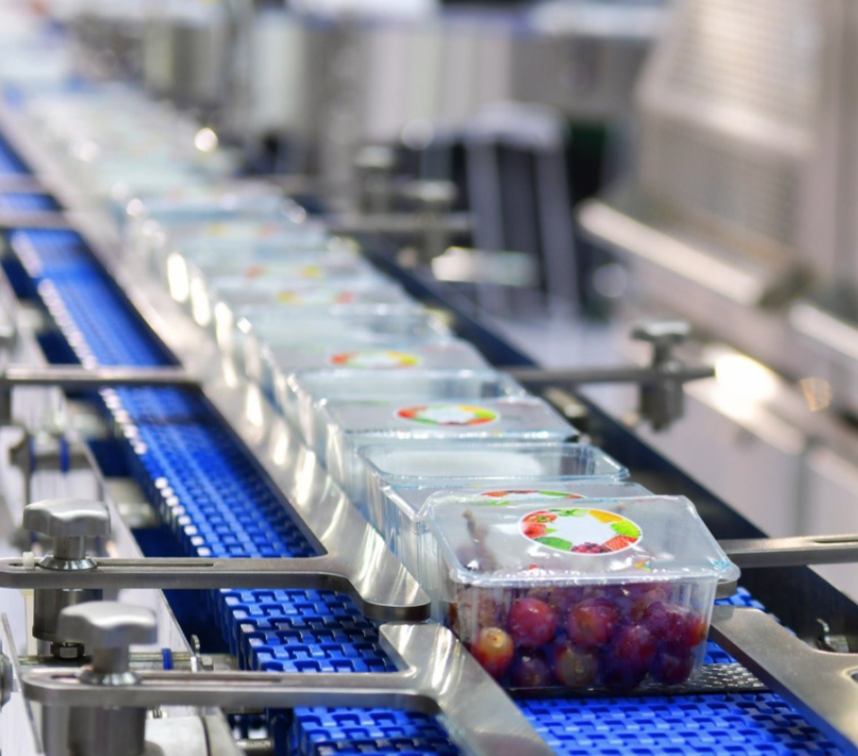
Research & Development Manager
Make healthier products and process for consumers
Travel
Budgeting and forecasting
Modelling Systems
Heat & Mass processes
Thermal design
Business evaluations (investments, returns, paybacks)
Analysis of statistical results
£71, 571
A-levels (maths, further maths, chemistry, physics)
Masters Degree in Chemical Engineering (Cambridge)
30 years experience in food production research & development
GCSEs
Notes:
Friends have known for 20years

Slide 4
Here are the ages of 30 people in a park.
1 | 51 | 53 | 15 | 26 | 32 | 19 | 7 | 11 | 34
45 | 21 | 19 | 17 | 15 | 25 | 32 | 17 | 18 | 11
12 | 15 | 18 | 36 | 44 | 9 | 22 | 30 | 41 | 16
Work out the mean of the ages.
Why would this be difficult and time consuming?
Lots of different values
An ungrouped frequency table would have too many rows.

Slide 5
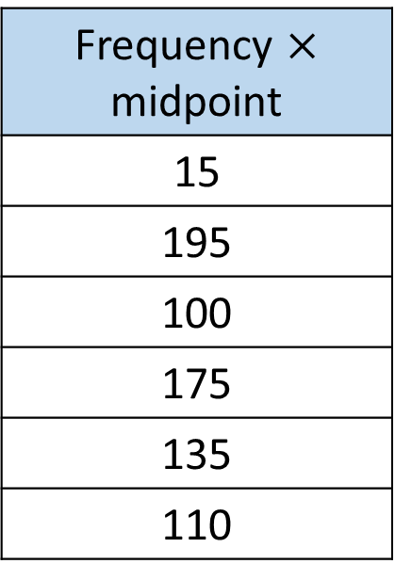
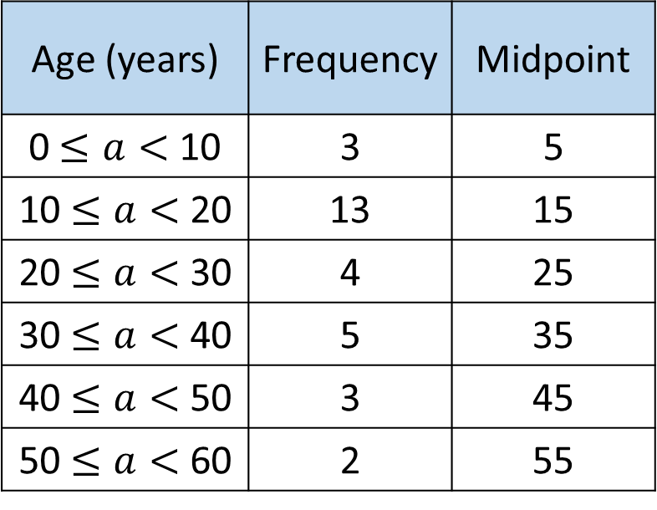
1 | 51 | 53 | 15 | 26 | 32 | 19 | 7 | 11 | 34
45 | 21 | 19 | 17 | 15 | 25 | 32 | 17 | 18 | 11
12 | 15 | 18 | 36 | 44 | 9 | 22 | 30 | 41 | 16
Age (years) | Frequency | Midpoint
0 $≤a<$ 10 | 3 | 5
10 $≤a<$ 20 | 13 | 15
20 $≤a<$ 30 | 4 | 25
30 $≤a<$ 40 | 5 | 35
40 $≤a<$ 50 | 3 | 45
50 $≤a<$ 60 | 2 | 55
Frequency $×$ midpoint
15
195
100
175
135
110

Slide 6
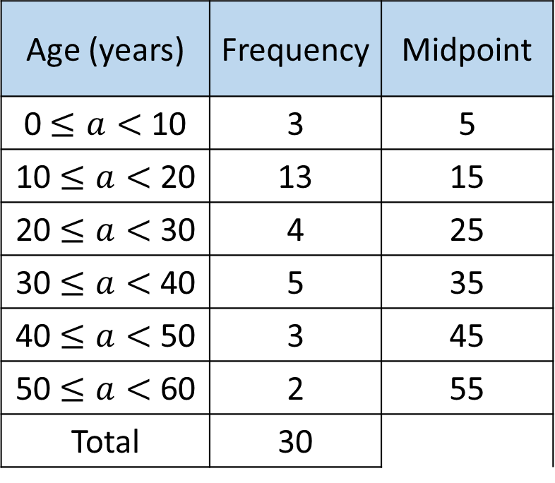
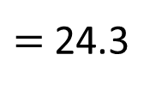
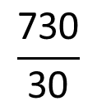
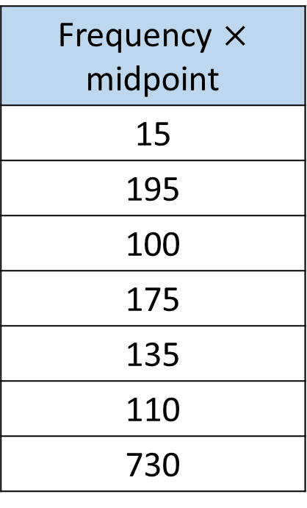
Age (years) | Frequency | Midpoint
0 $≤a<$ 10 | 3 | 5
10 $≤a<$ 20 | 13 | 15
20 $≤a<$ 30 | 4 | 25
30 $≤a<$ 40 | 5 | 35
40 $≤a<$ 50 | 3 | 45
50 $≤a<$ 60 | 2 | 55
Total | 30
Frequency $×$ midpoint
15
195
100
175
135
110
730
$$\frac{\text{730}}{\text{30}}$$
The estimated mean age of the people in the park is 24.3 years.
$=$ 24.3

Slide 7
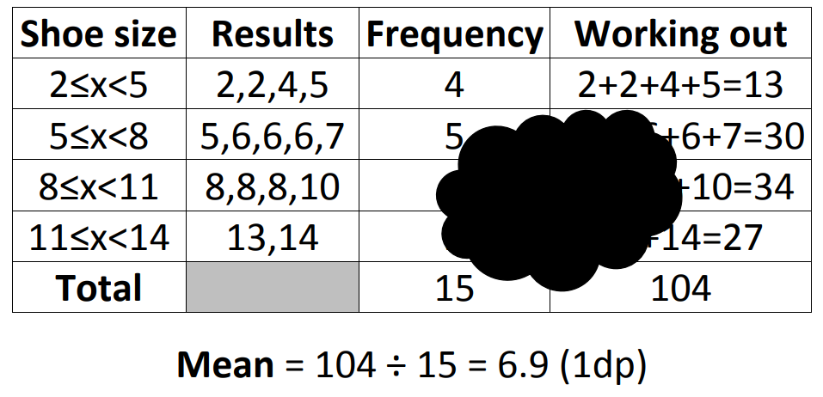


This table shows shoe sizes of a group of students and some working out to calculate the mean shoe size.
Some information has been blacked out.
What is the missing information?
5+6+6+
$$4$$
8+8+8+
$$2$$
13+
Notes:
Acknowledgements: mathssandpit.co.uk

Slide 8
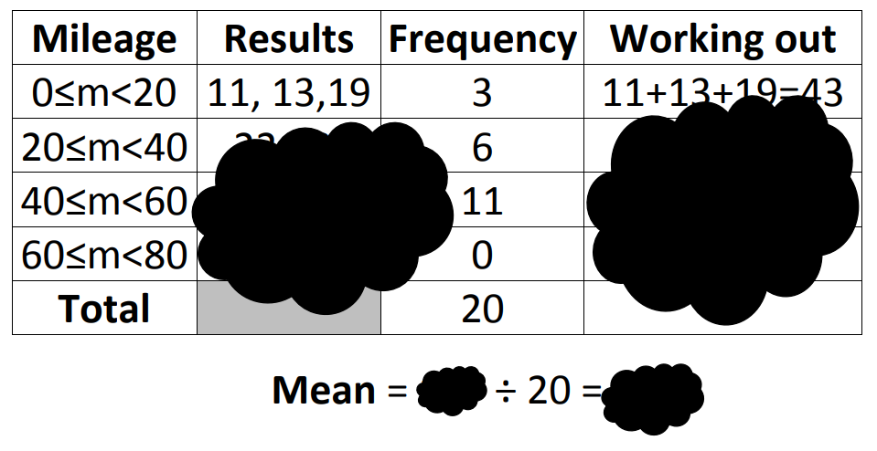
This table shows the weekly running mileage of a group of athletes.
Some information has been blacked out.
What is the missing information?
Notes:
Acknowledgements: mathssandpit.co.uk

Slide 9








This table shows the weekly running mileage of a group of athletes.
It is not possible to know what all of the missing information is.
What would be a sensible estimate for the 6 athletes who ran between 20 and 40 miles per week?
$$30, 30, 30, 30, 30, 30$$
$$30+30+30+30+30+30=180$$
$$50 each$$
$$50×11=550$$
$$70 each$$
$$0$$
$$773$$
$$773$$
$$38.65$$
Notes:
Acknowledgements: mathssandpit.co.uk

Slide 10
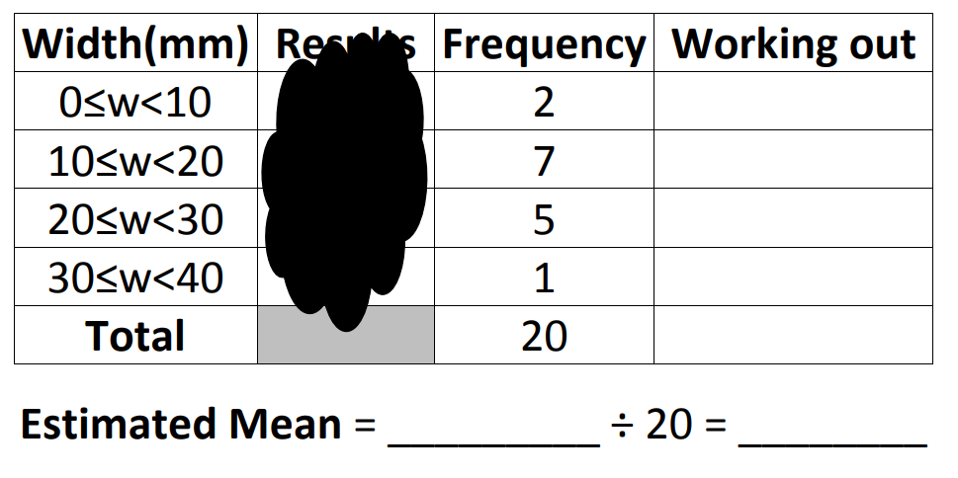











This table shows the widths of a tyres from a selection of road bikes.
Some information has been blacked out again.
Estimate the mean tyre width.
$$5$$
$$5×2=10$$
$$15$$
$$15×7=85$$
$$25$$
$$25×5=125$$
$$35$$
$$35×1=35$$
$$255$$
$$255$$
$$12.75$$
Notes:
Acknowledgements: mathssandpit.co.uk

Slide 11
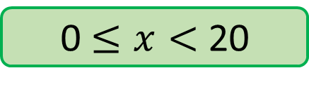
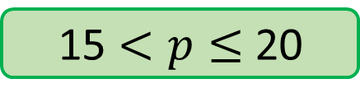
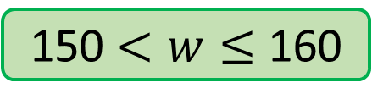
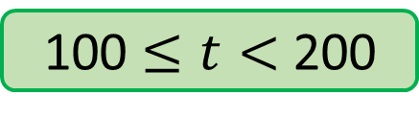
What would the midpoints be for each of these class intervals?
0 $≤x<$ 20
10
100 $≤t<$ 200
150
150 $<w≤$ 160
155
15 $<p≤$ 20
17.5

Slide 12
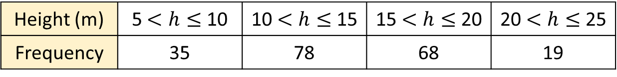
The table shows information about the heights, in m, of some trees.
Height (m) | 5 $<h≤$ 10 | 10 $<h≤$ 15 | 15 $<h≤$ 20 | 20 $<h≤$ 25
Frequency | 35 | 78 | 68 | 19
Does it make a difference that the table is presented horizontally rather than vertically?

Slide 13
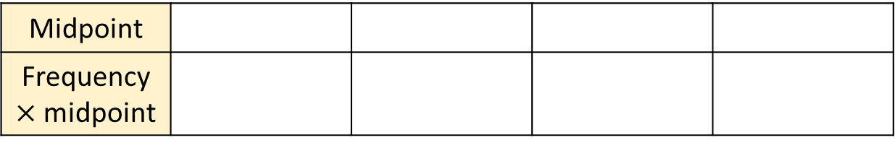

The table shows information about the heights, in m, of some trees.
Height (m) | 5 $<h≤$ 10 | 10 $<h≤$ 15 | 15 $<h≤$ 20 | 20 $<h≤$ 25
Frequency | 35 | 78 | 68 | 19
Midpoint
Frequency $×$ midpoint

Slide 14



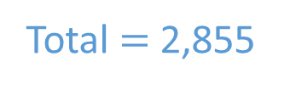

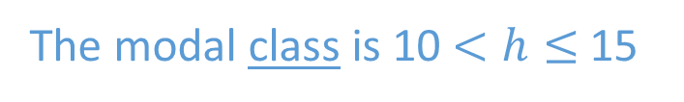
The table shows information about the heights, in m, of some trees.
Height (m) | 5 $<h≤$ 10 | 10 $<h≤$ 15 | 15 $<h≤$ 20 | 20 $<h≤$ 25
Frequency | 35 | 78 | 68 | 19
Midpoint | 7.5 | 12.5 | 17.5 | 22.5
Frequency $×$ midpoint | 262.5 | 975 | 1,190 | 427.5
Total $=$ 2,855
Total frequency $=$ 200
Mean $≈$ 2,855 $÷$ 200 $=$ 14.3
Can you work out the modal height of the trees?
The modal class is 10 $<h≤$ 15

Slide 15
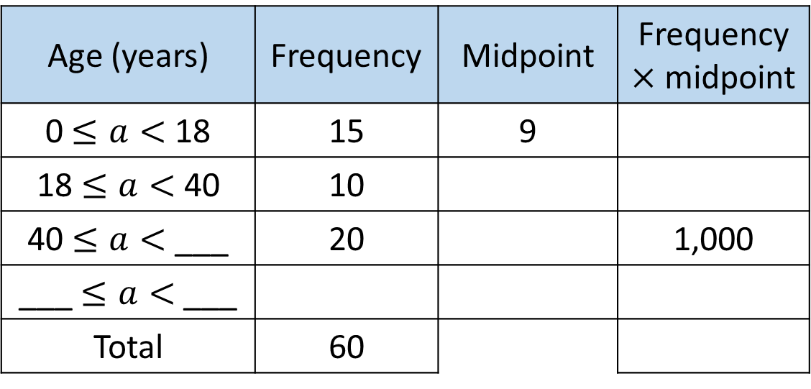
Age (years) | Frequency | Midpoint | Frequency $×$ midpoint
0 $≤a<$ 18 | 15 | 9
18 $≤a<$ 40 | 10
40 $≤a<$ ___ | 20 |  | 1,000
___ $≤a<$ ___
Total | 60
The estimate of the mean of the ages is 42.5
How can you find the missing values in the table?

Slide 16
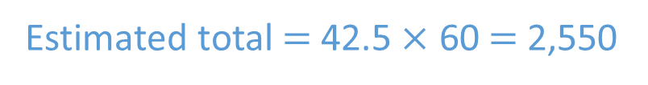
Age (years) | Frequency | Midpoint | Frequency $×$ midpoint
0 $≤a<$ 18 | 15 | 9
18 $≤a<$ 40 | 10
40 $≤a<$ ___ | 20 |  | 1,000
___ $≤a<$ ___
Total | 60
135
29
290
60
50
60
90
15
75
1,125
2,550
The estimate of the mean of the ages is 42.5
How can you find the missing values in the table?
Estimated total $=$ 42.5 $×$ 60 $=$ 2,550

Slide 17
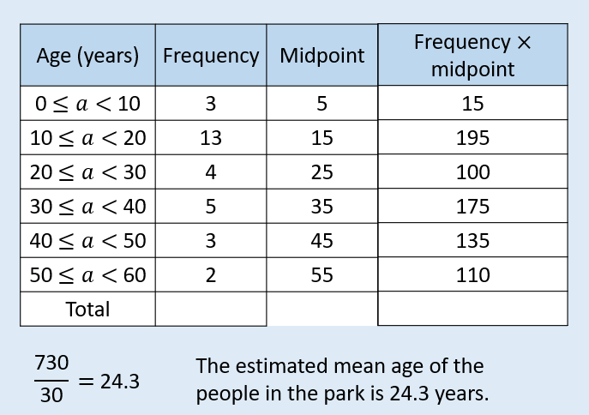
TITLE: Estimating a mean from grouped data
Find an estimate of the mean age for people at Wollaton Park on Sunday
The modal class will be here as this is group with most people in 10≤a<20

Slide 18
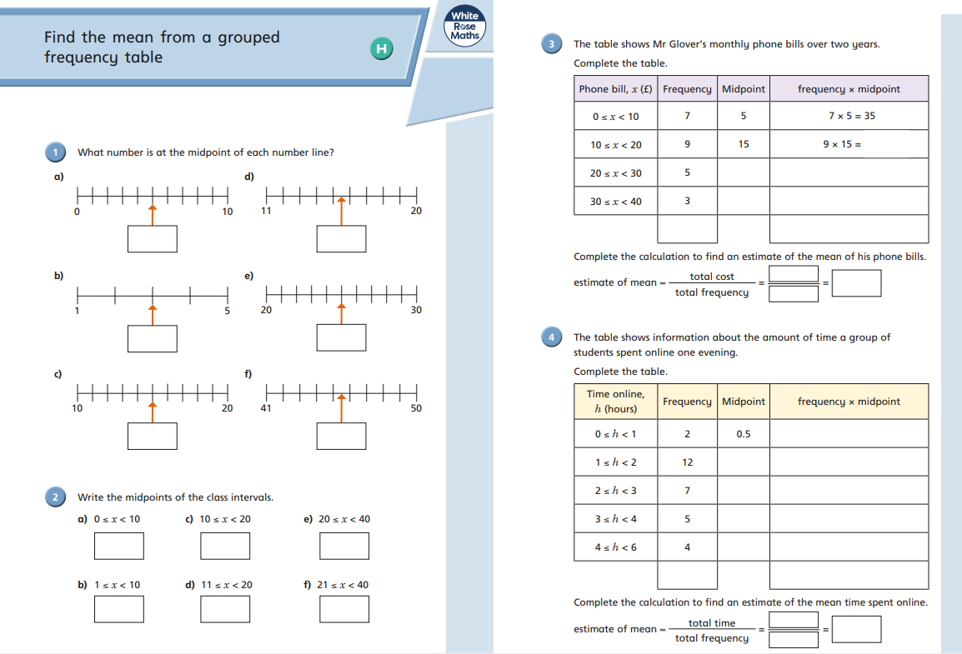
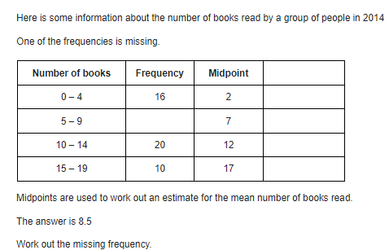
Challenge Problem

Slide 19
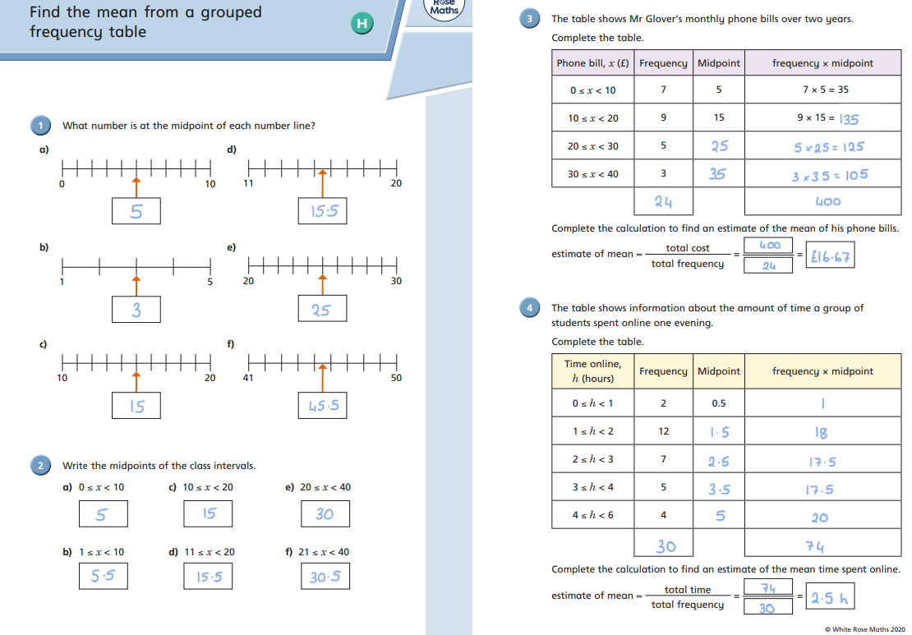

Slide 20
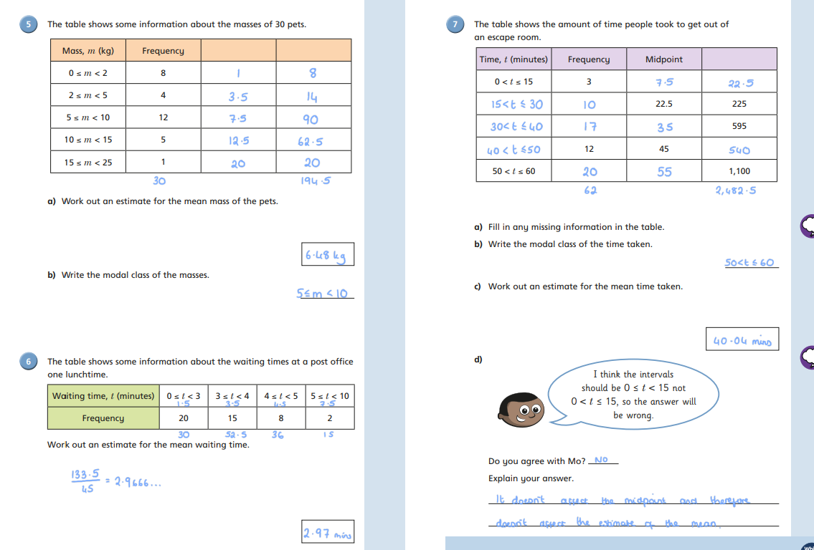

Slide 21
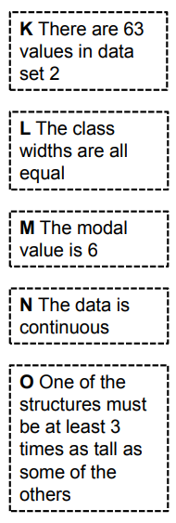
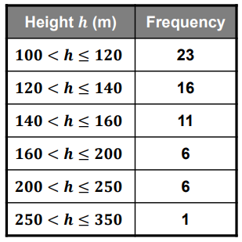
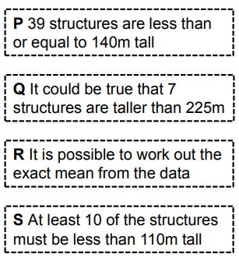
True or False
This data set represents the heights of London’s tallest structures.

Slide 22

Notes:
Acknowledgements: MathsPad

