Slide 1

Finance Director of ASDA
Ensure the business has realistic budgets i.e. how much money we make and spend, measure progress to make sure we make a profit.
Calculating profit margins
Predicting what cash there will be in the bank in the future
Work with all other teams across the business to help with their financial decisions
£150, 000
University degree
Finance Graduate Scheme
CIMA qualification whilst working
GCSEs
A-levels

Slide 2
What do the following words mean?
Discuss with your partner
Bank Balance
Credit
Debit
Income
Outgoings
Salary
Interest
Rent
Refund
Bank Transfer
Insurance

Slide 3
Bank Balance: the amount of money held in a bank account at a given moment.
Credit: add (an amount of money) to an account.
Debit: remove (an amount of money) from an account.
Income: money received, especially on a regular basis, for work or through investments.
Outgoings: a person's regular expenditure.

Slide 4
Salary: a fixed regular payment, typically paid on a monthly basis but often expressed as an annual sum, made by an employer to an employee
Interest: money paid regularly at a particular rate for the use of money
Rent: pay someone for the use of (something, typically property, land, or a car)
Refund: a repayment of a sum of money.
Bank Transfer: the sending of money from one bank account to another
Insurance: an arrangement by which a company undertakes to provide a guarantee of compensation for specified loss, damage, illness etc..

Slide 5
Date | Description | Credit (£) | Debit (£) | Balance(£)
Mar 1 | Opening balance |  |  | 185.72
Mar 3 | Phone bill |  | 39.99
Mar 5 | Refund | 50.00
Mar 8 | Groceries |  | 64.86
Mar 9 | Charges |  |  | 122.38
Balance – amount of money in an account
Credit – an amount paid into an account
Debit – an amount taken out of an account

Slide 6
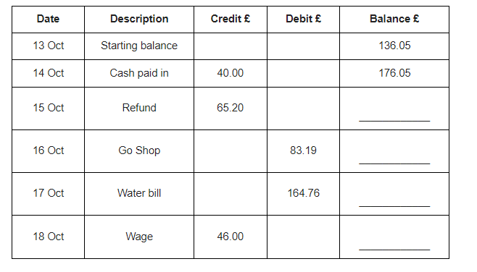
Complete the bank statement

Slide 7
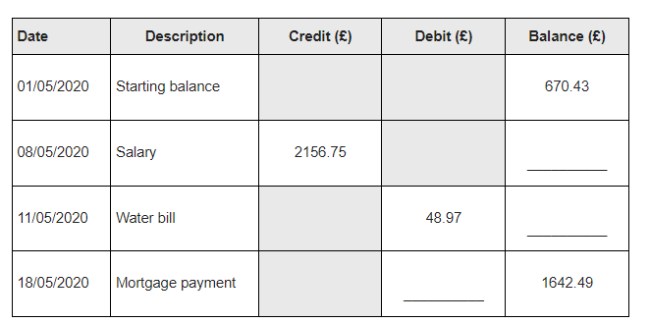
Complete the bank statement

Slide 8
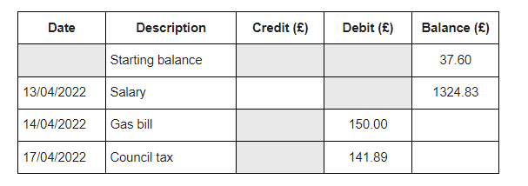
Complete the bank statement

Slide 9
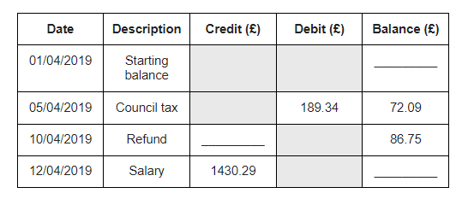
Complete the bank statement

Slide 10
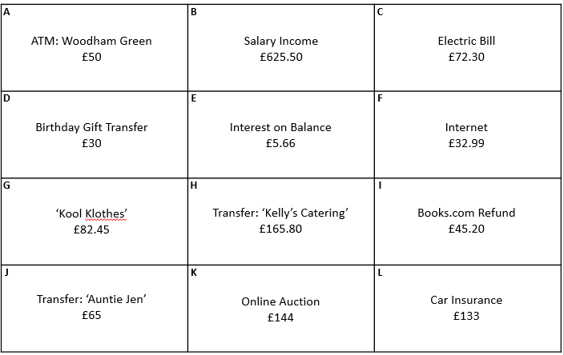
All these cards are items on a monthly bank statement.
Sort them into CREDITS & DEBITS.
If someone had a £500 starting balance at the beginning of the month,
what is the maximum or minimum they could have at the end of the month?

Slide 11
A
B
C
ATM: Woodham Green
£50
Salary Income
£625.50
Electric Bill
£72.30
D
E
F
Birthday Gift Transfer
£30
Interest on Balance
£5.66
Internet
£32.99
G
H
I
‘Kool Klothes’
£82.45
Transfer: ‘Kelly’s Catering’
£165.80
Books.com Refund
£45.20
J
K
L
Transfer: ‘Auntie Jen’
£65
Online Auction
£144
Car Insurance
£133

Slide 12
A
B
C
ATM: Woodham Green
£50
Salary Income
£625.50
Electric Bill
£72.30
D
E
F
Birthday Gift Transfer
£30
Interest on Balance
£5.66
Internet
£32.99
All these cards are items on a monthly bank statement. Sort them into CREDITS & DEBITS.
If someone had a £500 starting balance at the beginning of the month,
what is the maximum or minimum they could have at the end of the month?

Slide 13
All these cards are items on a monthly bank statement. Sort them into CREDITS & DEBITS.
If someone had a £500 starting balance at the beginning of the month,
what is the maximum or minimum they could have at the end of the month?
A
B
C
ATM: Woodham Green
£50
Salary Income
£625.50
Electric Bill
£72.30
D
E
F
Birthday Gift Transfer
£30
Interest on Balance
£5.66
Internet
£32.99
G
H
I
‘Kool Klothes’
£82.45
Transfer: ‘Kelly’s Catering’
£165.80
Books.com Refund
£45.20
J
K
L
Transfer: ‘Auntie Jen’
£65
Online Auction
£144
Car Insurance
£133

