Slide 1

Research & Development Manager
Make healthier products and process for consumers
Travel
Budgeting and forecasting
Modelling Systems
Heat & Mass processes
Thermal design
Business evaluations (investments, returns, paybacks)
Analysis of statistical results
£71, 571
A-levels (maths, further maths, chemistry, physics)
Masters Degree in Chemical Engineering (Cambridge)
30 years experience in food production research & development
GCSEs
Notes:
Friends have known for 20years

Slide 2
Where does money come from?
Discuss with your partner and estimate the following:
The minimum amount per hour that people under the 18 years of age are legally entitled to earn during the 2023/24 tax year
The minimum amount per hour that people over 23 years of age are legally entitled to earn during the 2023/24 tax year
The full basic weekly state pension for the 2023/24 tax year
The current average UK annual salary
The average percentage difference between the salaries of men and women in the UK.

Slide 3
Where does money come from?
Discuss with your partner and estimate the following:
The minimum amount per hour that people under the 18 years of age are legally entitled to earn during the 2023/24 tax year £5.28
The minimum amount per hour that people over 23 years of age are legally entitled to earn during the 2023/24 tax year £10.42
The full basic weekly state pension for the 2023/24 tax year £203.85
The current average UK annual salary £33402 (Mean average)
The average percentage difference between the salaries of men and women in the UK. 14.3% less for women

Slide 4

How much will Jacob earn in a week if he works:
3 hours?
6 hours?
12 hours?

Slide 5


Jane earns £8.45 an hour.
On Tuesday she works 6 hours.
How much does she get paid?
6 × 8.45 =
£50.70

Slide 6

John earns £64.80 a day for working 6 hours.
What is his pay rate per hour?
46.80 ÷ 6 =
£10.80 per hour

Slide 7

Joe’s pay rate is £6.50 an hour.
Joe earns £45.50 a day.
How many hours does he work in a day?
304 ÷ 8 =
7 hours

Slide 8

In a week, Janice works for 8 hours a day for 5 days.
Janice earns £8.62 an hour.
How much does she get paid a week?
(8 × 5) × 8.62 =
£344.80

Slide 9

Jack works 38 hours a week.
He earns £532 a week.
What is his pay rate per hour?
532 ÷ 38 =
£14 per hour

Slide 10

June earns £1501 a month.
June’s pay rate is £9.50 an hour.
How many hours does she work every month?
1501 ÷ 9.5 =
158 hours

Slide 11
Real world problem 1
National Minimum Wage (from April 2024)
16 – 17 years old | £6.40
18 – 20 years old | £8.60
21 years plus | £11.44
How much would a 20 year old earn in a week if they worked 32 hours?

Slide 12
Real world problem 2
National Minimum Wage (from April 2024)
16 – 17 years old | £6.40
18 – 20 years old | £8.60
21 years plus | £11.44
How much would a 16 year old earn in a week where they worked 2 hours per day for 3 days?

Slide 13
Real world problem 3
National Minimum Wage (from April 2024)
16 – 17 years old | £6.40
18 – 20 years old | £8.60
21 years plus | £11.44
How many hours would a 30 year old have to work in a week to earn £240.24?

Slide 14
A | £8.50 per hour for 5 hours. | 7
B | £40 for 5 hours work. | 446.25
C | £59.85 at £8.55 per hour. | 117
D | £36 for 6 hours work. | 1359.38
E | £113.49 at £12.61 per hour. | 6
F | £6.50 per hour for 3 days and 6 hours per day. | 42.50
G | £8.50 per hour for 7 days and 7.5 hours per day. | 7.50
H | £59.93 at £9.22 per hour. | 913.68
I | £318.75 per five day week with 8 ½ hours per day. | 8
J | 5 days a week for 6 weeks and 6 ¼ hours per day for £7.25 per hour | 6.5
K | £11.28 per hour over 6 weeks of 3 days a week part time (4 ½ hours a day). | 9
Match each calculation with an answer.
You must state what the answer is
( time / money / a total ).

Slide 15


Match each calculation with an answer.
You must state what the answer is
( time / money / a total ).
Match each calculation with an answer.
You must state what the answer is
( time / money / a total ).
A | £8.50 per hour for 5 hours. | 7
B | £40 for 5 hours work. | 446.25
C | £59.85 at £8.55 per hour. | 117
D | £36 for 6 hours work. | 1359.38
E | £113.49 at £12.61 per hour. | 6
F | £6.50 per hour for 3 days and 6 hours per day. | 42.50
G | £8.50 per hour for 7 days and 7.5 hours per day. | 7.50
H | £59.93 at £9.22 per hour. | 913.68
I | £318.75 per five day week with 8 ½ hours per day. | 8
J | 5 days a week for 6 weeks and 6 ¼ hours per day for £7.25 per hour | 6.5
K | £11.28 per hour over 6 weeks of 3 days a week part time (4 ½ hours a day). | 9
A | £8.50 per hour for 5 hours. | 7
B | £40 for 5 hours work. | 446.25
C | £59.85 at £8.55 per hour. | 117
D | £36 for 6 hours work. | 1359.38
E | £113.49 at £12.61 per hour. | 6
F | £6.50 per hour for 3 days and 6 hours per day. | 42.50
G | £8.50 per hour for 7 days and 7.5 hours per day. | 7.50
H | £59.93 at £9.22 per hour. | 913.68
I | £318.75 per five day week with 8 ½ hours per day. | 8
J | 5 days a week for 6 weeks and 6 ¼ hours per day for £7.25 per hour | 6.5
K | £11.28 per hour over 6 weeks of 3 days a week part time (4 ½ hours a day). | 9
Notes:
To print

Slide 16
Match each calculation with an answer.
You must state what the answer is
( time / money / a total ).
Half Answers
A | £8.50 per hour for 5 hours. | 7 hours | C
B | £40 for 5 hours work. | 446.25
C | £59.85 at £8.55 per hour. | 117
D | £36 for 6 hours work. | 1359.38
E | £113.49 at £12.61 per hour. | £6 per hour | D
F | £6.50 per hour for 3 days and 6 hours per day. | £42.50 in total | A
G | £8.50 per hour for 7 days and 7.5 hours per day. | 7.50
H | £59.93 at £9.22 per hour. | 913.68
I | £318.75 per five day week with 8 ½ hours per day. | £8 per hour | B
J | 5 days a week for 6 weeks and 6 ¼ hours per day for £7.25 per hour | 6.5
K | £11.28 per hour over 6 weeks of 3 days a week part time (4 ½ hours a day). | 9 hours | E

Slide 17
Match each calculation with an answer.
You must state what the answer is
( time / money / a total ).
Answers
A | £8.50 per hour for 5 hours. | 7 hours | C
B | £40 for 5 hours work. | £446.25 in total | G
C | £59.85 at £8.55 per hour. | £117 in total | F
D | £36 for 6 hours work. | £1359.38 in total | J
E | £113.49 at £12.61 per hour. | £6 per hour | D
F | £6.50 per hour for 3 days and 6 hours per day. | £42.50 in total | A
G | £8.50 per hour for 7 days and 7.5 hours per day. | £7.50 per hour | I
H | £59.93 at £9.22 per hour. | £913.68 in total | K
I | £318.75 per five day week with 8 ½ hours per day. | £8 per hour | B
J | 5 days a week for 6 weeks and 6 ¼ hours per day for £7.25 per hour | 6.5 hours | H
K | £11.28 per hour over 6 weeks of 3 days a week part time (4 ½ hours a day). | 9 hours | E

Slide 18
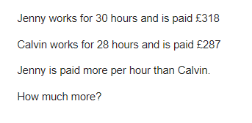
Problem 1

Slide 19
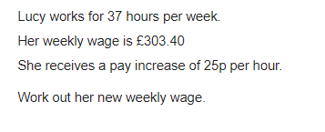
Problem 2

Slide 20
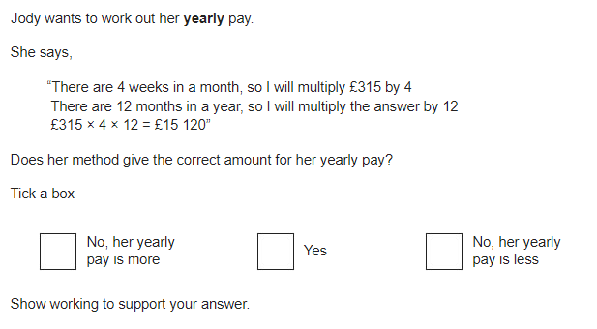
Problem 3
Jody is paid £315 for 4 weeks of work

Slide 21
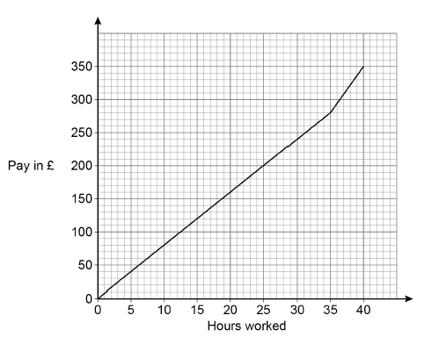
Problem 4
The graph shows how much Molly is paid for working for up to 40 hours.
She receives
a basic rate of pay for the first 35 hours worked
a higher rate of pay for the next 5 hours worked.
Work out the difference between the higher rate of pay and the basic rate of pay.
Give your answer in £ per hour.

