Slide 1
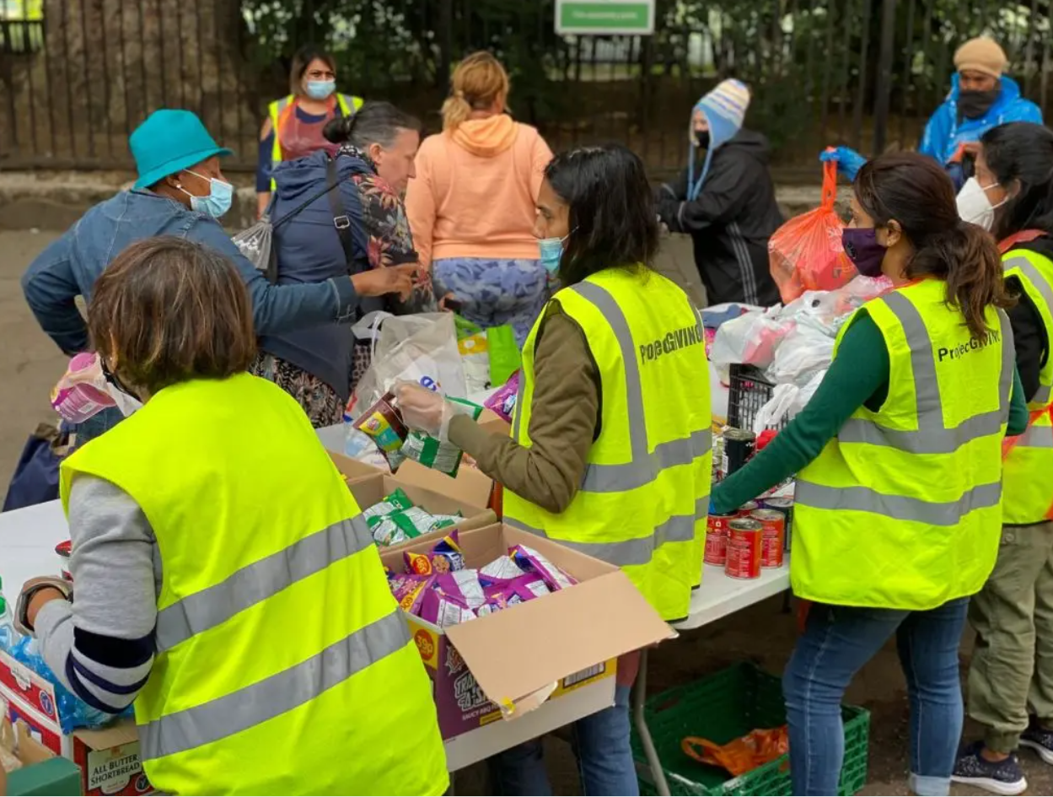
Working for Charities
Helping people
Collating Statistics to lobby the government funding
Budgeting & allocating spending of grants
Help people with household budgets
£35, 000
GCSEs
Alevels inc. Maths
Maths & Psychology Degree
Notes:
Neighbour

Slide 2
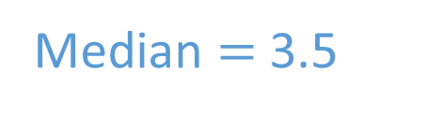

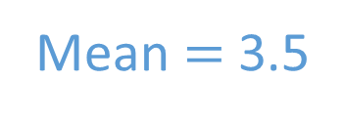
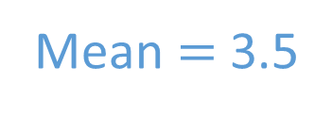
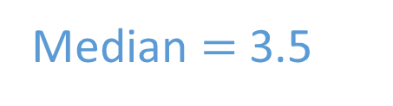
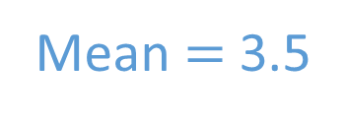
TITLE: Choosing the most appropriate average
For each set of data, find the mean, the median and the mode.
1 2 3 4 5 6
Mean $=$ 3.5
Median $=$ 3.5
No mode
1 1 3 4 6 6
Mean $=$ 3.5
Median $=$ 3.5
1 & 6 are both
modes
1 1 1 6 6 6
Mean $=$ 3.5
Median $=$ 3.5
No mode

Slide 3
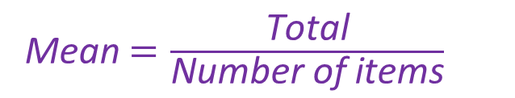
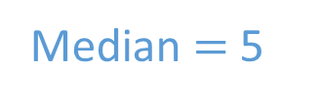
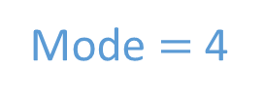
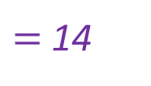
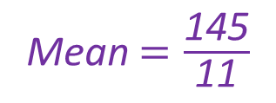
Think, pair, share
Here are the ages of 11 people at a birthday party.
2 4 4 4 4 5 6 6 32 35 43
Mo works out the mean of the ages.
Mean $=\frac{\text{Total}}{\text{Number} \text{of} \text{items}}$
Mean $=\frac{\text{145}}{\text{11}}$
$=$ 14
Does the mean represent the data well?
As none of the ages are very close to 14, the mean does not represent the data well.
Would the mode or median be more representative?
Mode $=$ 4
Both values are fairly close to several of the data items
Median $=$ 5

Slide 4

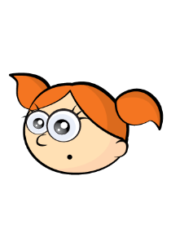
Two students are collecting data and plan to find an average to represent their results.
I’m investigating heights.
I’m going to use the range.
The range is not an average.
I’m investigating favourite books.
I’m going to use the mean.
Do you think their choices of averages are suitable?
The data isn’t numerical so you can’t use the mean.

Slide 5
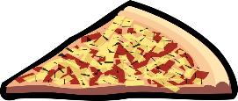
MWB
Consider the scenario, which average would be best to use and why?
Mean or Median or Mode
A restaurant records the meals each customer buys.
Mode

Slide 6

MWB
Consider the scenario, which average would be best to use and why?
Mean or Median or Mode
A zoo recorded the weight of each of its penguins.
Mean

Slide 7

MWB
Consider the scenario, which average would be best to use and why?
Mean or Median or Mode
10 friends took a science test:
1 person got more than double the
score of the next best person!
Median

Slide 8
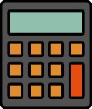
MWB
Consider the scenario, which average would be best to use and why?
Mean or Median or Mode
50 Year 9 students took a maths test,
but 5 of the students were 30 minutes late &
scored very low marks!
Median

Slide 9
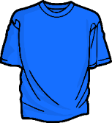
MWB
Consider the scenario, which average would be best to use and why?
Mean or Median or Mode
A clothes shop records how much each customer spends.
Mean

Slide 10
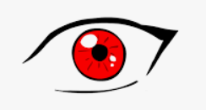
MWB
Consider the scenario, which average would be best to use and why?
Mean or Median or Mode
Jen records the eye-colour of everyone in her class.
Mode

Slide 11
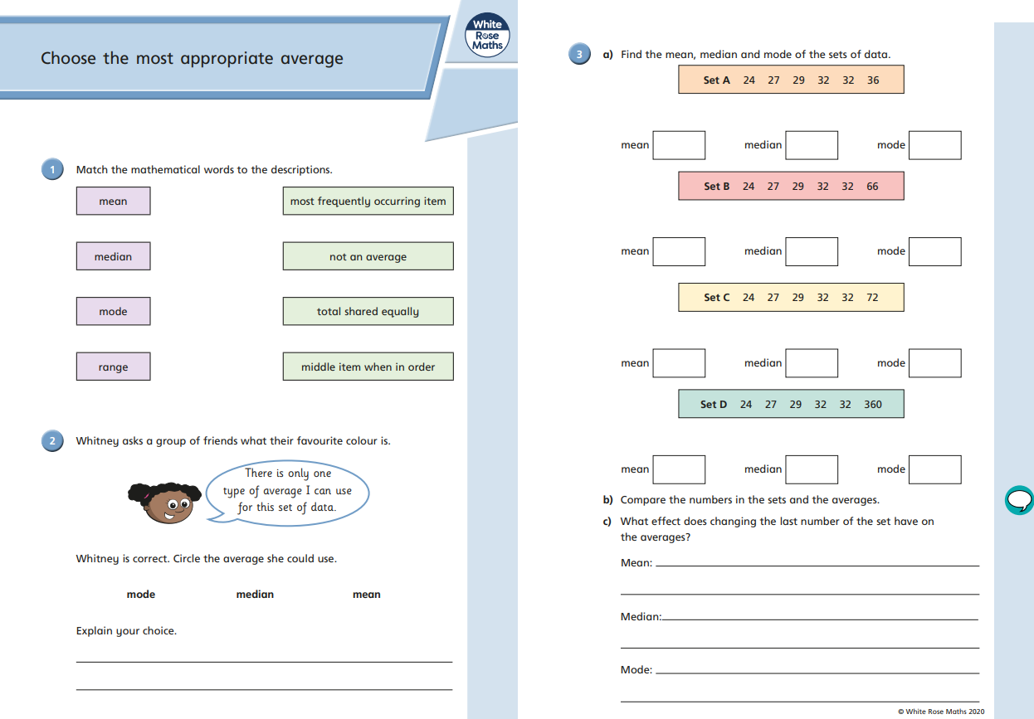
Complete side 1

Slide 12
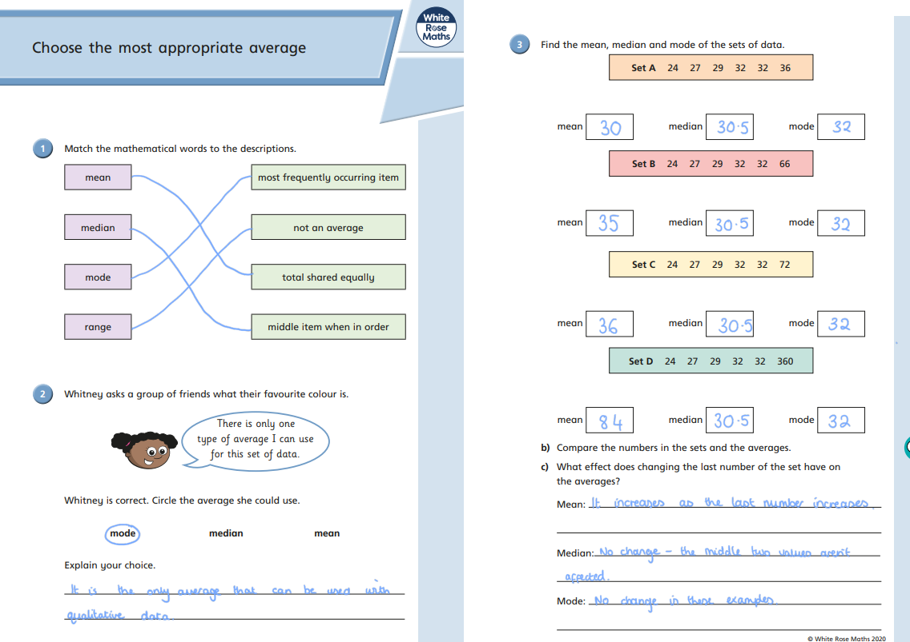
Mark your work

Slide 13
In pairs, discuss:
Some suggestions
 | Advantage | Disadvantage
Mean
Median
Mode
Takes account all the data.
Can’t be used with qualitive data.
Distorted by extreme values
Easy to find when in order.
Not distorted by extreme values.
Time consuming if large data set.
Sometimes not a good representation.
Can be used with non-numerical data.
Easy to find.
Less useful for small groups.
Sometimes doesn’t exist or more than 1

Slide 14
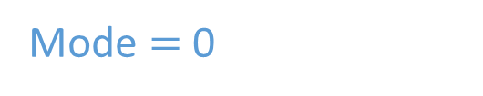
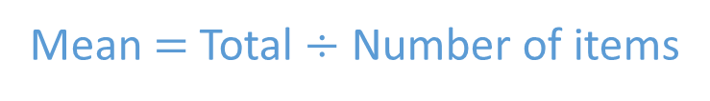
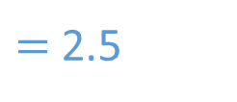
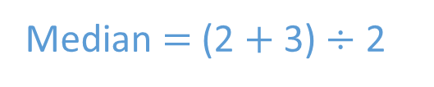
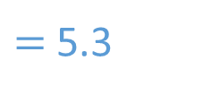
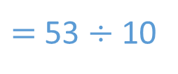
MWB
Here are the number of letters received in 10 houses on a street one day.
0 0 0 2 2 3 3 4 4 35
Find the mean, median and mode of the number of letters received.
Which average do you think is most suitable?
Mean $=$ Total $÷$ Number of items
$=$ 53 $÷$ 10
$=$ 5.3
Median $=$ (2 $+$ 3) $÷$ 2
$=$ 2.5
Mode $=$ 0

Slide 15
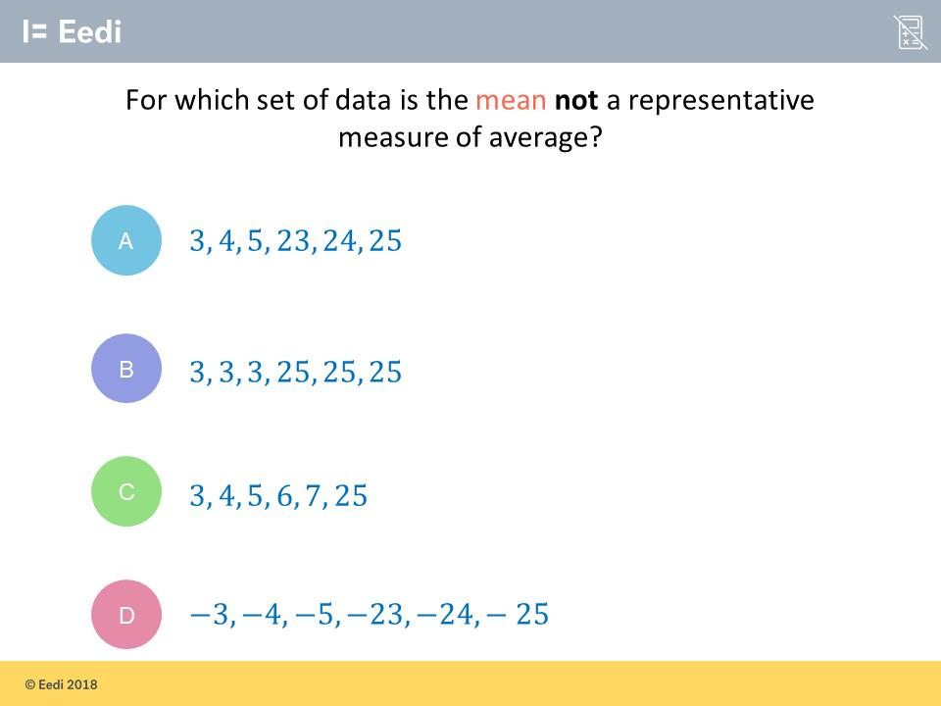

Slide 16
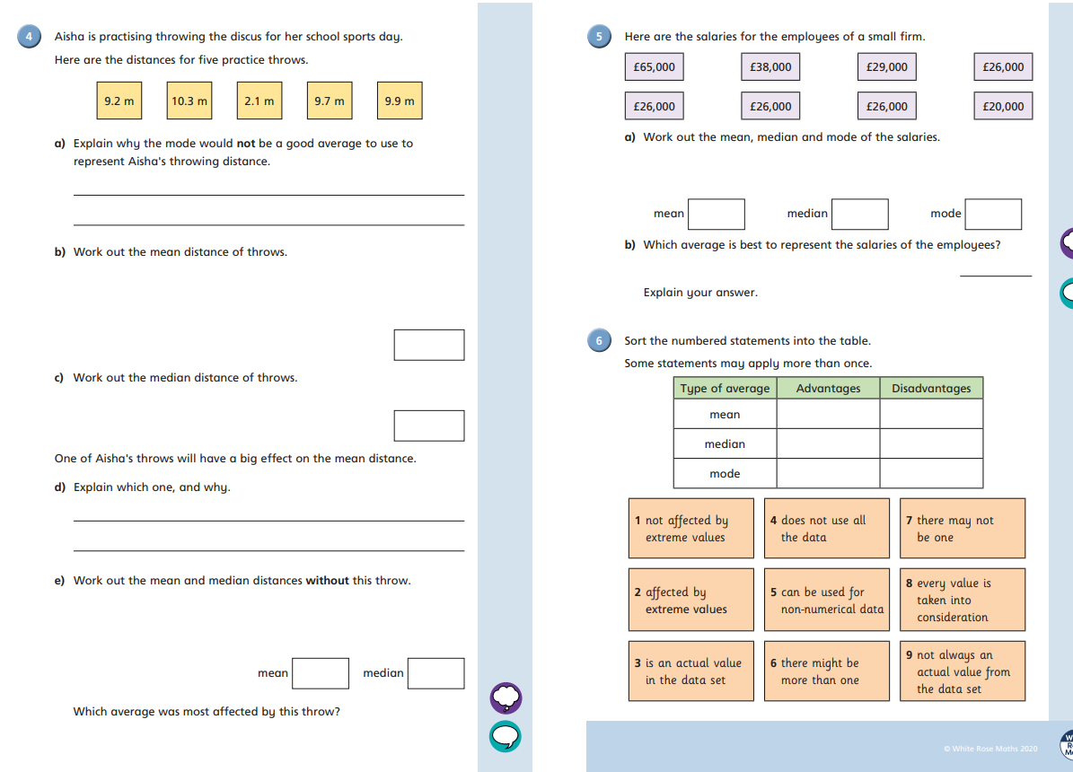
Complete side 2 of the sheet

Slide 17
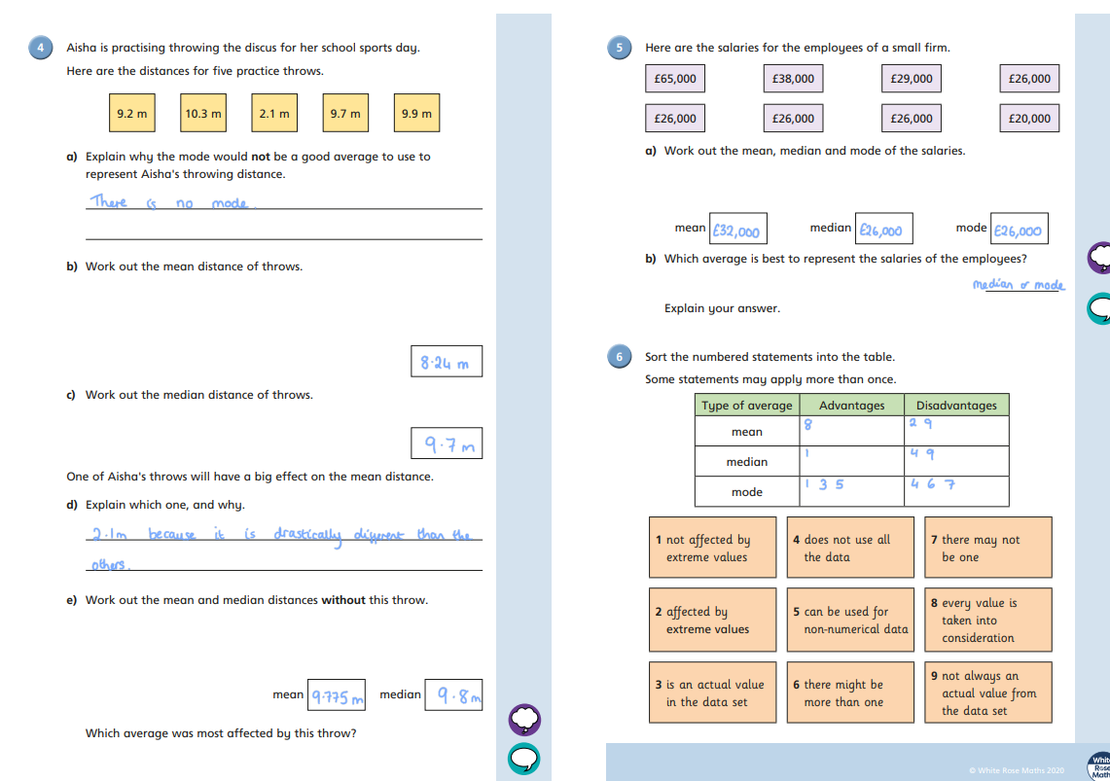
Mark your work

Slide 18
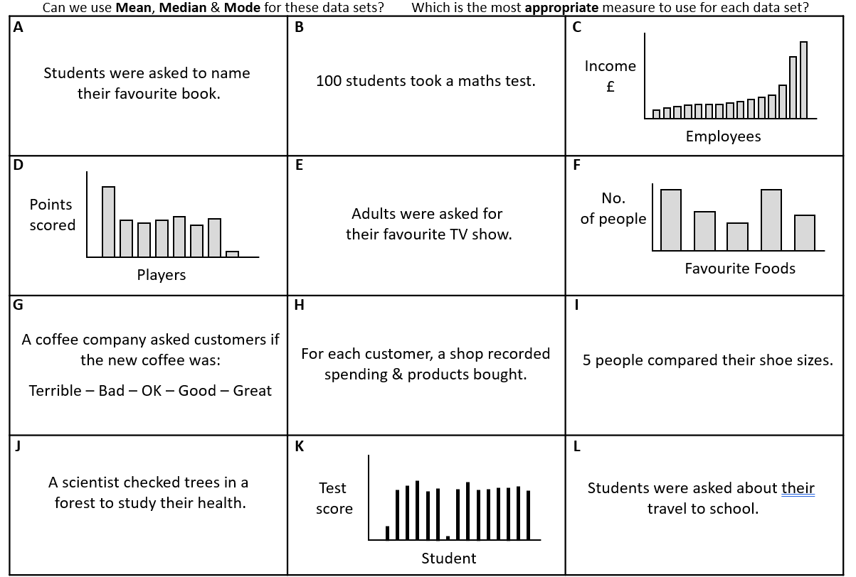
Optional card sort task

Slide 19
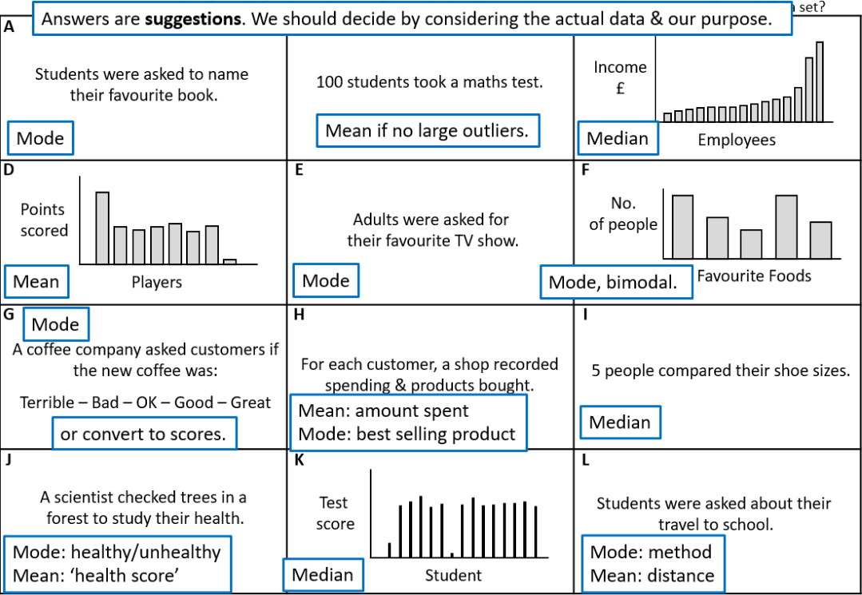
ANSWERS

Slide 20
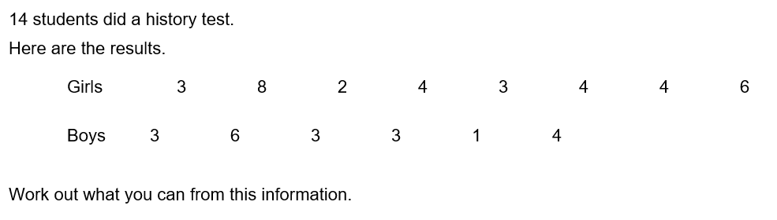
Goal free problem

Slide 21
Challenge
Give an example of a data set where the mean is the best average.
Give an example of a data set where the median is the best average
Give an example of a data set where the mode is the best average

Slide 22
Can we use Mean, Median & Mode for these data sets? Which is the most appropriate measure to use for each data set?
A
B
C
Students were asked to name
their favourite book.
Income
£
100 students took a maths test.
Employees
D
E
F
Points
scored
No.
of people
Adults were asked for
their favourite TV show.
Players
Favourite Foods
G
H
I
A coffee company asked customers if
the new coffee was:
Terrible – Bad – OK – Good – Great
For each customer, a shop recorded
spending & products bought.
5 people compared their shoe sizes.
J
K
L
A scientist checked trees in a
forest to study their health.
Test
score
Students were asked about their
travel to school.
Student

