Slide 1
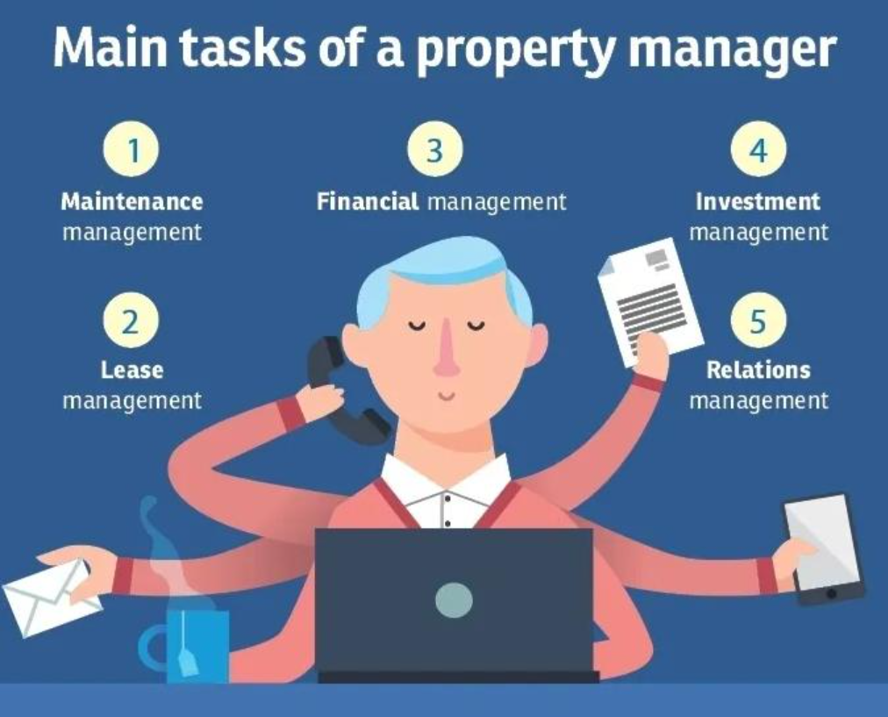
Property Manager
Being a Business Owner
Providing high-quality service to ensure clients are satisfied with their rented properties
Calculating arrears
Drawing up rent schedules
Loan negotiations
Monitoring interest payments
£55, 000
GCSEs
A-levels
University Degree
Experience in Law and Admin

Slide 2
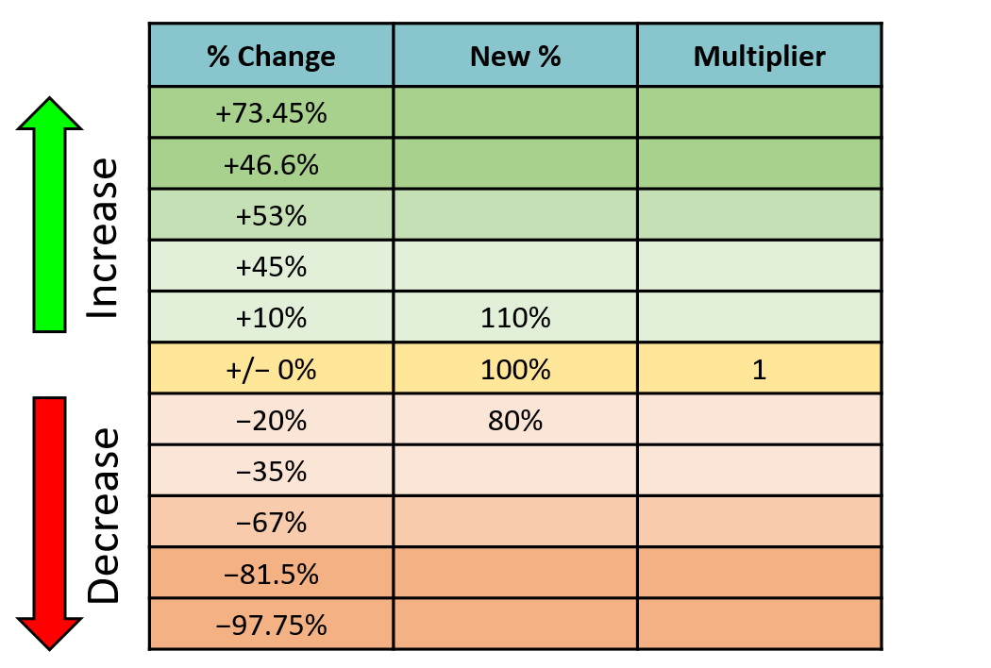
Work out the percentage multipliers
Notes:
Revision from Y8 Spr 2

Slide 3
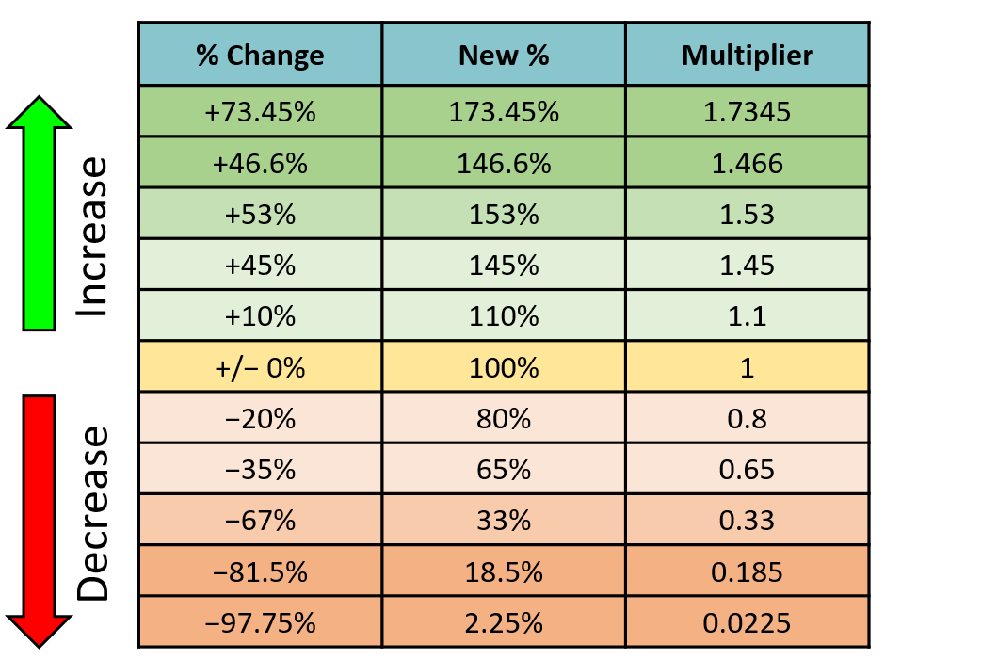

Slide 4

A bank offers two types of investment plan:
Principal: £2000
Principal: £2000
Interest per year: 10%
Interest per year: 10%
Term: 3 years
Term: 3 years
Interest paid out every year.
Interest reinvested every year.
Which plan will earn more interest?
£600 total
£662 total
Simple Interest
Compound Interest
Normally fixed-term investments
Often, ongoing,
variable-rate investments

Slide 5
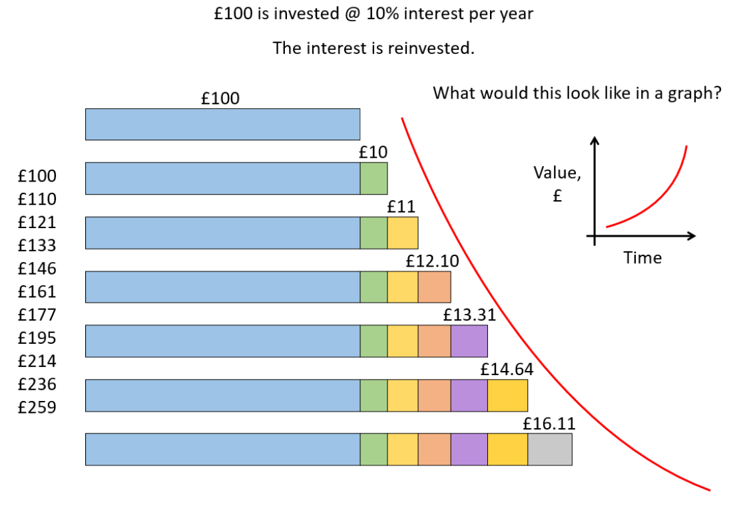
Compound Interest
Principal: £2000
Interest per year: 10%
Term: 3 years
Interest reinvested every year.
Year 1: 2000 x 0.1 = £200 interest earned
Year 2: 2200 x 0.1 = £220 interest earned
Year 3: 2420 x 0.1 = £242 interest earned

Slide 6
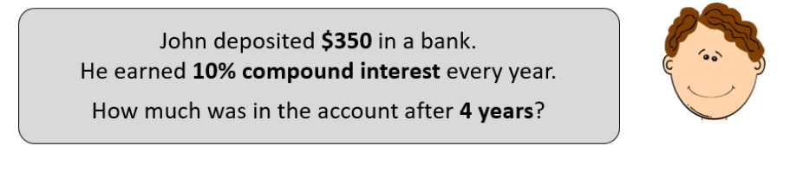
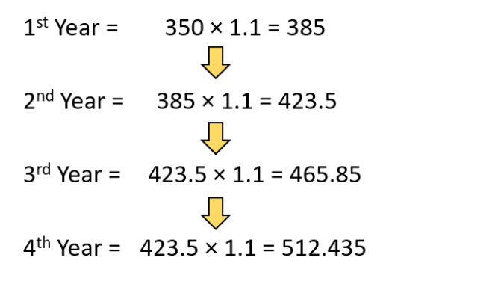

Slide 7
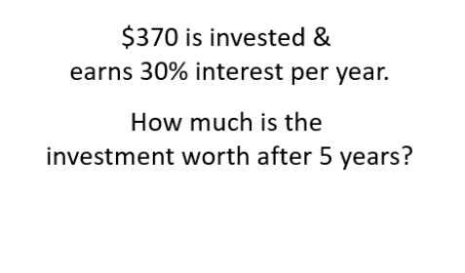
On your whiteboard… show the calculation

Slide 8
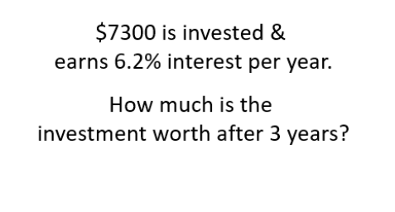
On your whiteboard… show the calculation

Slide 9
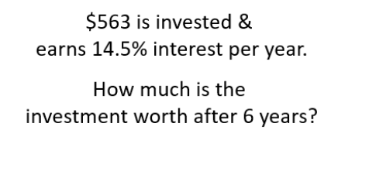
On your whiteboard… show the calculation

Slide 10
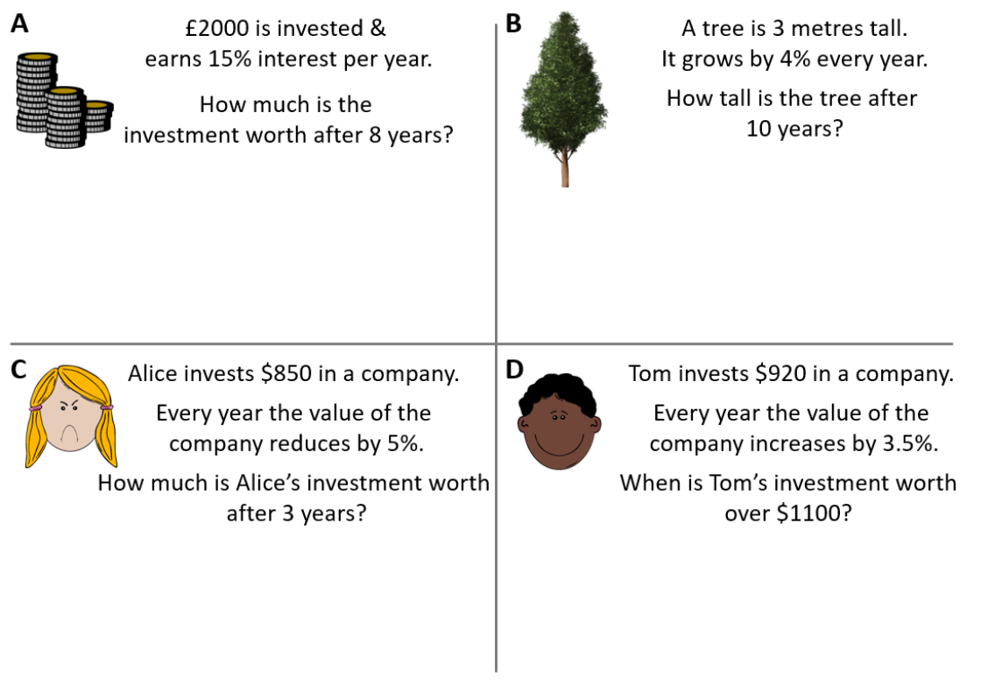

Slide 11
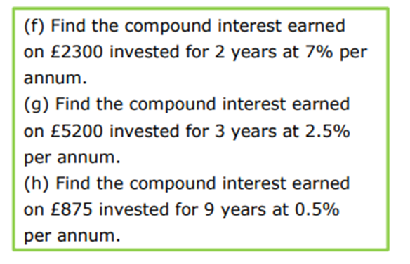
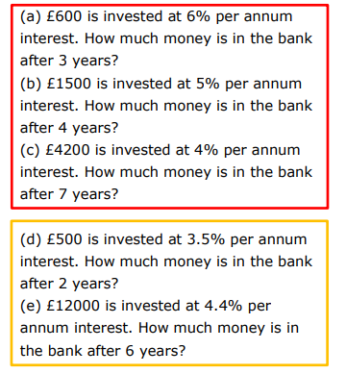
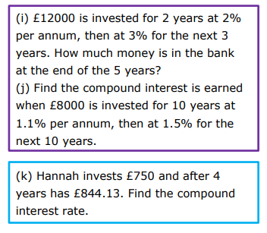
Compound Interest

Slide 12
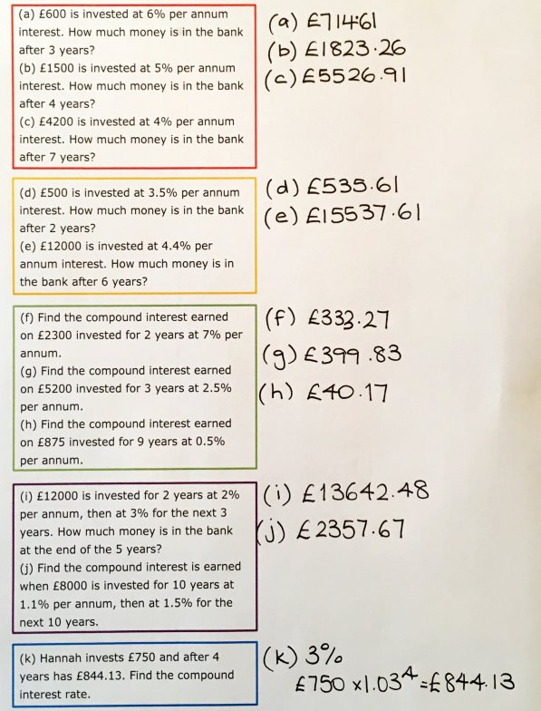

Slide 13
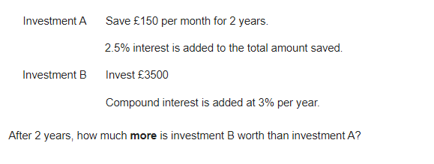
Problem 1

Slide 14
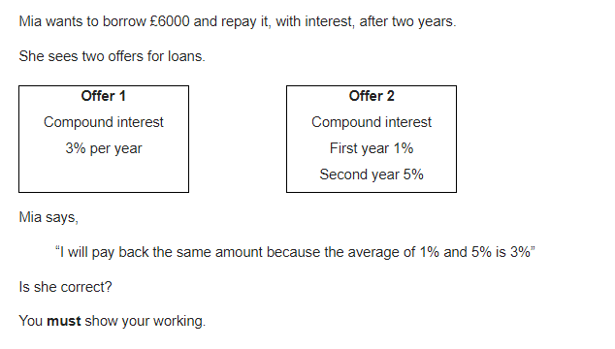
Problem 2

Slide 15
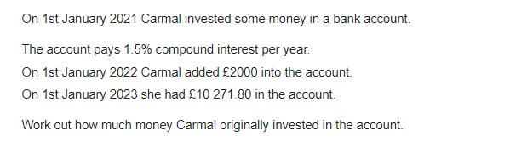
Problem 3

Slide 16
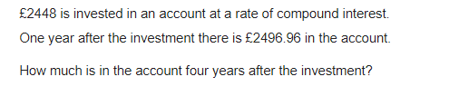
Problem 4

