Slide 1

Industrial Printer Repair Engineer
Satisfaction of repairing something broken
Supervising the lifting of very heavy (50 tonnes) equipment around
Travelling all over the work
Getting paid
Reading Scaled Drawings
Checking equipment was square (if it was not lined up properly with the rest of the equipment it would all fail!)
Used 3,4,5 triangles (Pythagoras) or perpendicular bisectors depending on the factory layout
£31, 000
GCSEs
Apprenticeship Training at 17
Notes:
Know from Archery (represented Britain, regional judge & county chairman)

Slide 2
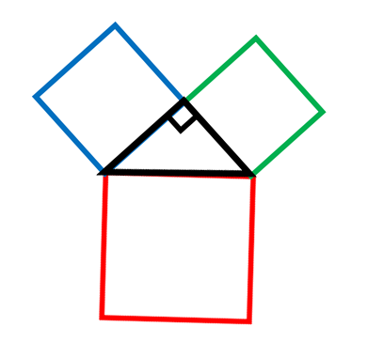
Find three possible areas that will satisfy Pythagoras’ Theorem.
… and another
…and another
Find three possible side lengths that will satisfy Pythagoras’ Theorem.
Notes:
Can they find three that will work? How do they know it works?

Slide 3
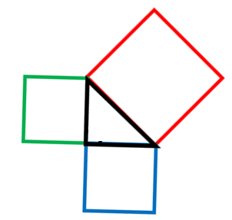
36
64
100
64
49
25
What’s the same?
What’s different?

Slide 4
36
64
100
64
49
25
Only one of these is right-angled, which one?
How do you know?

Slide 5




Pythagoras’ Theorem only works for right angled triangles…
For a right-angled triangle, the area of the square on the longest side is equal to the sum of the squares on the shorter sides.
36
64
100
64
-Pythagoras’ Theorem
49
25
$$36+64=100$$
$$25+49≠64$$
$$Right−angled$$
$$Not right−angled$$

Slide 6
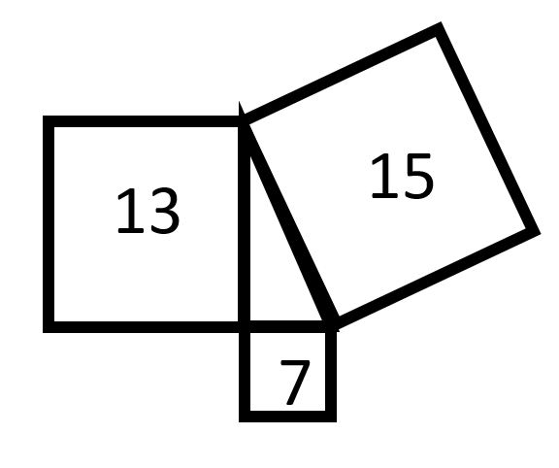
So, Pythagoras’ Theorem only works for right angled triangles…
Is this triangle right-angled?
On whiteboards…

Slide 7
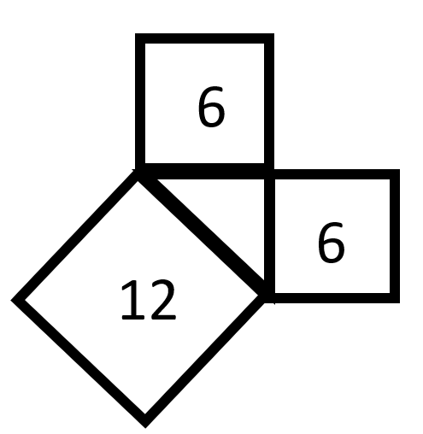
So, Pythagoras’ Theorem only works for right angled triangles…
Is this triangle right-angled?
On whiteboards…

Slide 8
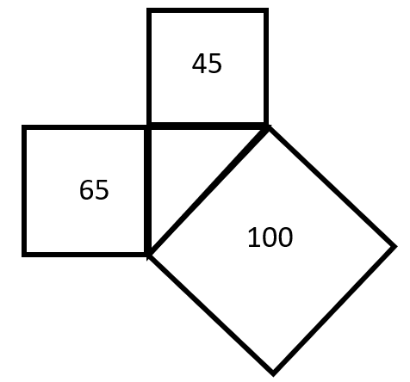
So, Pythagoras’ Theorem only works for right angled triangles…
Is this triangle right-angled?
On whiteboards…

Slide 9
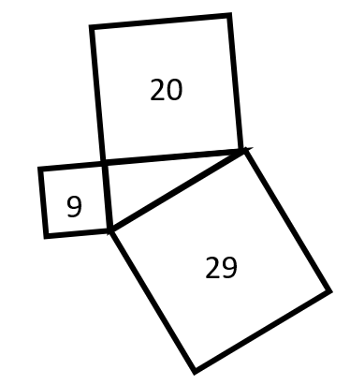
So, Pythagoras’ Theorem only works for right angled triangles…
Is this triangle right-angled?
On whiteboards…

Slide 10
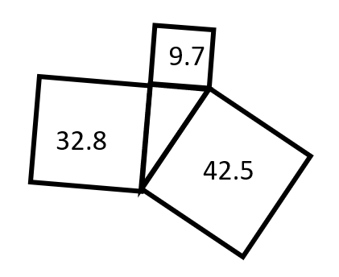
So, Pythagoras’ Theorem only works for right angled triangles…
Is this triangle right-angled?
On whiteboards…

Slide 11
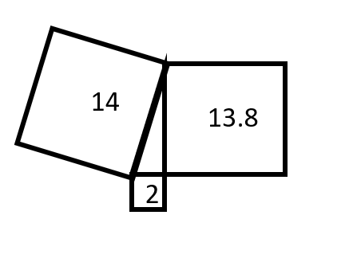
So, Pythagoras’ Theorem only works for right angled triangles…
Is this triangle right-angled?
On whiteboards…

Slide 12
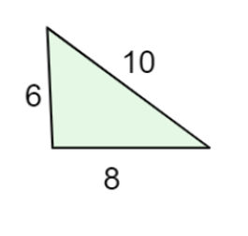
So, Pythagoras’ Theorem only works for right angled triangles…
Is this triangle right-angled?
On whiteboards…
What is the same?
What is different?

Slide 13
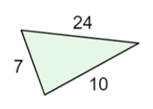
So, Pythagoras’ Theorem only works for right angled triangles…
Is this triangle right-angled?
On whiteboards…

Slide 14
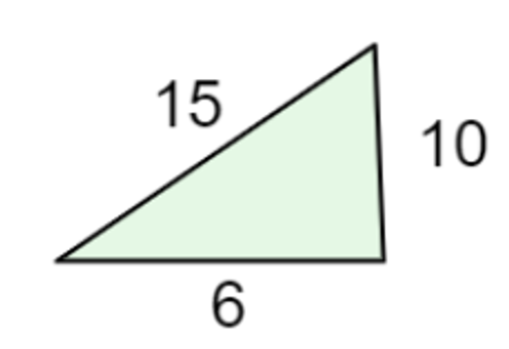
So, Pythagoras’ Theorem only works for right angled triangles…
Is this triangle right-angled?
On whiteboards…

Slide 15
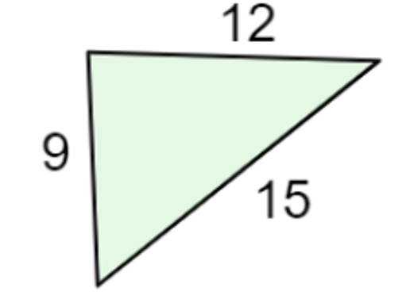
So, Pythagoras’ Theorem only works for right angled triangles…
Is this triangle right-angled?
On whiteboards…

Slide 16
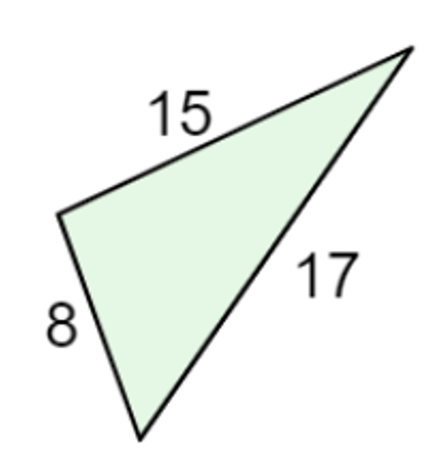
So, Pythagoras’ Theorem only works for right angled triangles…
Is this triangle right-angled?
On whiteboards…

Slide 17
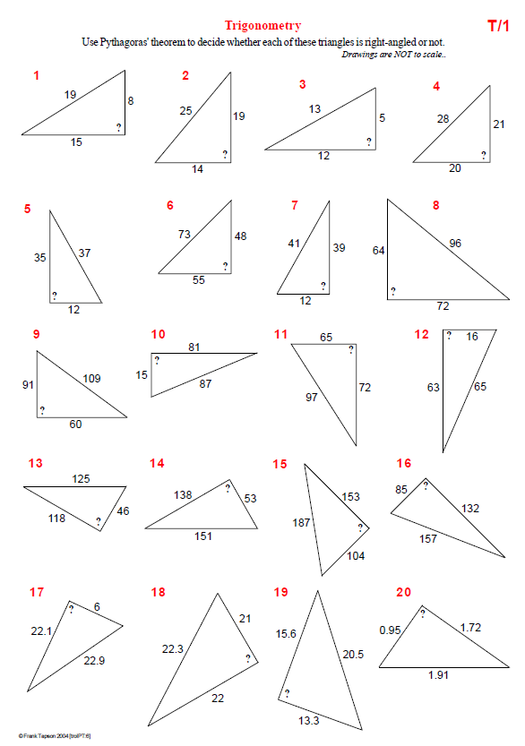
Have a go at the worksheet:

Slide 18
Notes:
Additional Practice

Slide 19
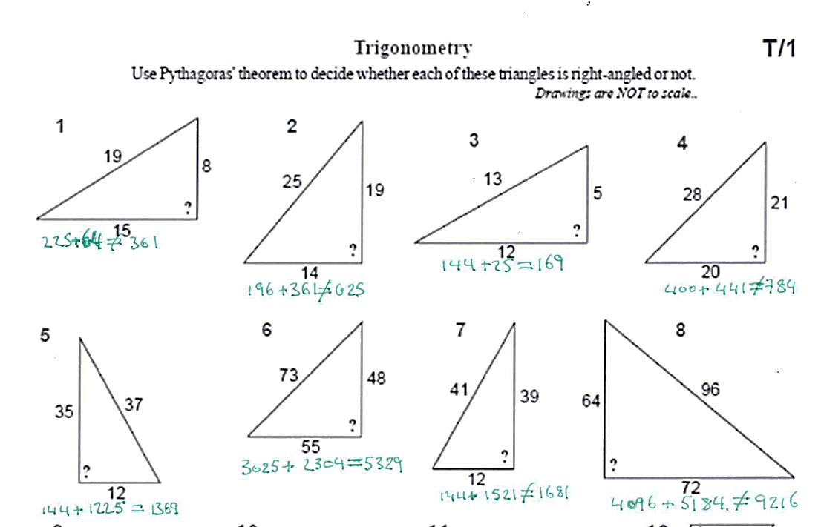
ANSWERS

Slide 20
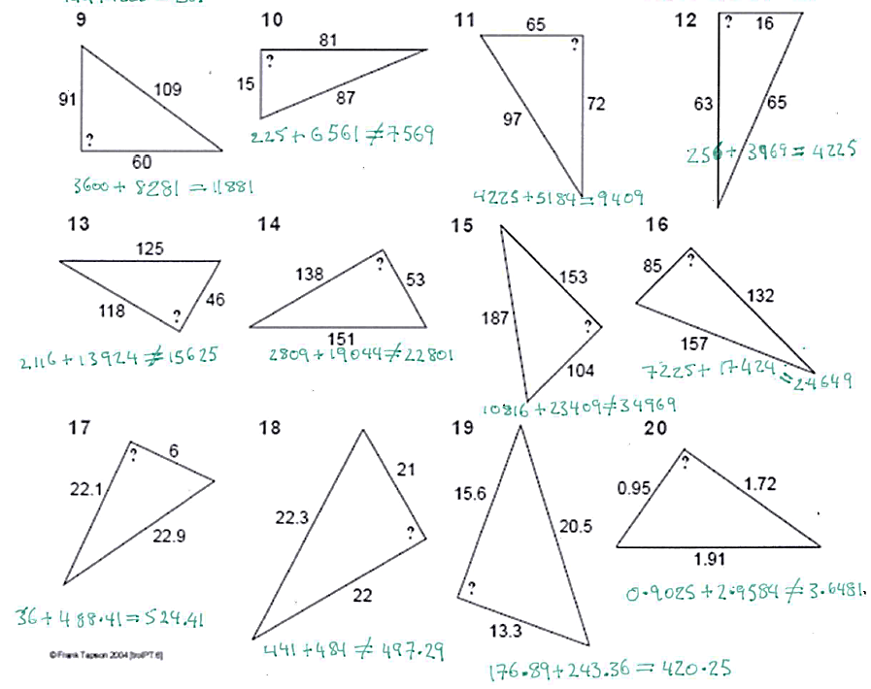
ANSWERS

Slide 21
On whiteboards, split this shape into triangles.

Slide 22
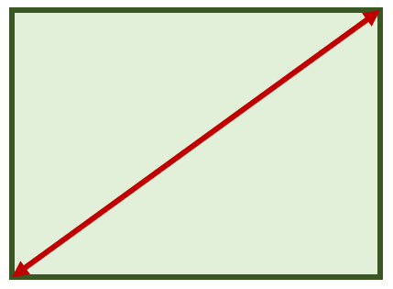
13cm
5cm
12cm
Is this a rectangle?
How do you know?

Slide 23
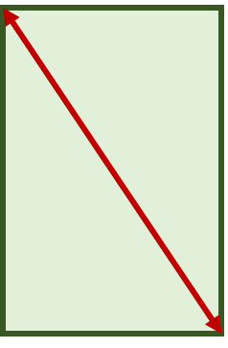
10cm
8m
5m
Is this a rectangle?
How do you know?

Slide 24
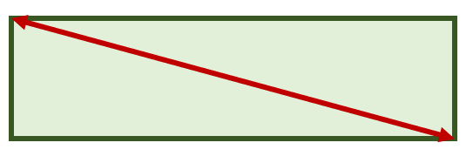
0.6m
1.34m
1.2m
Is this a rectangle?
How do you know?

Slide 25
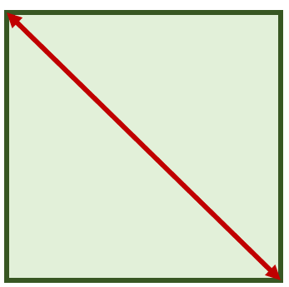
1000cm
7.07m
7.07m
Is this a rectangle?
How do you know?
Notes:
Real life applications – is it close enough to right angled?

