Slide 1
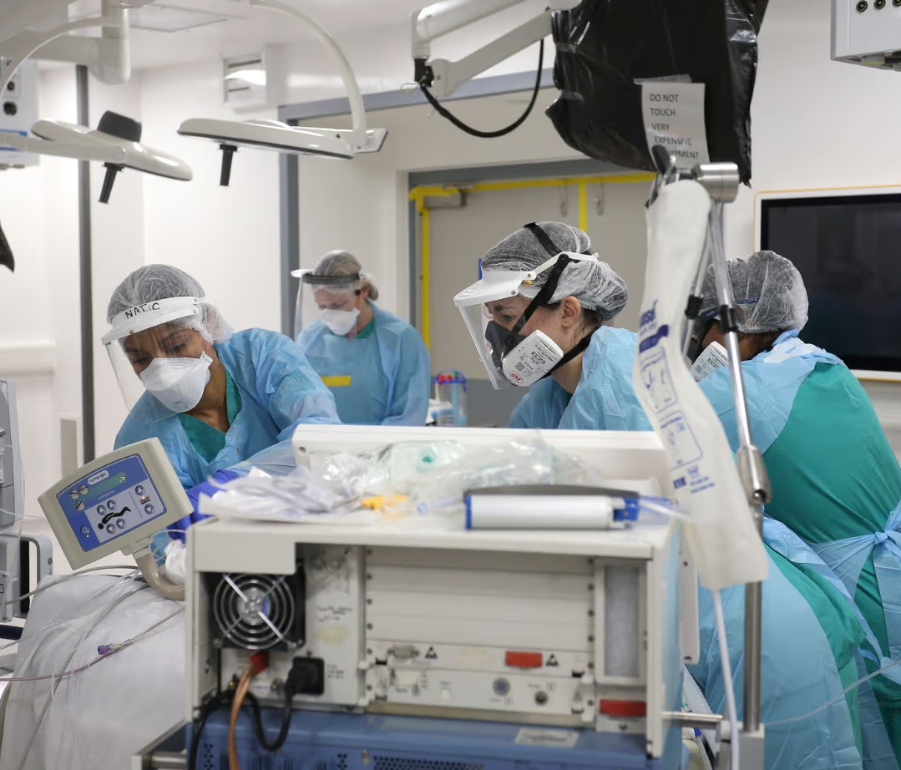
Intensive Care Consultant & Deputy Medical Director
Healing people
Treatments for patients
Does of medications
Review of charts & graphs
Statistics to understand research
Spending and forecasting of multimillion pound budgets
£86, 427
Top Grades at GCSE
Top A-levels
(inc biology & chemistry)
Post Graduate Training
Medical Degree
Notes:
Neighbour

Slide 2
What is the ratio of Triangles to Squares ?
3 : 9
“For every triangle
there are 3 squares.”
We can simplify this ratio.
1 : 3

Slide 3
Ben the painter needs 6 litres of dark purple, he uses 4 litres of red paint and 2 litres of blue paint.
What is the ratio of
Red : Blue
4 : 2
We can simplify this ratio.
:
2
1

Slide 4
Sarah has a number of white and black counters in a bag..
What is the ratio of
Black : White
3 : 9
:
1
We can simplify this ratio.
3

Slide 5
To simplify or cancel down ratios, we need to divide by the highest common factor (HCF) of both parts.

Slide 6
What is the highest common factor (HCF) of 6 and 8?
12
2
A
C
10
4
B
D

Slide 7
What is the highest common factor (HCF) of 6 and 8?
12
2
A
C
10
4
B
D

Slide 8
What is the highest common factor (HCF) of 12 and 16?
48
12
A
C
4
24
B
D

Slide 9
What is the highest common factor (HCF) of 12 and 16?
48
12
A
C
4
24
B
D

Slide 10
What is the highest common factor (HCF) of 10 and 25?
5
10
A
C
50
2.5
B
D

Slide 11
What is the highest common factor (HCF) of 10 and 25?
5
10
A
C
50
2.5
B
D

Slide 12
What is the highest common factor (HCF) of 24 and 36?
6
12
A
C
8
24
B
D

Slide 13
What is the highest common factor (HCF) of 24 and 36?
6
12
A
C
8
24
B
D

Slide 14
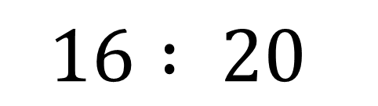
Simplifying Ratios
Simplify
What’s the highest common factor of 16 and 20?
$$16 : 20$$
4
So divide both numbers by 4

Slide 15
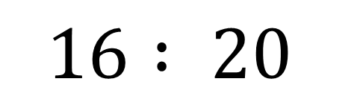
Simplifying Ratios
Simplify
$$16 : 20$$
÷ 4
÷ 4
4 :
5

Slide 16
Simplifying Ratios
Simplify
What’s the highest common factor of 6 and 27?
6 : 27
3
So divide both numbers by 3

Slide 17
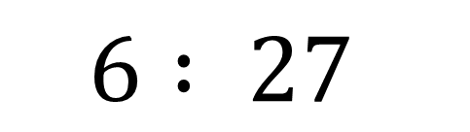
Simplifying Ratios
Simplify
$$6 : 27$$
÷ 3
÷ 3
2 :
9

Slide 18
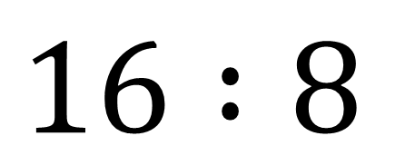
Simplify
$$16 :8$$

Slide 19
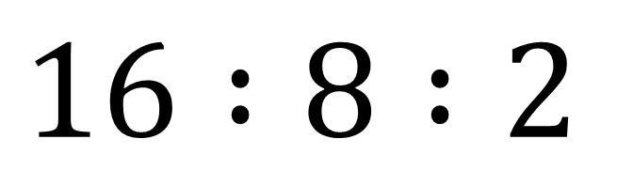
Simplify
$$16 :8 :2$$

Slide 20
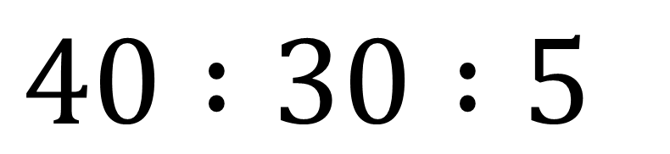
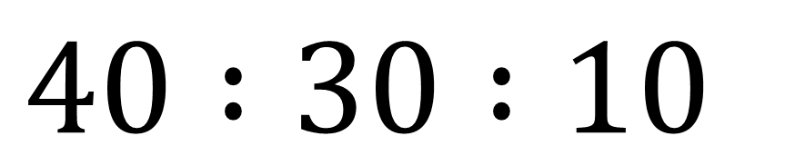
Simplify
$$40 :30 :10$$
$$40 :30 :5$$

Slide 21
Give an example of a ratio that can not be simplified

Slide 22
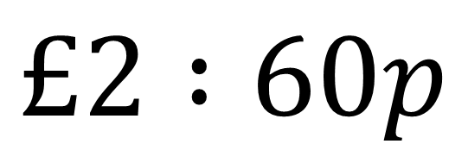
Simplify
$$£2 :60p$$

Slide 23
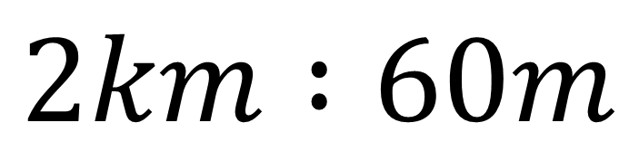
Simplify
$$2km :60m$$

Slide 24

Simplify
$$2 hours :60 minutes$$

Slide 25

Simplify
$$2 hours :90 minutes$$

Slide 26
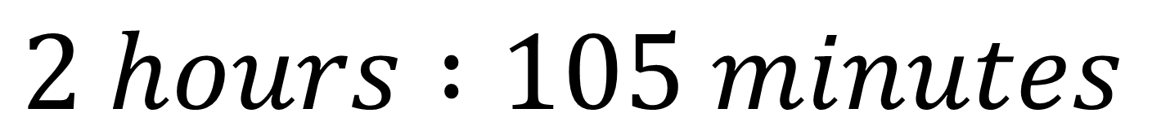
Simplify
$$2 hours :105 minutes$$

Slide 27
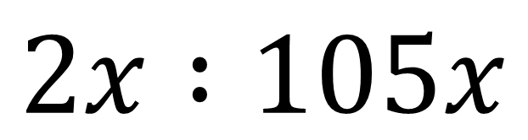
Simplify
$$2x :105x$$

Slide 28
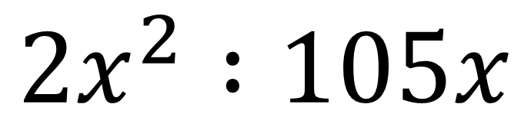
Simplify
$$2x^{2} :105x$$

Slide 29
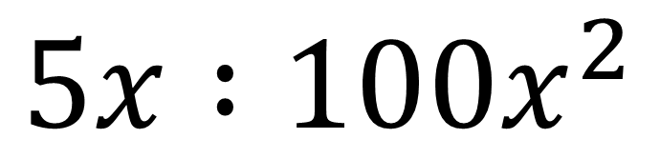
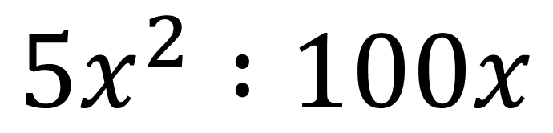
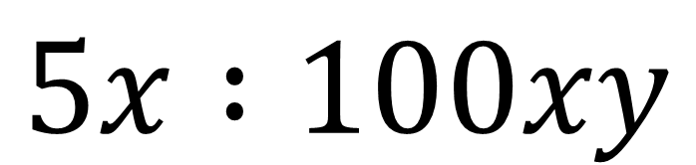
Simplify
$$5x^{2} :100x$$
$$5x :100x^{2}$$
$$5x :100xy$$

Slide 30
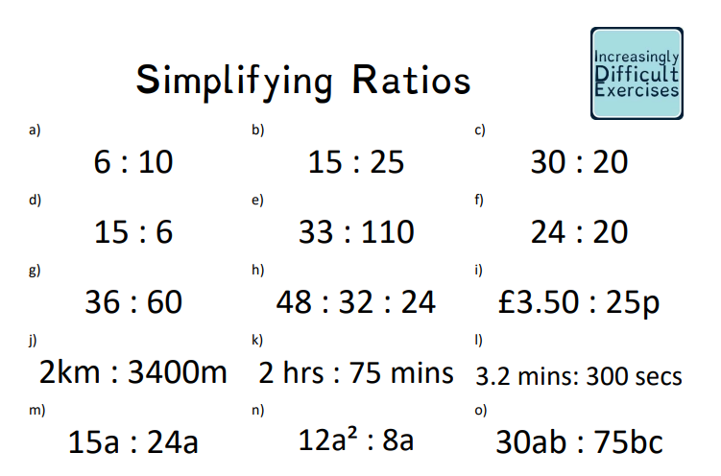

Slide 31
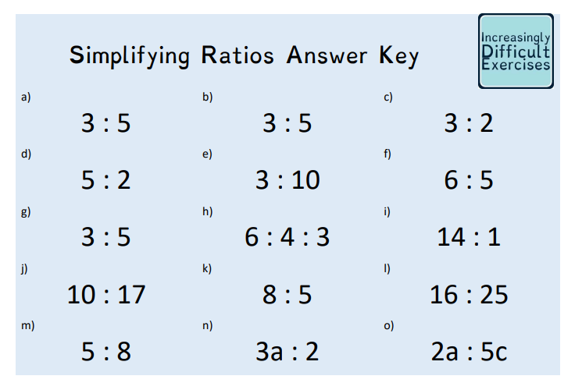
Mark your work

Slide 32
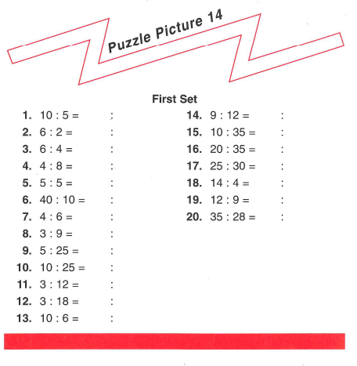
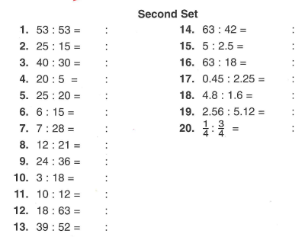

Slide 33
Additional Questions
Leave all ratio answers in their simplest form:
This month there were 14 sunny days and 16 wet days. Find the ratio of sunny days to wet days.
In a bag of sweets, 10 are yellow and 15 blue. Find the ratio of yellow sweets to blue sweets.
A coach has room for 28 sitting and 16 standing passengers Find the ratio of sitting to standing passengers.
In a class there are 12 girls and 18 boys. Find the ratio of girls to boys in the class.
Simplify the following:
1) 6 : 15 : 21 2) 8 : 16 : 32 3) 9 : 12 :21
4) 9 : 18 : 45 5) 16 : 32 : 56 6) 36 : 48 : 72

Slide 34
1) 7 : 8 2) 2 : 3 3) 7 : 4 4) 2 : 3
1) 2 : 5 : 7 2) 1 : 2 : 4 3) 3 : 4 : 7
4) 1 : 2 : 5 5) 2 : 4 : 7 6) 3 : 4 : 6

