Slide 1
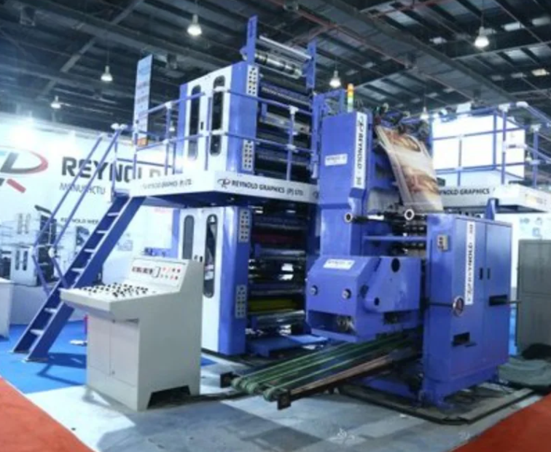
Industrial Printer Repair Engineer
Satisfaction of repairing something broken
Supervising the lifting of very heavy (50 tonnes) equipment around
Travelling all over the work
Getting paid
Reading Scaled Drawings
Checking equipment was square (if it was not lined up properly with the rest of the equipment it would all fail!)
Used 3,4,5 triangles (Pythagoras) or perpendicular bisectors depending on the factory layout
£31, 000
GCSEs
Apprenticeship Training at 17
Notes:
Know from Archery (represented Britain, regional judge & county chairman)

Slide 2

Write down a ratio equivalent to…
$$1 :5$$
And another…
and another…

Slide 3
Ratio is used by architects when designing buildings.
Architects build scale models as a form of three-dimensional sketching and to help visualise how light will illuminate spaces and to analyse the best forms, spatial and material relationships.
Scale drawing is also used in product design, map reading and scientific imaging.

Slide 4
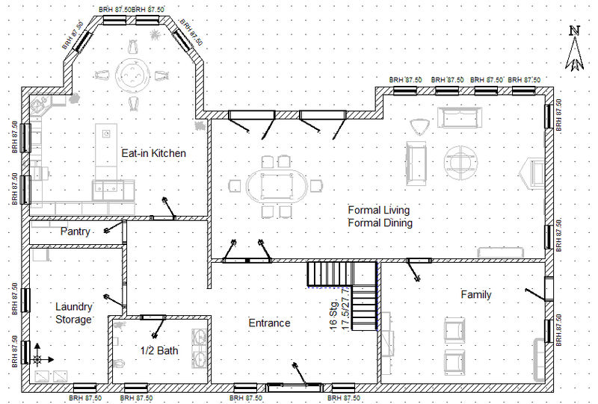
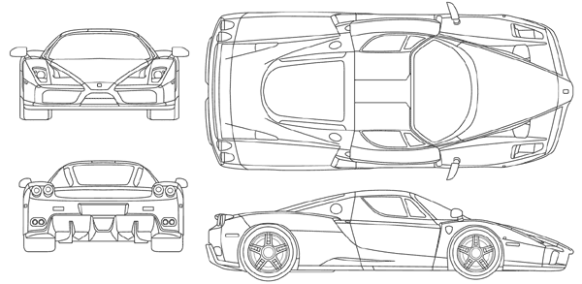
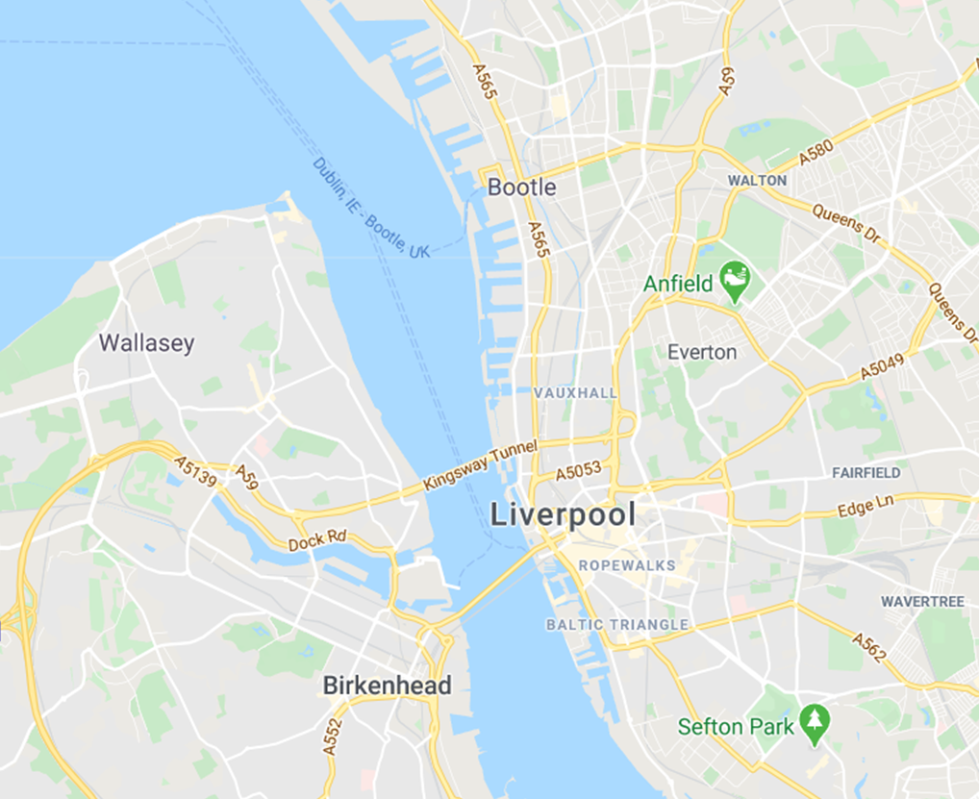
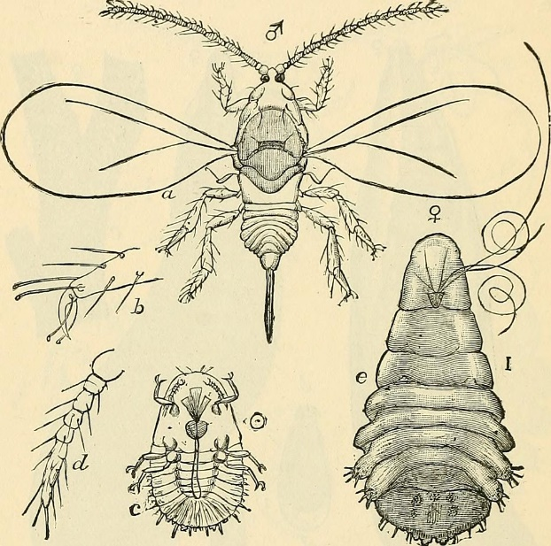

Architecture
Product Design
Maps
Scientific Imaging

Slide 5
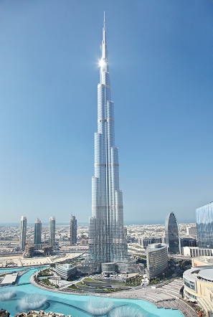
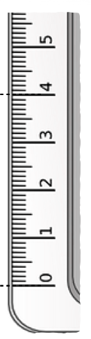
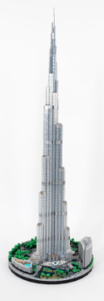

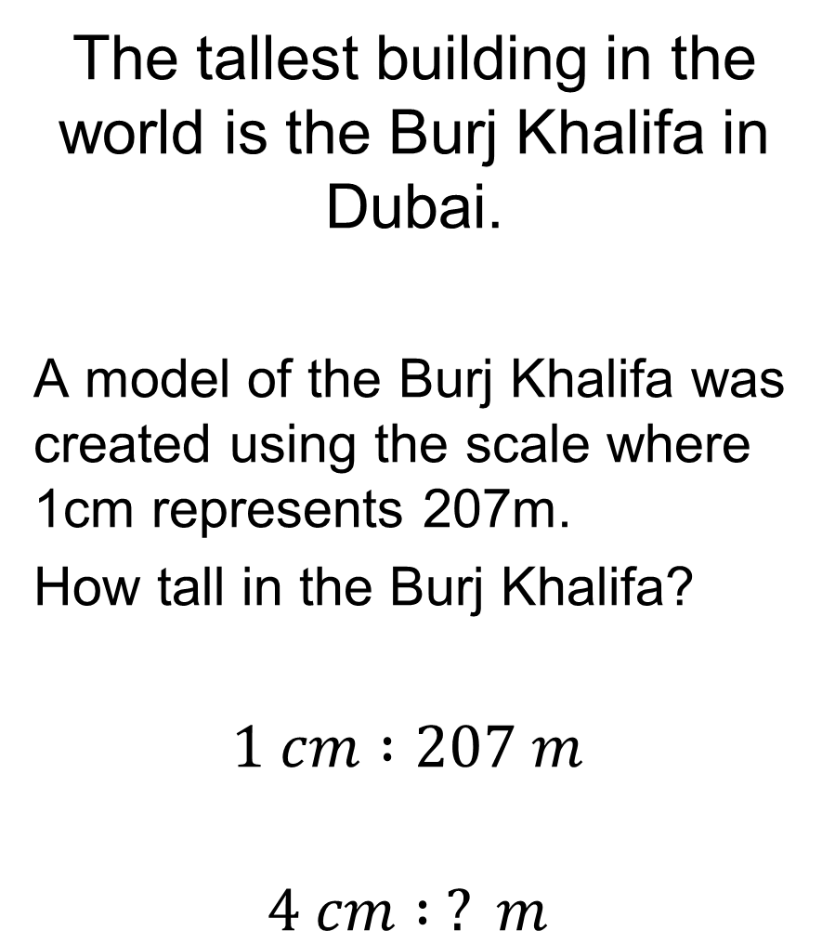

The tallest building in the world is the Burj Khalifa in Dubai.
A model of the Burj Khalifa was created using the scale where 1cm represents 207m.
How tall in the Burj Khalifa?
$$1 cm :207 m$$
$$4 cm : ? m$$
$$×4$$
$$×4$$

Slide 6
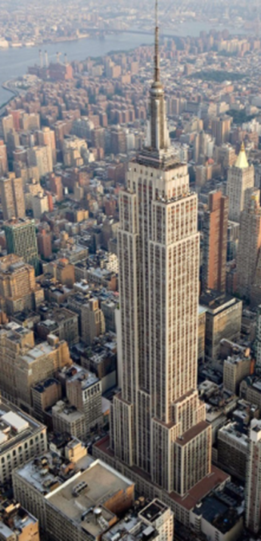

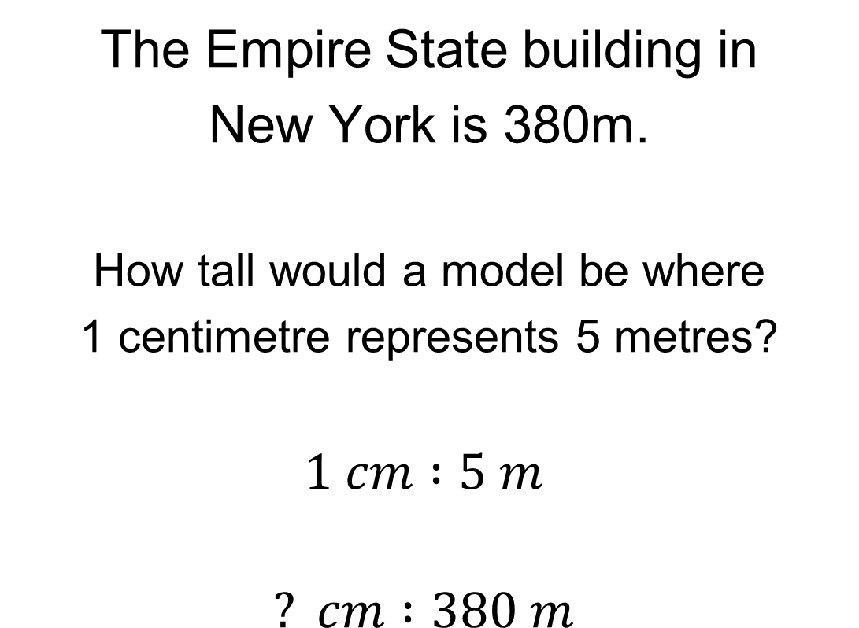

The Empire State building in
New York is 380m.
How tall would a model be where
1 centimetre represents 5 metres?
$$1 cm :5 m$$
$$? cm :380 m$$
$$×76$$
$$×76$$

Slide 7
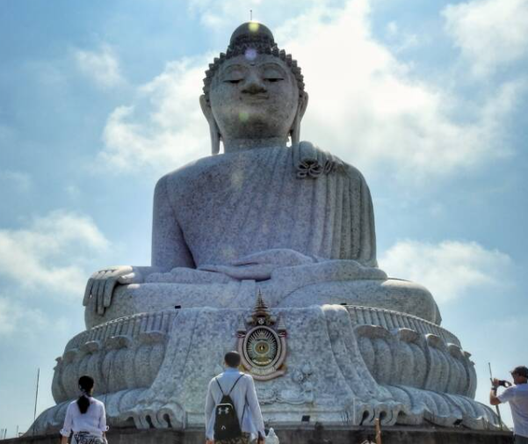

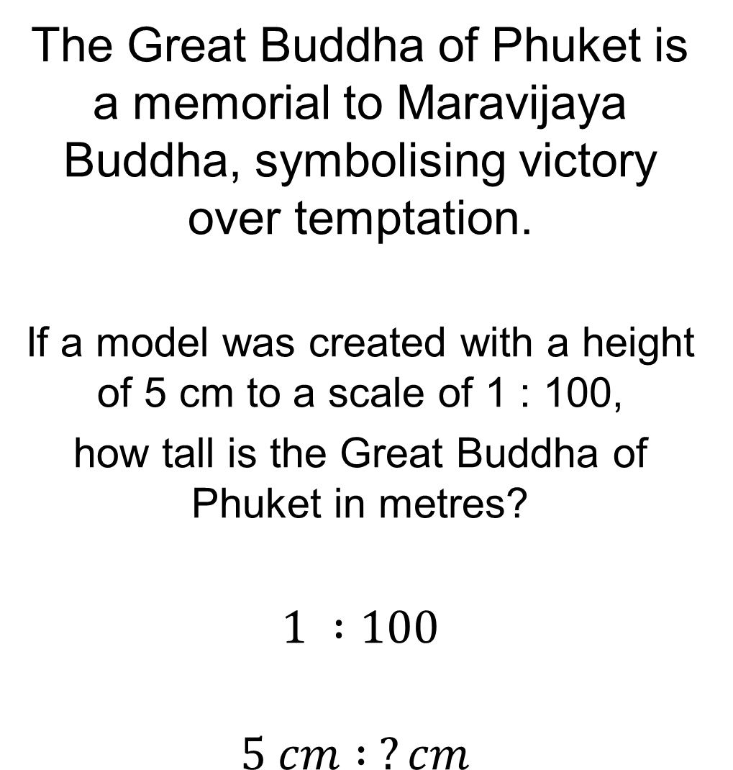

The Great Buddha of Phuket is a memorial to Maravijaya Buddha, symbolising victory over temptation.
If a model was created with a height of 5 cm to a scale of 1 : 100,
how tall is the Great Buddha of Phuket in metres?
$$1 :100$$
$$5 cm : ?cm$$
$$×5$$
$$×5$$

Slide 8
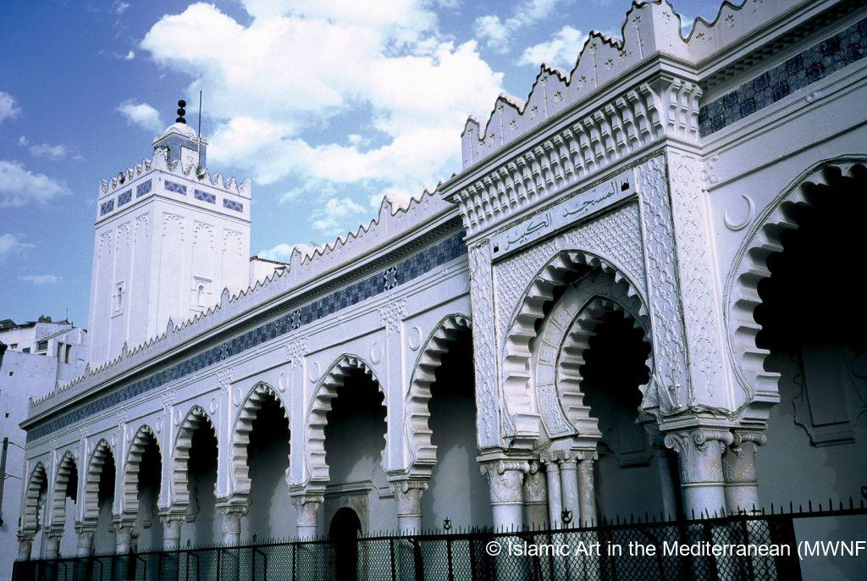

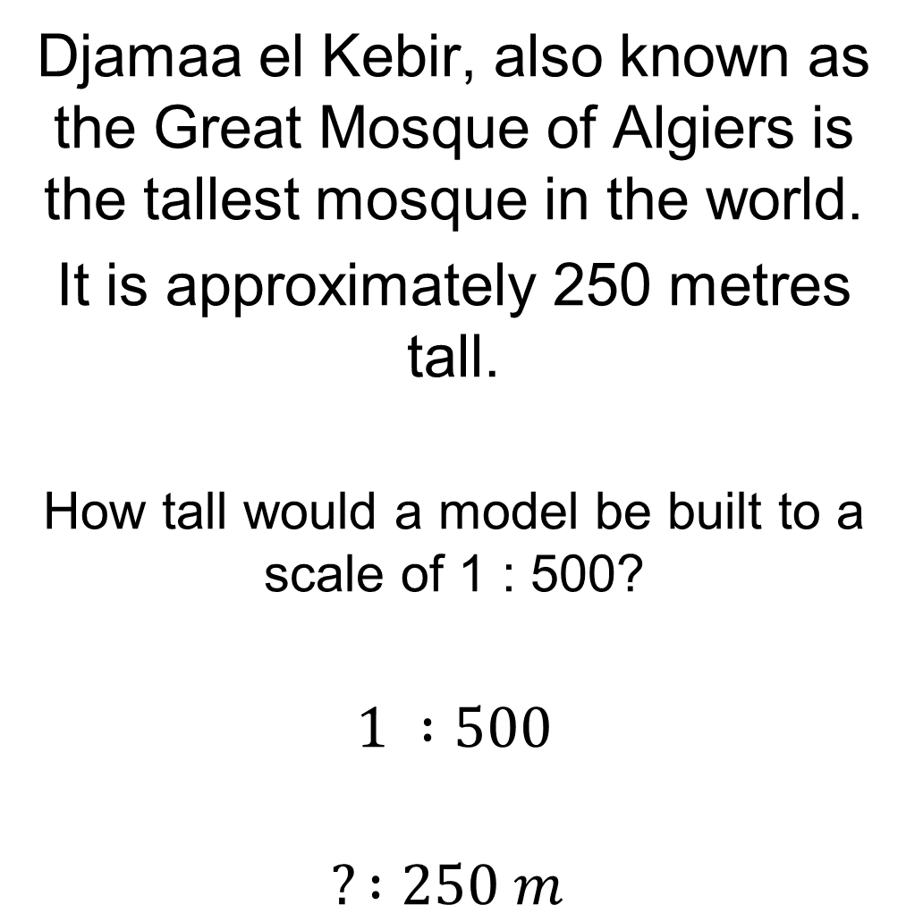

Djamaa el Kebir, also known as the Great Mosque of Algiers is the tallest mosque in the world.
It is approximately 250 metres tall.
How tall would a model be built to a scale of 1 : 500?
$$1 :500$$
$$? :250 m$$
$$×0.5$$
$$×0.5$$

Slide 9
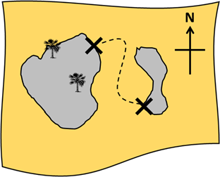
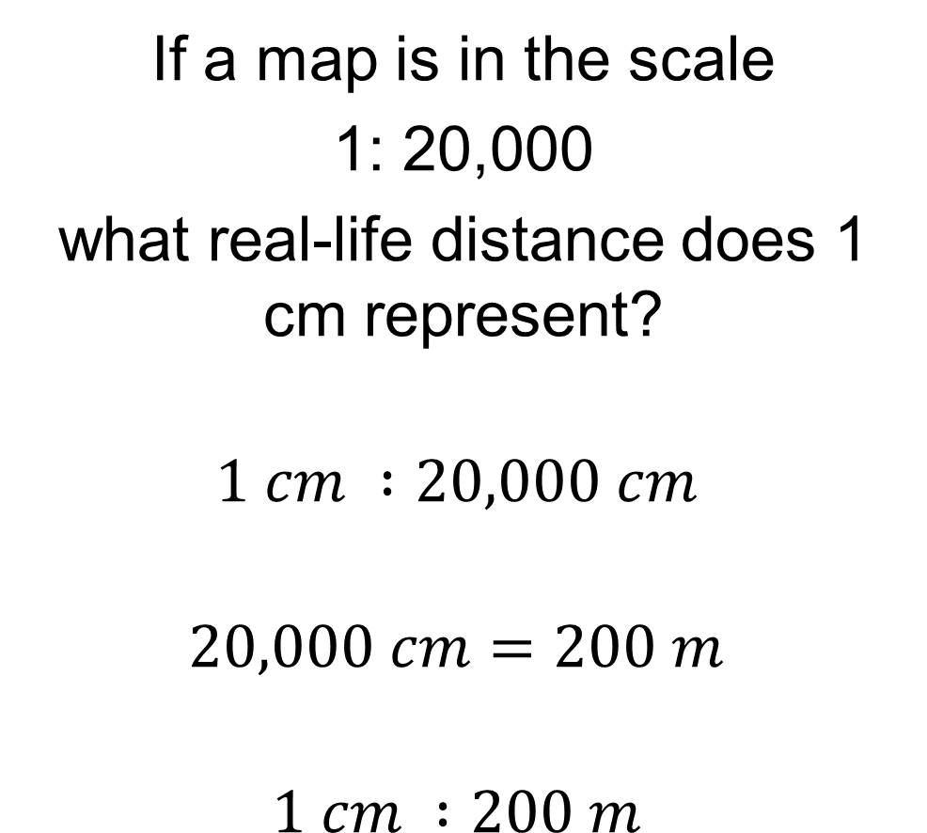
If a map is in the scale
1: 20,000
what real-life distance does 1 cm represent?
$$1 cm :20,000 cm$$
$$20,000 cm=200 m$$
$$1 cm :200 m$$

Slide 10
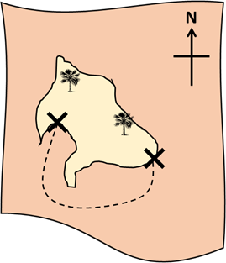
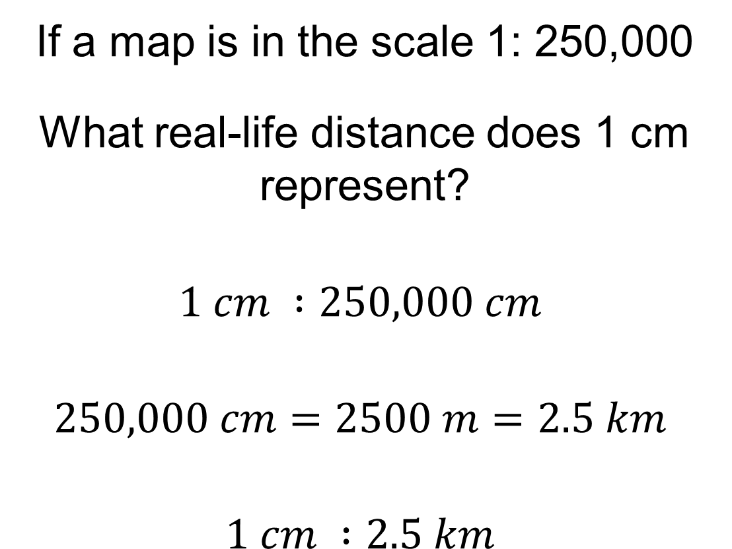
If a map is in the scale 1: 250,000
What real-life distance does 1 cm represent?
$$1 cm :250,000 cm$$
$$250,000 cm=2500 m=2.5 km$$
$$1 cm :2.5 km$$

Slide 11
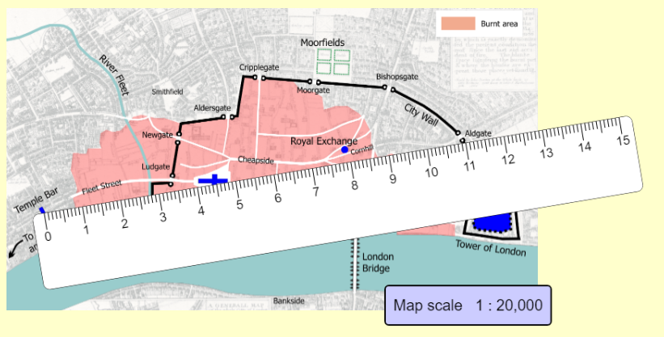
Work out the straight line distance from Temple Bar to Aldgate?
Notes:
Acknowledgements : https://www.mathspad.co.uk/interactives/ratioMaps/ratioMaps.php
Great to use for dynamic modelling

Slide 12
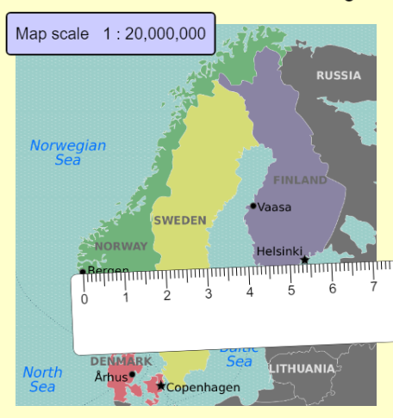
Work out the straight line distance from Bergen to Helsinki?
Notes:
Acknowledgements : https://www.mathspad.co.uk/interactives/ratioMaps/ratioMaps.php
Great to use for dynamic modelling

Slide 13
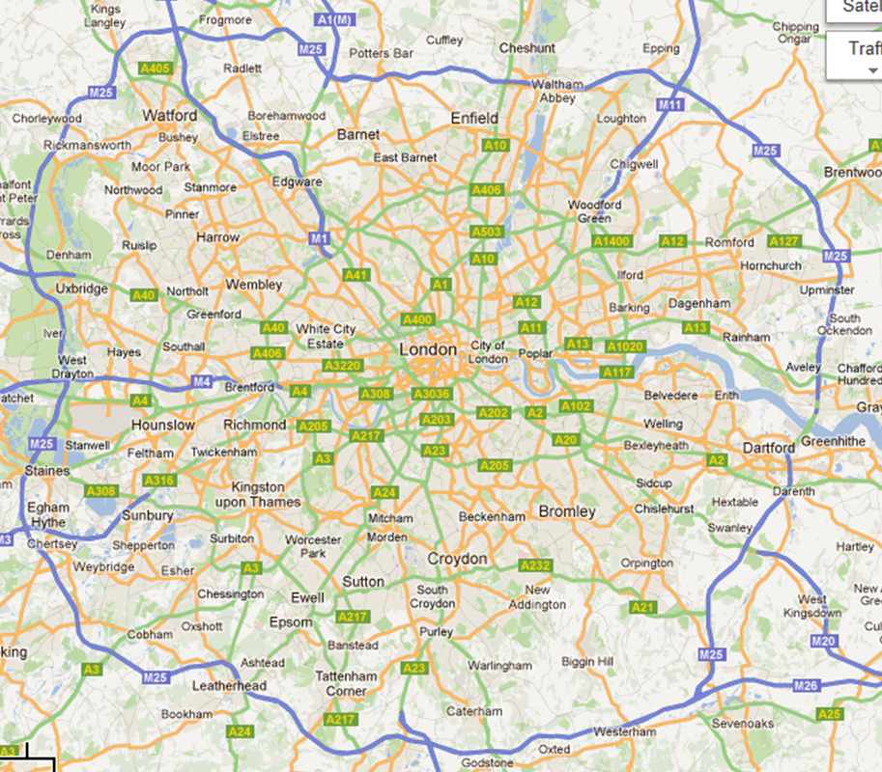
Here is a map of London with scale
1 : 200, 000
How far is Barnet from Enfield?
How far is Weybridge from Croydon?
Chelsea’s training ground is in Cobham, while Arsenal’s is in Radlett. How far apart are their training grounds?
The Metropolitan Line in London divides into branch lines at Harrow. One branch goes to Uxbridge, the other to Watford. Which branch line is longer and by how much?
The Northern line runs from Morden in South London to Edgware in North London. The District line runs from Richmond in West London to Upminster in East London. Which line is longer and by how far?
Notes:
Rulers needed

Slide 14
Mark your work
Barnet to Enfield = 4.6 km
Weybridge to Croydon = 13km
Cobham to Radlett = 20.4km
Harrow to Uxbridge is longer by 0.6km
The district line is longer by 7.6km
All distances are approximate and as the crow flies.

Slide 15
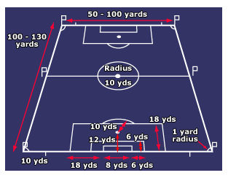
Not all football pitches are the same size!
Draw a scale drawing of a football pitch in your Maths book using a scale of your choice.

