Slide 1
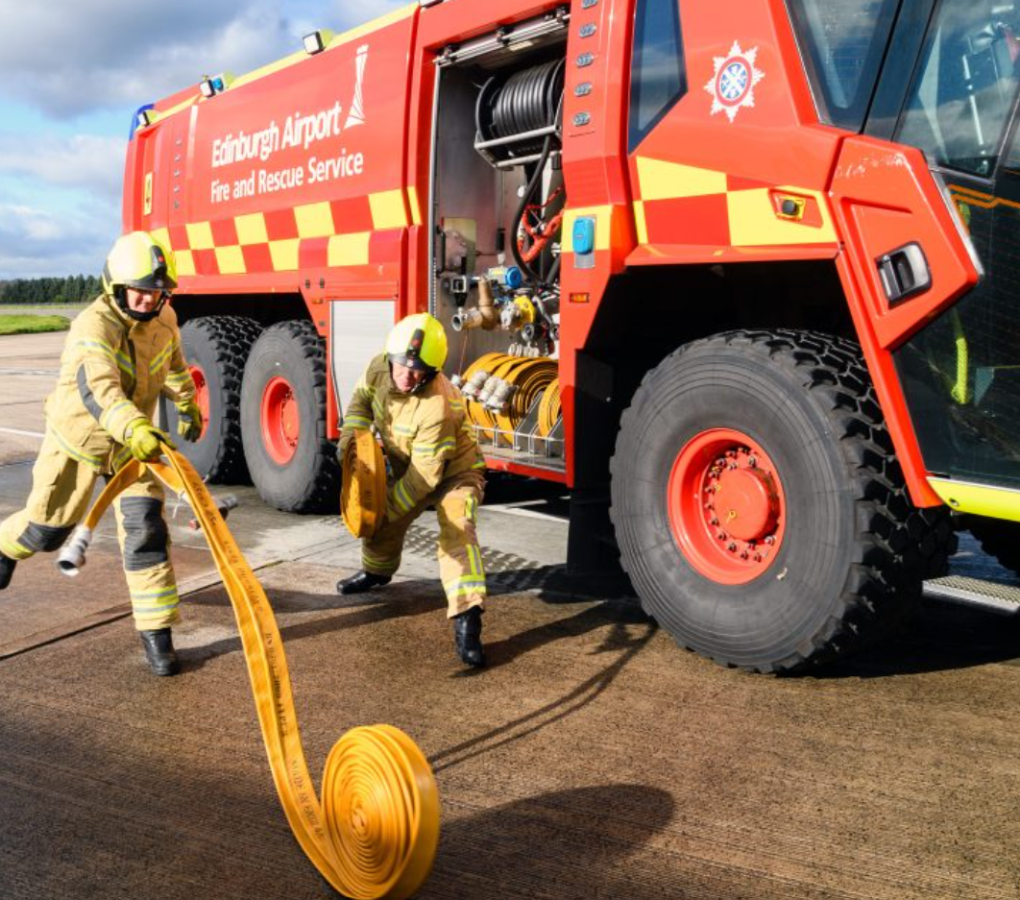
Firefighter at East Midlands Airport
Adrenaline going to a call
Calculate height for hoses
Water pressure required at based of hose to get the water to the top of the building
Different calculations required for 45mm & 70mm hoses
£32, 129
GCSEs
NVQ in vocational preparation
Joined the Royal Air Force as a firefighter at 18
Notes:
A dad from Ben's football team

Slide 2
1. If I walk at a constant speed of 6 miles per hour how long does it take me to walk 6 miles?
2. If I run at a constant speed of 10 km per hour, how long does it take me to run 5km?
3. If I jog at a constant speed of 8 miles per hour, how far can I jog in 45 mins?
4. If I swim at a constant speed of 25 metres per min, how long will it take me to swim 1km?
5. If I drive at a constant speed of 50 mph, how far will I travel in 3.5 hours?
Notes:
Linking understanding of rates from Speed work from Y9 Aut 1

Slide 3
Mrs Grimshaw fills a cuboid container made with water.
If she fills it at a constant rate of 25 cm³ per second how long will it take her to completely fill the container?
State the units with your answer.
50cm
5cm
8cm
Notes:
Worked Example 1

Slide 4
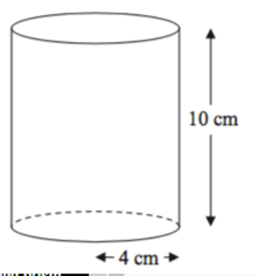
Mr Wilson fills a cylinderical container made with water.
If he fills it at a constant rate of 250 cm³ per minute how long will it take him to completely fill the container?
State the units with your answer.
Notes:
Worked Example 2

Slide 5
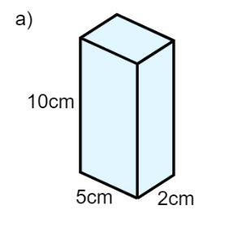
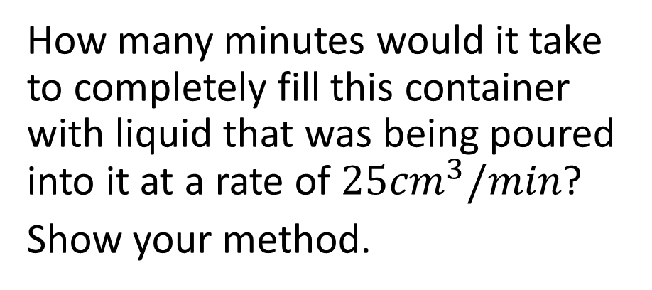
How many minutes would it take to completely fill this container with liquid that was being poured into it at a rate of $25{cm}^{3}/min$?
Show your method.
If we increase the rate what would happen to the time taken?

Slide 6
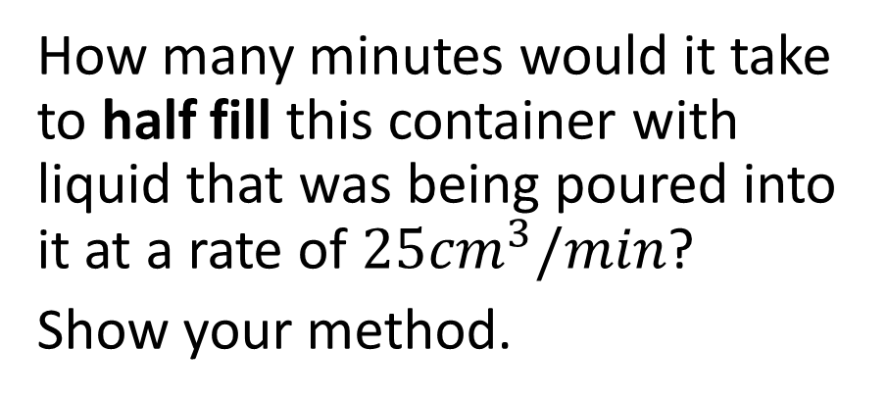
How many minutes would it take to half fill this container with liquid that was being poured into it at a rate of $25{cm}^{3}/min$?
Show your method.

Slide 7
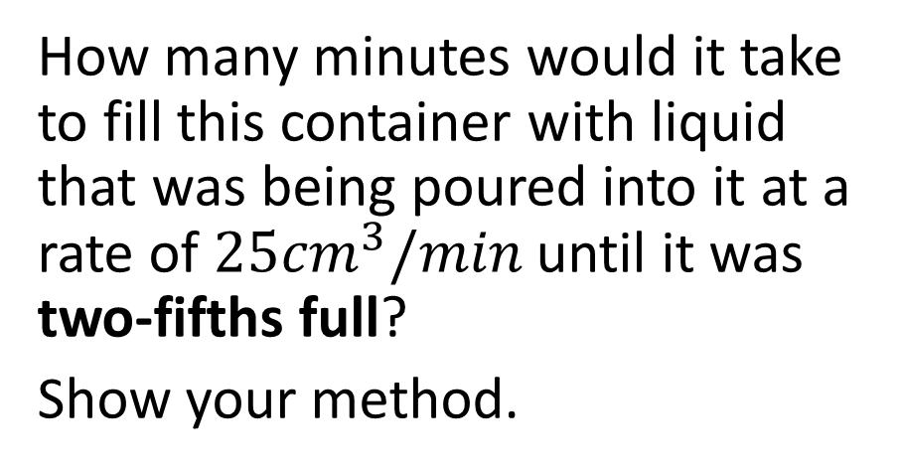
How many minutes would it take to fill this container with liquid that was being poured into it at a rate of $25{cm}^{3}/min$ until it was two-fifths full?
Show your method.

Slide 8
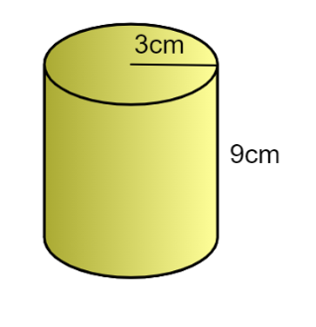
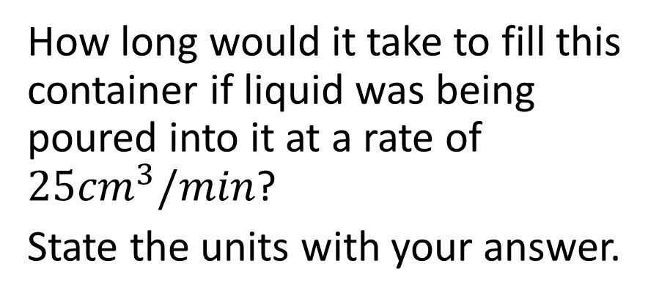
How long would it take to fill this container if liquid was being poured into it at a rate of $25{cm}^{3}/min$?
State the units with your answer.

Slide 9
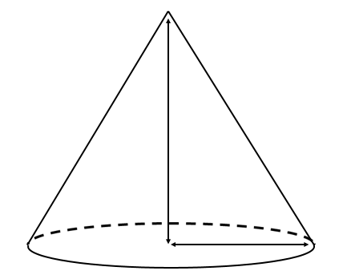
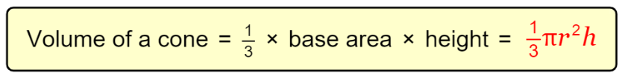
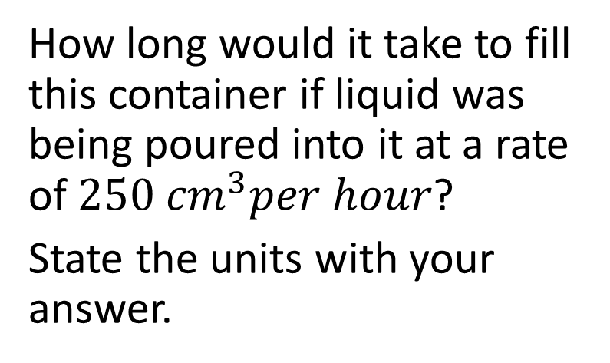


How long would it take to fill this container if liquid was being poured into it at a rate of $250 {cm}^{3}per hour$?
State the units with your answer.
$$50 cm$$
$$0.8 m$$

Slide 10
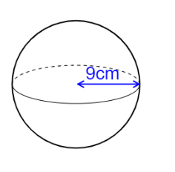
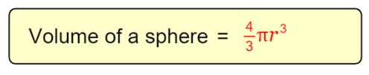
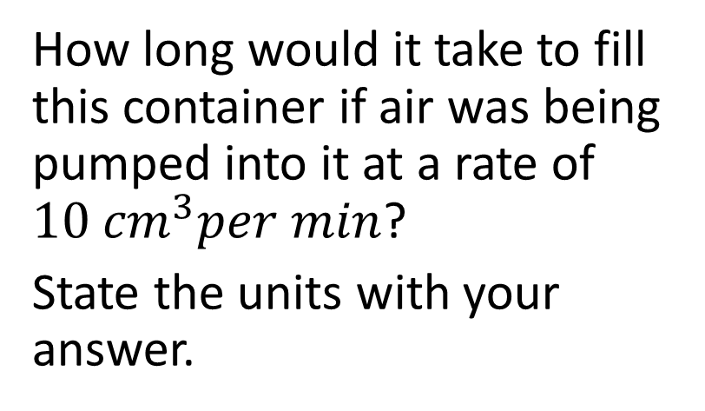
How long would it take to fill this container if air was being pumped into it at a rate of $10 {cm}^{3}per min$?
State the units with your answer.

Slide 11
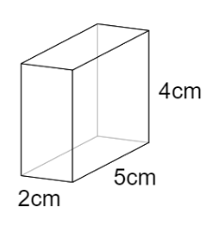
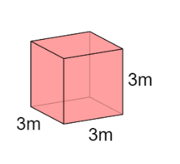
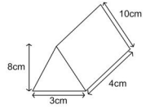
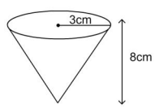
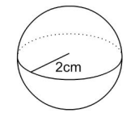
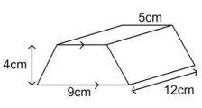
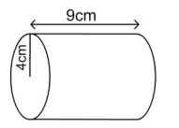
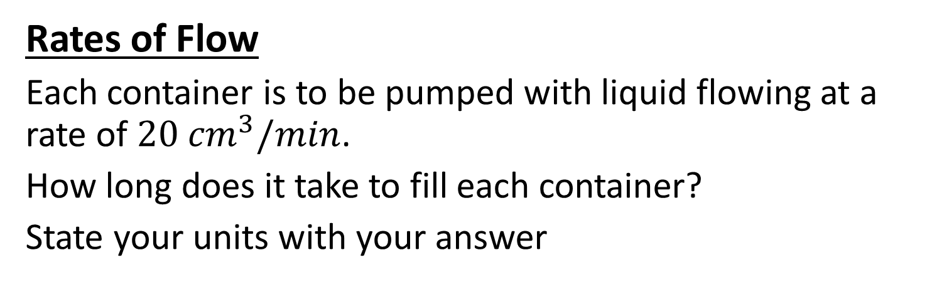
Rates of Flow
Each container is to be pumped with liquid flowing at a rate of $20 {cm}^{3}/min$.
How long does it take to fill each container?
State your units with your answer

Slide 12
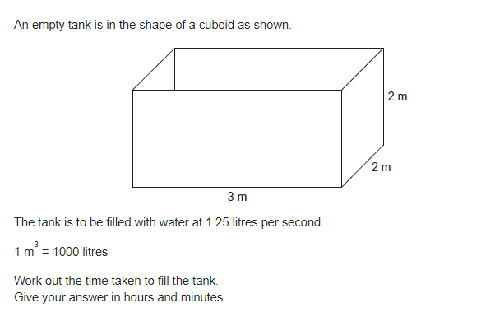
Problem 1

Slide 13
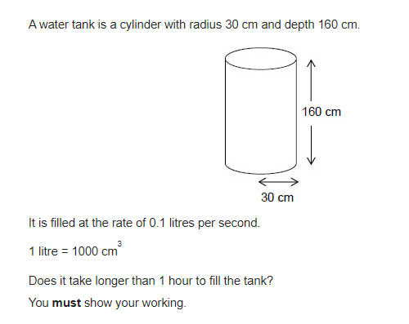
Problem 2

Slide 14
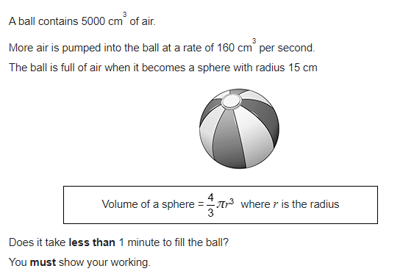
Problem 3

Slide 15
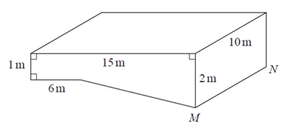
Problem 4
The diagram shows a swimming pool in the shape of a prism. The swimming pool is empty. The swimming pool is filled with water at a constant rate of 50 litres per minute.
Work out how long it will take for the swimming pool to be completely full of water. Give your answer in hours.
(1 m³ = 1000 litres)

